Slide 1
DO NOW
Pick up notes.
Get out Ionic Nomenclature practice.

Slide 2
MULTIPLE OXIDATION NUMBERS
Some cations can have more than one charge.
Most are transition elements. Lead and tin are exceptions.
Example: Cu⁺¹ and Cu⁺².
It is important to distinguish which ion is in the compound.

Slide 3
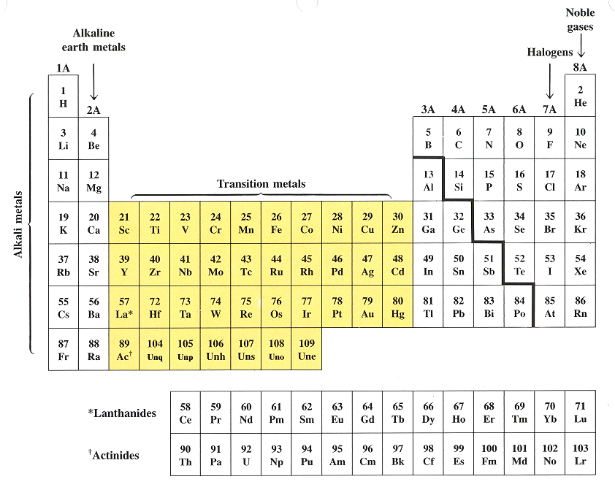
TRANSITION ELEMENTS groups 3-12

Slide 4
MULTIPLE OXIDATION NUMBERS
There are two ways used in chemistry.
1. Stock System 2. Classical (Latin)
Cu⁺¹ copper (I) cuprous
Cu⁺² copper (II) cupric
Sn⁺² tin(II) stannous
Sn⁺⁴ tin (IV) stannic
Hg₂⁺² mercury (I) mercurous
Hg⁺² mercury (II) mercuric
The lower charge ends in –ous and the higher charge ends in –ic.

Slide 5
MULTIPLE OXIDATION NUMBERS
You are responsible in class for both systems, but only the Stock system will be on the test.

Slide 6
Examples
cupric oxide/copper (II) oxide CuO
ferrous sulfide/iron (II) sulfide FeS
cobaltic bromide/cobalt (III) bromide CoBr₃
mercurous chloride/mercury (I) chloride Hg₂Cl₂

Slide 7
NAMING MORE COMPLEX IONIC COMPOUNDS
FIRST: Write the name of the cation (metal)
SECOND: Write the name of the anion – ends in “ide”.
THIRD: If the cation (metal) has more than one charge, designate the correct charge with the roman numeral.
Example: FeO iron (II) oxide
Fe₂O₃ iron (III) oxide

Slide 8
PRACTICE
FeO
Fe₂O₃
CuCl₂
CuCl
PbF₄
SnCl₂

Slide 9
WRITING FORMULAS FOR THESE
FIRST: Write the cation with the correct charge (given in the name).
SECOND: Write the anion with the correct charge.
Copper(II) chloride
Cu⁺² and Cl⁻¹ CuCl₂

Slide 10
PRACTICE
1. copper(I) fluoride
2. copper(II) oxide
3. chromium(III) bromide
4. manganese(II) iodide
5. mercury(II) chloride
6. cobalt(III) sulfide

Slide 11
POLYATOMIC IONS
An ion made up of more than one atom: NH₄⁺¹, SO₄⁻², C₂H₃O₂⁻¹;
The charges given to polyatomic ions apply to the whole group of atoms.
NEVER change the subscripts of a polyatomic ion.
If more than one ion is needed, a parenthesis is placed around the ion and the subscript is written outside; Example: Al(OH)₃

Slide 12
NAMING MORE COMPLEX IONIC COMPOUNDS
FIRST: Write the name of the cation (metal). If it gets a roman numeral, be sure to write it.
SECOND: Write the name of the anion. If it is a polyatomic ion, use the name given on your ion sheet.

Slide 13
PRACTICE
6. CuSO₄
7. Al₂(CO₃)₃
Fe(NO₃)₃
AlPO₄
NH₄IO₃
1. Ca(OH)₂
2. LiCN
3. Na₂SO₃
4. KC₂H₃O₂
5. KNO₂

Slide 14
WRITING IONIC FORMULAS
Write the symbol for the cation, then the symbol for the anion.
Balance the charges - use the crisscross method - by placing subscripts and “( )” for polyatomic ions if needed.
Monatomic ions don’t need “( )”.
Net charges must be zero. Use ion sheet to get charges.

Slide 15
PRACTICE
Potassium iodate
Iron (II) hydroxide
Iron (III) oxalate
Beryllium silicate
Sodium acetate
Potassium sulfate
Copper (II) sulfite
Barium cyanide
copper (II) sulfite
tin (IV) chlorate

Slide 16
DO NOW
Do the PRACTICE PROBLEMS, backside of Ionic Nomenclature Practice, for tomorrow.

