Slide 1
DO NOW
Pick up notes.
Get out Concept Review handout and notes from Friday.

Slide 2
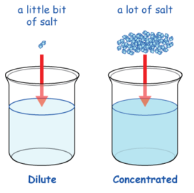
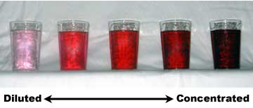
SOLUBILITY
Solubility is how much solute can dissolve in a given amount of solvent.
It is measured in g/L or mol/L. It is usually the grams of solute per 100g of solvent.
A CONCENTRATED solution is said to have a high ratio of solute to solvent.
A DILUTE solution is the opposite of this.

Slide 3
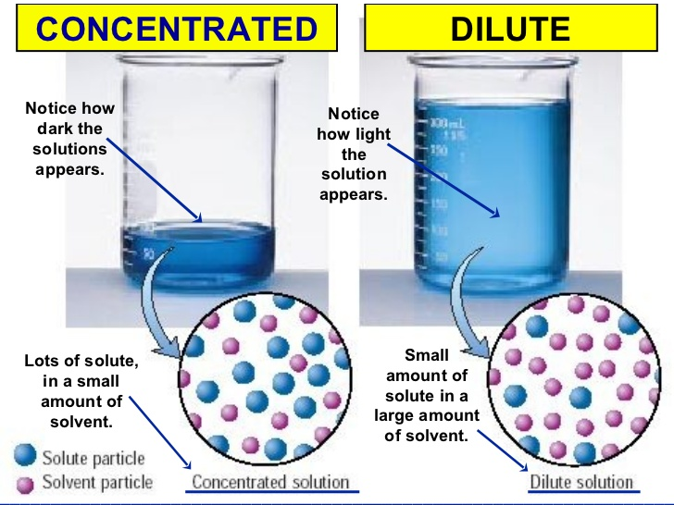

Slide 4
SOLUBILITY
Solubility curves have temperature and solubility (usually in grams solute per 100g solvent) on their axes.
For solids: solubility generally increases with increased temperature
For gases: solubility generally decreases with increased temperature

Slide 5
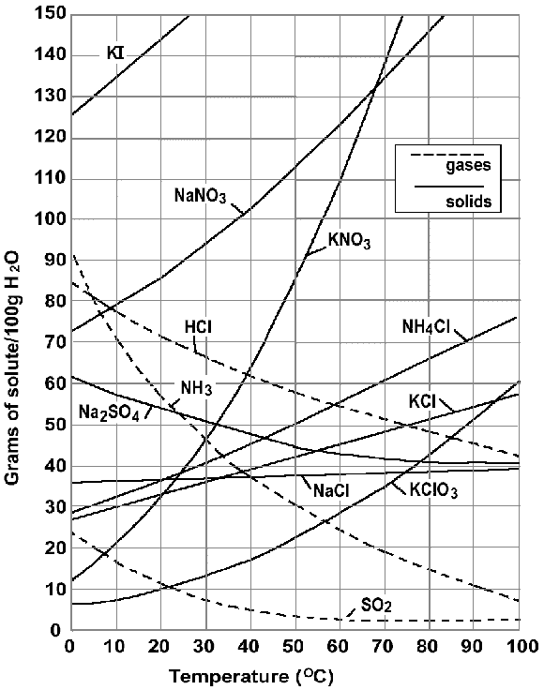
SOLUBILITY
Each line is a saturation line for that substance indicating temperature and amount dissolved in 100g solvent (in this case water).

Slide 6
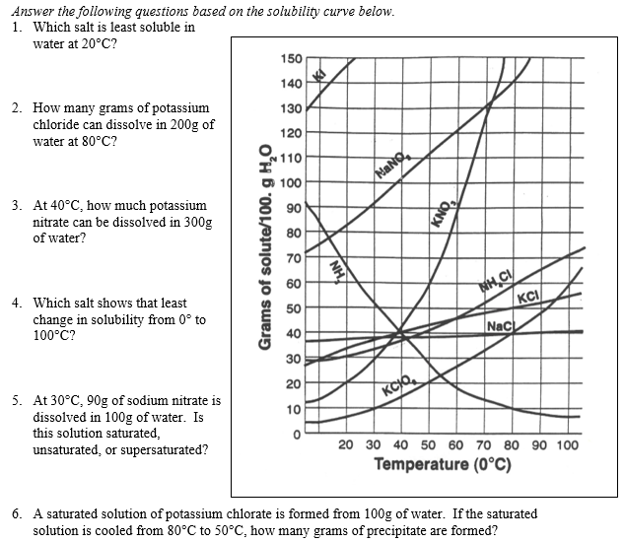

Slide 7
FACTORS AFFECTING SOLUBILITY
Nature of the solvent and solute -
“like dissolves like”.
This means that polar solvent dissolves a polar solute and nonpolar solvent dissolves nonpolar solute. Polar does not dissolve nonpolar.
In other words – will it even dissolve?

Slide 8
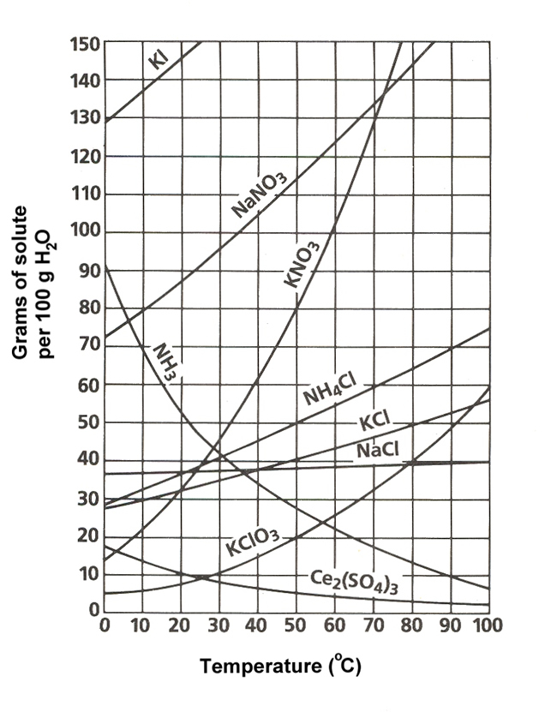
FACTORS AFFECTING SOLUBILITY
Temperature
increase the temperature and solubility increases (except gases).

Slide 9
FACTORS AFFECTING SOLUBILITY
Pressure
increase the pressure and you increase solubility. Gases ONLY.
How much is already dissolved
saturated versus unsaturated versus supersaturated…

Slide 10
FACTORS AFFECTING RATE OF SOLUBILITY (How fast something will dissolve)
Agitation (shaking, stirring)
Increased temperature (except gases)
Smaller Particle size (greater surface area)
Each allows more solvent to come in contact with the solute faster.

Slide 11
TO DO
Handout due tomorrow.
We are doing a lab tomorrow.

