Slide 1
DO NOW
Pick up notes and Review #9
Article Summaries are due today by 3:30 or you only get half credit.

Slide 2
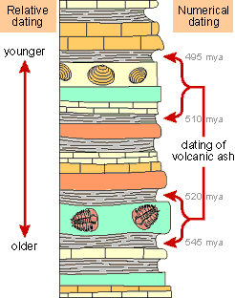
REVIEW
In an undisturbed rock column….
Where are the oldest fossils found?
Youngest?
Why?
What is:
Absolute Dating?
Relative Dating?

Slide 3
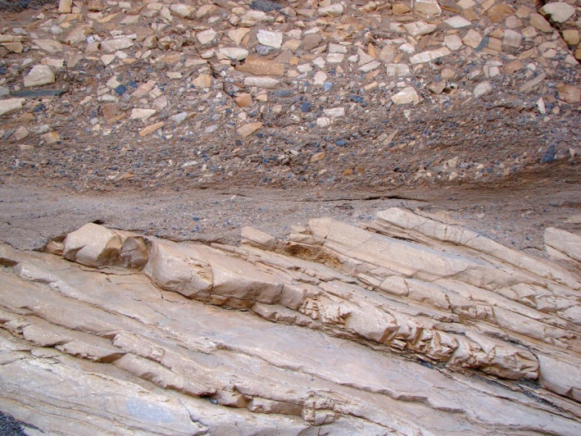
UNCONFORMITIES
SES4. Students will understand how rock relationships and fossils are used to reconstruct the Earth’s past.
a. Describe and apply principles of relative age (superposition, original horizontality, cross-cutting relations, and original lateral continuity) and describe how unconformities form.

Slide 4
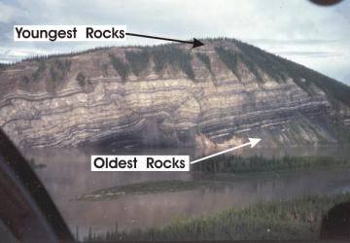
REVIEW
Law of Superposition:
In an undisturbed rock column, the layers on the bottom will be the oldest and the youngest rocks will be on the top.
Provides RELATIVE AGE (older, younger).

Slide 5
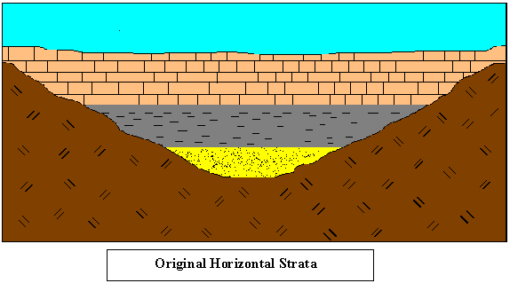
Principle Of Original Horizontality
Sedimentary particles settle from fluids under the influence of gravity.
Generally form in horizontal layers .

Slide 6
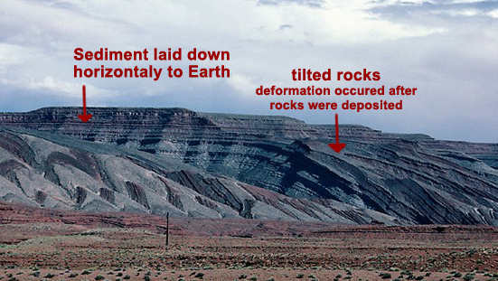
Principle Of Original Horizontality
Sediments deposited in layers that were nearly horizontal and parallel to the surface on which they were accumulating.
What does it mean when layers don’t appear horizontal?

Slide 7
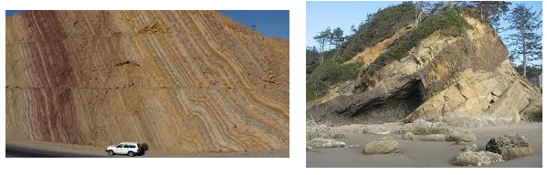
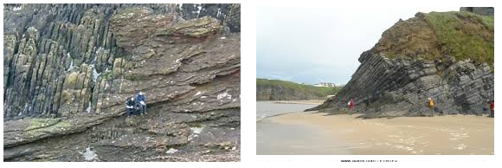
Principle Of Original Horizontality

Slide 8
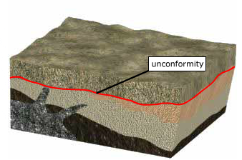
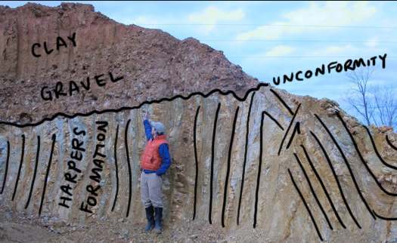
UNCONFORMITIES
Sometimes there are “breaks and bends” in the geologic record – boundary or break area
Called an Unconformity.

Slide 9
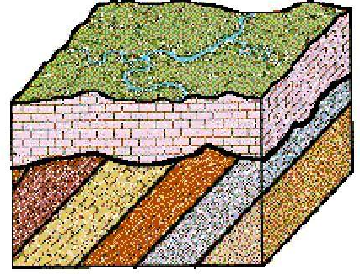
UNCONFORMITIES
An unconformity is a break in a stratigraphic sequence resulting from a change.
Deposition stops for a period of time.
Uplift and erosion occur.
Part of geologic/fossil record is lost – there is a gap in record.
ANIMATION LINK

Slide 10
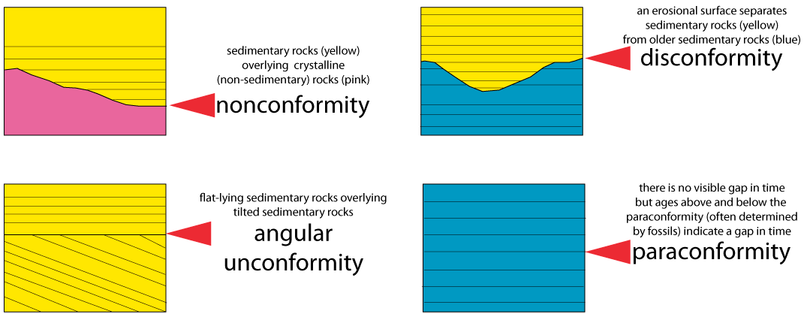
TYPES OF UNCONFORMITIES

Slide 11
DISCONFORMITY
Erosion between two layers of sediment.
Possible period of non deposition.
Part of a layer is missing.
Can be difficult to identify.
Missing fossils often provide a clue to a disconformity.
Link to Animation

Slide 12
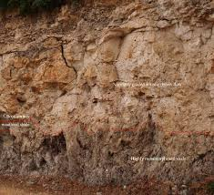
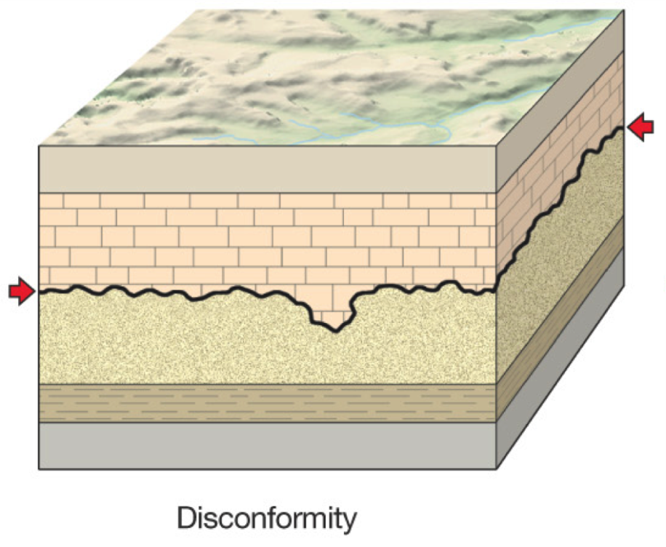
DISCONFORMITY

Slide 13
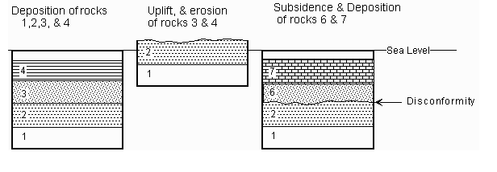
DEVELOPMENT OF A DISCONFORMITY

Slide 14
ANGULAR UNCONFORMITY
Older layer is tilted, eroded, then a younger layer forms on top.
First: deposition forms rock layer(s).
Second: rocks are uplifted and tilted.
Third: erosion removes the uplifted rock.
Fourth: new deposition occurs on top the previous land surface.
Link to Animation

Slide 15
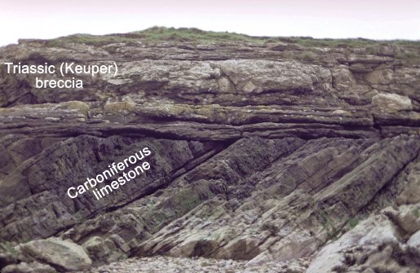
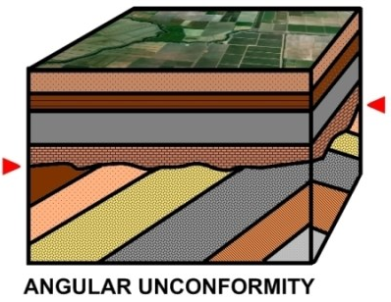
ANGULAR UNCONFORMITY

Slide 16
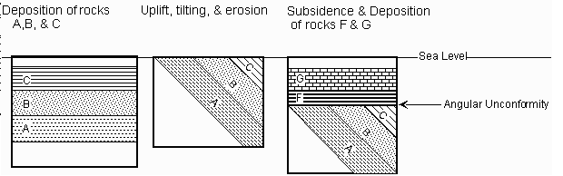
Development of an Angular Unconformity

Slide 17
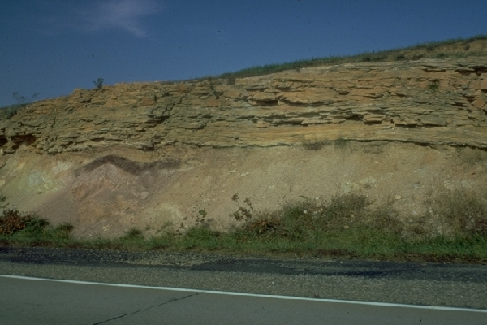
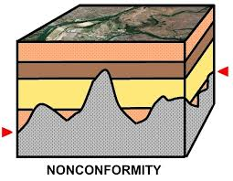
NONCONFORMITY
Where igneous or metamorphic rock is exposed and weathered, then sedimentary rock builds above it.
Link to Animation

Slide 18
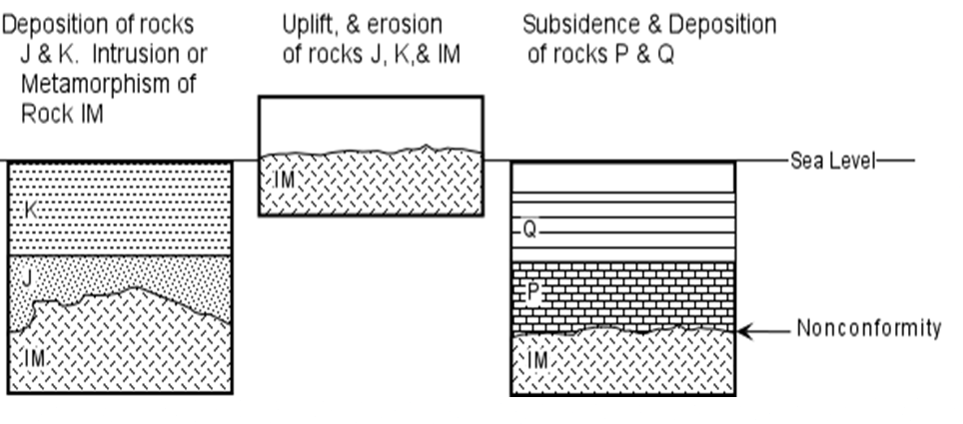
DEVELOPMENT OF NONCONFORMITIES

Slide 19
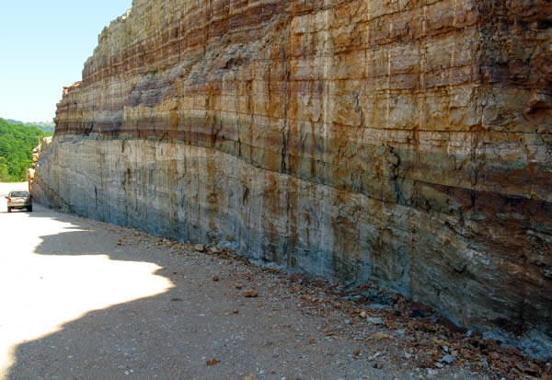
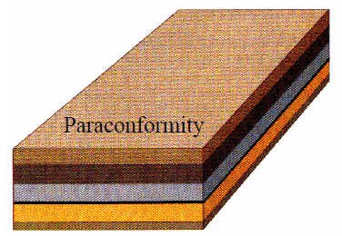
PARACONFORMITY
Parallel Unconformity or Non-depositional unconformity.
Little or no evidence of erosion because the layers are parallel and some are missing.
Period of non-deposition.
Difficult to detect.

Slide 20
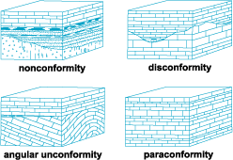
IDENTIFYING UNCONFORMITIES
Classify the Unconformities

Slide 21
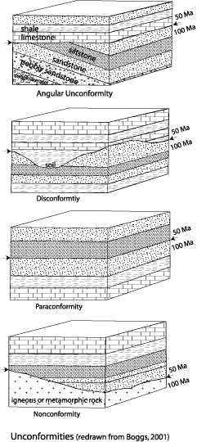
REVIEW
Unconformities are based on the Principle of Original Horizontality which states:
A. In an undisturbed rock column the layers on the bottom will be the oldest and the youngest rocks will be on the top.
B. Sediments deposited in layers that were nearly horizontal and parallel to the surface on which they were accumulating.
C. Intrusions always younger than rock it cuts through.
D. The same geologic processes that occur today were the same process that occurred in the past.

Slide 22
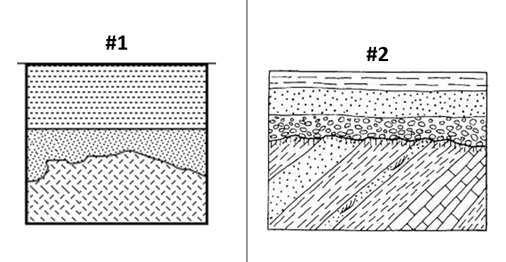
IDENTIFYING UNCONFORMITIES
Look at the the cards and determine what kind of unconformity it is.
Check the appropriate box.

Slide 23
TO DO
Do the Identifying Unconformities handout and turn it in today.
Complete Review #9 for Monday.

Slide 24
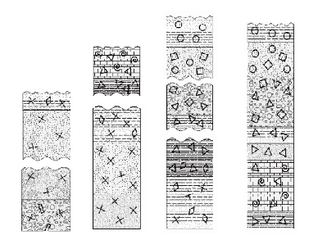
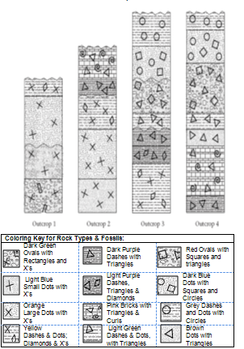
Activity: How Do You Stack Up?
How do Unconformities show up in the geologic record?
Instructions:
Color rock layers
Cut outcrops along unconformities
Reassemble matching bedding planes
Interpret geologic history using cross section and fossil evidence
While you work… Unit 6 Post-Test Conferences

