Slide 1
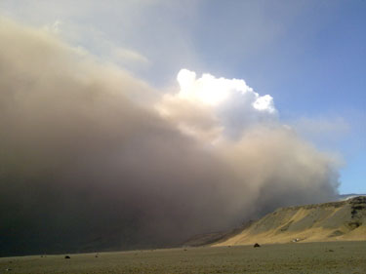
REVIEW
Soil Erosion Lab:
How well did the moss protect your soil?

Slide 2
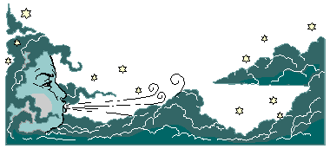
WIND EROSION AND LANDFORMS
SES3. Students will explore the actions of water, wind, ice, and gravity that create landforms and systems of landforms (landscapes).
d. Relate the past and present actions of ice, wind, and water to landform distribution and landscape evolution.

Slide 3
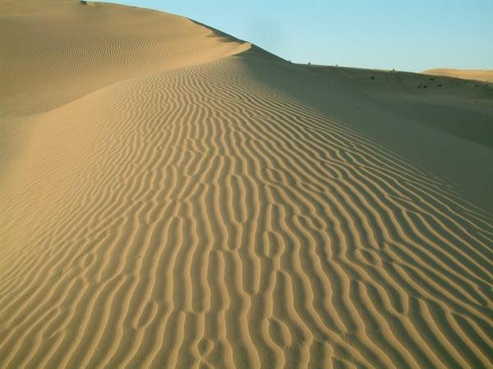
WIND DEPOSITION
Obstacles slow wind
  Ex: a rock or tree
Like water:
  When wind slows down it drops the sediment it's carrying
  As the wind slows, it deposits the largest particles first.
Size of particles (sand, silt, clay) affects what forms.

Slide 4
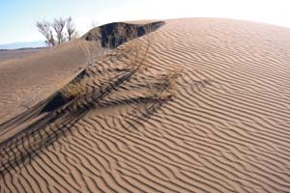
WIND DUNES
A dune is a pile of wind blown sand.
Formation:
  Wind meets obstacle.
  Obstacle causes wind to slow down.
  Sand (load) is dropped.
  Dune forms and grows.
  The more sand deposited, the bigger the obstacle, the more sand is dropped.

Slide 5

DUNE SHAPES
A sand dune has a gentle slope on the side the wind blows from – windward side.
The opposite side has a steep slope called the slip face – leeward side.
Five types of dunes.

Slide 6
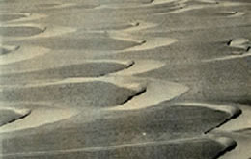
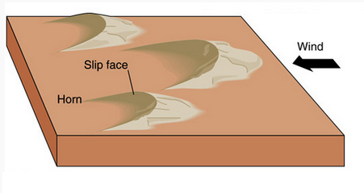
BARCHAN DUNES
Most common – “C” shape with wind on crescent side.
Also called Crescent Dunes - Crescent-shaped mounds.
Needs constant wind in same direction.
Generally are wider than long.
Form where there is a limited supply of sand and relatively flat ground.

Slide 7
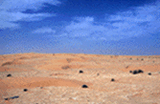
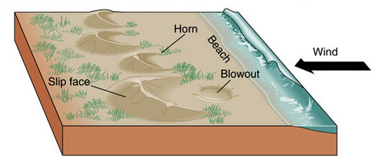
PARABOLIC DUNES
Always in moist environments.
Also called “blowout” dunes.
Common on the coast.
Moderate winds.
Always associated with vegetation.
Vegetation anchors ends while center moves forward.

Slide 8
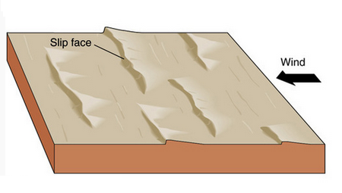
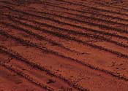
TRANSVERSE DUNES
Long asymmetrical dunes.
Form at right angles to the wind direction.
Abundant supply of sand.
Relatively weak winds.
Steep slip face.
A group of transverse dunes resembles sand ripples on a large scale.

Slide 9
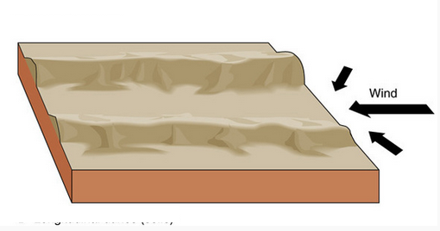
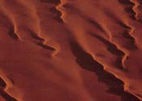
LONGITUDINAL DUNES
Also called LATERAL
Abundant sand.
Strong cross winds converge from at least two directions.
Sand pushed into long lines or ridges.
Crests or summits often straight or slightly wavy.
Slip faces on either side.
Can reach more than 655 feet (200 meters) in height and 62 miles (103 kilometers) in length.

Slide 10
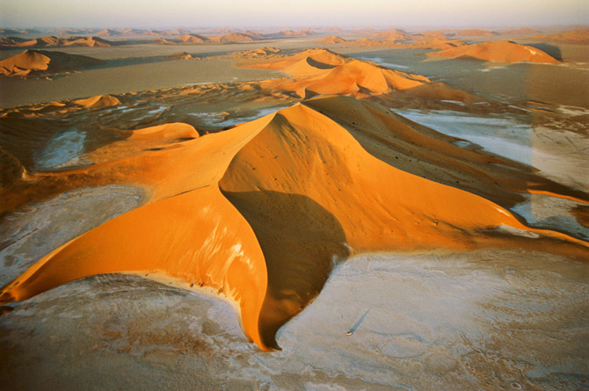
STAR DUNES
Complex winds.
Varied directions
Three or more arms.

Slide 11
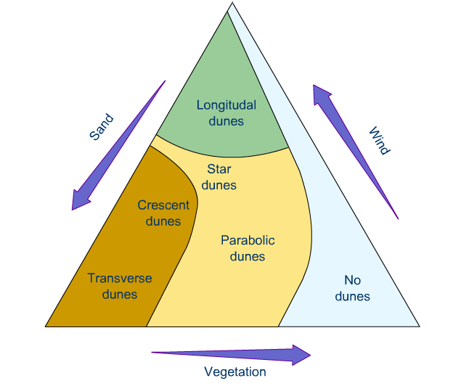
DUNES TRIANGLE

Slide 12
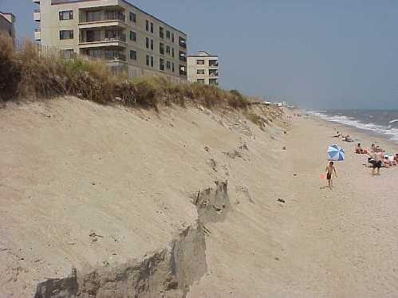
DUNE CONCERNS
A major concern near coastal areas is that dunes are being damaged and destroyed.

Slide 13
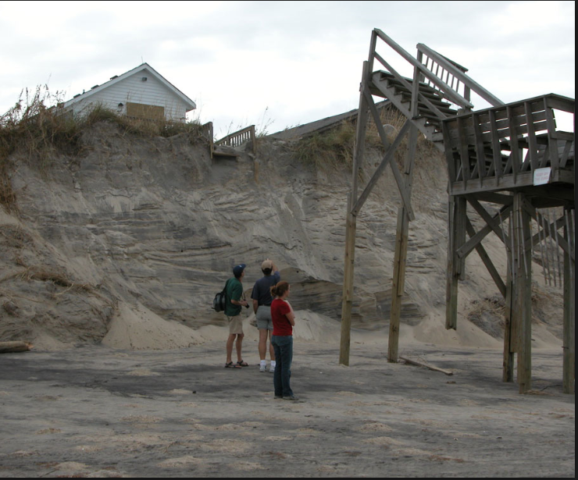
DUNE CONCERNS
The removal and disturbance of coastal dunes leads to:
  Increased beach erosion.
  Near shore flooding.
  Loss of habitat.

Slide 14
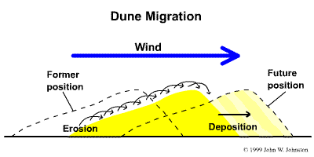
DUNE MIGRATION
Dune migration is the erosion and deposition of an entire dune due to the direction of the wind.
They can cover roads, houses or other structures
Dune Migration

Slide 15
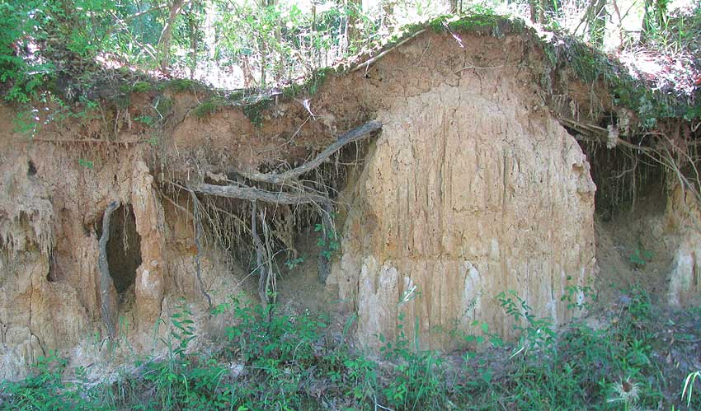
LOESS
A blanket of fine-grained sediments deposited by the wind.
Extremely fertile and provides excellent soil.
Example: Midwestern United States- along the eastern border of the Mississippi River Valley.

Slide 16
REVIEW
What kind of dune?
Transverse
Longitudinal
Parabolic
Barchan

Slide 17
SAND DUNE LAB
Erosion is the process by which materials of Earth's surface are broken down and carried away by natural agents, such as wind and water.
Where sand is present and winds are strong and blow, hills of loose sand called sand dunes are formed.
The type of sand dune formed depends on the wind speed and direction, vegetation cover and type of sand.

Slide 18
SAND DUNE LAB
Sand dunes can change size as well as migrate (move to another location).
Dunes in the Sahara desert can be over 800 feet (240 m) high.
Some dunes migrate as much as 100 feet (30 m) per year, depending on the speed and duration of the wind. Faster winds and consistent winds cause higher dunes and farther migrations.
The following table summarizes each type of dune:

Slide 19
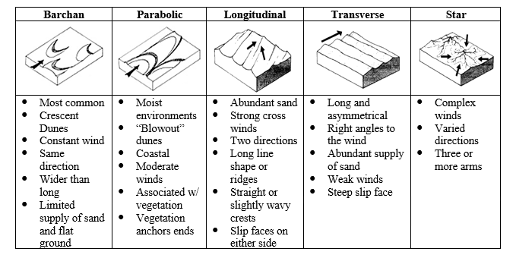
SAND DUNE LAB

Slide 20
SAND DUNE LAB
Purpose: To discover how wind erosion shapes Earth’s surface & creates landforms.
Materials:
  Dry sand
  Pan with clear lid with holes cut in the top
  Straws
  Moss

Slide 21
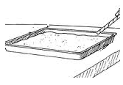
SAND DUNE LAB
Procedure:
Pour sand into aluminum pan and spread out level.
Put plastic lid over the pan.
Try to create AT LEAST THREE of the different dune types by blowing through the straws inserted in the holes at different locations to simulate winds from different directions. Use the moss to create parabolic dunes.
NOTE: Blow ONLY – do NOT inhale!

Slide 22
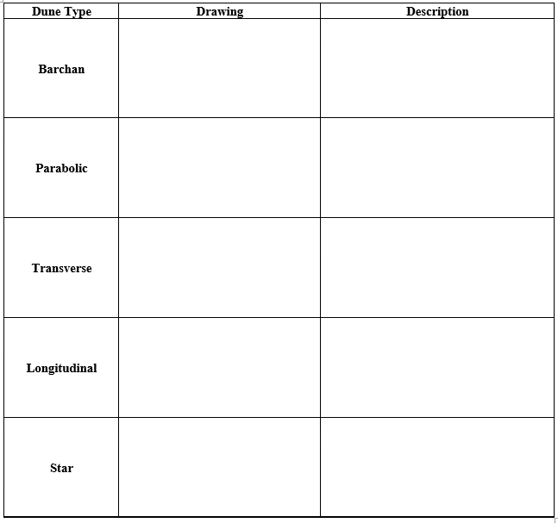
SAND DUNE LAB

Slide 23
SAND DUNE LAB
Analysis:
How did wind speed, wind direction and vegetation affect the type of dunes that formed?
How could what you learned in this lab help preserve dunes along the Georgia coast?

Slide 24
TO DO
Do at least three sand dune types.
Review #29 is due tomorrow.

