Slide 1
DO NOW
Pick up notes.
Properties of Acids and Bases is due Friday.
Your $1, 100% cotton t-shirt, and your plastic bag is due by NEXT Thursday.

Slide 2
DVD
Defining Acids and Bases:
What is the difference between Arrhenius base and a Brønsted-Lowry base?
2. What is the conjugate base of HCl? Is it strong or weak?
3. Name three acids that are 100% ionized in water?

Slide 3
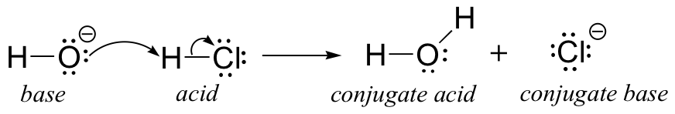
CONJUGATE ACIDS AND BASES
When an acid loses an H⁺ ion it becomes a conjugate base.
For example, hydrochloric acid (HCl) loses an H⁺ ion to become its conjugate base Cl⁻¹. The conjugate base of water, H₂O, is the hydroxide ion, OH⁻¹.

Slide 4
CONJUGATE ACIDS AND BASES
Likewise, when a base gains an H⁺ ion, it becomes its conjugate acid.
For example, ammonia, NH₃ gains an H⁺ to become its conjugate acid NH₄⁺. And the conjugate acid of OH⁻¹ is H₂O.
Generally speaking, the stronger the acid, the weaker the conjugate base and vice versa.

Slide 5
CONJUGATE ACIDS AND BASES
PRACTICE
HF + H₂O → F⁻ + H₃O⁺
HSO₄⁻ + NH₃ → SO₄⁻² + NH₄⁺

Slide 6
CONJUGATE ACIDS AND BASES
Amphoteric: A substance that acts as both an acid and a base.
HF + H₂O → H₃O⁺ + F⁻
base
NH₃ + H₂O → NH₄⁺ + OH⁻
Acid

Slide 7
STRONG vs. WEAK, CONCENTRATED vs. DILUTE
These terms are not interchangeable.
Strong versus weak deals with the amount of ionization.
Concentrated versus dilute deals with molarity or some other form of concentration.

Slide 8
STRENGTHS OF ACIDS
Which is stronger, HNO₃ or H₃PO₄?
Can you rank the strength of HF, H₃BO₃, and H₂SO₃ based on the formula alone?
DEMO: HCl and Acetic acid
1. What happens when the molarity of HCl and HC₂H₃O₂ goes down?
2. Why does HCl have a brighter glow than HC₂H₃O₂?

Slide 9
STRENGTHS OF ACIDS
Ions can carry electricity through a solution and HCl forms more ions than acetic acid does.
A strong acid readily transfers H⁺ ions to water to form H₃O⁺ ions.
Strong acids react completely to form ions and are strong electrolytes. These acids produce the maximum number of ions.
HCl _{(aq)} + H₂O_{(aq)} → H₃O⁺_{(aq)} + Cl⁻_{(aq)}
strong acid - one way arrow

Slide 10
STRENGTHS OF ACIDS
A weak acid transfers only some of its H⁺ ions to water.
Weak acids, because so many fewer ions are formed, are weak electrolytes.
The ions only partially ionize.
One way to signify a strong acid from a weak acid is by their equations:
HC₂H₃O_{2(aq)} + H₂O_{(aq)} ↔ H₃O⁺_{(aq)} + C₂H₃O₂⁻_{(aq)}
weak acid - reversible arrow

Slide 11
Strength of acids
Strong Acids Weak Acids
HCl HC₂H₃O₂ HBr HCN HI HClO
H₂SO₄ HCO₃⁻
HClO₄ HNO₂­
HNO₃ HF

Slide 12
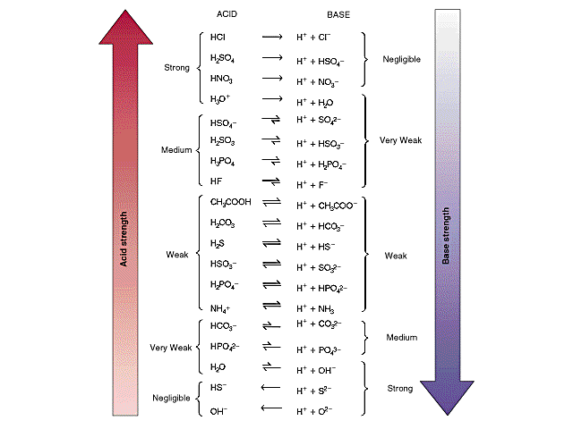

Slide 13
STRENGTH OF ACIDS
The reason behind this has to do with acid strength and the Brønsted-Lowery Model.
HX + H₂O → H₃O⁺ + X⁻
acid base CA CB
Water is a stronger base (in the forward reaction) than is the conjugate base, X⁻.
The ionization equilibrium lies almost completely to the right because water has a much greater attraction for H⁺ than does the base X⁻.
It is basically a battle of the bases.

Slide 14
STRENGTH OF BASES
The substances that have a strong affinity for H⁺ are called strong bases.
Strong bases are also strong electrolytes because they completely ionize in water.
Weak bases only partially ionize and are considered weak electrolytes.

Slide 15
STRENGTH OF BASES
Strong Bases: Weak Bases:
CaO NaOH NH₃ H₂NNH₂
KOH Ca(OH) ₂ CO₃⁻² PO₄⁻³
Some metallic hydroxides, like Ca(OH)₂ and Mg(OH)₂ have low solubility and are poor sources of OH⁻.
But they are considered strong bases because what does dissolve ionizes completely.

Slide 16
TO DO
Strengths of Acids and Bases / Brönsted-Lowry handout due tomorrow.

