Slide 1
DO NOW
Turn in Review #21
Pick up notes.

Slide 2
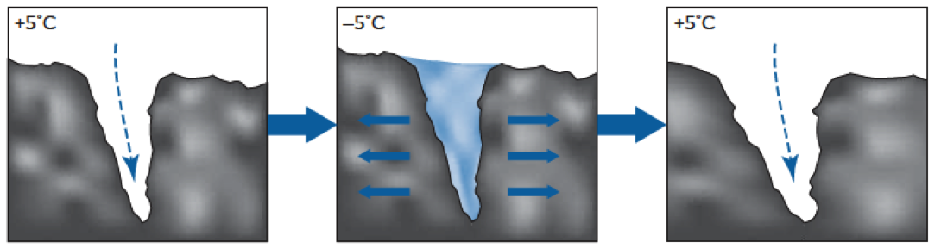
REVIEW
What type of weathering is shown in the diagram?
How can you tell?
ICE WEDGING
Water enters, freezes, moves rocks apart.

Slide 3
CHEMICAL WEATHERING
How can chemical reactions cause rock to weather?

Slide 4
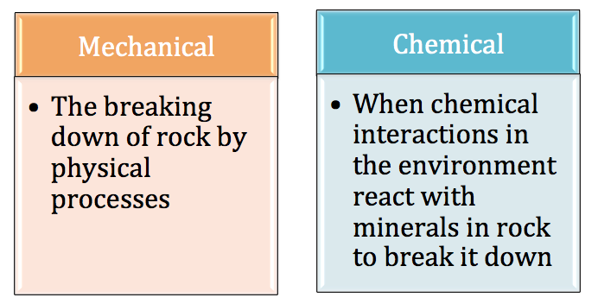
TYPES OF WEATHERING
MECHANICAL
CHEMICAL
Does not change the rock chemically.

Slide 5
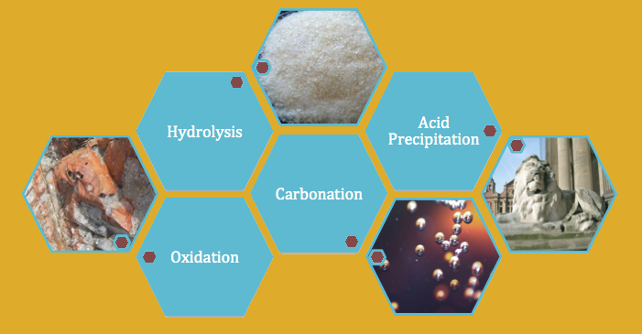
TYPES OF CHEMICAL WEATHERING
When chemical interactions in the environment react with minerals in rock to break it down
Can change the mineral composition of rock!

Slide 6
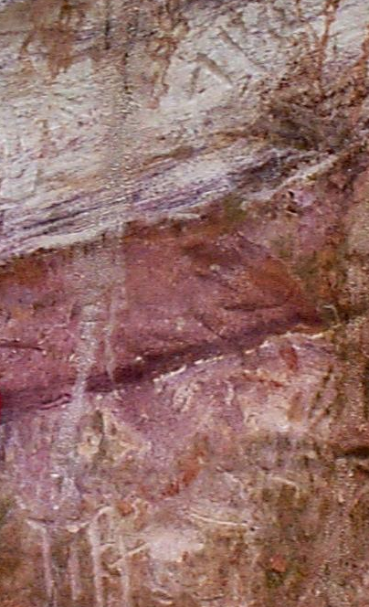
A. HYDROLYSIS
Chemical weathering by water. A chemical reaction between water and minerals in a rock forms new rocks.
Mineral composition changes – minerals react chemically with water.

Slide 7
A. HYDROLYSIS
  Minerals dissolve in water.
  Leaching – water carries dissolved minerals to lower layers of rock.
  Feldspar combines with water to produce kaolin.

Slide 8
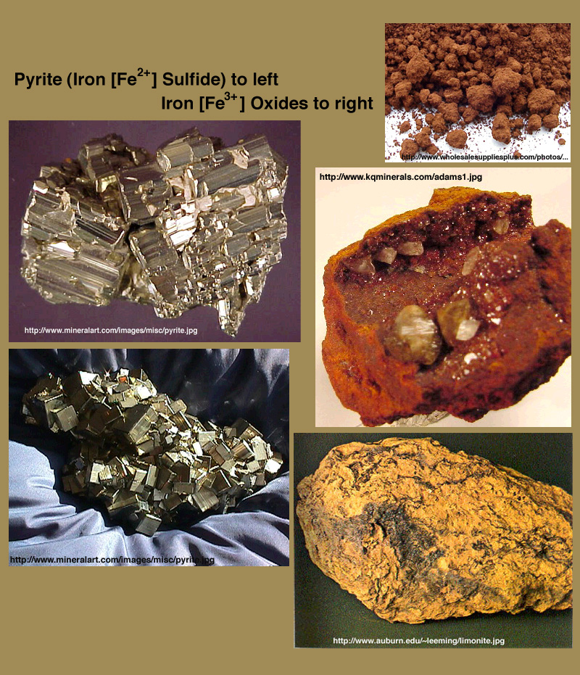
B. OXIDATION
Elements combine with oxygen in chemical process.
  Rust!
  Common in rocks containing iron bearing minerals – ex: hematite, magnetite.
Turns iron minerals a brown-red color because the minerals react with oxygen in the air.

Slide 9
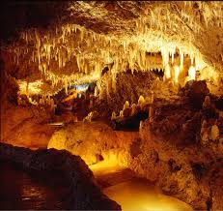
C. CARBONATION
Carbonation is when a compound is changed into a carbonate compound.
Carbon dioxide, CO₂, dissolves in H₂O to form Carbonic Acid (H₂CO₃). Carbonic acid breaks down compounds chemically.

Slide 10
C. CARBONATION
  Example – calcite in limestone - dissolves and weathers.
Carbonic Acid: most common natural acid on the Earth's surface.

Slide 11
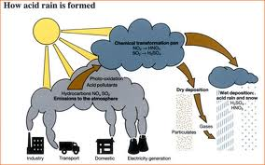
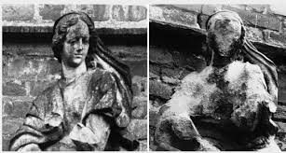
D. ACID PRECIPITATION
Rainwater naturally contains a weak carbonic acid.
  Some rocks are more affected than others – ex: limestone and chalk.
Acid Precipitation – compounds that combine with water in the atmosphere to produce weak acids and fall to Earth.

Slide 12

MEASURING ACIDITY
pH
pH
0
2
4
6
8
10
12
14
Acidic: High H⁺ concentration
Basic: Low H⁺ concentration
The pH scale is used to measure how acidic or basic a liquid is. Distilled water is a neutral 7 (right in the middle).
Acids are from 0 to 7.
Bases are from 7 to 14.

Slide 13
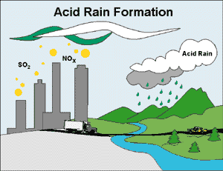
HOW ACID RAIN FORMS
Natural Process:
CO₂ in atmosphere reacts with water to form carbonic acid – most common natural acid.

Slide 14
HOW ACID RAIN FORMS
Human Impact:
SO₂ (sulfur dioxide) and NO_{X} (nitrous oxides) released into atmosphere.
SO₂ sources include coal-fired power plants, industries, volcanoes.
NO_{x} sources include vehicles and fuel combustion.
Pollution may move large distances before acid rain falls.

Slide 15
pH OF ACID RAIN
Normal rainfall has a pH of 5.6 from reaction with CO₂ in atmosphere.
Acid rain has a pH less than 5.6 and has been found as low as 4.2 in the U.S.
Around Pike County, GA., the average rain pH is 4.6.
English chemist Robert Angus Smith first used the phrase "acid rain" in 1852.

Slide 16
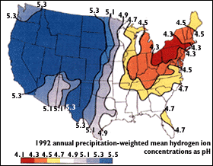
pH OF ACID RAIN
Map & DC average source: USGS

Slide 17
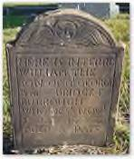
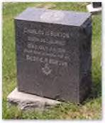
WEATHERING FROM ACID RAIN
Acid rain slowly reacts with rocks due to chemical reactions between the acid and the minerals in the rock.
Differential Weathering: Softer, less resistant rocks wear away at a faster rate than more weather resistant rocks.

Slide 18
WEATHERING FROM ACID RAIN
Limestone and chalk are made of a mineral called calcium carbonate and weather more quickly because rainwater contains a weak carbonic acid
More exposure to acid rain results in more rapid weathering.

Slide 19
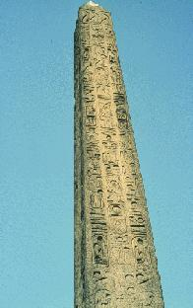
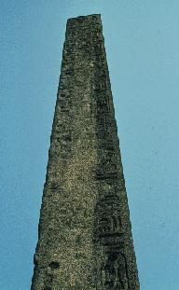
WEATHERING AN OBELISK
Cleopatra’s Needle was carved from granite, a hard tough, crystalline rock in Egypt around 1450B.C.
It stood in the dry, hot Egyptian desert for over 3000 years. During that time, the hieroglyphs remained distinct.
In 1800, the monument was moved to New York City.
Almost immediately, the hieroglyphs began to fade and the Egyptian writing became unreadable.
Chemical Weathering Video

Slide 20

REVIEW
Which common acid is found naturally in rain?
Carbonic Acid
Ascorbic Acid
Sulfuric Acid
Acetic Acid

Slide 21

Activity 1:
Weathering from Acid Rain
Acid rain is one way in which rocks can be chemically weathered. It can harm forests and crops, damage bodies of water, and contribute to the damage of statues and buildings.
In this activity you will simulate the chemical weathering of limestone, which is a soft, sedimentary rock that reacts easily to acid rain.
Review instructions – use the pH chart on the following slide with your pH strips
When finished with lab, complete the reading activity.

Slide 22
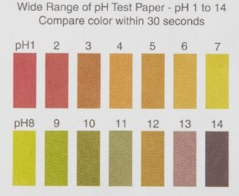
pH Chart for Lab Activity
Use this chart to determine the pH of the vinegar before and after dilution.

Slide 23

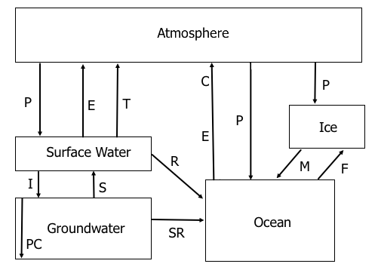
Activity #2
Water Cycle Illustration

