Slide 1
DO NOW
Pick up notes and handout
Do Ion Review NOW – use your ion sheet.

Slide 2
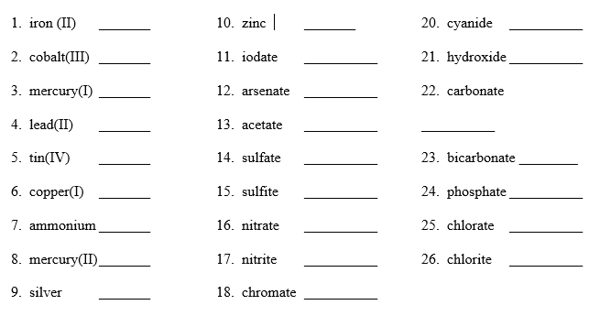
ION REVIEW

Slide 3
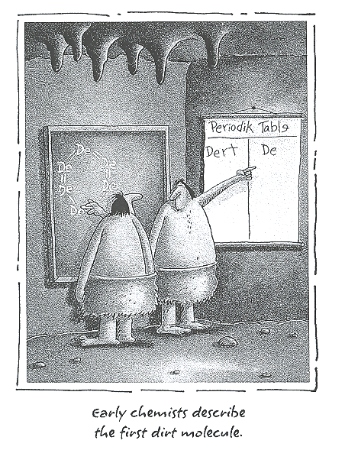
COVALENT NOMENCLATURE

Slide 4
NPR Report

Slide 5
MOLECULAR COMPOUNDS
Another word for covalent molecules
usually binary; called a molecule.
usually contain two nonmetals; solid, liquid or gas
need to be able to distinguish between molecular and ionic compounds.

Slide 6
NAMING MOLECULAR COMPOUNDS
Rules:
Happens between two nonmetals (sometimes a metalloid).
Use prefixes to identify the number of atoms present.
If only one of the first atom (nonmetal), then NO prefix is used.
Last element ends in “ide”.
Nonmetals can combine in different ratios so you MUST use prefixes.

Slide 7
NAMING MOLECULAR COMPOUNDS
Prefixes:
1 - mono 6 - hexa
2 - di 7 - hepta
3 - tri 8 - octa
4 – tetra 9 - nona
5 - penta 10 - deca

Slide 8
MOLECULAR COMPOUNDS
Examples:
CO₂ carbon dioxide N₂O dinitrogen monoxide
PCl₃ phosphorus trichloride
COMMON NAMES
Dihydrogen monoxide, H₂O, WATER
Nitrogen trihydride, NH₃, AMMONIA

Slide 9
PRACTICE
1. NCl₃
2. CS₂
3. Si₂Br₆
4. S₄N₄
5. SF₆
6. N₂O₅

Slide 10
WRITING MOLECULAR FORMULAS
1. Write the symbol of the first element adding a subscript of the number of atoms present. If only one of the first atom (nonmetal), then NO number is used.
2. Write the symbol of the second element adding a subscript of the number of atoms present.

Slide 11
PRACTICE
boron trifluoride
silicon tetrachloride
iodine heptafluoride
tetraphosphorus decoxide
chlorine trifluoride
sulfur dichloride

Slide 12
TO DO
Nomenclature Study Sheet #1-40 due tomorrow.

