Slide 1
DO NOW
Turn in your Seasonal Changes lab if I did not get iot yesterday.
Pick up notes and Review #22.

Slide 2

REVIEW
We've seen that Earth's tilt is responsible for seasonal changes. We have four distinct seasons in Georgia
Question: Are seasons experienced the same everywhere on Earth?

Slide 3
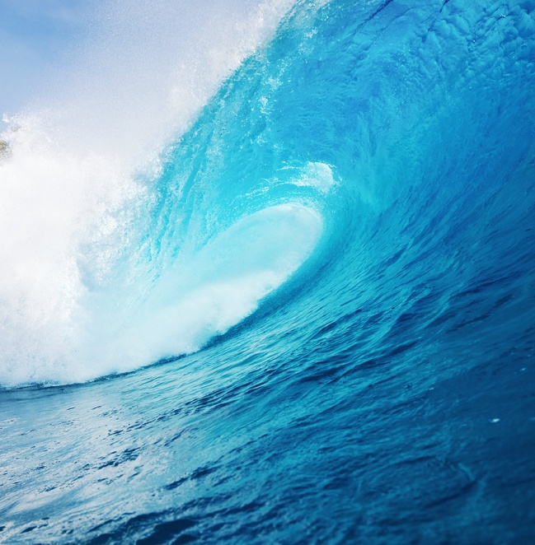
CURRENTS AND OCEAN CIRCULATION
SES5. Students will investigate the interaction of Earth systems to produce weather and climate.
c. Relate weather patterns to interactions among ocean currents, air masses, and topography.

Slide 4
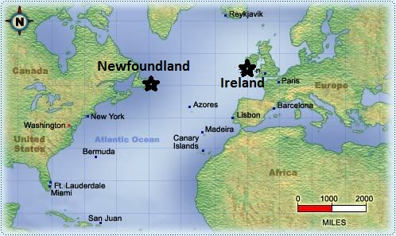
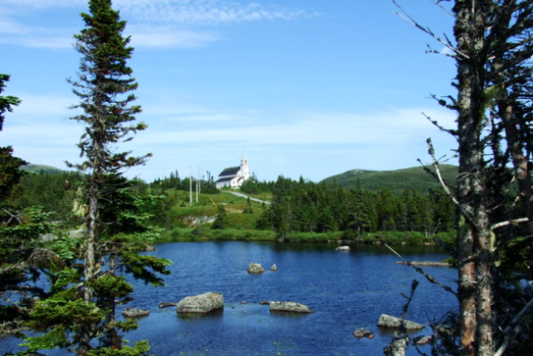
WHY ARE THEY DIFFERENT?
Newfoundland and Ireland
Newfoundland
St. John - 47° N Latitude
Average temperature range is 17°F to 69°F.
Snowfall is up to 20 feet per year.
Total precipitation is 45 inches per year.

Slide 5
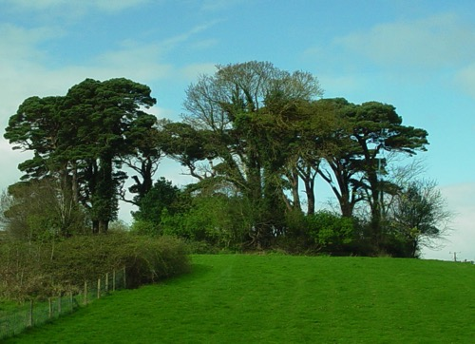
WHY ARE THEY DIFFERENT?
Ireland
Dublin - 53° N Latitude
Average temperature range is 44°F to 55°F.
Snowfall average is up to 1 foot per year.
Total precipitation is 40 inches per year.

Slide 6
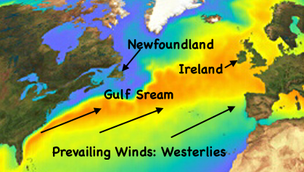
OCEAN CURRENTS: GULF STREAM!
Ocean currents store and transport heat from the equator to the poles!

Slide 7
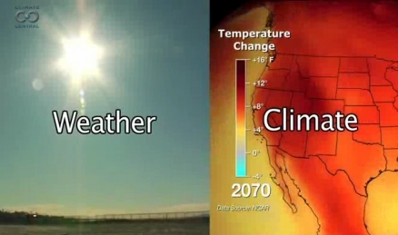
CURRENTS AFFECT CLIMATE
The difference between weather and climate is a measure of time.
Weather is what conditions of the atmosphere are over a short period of time
Climate is how the atmosphere behaves over relatively long periods of time.

Slide 8
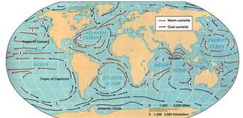
CURRENTS
- A current is a permanent or continuous, directed movement of ocean water that flows in one of the Earth's oceans
- Ocean currents move in circular patterns called gyres - formed by Earth’s Rotation (Coriolis) – like the wind belts!
- Currents controlled by:
Air currents – prevailing winds (Trades, Westerlies, etc.)
Earth’s rotation – Coriolis creates gyres (circle motion)
Location of continents - land masses act as barriers

Slide 9
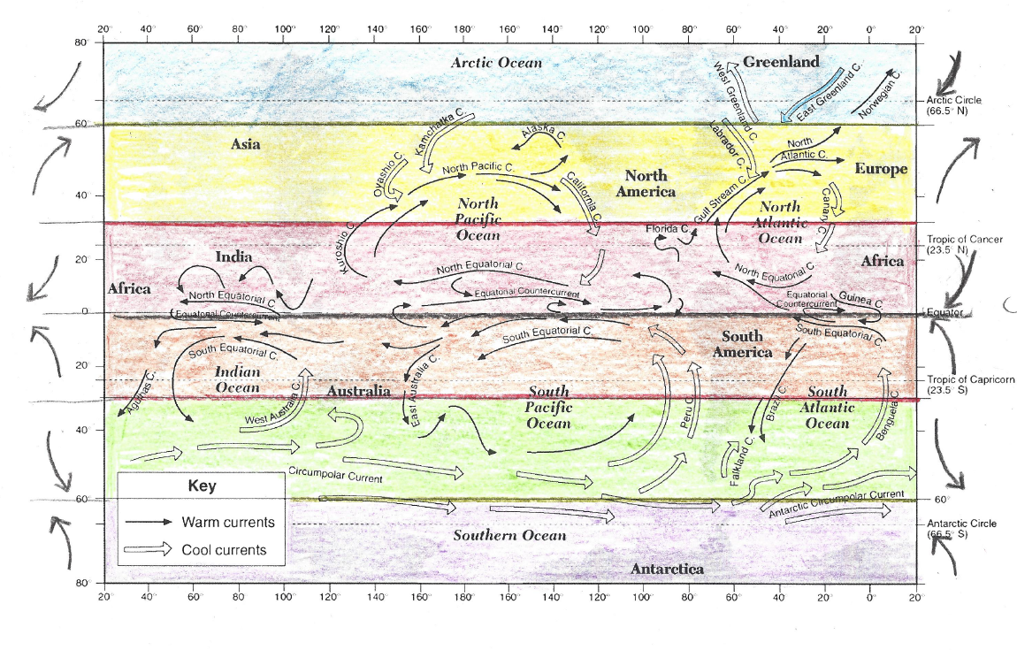

Slide 10
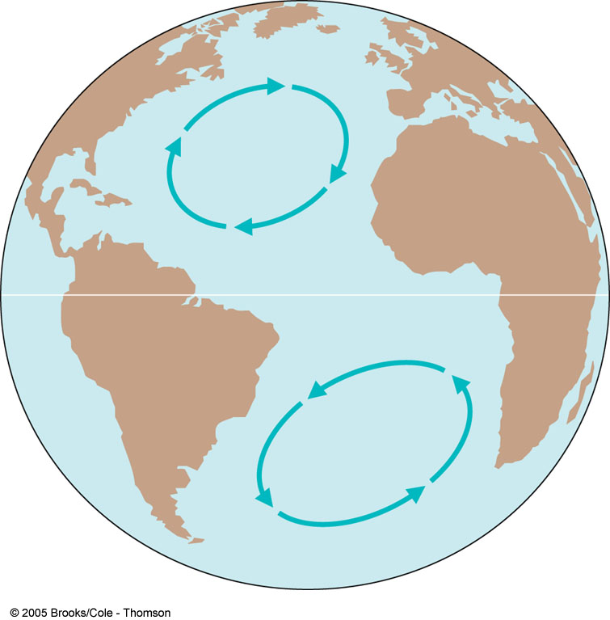
CURRENTS AND CORIOLIS
Global winds drag on the water’s surface, causing it to move and build up in the direction that the wind is blowing.
Major surface ocean currents deflected to the right in the Northern Hemisphere (clockwise) and to the left in the Southern Hemisphere (counter-clockwise ).

Slide 11
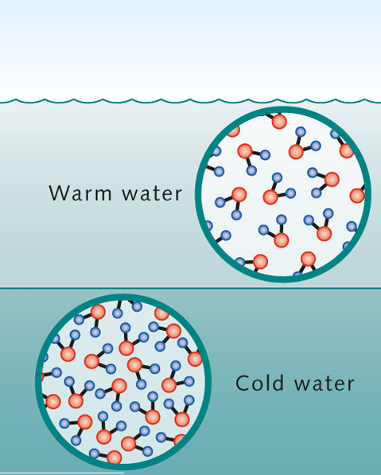
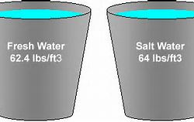
CURRENTS AND WATER DENSITY
Density of water depends on:
Temperature
  Cold water: molecules pack together, greater density.
  Warm water: molecules spread out, less dense.
Salinity
  Salt water is more dense than fresh water.
How can differences in water density create currents?

Slide 12
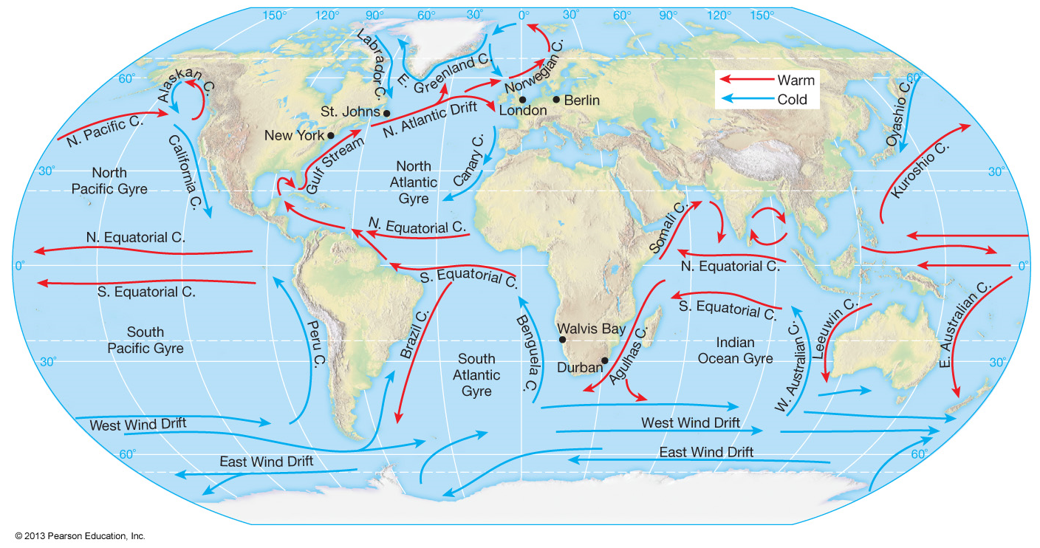
SURFACE CURRENTS
Cold currents flow toward equator.
Warm currents flow away from equator.
Equatorial – warm, move westward.
  Countercurrent lies between, moves east.

Slide 13
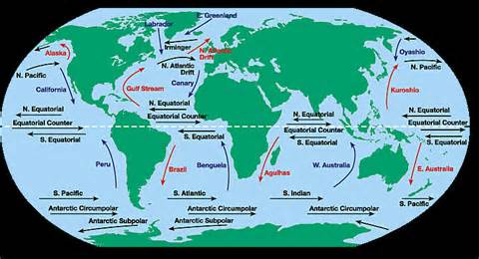
SURFACE CURRENTS
Southern –Antarctic Circumpolar (West Wind Drift)
Atlantic – Gulf Stream and Brazil (warm), Canary and Labrador (cold)
Pacific – Kuroshio and Eastern Australian (warm), California and Peru (cold)
The warm current that flows northward along the east coast of the United State is the Gulf Stream - warms the climate of northwestern Europe.

Slide 14
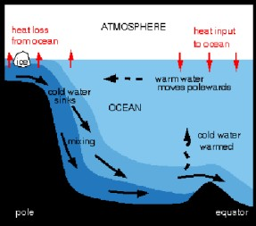
DEEP OCEAN CURRENTS
Have differences in density and they move slower than surface.
Temperature:
  Polar water is cold and dense, and it sinks.
  Warm water is warm and expands, and it rises.

Slide 15
DEEP OCEAN CURRENTS
Salinity:
  Cold polar water has greater salinity because salt doesn’t freeze – greater density.
  Fresh water is less dense than salty water.

Slide 16
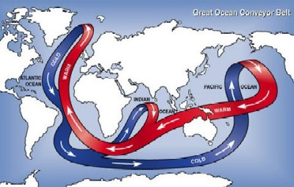
GREAT OCEAN CONVEYOR BELT
Deep Ocean current that absorbs, stores, and redistributes heat around the globe.
Transfers warm water from the Pacific Ocean to the Atlantic Ocean as a shallow current .
Returns cold water from the Atlantic Ocean to the Pacific Ocean as a deep current that flows further south.

Slide 17
GREAT OCEAN CONVEYOR BELT
Without the Great Ocean Conveyor Belt, places at the same latitude across the globe would generally have the same average temperatures.
However, because of this circulation, Norway, located at similar latitude to Manitoba, Canada has an average annual temperature that is nearly 20°F warmer.

Slide 18
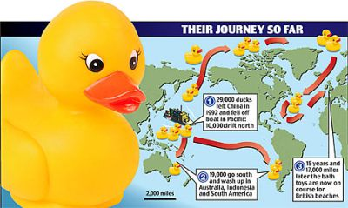
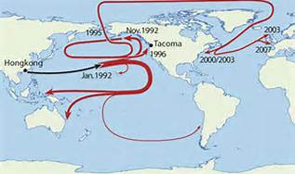
MOVING ON A CURRENT…
In 1992, a container ship spilled 29,000 toys in the Pacific. The map shows where they have been found.
What currents have they followed?

Slide 19
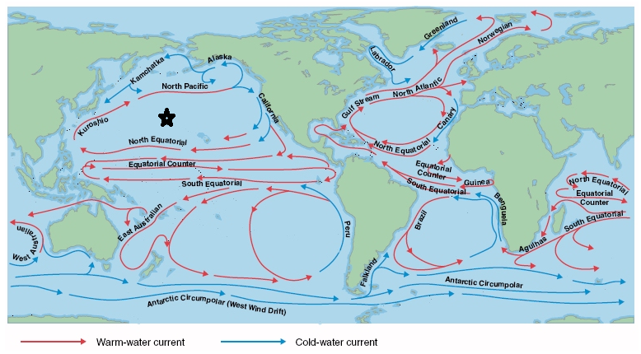

Slide 20
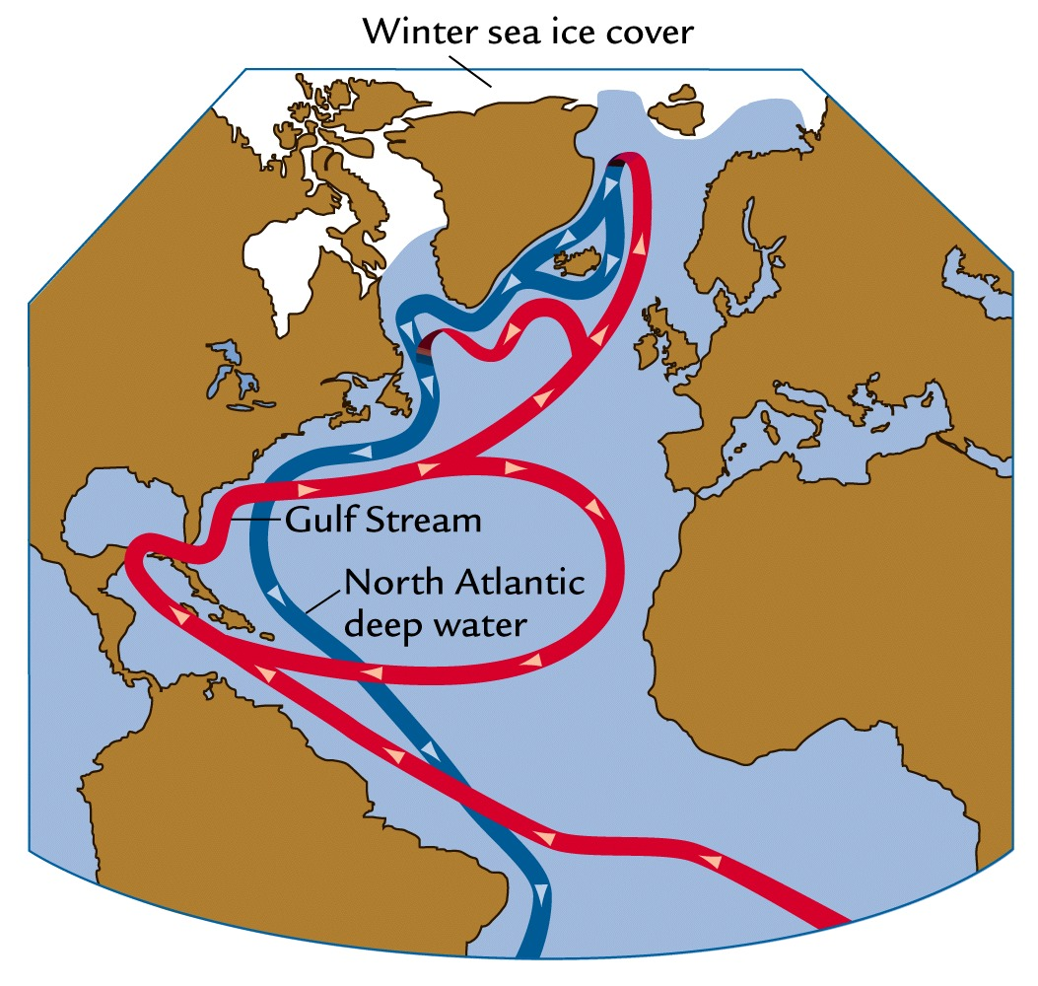
Review
Currents have an effect on:
A. Weather
B. Climate
C. Tornadoes
D. Cold Fronts

Slide 21
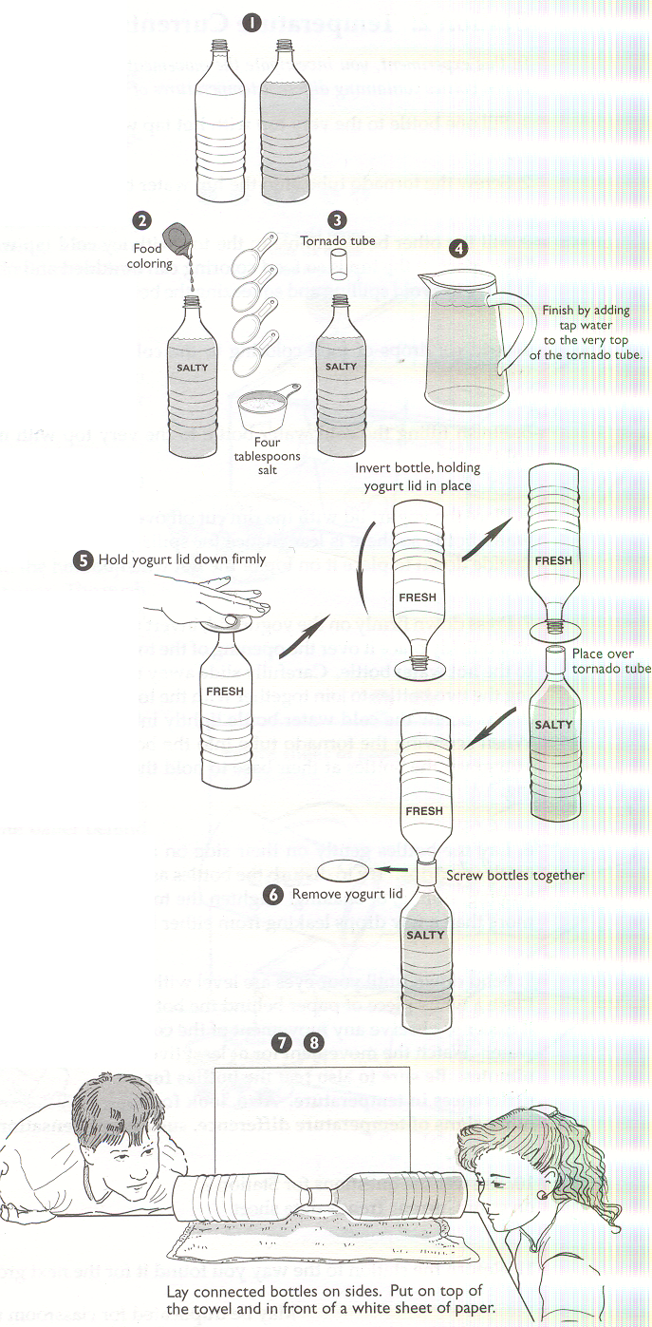
LAB
Salinity and Temperature Currents Lab

Slide 22
LAB
Purpose: Surface currents are swift and driven by the wind. Density-driven currents are slow, and result from changes in seawater density which occurs because of temperature and salinity changes. Surface currents are subject to large deflections due to the Coriolis effect; density-driven currents are less influenced by the Coriolis effect because they are so slow moving. Landmasses can create barriers to the flow of surface currents while the landscape of the ocean floor impedes the flow of deep-water currents. In this lab, you will investigate currents caused by temperature and salinity differences.

Slide 23
LAB
Materials:
2 plastic bottles
1 tornado tube
water
cup
4 tablespoons salt
food coloring
paper towels

Slide 24
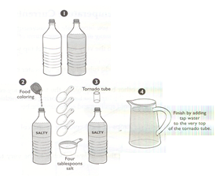

Slide 25
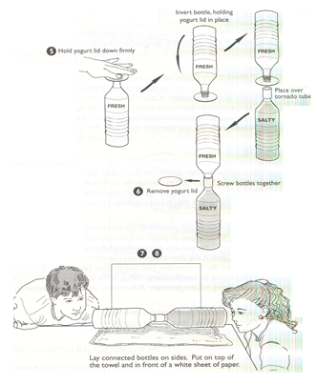

Slide 26
TO DO
Lab due by Friday.
Review #22 due tomorrow.

