Slide 1
DO NOW
Pick up notes.
Turn in National Chemical Week Extra Credit.
Get our Bonding handout form yesterday.

Slide 2
BONDING

Slide 3
VIDEO: BONDING
How are the atoms arranged in crystalline sodium chloride?
What is a polar covalent bond?

Slide 4
HOW TO DETERMINE THE TYPE OF BOND
How can you tell what type of bond it is?
The table of electronegativities can help you.
Look up the two element’s electronegativities and then subtract.

Slide 5
HOW TO DETERMINE THE TYPE OF BOND
The answer is ALWAYS positive.
If the difference is:
>1.67 ionic bond
0.5 to 1.67 polar covalent bond
< 0.5 nonpolar covalent bond

Slide 6
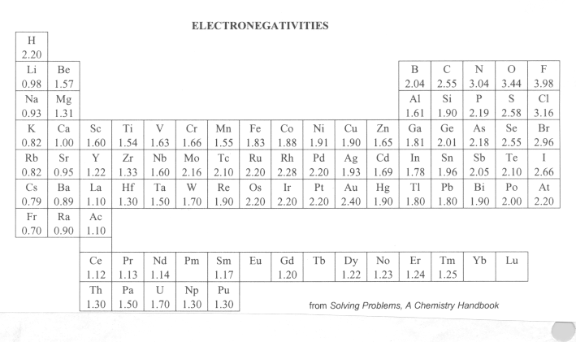

Slide 7
POLAR COVALENT BONDS
A POLAR covalent bond happens when one atom is significantly more electronegative than the other atom in the bond.
This means that one of the atoms has a slight negative charge and one atom has a slight positive charge.
A polar covalent bond means that there is a slight electronegativity difference, but not enough to make the bond ionic.

Slide 8
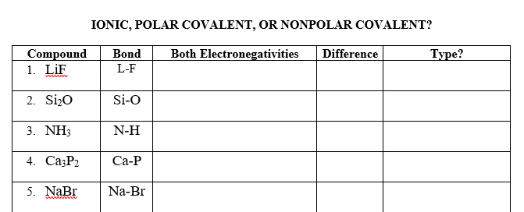
BOND TYPE?

Slide 9
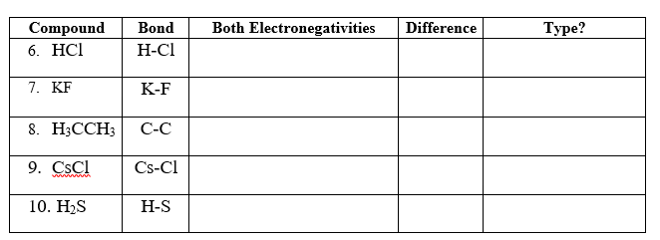
BOND TYPE?

Slide 10
PREDICTING BOND TYPES
There are two ways:
  Just by the periodic table:
    Metallic – two metals
    Ionic – metal and nonmetal
    Covalent – two nonmetals
  By electronegativities:
    >1.67 ionic bond
    0.5 to 1.67 polar covalent
    < 0.5 nonpolar covalent
    Be sure you are clear what the question is asking for.

Slide 11
PREDICTING BOND TYPES
IONIC BONDS
high reactivity.
usually between metals (loses electrons) and nonmetals (gains electrons).
electronegativity difference more than 1.67.

Slide 12
PREDICTING BOND TYPES
COVALENT BONDS
two elements who both want to gain electrons
usually nonmetals.
POLAR bonds have an electronegativity difference between 0.5 and 1.67.
NONPOLAR bonds have an electronegativity difference less than 0.5.

Slide 13
PREDICTING BOND TYPES
METALLIC BONDS
all metals (exception: alloys with carbon)

Slide 14
TO DO
Do Bonding Predictions handout for Thursday.

