Slide 1
DO NOW
Pick up notes sheet and Subatomic particle table.
Do Subatomic table NOW.
Get out Atomic Structure and Mass handout from yesterday.

Slide 2
PARTICLE TABLE
 |  |  |  | HOW TO DETERMINE THE
PARTICLE | LOCATION | CHARGE | MASS | NUMBER IN AN ATOM
PROTON | nucleus | + | 1 amu | Same as atomic number
NEUTRON | nucleus | neutral | 1 amu | Mass # - atomic #
ELECTRON | electron cloud | - | 1/1840 | Same as protons
 |  |  | amu

Slide 3
QUIZ TOMORROW
Over Subatomic Particle table

Slide 4
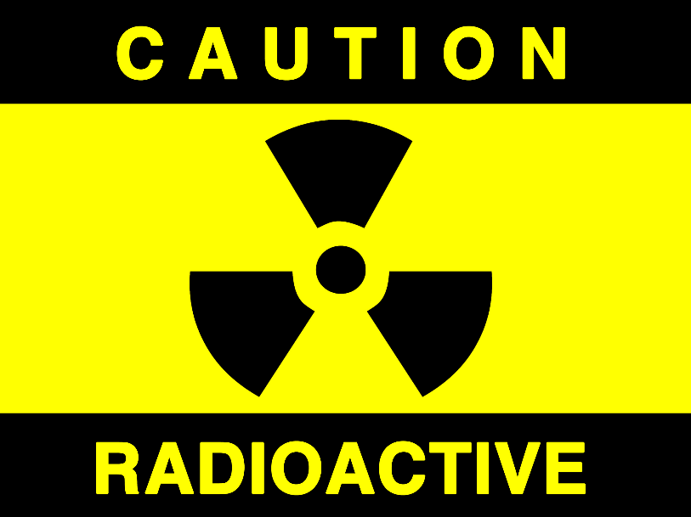
RADIATION

Slide 5
PERIODIC TABLE
Increasing atomic number.
True chemical symbols are 1 or 2 letters.
In each square:
  Atomic Number
  Symbol
  Name
  Atomic Mass
1
H
Hydrogen
1.01

Slide 6
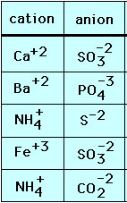
WHAT ARE IONS?
An atom with an electrical charge.
It has gained or lost one or more electrons
To find the net charge of an atom, subtract the number of electrons from the number of protons.
The charge is placed to the top right of an element’s symbol.
GAIN electrons = negative ion = anion
LOSE electrons = positive ion = cation

Slide 7
PRACTICE
1. Fluorine has 9 protons, 10 neutrons, and 10 electrons. What is the atomic number, mass number, and ion formed (write the symbol)?
2. Cobalt has 27 protons, 32 neutrons, and 25 electrons. What is the atomic number, mass number, and ion formed (write the symbol)?
3. Potassium has 19 protons, 20 neutrons, and 18 electrons. What is the atomic number, mass number, and ion formed (write the symbol)?
4. Selenium has 34 protons, 45 neutrons, and 37 electrons. What is the atomic number, mass number, and ion formed (write the symbol)?
Z = 9, A = 19, F⁻¹
Z = 27, A = 59, Co⁺²
Z = 19, A = 39, K⁺¹
Z = 34, A = 79, Se⁻³

Slide 8
ISOTOPES
Isotopes are atoms of the same element that have a different number of neutrons.
They differ in mass, but the atom’s chemical behavior are the same.
To identify an isotope, you write the element’s name and follow it with its mass number.
Examples: Carbon-12, Uranium-238.

Slide 9
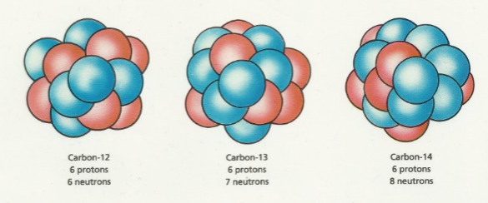
ISOTOPES
Carbon-12 p⁺=6 n°=6
Carbon-13 p⁺=6 n°=7
Carbon-14 p⁺=6 n°=8
Carbon-14 is not as
stable as carbon-12
and breaks down
radioactively.

Slide 10

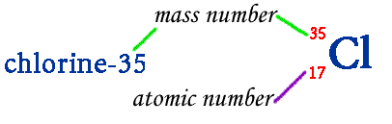
ISOTOPES
It can also be identified by writing
The mass of individual atoms is too small to measure so the mass of an atom is compared to a standard, Carbon-12 – Carbon-12 = 12 amu. AMU stands for atomic mass unit.
Remember, the ATOMIC MASS is the weighted average of the isotopes of an element and can be calculated if you know the isotope’s mass numbers and the percentage abundance of each.

Slide 11
PRACTICE – Isotope or Different Element?
1. Element D 6 p+ and 7 n°
Element F 7 p+ and 7 n°
2. Element J 27 p+ and 32 n°
Element L 27 p+ and 33 n°
3. Element X 17 p+ and 18 n°
Element Y 18 p+ and 17 n°
4. Element Q 56 p+ and 81 n°
Element R 56 p+ and 82 n°
Different element
Isotope
Different element
Isotope

Slide 12
PRACTICE – Isotope or Different Element?
5. Element T Z = 20 and A = 40
Element Z Z = 20 and A = 41
6. Element W 8 p+ and 8 n°
Element V 7 p+ and 8 n°
7. Element P Z = 92 and A = 238
Element S 92 p+ and 143 n°
Isotope
Different element
Isotope

Slide 13
NUCLEAR CHANGE
Three types of change:
PHYSICAL – does not affect the atom or its parts
CHEMICAL – affects the outermost electrons of the atom
NUCLEAR – affects the nucleus; the nucleus of one atom is changed into another; energy is always released.

Slide 14
RADIOACTIVITY
Henri Becquerel
  Discovered mysterious rays coming from uranium.
  Called it RADIATION.
  Radioactivity is the spontaneous emission of radiation from an element.
  It is the release of matter and energy that results from changes in the nucleus of an atom.
  All elements with an atomic number greater than 82 are radioactive.

Slide 15
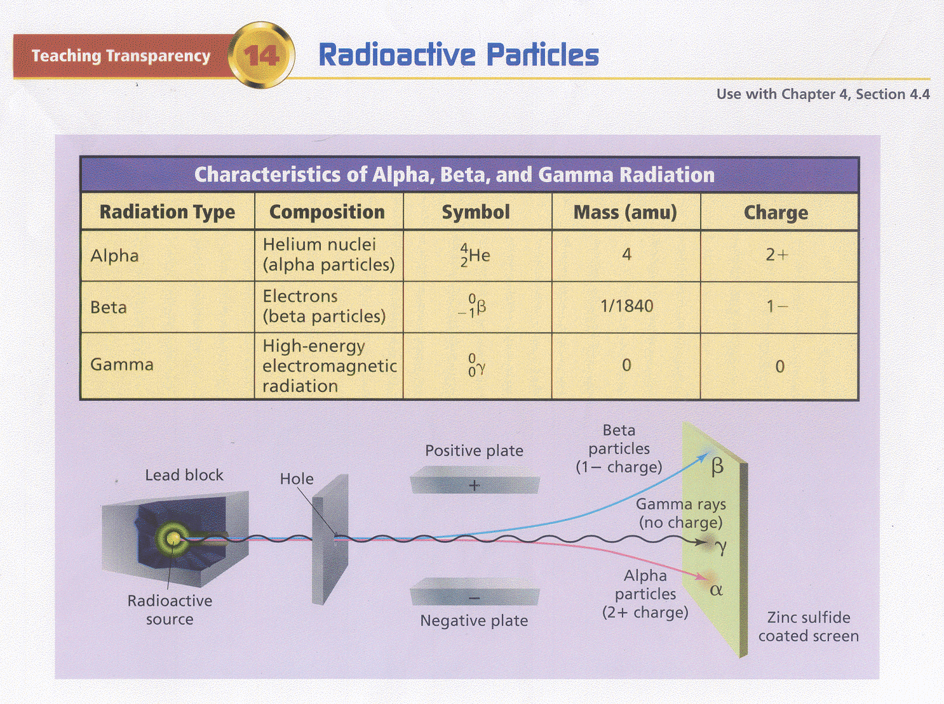

Slide 16
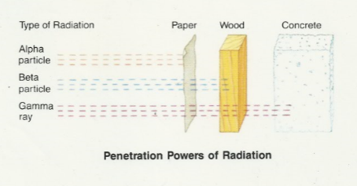
RADIATION
- Alpha particles are stopped by thin tissue.
- Beta particles are stopped by thin foil.
- Gamma energy is stopped by lead or concrete.

Slide 17
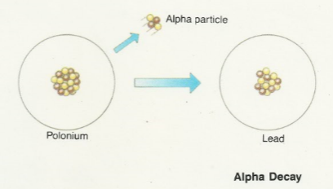
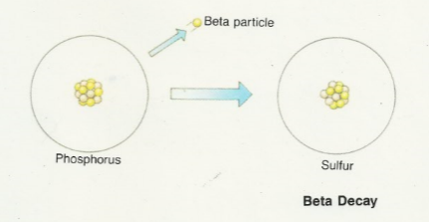
RADIATION
Atomic Number Changes:
When an alpha particle leaves the nucleus, the atomic number goes down by TWO .
When a beta particle leaves the nucleus, the atomic number goes up by ONE.
When gamma energy leaves the nucleus, the atomic number does not change.

Slide 18
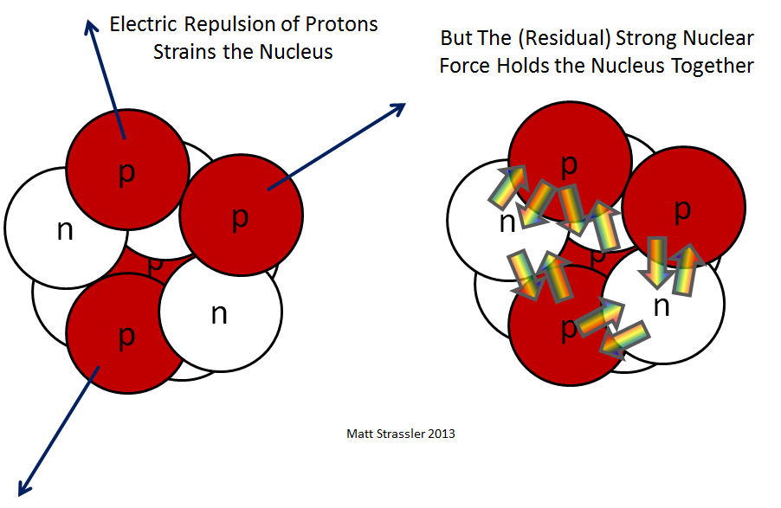
RADIOACTIVITY
The strong nuclear force holds neutrons and protons together in the nucleus.

Slide 19
RADIOACTIVITY
It acts only on subatomic particles that are extremely close together.
A stable atom has a strong enough strong force to hold it together.
An unstable atom is radioactive because it cannot stay together. This is caused by an imbalance of neutrons and protons.
When the strong force is broken, a lot of energy is released.

Slide 20
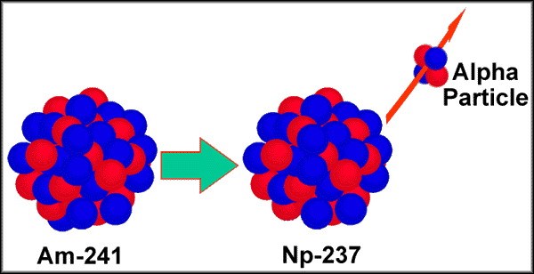
THREE TYPES OF NUCLEAR REACTIONS
1. SPONTANEOUS
a single nucleus releases energy and particles of matter.
The nucleus undergoes nuclear changes in the form of radioactive decay.

Slide 21
THREE TYPES OF NUCLEAR REACTIONS
2. FISSION
splitting of an atomic nuclei into two smaller nuclei of approximately equal mass.
NOT spontaneous
must be started with a neutron “bullet”.
forms a CHAIN REACTION - a continuous series of reactions. This splits a lot of atoms at the same time which releases a lot of energy. The reaction releases energy and mass.

Slide 22
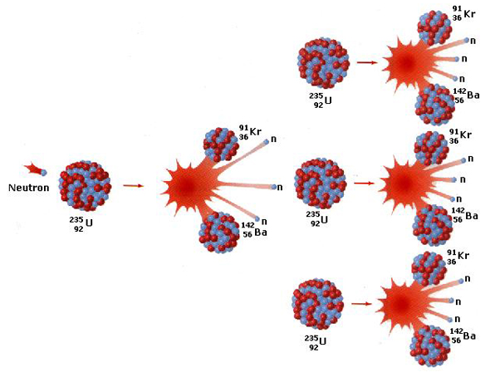
THREE TYPES OF NUCLEAR REACTIONS
FISSION
Examples: nuclear bomb (uncontrolled), nuclear power plant (controlled)
Uranium is the most common element used

Slide 23
THREE TYPES OF NUCLEAR REACTIONS
3. FUSION
joining of two atomic nuclei of smaller masses to form a single nucleus of a larger mass.
called a thermonuclear reaction ; requires at least 1 million °C; forms plasma.
reaction exists in the sun, stars.
produces a lot of energy.

Slide 24
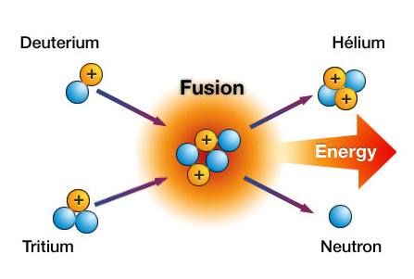
THREE TYPES OF NUCLEAR REACTIONS
FUSION
this reaction is difficult to start and control
examples: reaction of the sun; hydrogen bomb
This is how we got all the elements in the universe.

Slide 25
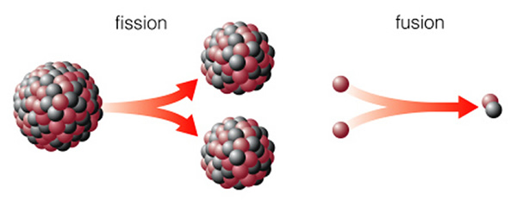
IMPORTANT TO REMEMBER
1. ALWAYS involves a change in the nucleus;
2. ALWAYS involves a release in energy

Slide 26
IMPORTANT TO REMEMBER
3. You can change the number of neutrons without changing the type of atom.
4. If you change the number of protons in a nucleus, you change the type of atom (element name changes).
5. A nuclear force holds protons and neutrons together. When the force is broken, lots of energy is released.
6. One atom type always changes into another type of atom during a nuclear change.

Slide 27
RADIOACTIVITY DECAY RATES
Radioactive decay rates are measured in half-lives.
A HALF-LIFE is the time it takes for one half of the radioactive sample to decay.
Different isotopes have different half-lives.
Examples include uranium-238 (4.46 x 10⁹ years), carbon-14 (5730 years), radon-222 (3.8 days) and polonium-214 (163.7 microseconds).

Slide 28
RADIOACTIVITY DECAY RATES
If you were given a 10.0g sample of carbon-14, how much would be stable after 3 half-lives?
radioactive stable
original 1st half-life 2nd half-life 3rd half-life
0.0g stable 5.0g stable 7.5g stable 8.75g stable

Slide 29
PRACTICE
A. How much of a 50.0g sample of nitrogen-16 is left after three half-lives if its half life is 14.4s? How much time has elapsed?
B. The half-life of potassium-42 is 12 hours. How much of a 750.0g sample is left after 60.0 hours?

Slide 30
TO DO
Handout due tomorrow.
Quiz tomorrow over subatomic particles.

