Slide 1
DO NOW
Turn in Review #22.
Pick up notes and Review #23

Slide 2
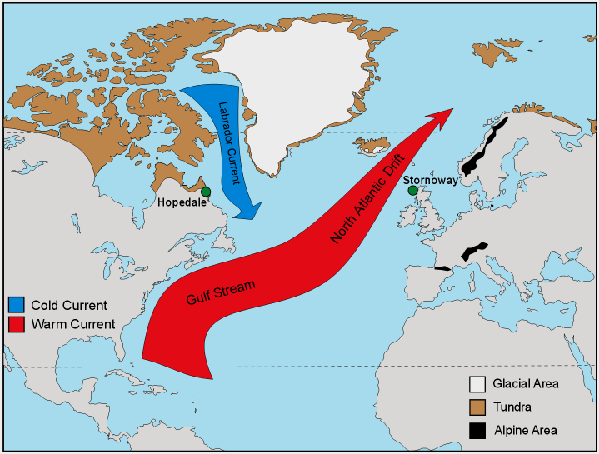
REVIEW
How does the Gulf Stream impact the climate of Europe?
Why doesn’t it impact the climate of the United States?

Slide 3
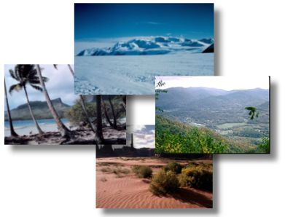
Climate FACTORS
SES5. Students will investigate the interaction of insolation and Earth systems to produce weather and climate.
c. Relate weather patterns to interactions among ocean currents, air masses, and topography.
.

Slide 4
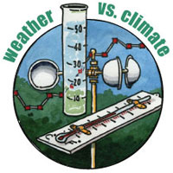
CLIMATE VS. WEATHER
Weather: condition of the atmosphere at a specific time.
Climate: the average weather conditions in an area over a long period of time.

Slide 5
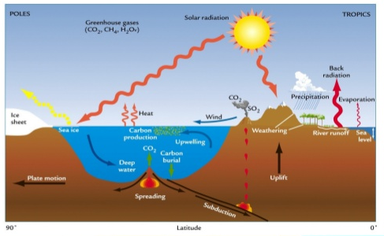
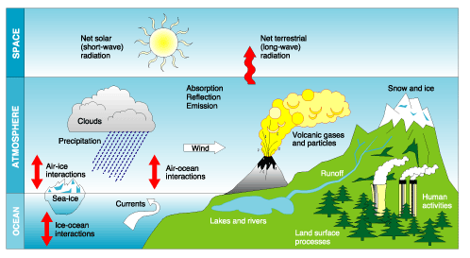
CLIMATE FACTORS
Factors that Influence Climate
Prevailing Winds
Pressure Belts
Latitude
Elevation
Topography
Coastlines
Cities
Seasonal Winds
Sea Surface Temperatures

Slide 6
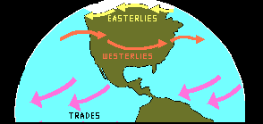
1. PREVAILING WINDS
Air over water:
Becomes wet
Warms in winter
Cools in summer
Moves inland
Air over land:
Becomes dry
Warmer in summer
Cooler in winter
Air masses take on characteristics of:
Where it is formed
What it passes over

Slide 7
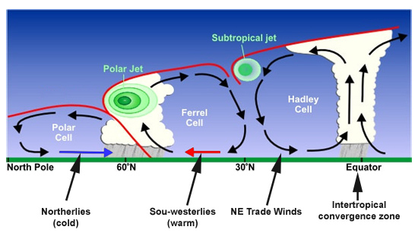
2. PRESSURE BELTS
Doldrums – equator – rising air – wetter – rainforests.
Horse latitudes – sinking air – drier – deserts located here.
Seasonal shifts due to Earth’s tilt.

Slide 8
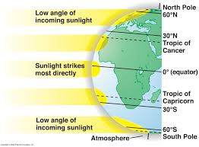
3. LATITUDE
Angle of sunlight:
Higher latitudes receive less solar energy
Seasonal variations due to Earth’s tilt.
Warmer near equator, cooler farther away.

Slide 9
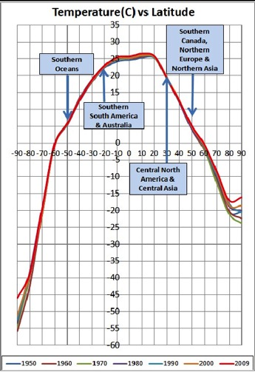
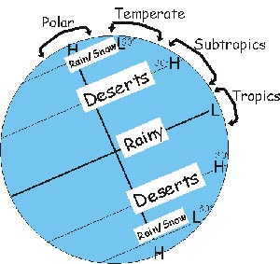
LATITUDE AND TEMPERATURE

Slide 10
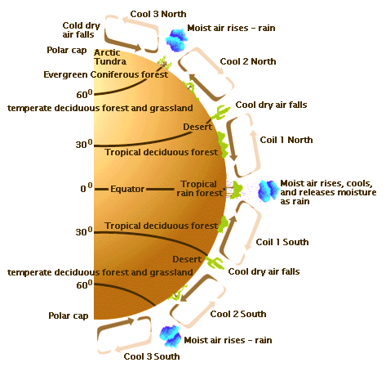
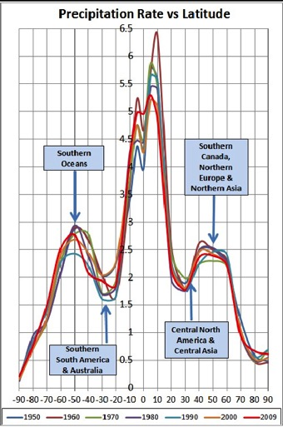
LATITUDE AND PRECIPITATION

Slide 11
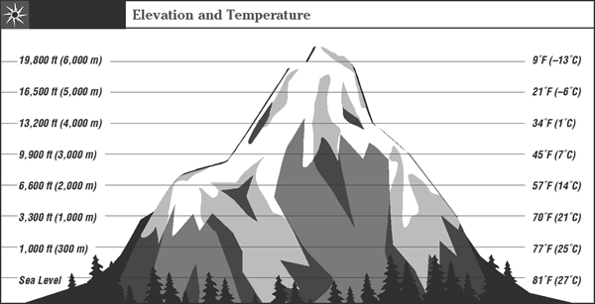
4. ELEVATION
Higher elevation colder – lower elevation warmer
Large variation in temperature and precipitation

Slide 12
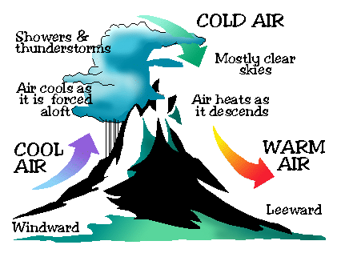
5. TOPOGRAPHY
Elevation
Mountains – air rises, cools and drops moisture on windward side – dry on leeward side.
Rain Shadows – dry, warm air that flows down leeward side of a mountain range

Slide 13
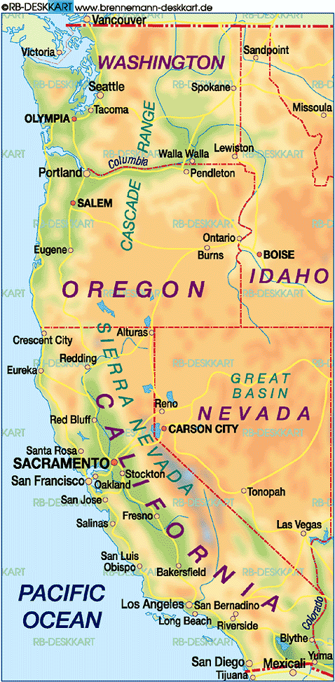
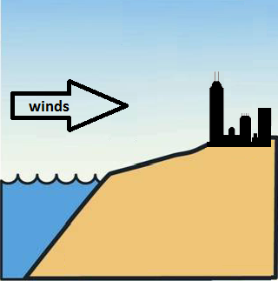
6. COASTLINES
Coastal cities near the ocean where prevailing winds are from the ocean:
Warmer in the winter – water warms air
Cooler in the summer – water cools air
More precipitation all year – humid
Common in United States on West coast.

Slide 14
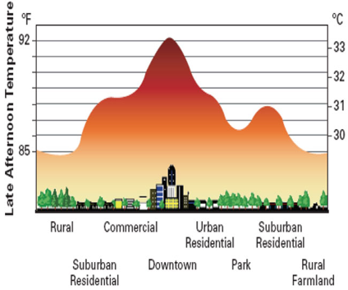
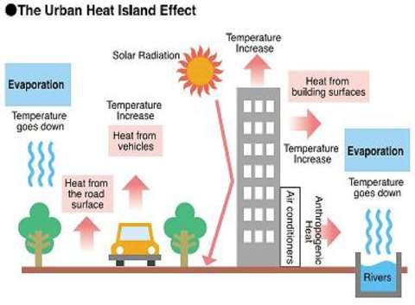
7. CITIES
HEAT ISLANDS:
Pavement and buildings in cities absorb and re-radiate heat - causes increased temperature.

Slide 15
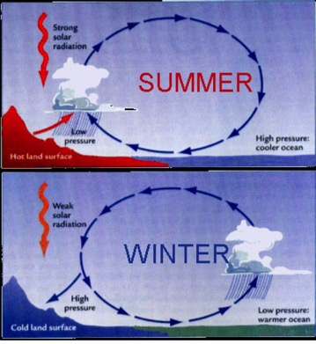
8. SEASONAL WINDS
Prevailing winds shift in some parts of the world seasonally.
Bring major climate differences.
Similar to coastal sea and land breeze effect – only BIGGER!

Slide 16
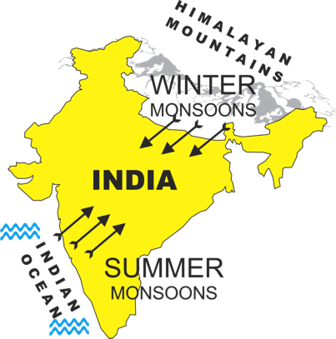
SEASONAL WINDS: MONSOONS
Seasonal changes in the direction of the prevailing, or strongest, winds
Differences in heating and cooling of land and water
Summer :
High pressure over water.
Low over land (water hasn’t warmed up yet)
Sea breeze
Heavy rains from ocean

Slide 17
SEASONAL WINDS: MONSOONS
Winter:
High pressure over land
Low over water (water remains warm)
Land breeze
Dry weather from land

Slide 18
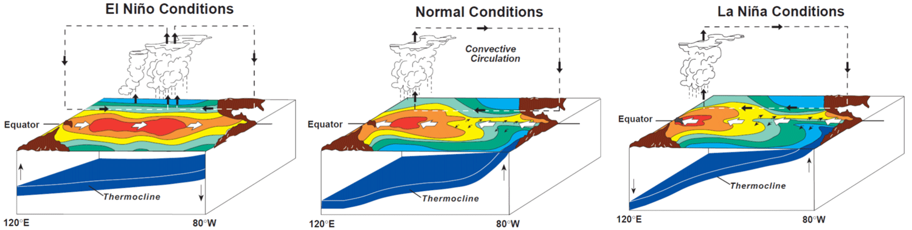
9. SEA SURFACE TEMPERATURES
El Niño/La Niña - Southern Oscillation:
Ocean heats unevenly.
Warm water moves back and forth from one side of ocean to other.
Creates shifts in patterns due to ocean-atmosphere interactions.
Other oceans also have oscillations: Arctic, Atlantic, etc.
EL NINO VIDEO LINK

Slide 19
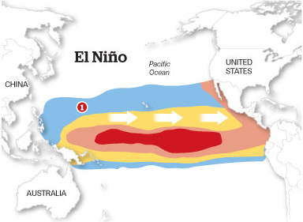
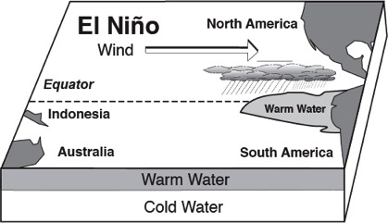
El Niño
Eastern Pacific Ocean near South America warms up.
Increased air temperature and precipitation in USA.
Wet winters in the Southeastern USA.

Slide 20
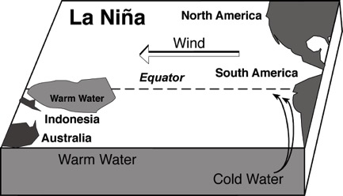
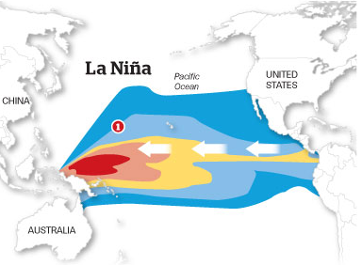
La Niña
La Niña: Eastern Pacific Ocean cooler – Western Pacific near Asia warms.
Decreased temperature and precipitation in USA.
Greater hurricane activity in the Atlantic.

Slide 21
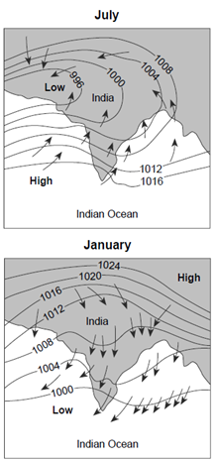
REVIEW
In areas that have a Monsoon, the dry season is in:
Summer
Fall
Winter
Spring

Slide 22
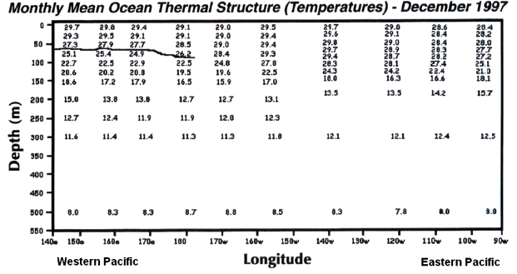
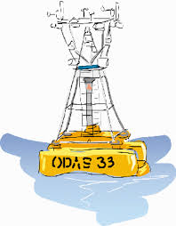
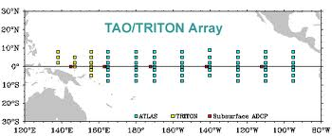
LAB:
Identifying ENSO Periods
You will use data from TAO and TRITON buoys in the equatorial Pacific to identify El Nino and La Nina periods

