Slide 1
DO NOW
Pick up Notes.
Get out Solubility handout and Concept Review handout.

Slide 2
COPY DATA FROM LAB

Slide 3
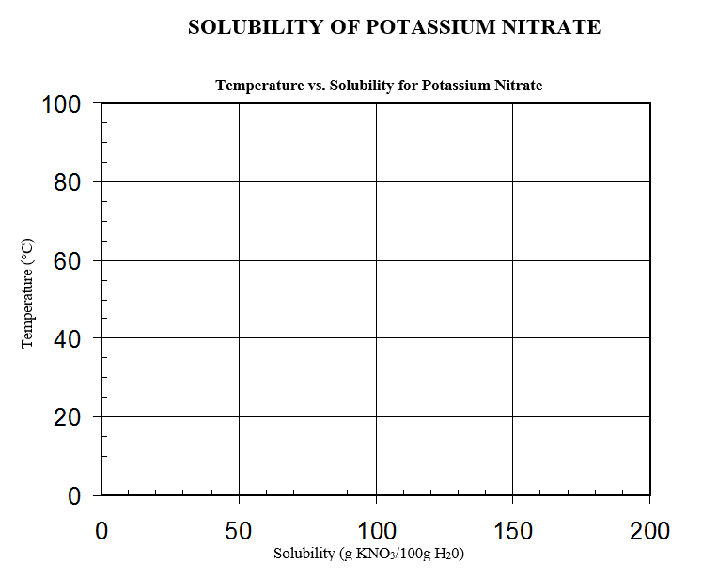

Slide 4
CONCENTRATION
Concentration is how many particles of a solute are dissolved.
Concentration is NOT dependent upon the sample size and it can be measured.
There are many units associated with concentration like:
Grams/100.0 grams measures solubility
Parts per million (ppm) measures small concentrations
Parts per billion (ppb) measures pollutants
We will learn to calculate molarity and molality.

Slide 5
MOLARITY SONG

Slide 6
MOLARITY, M
This is the ratio between the moles of dissolved substance and the volume (L) of the solution expressed in liters.
Molarity, M = moles of solute
volume of solution in liters
A one-molar (1M) solution of HCl contains one mole of HCl in one liter of water which means it contains 36.46g of HCl in 1 liter of water.

Slide 7
EXAMPLE
Sandy dissolves 45.0 g of NaCl in 2.5 liters of solution. What is the concentration in molarity of NaCl?
Mass = 45.0 g Molar Mass = 58.44 g/mol
V = 2.5 L NaCl
Molarity = 45.0 g NaCl 1 mol NaCl
2.5 L 58.44 g NaCl
=

Slide 8
EXAMPLE
You can also do this in two steps:
1. Mole = 45.0 g NaCl 1 mol NaCl
58.44 g NaCl
=
2. Molarity = mole solute = 0.770mol
Liters Soln 2.5L
=

Slide 9
PRACTICE
What is the molarity of 58.5g of NaCl dissolved in 2.0L of solution?

Slide 10
MOLALITY, m
This is concentration expressed in terms of moles of solute per kilogram of solvent. Volume is not a factor.
Molality, m = moles solute
Kg solvent
A 1.0 molal aqueous sugar solution is one mole sugar in one kilogram water .

Slide 11
EXAMPLE
Calculate the molality of 98.0g RbBr in 0.824 Kg water.
Mass – 98.0G RbBr 0.824kg water
Molar mass – 165.38g RbBr
m = 98.0 g RbBr 1 mol RbBr
0.824Kg H₂O 165.38g RbBr
=

Slide 12
EXAMPLE
You can also do this in two steps:
1. Mole = 98.0 g RbBr 1 mol RbBr
165.38g RbBr
=
2. Molarity = mole solute = 0.593mol
Kg solvent 0.824Kg H₂O
=

Slide 13
PRACTICE
Calculate the molality of 85.2g SnBr₂ in 140.0g water.

Slide 14
PREPARING AND DILUTING SOLUTIONS
A 3M solution of HCl is not bought but made from 12M stock solutions.
In addition, a 1.0M solution of NaOH is made from a calculated amount of solid NaOH added to water.
It is important to know how to make different concentration of solutions.

Slide 15
PREPARING AND DILUTING SOLUTIONS
DISSOLVING A SOLID INTO A LIQUID
1. Work backwards from molarity and volume to get moles of solute.
M = moles solutes/liters soln SO
moles = M x V(in liters)
2. Convert moles of solute back to grams using the substance’s molar mass.

Slide 16
PREPARING AND DILUTING SOLUTIONS
EXAMPLE
Prepare 1.0 liter of a 1.0M NaOH:
M = mol mole = (M)(V)
L
mol = (1.0M)(1.0L) =
1.0mol NaOH 40.00g NaOH = 1 mol NaOH
So, you will put 40.00g NaOH in a flask, add 1.0L water, and mix well.

Slide 17
PREPARING AND DILUTING SOLUTIONS
PRACTICE:
Prepare 1.0L of a 6.0M aqueous solution of KCl. The molar mass of KCl is 74.55g/mol.

Slide 18
PREPARING AND DILUTING SOLUTIONS
DISSOLVING A LIQUID INTO A LIQUID:
To dilute a solution, you can form a ratio between molarity and volume.
M₁V₁ = M₂V₂

Slide 19
PREPARING AND DILUTING SOLUTIONS
What volume would you use to make 0.500L of 6.0M HCl solution? You are essentially diluting 12.0M HCl to 6.0M HCl.
M₁V₁ = M₂V₂
V₁ = M₂V₂ = (6.0M HCl)(0.500L HCl)
M₁ (12.0M)
=
Thus you would need 0.250L HCl and 0.250L water to make the solution.

Slide 20
PRACTICE
What volume would you use of 12.0M HCl to make 1.0L of 0.10M HCl?

Slide 21
TO DO
Molarity and Molality handout is due tomorrow.
Solubility of KNO₃ lab due on Friday.

