Slide 1
DO NOW
Pick up notes and Review #10.

Slide 2
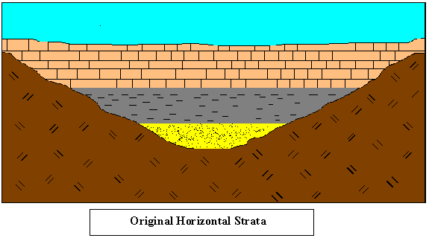
REVIEW
What is the “Principle of Original Horizontality”?

Slide 3
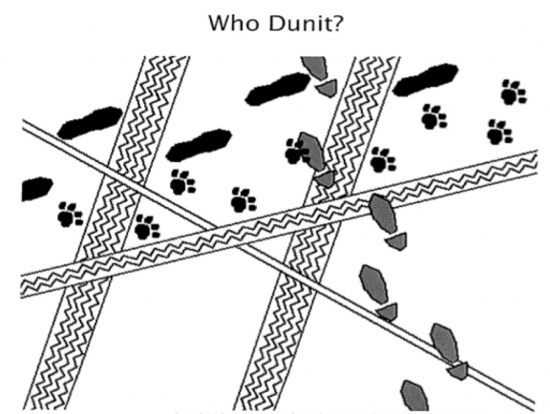
SNEAK PEAK….
Someone stole the cookies last night from the cookie jar. The last person to leave was the thief. Who was it?
The butler walks to work
The handyman rides a bike
The cook rides a motorcycle
The maid drives a car
The nephew has a seeing-eye dog
How do you know?

Slide 4
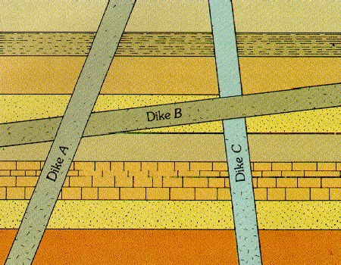
CROSS CUTTING RELATIONSHIPS
SES4. Students will understand how rock relationships and fossils are used to reconstruct the Earth’s past.
Describe and apply principles of relative age (superposition, original horizontality, cross-cutting relations, and original lateral continuity) and describe how unconformities form.
Interpret the geologic history of a succession of rocks and unconformities.

Slide 5
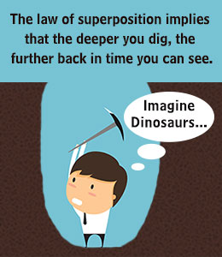
REVIEW
Law of Superposition - a principle holding that in a vertical sequence of undeformed sedimentary rocks, the relative ages of the rocks can be determined by their position in sequence-oldest at the bottom followed by successively younger layers.

Slide 6
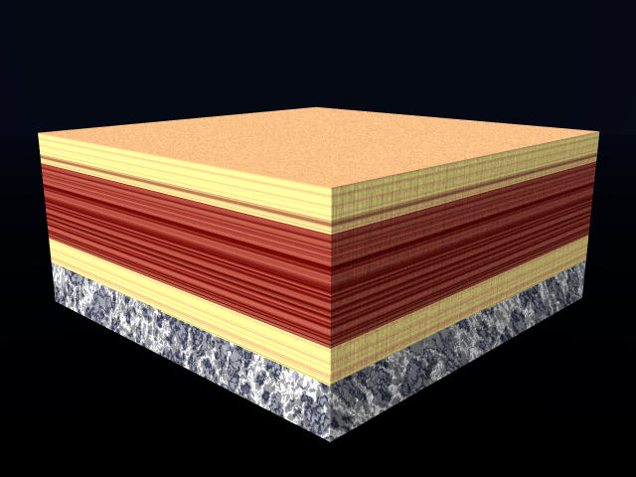
REVIEW
Principle of Original Horizontality - layers of sediment are originally deposited horizontally under the action of gravity.

Slide 7
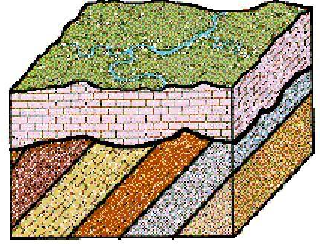
REVIEW
Unconformities - breaks in a stratigraphic sequence resulting from a change.

Slide 8
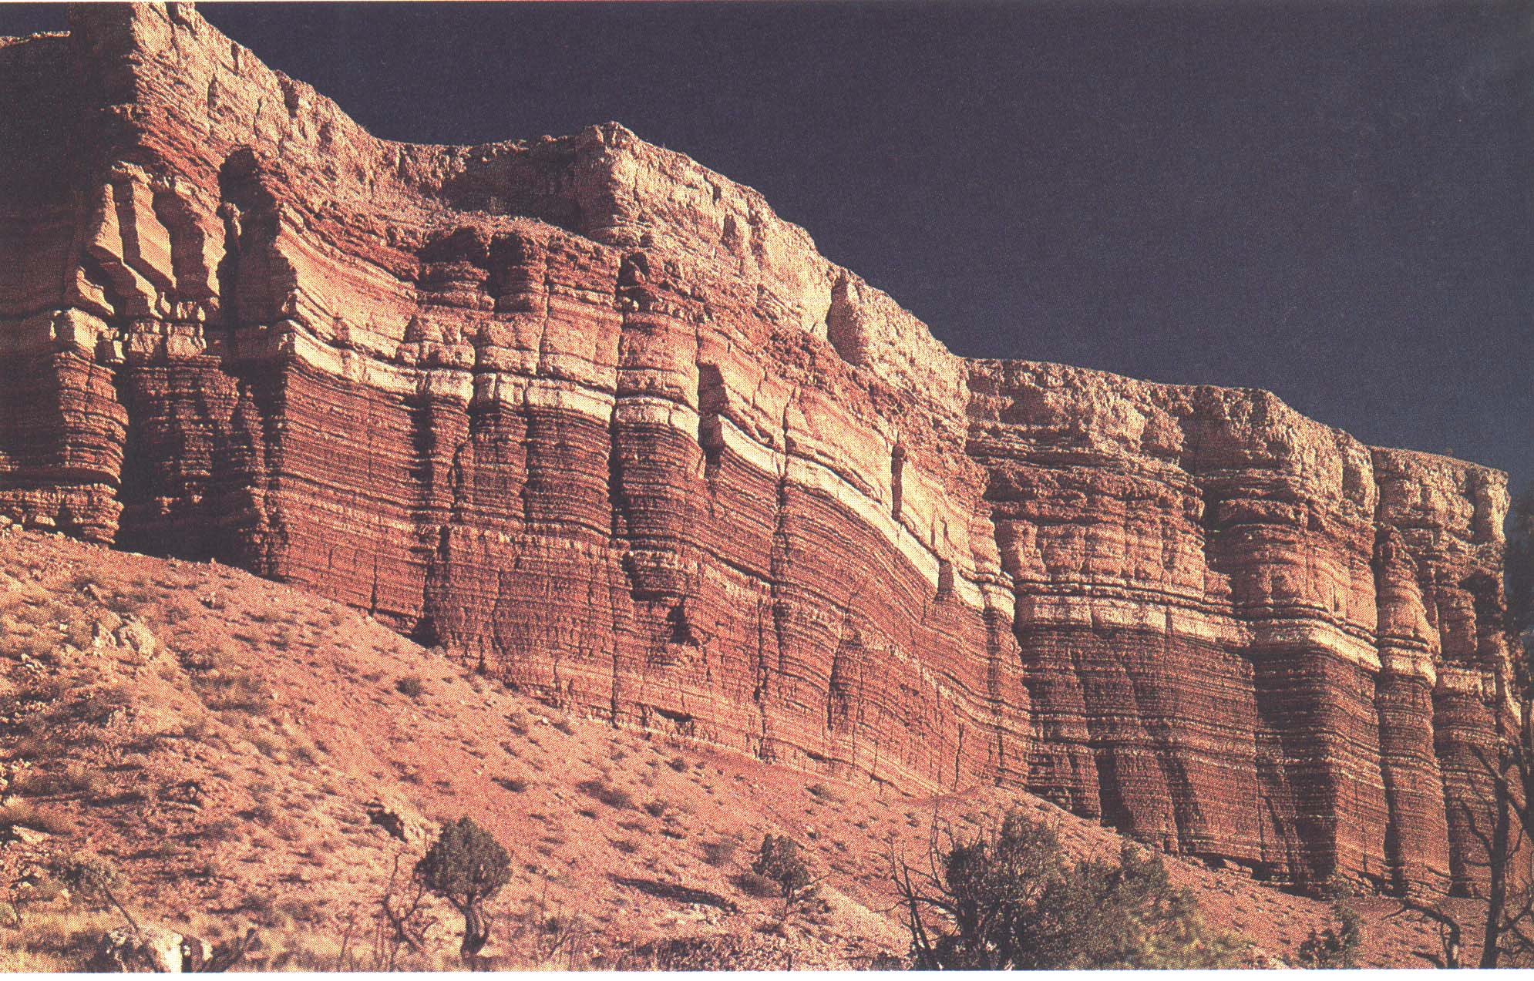
UNIFORMITARIANISM
The geological processes that took place in the past are generally similar to those that occur now.
The present is not really different from most of the geological past.
This assumption is the key to interpreting the past.

Slide 9
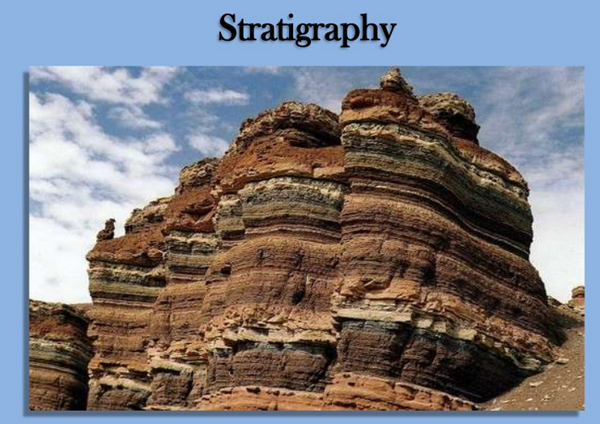
UNIFORMITARIANISM
The processes we see at work today are the same as the ones in the past.
Those processes have shaped the Earth we now see over a 4.5 billion year history.

Slide 10
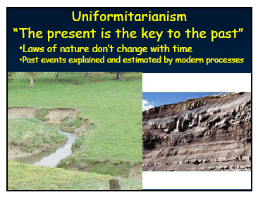
UNIFORMITARIANISM
The Present is the Key to the Past
Laws of nature DON’T change with time.
Past events are explained and estimated by modern processes.

Slide 11
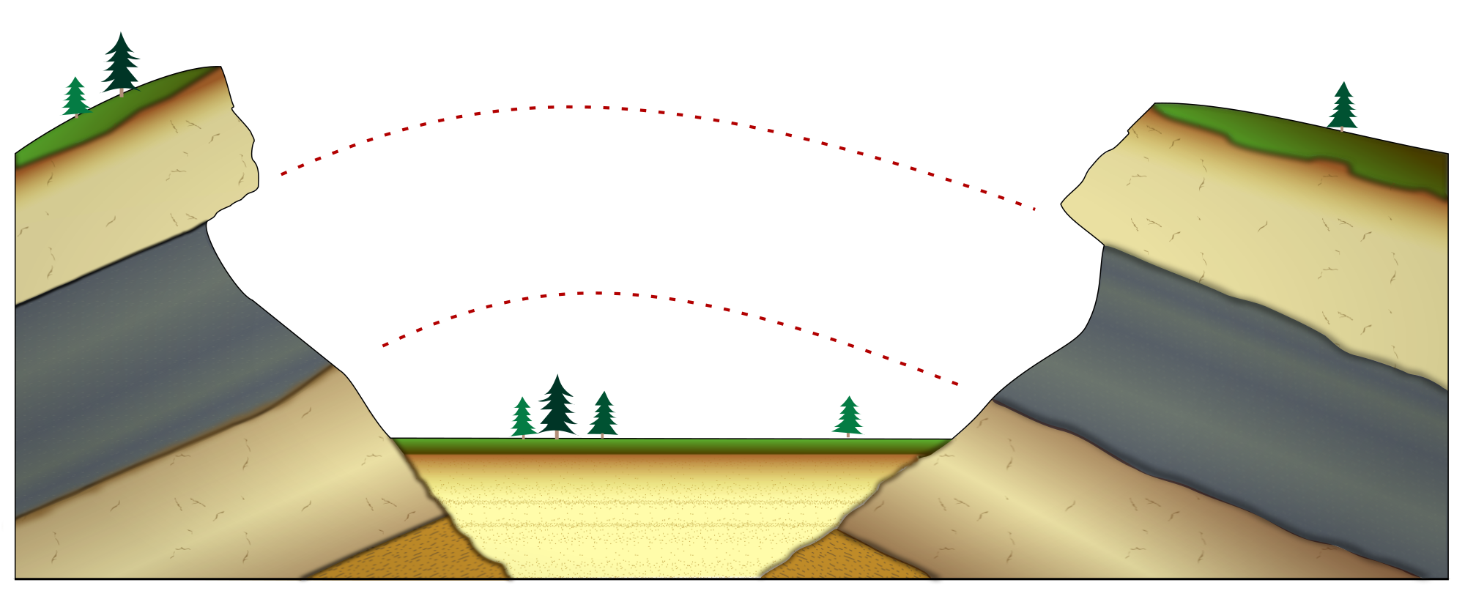
LAW OF LATERAL CONTINUITY
When layers of sediment are deposited, they spread outward in all directions.
They will either thin out due to lack of material or hit a barrier.

Slide 12
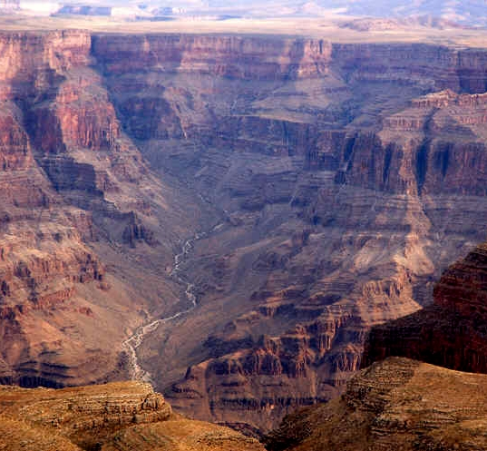
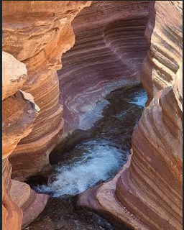
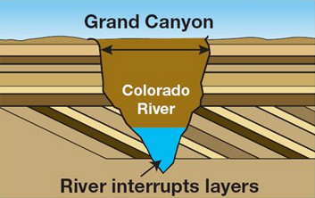
LAW OF LATERAL CONTINUITY
When a valley cuts through sedimentary layers, it can be assumed that the rocks on either side of the valley were originally continuous.

Slide 13
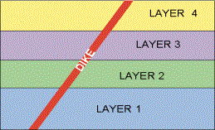
LAW OF CROSS-CUTTING RELATIONSHIPS
Any feature that cuts across a rock or layer of sediment is younger than the rock or layer it cuts.
youngest layer

Slide 14
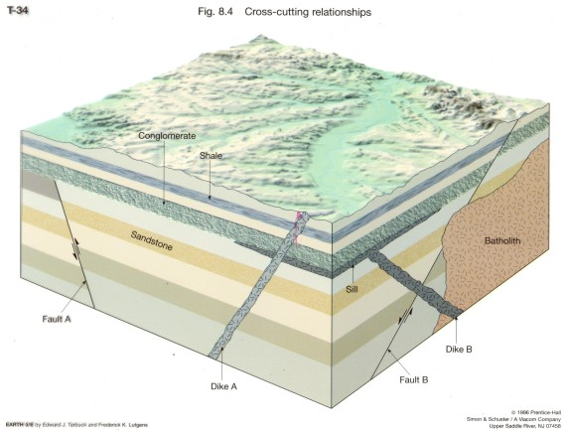
EXAMPLE OF CROSS-CUTTING
Intrusion - igneous rock that forms when magma squeezes between existing rock and hardens.

Slide 15
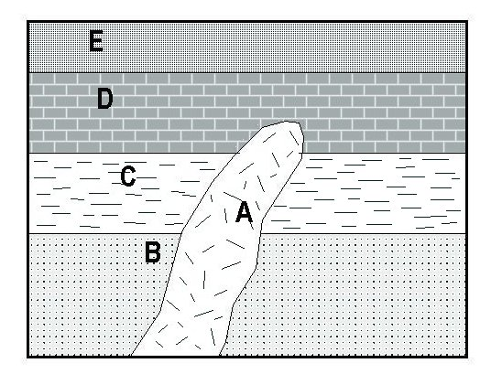
WHAT IS THE ORDER?
(Oldest to Youngest)

Slide 16
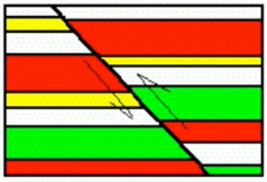
EXAMPLE OF CROSS-CUTTING
Faults, joints, tilts, and veins also follow the
law of cross--cutting relationships.
The sedimentary rocks are older than the fault which cuts them because they had to be there first before they could be faulted.

Slide 17
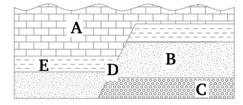
WHAT IS THE ORDER?
(Oldest to Youngest)

Slide 18
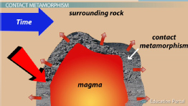
CONTACT METAMORPHISM
When Igneous rock comes in contact with other rock, the heat can “cook” the rock.
This is called Contact Metamorphism because hot magma changes when it contacts a small area of metamorphic rock where it touches.

Slide 19
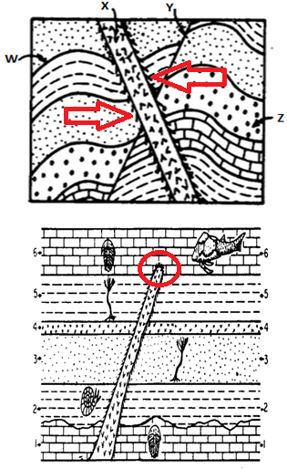
CONTACT METAMORPHISM
This is indicated on cross section diagrams with little “whiskers.”
It provides a clue – if there is contact metamorphism shown, the intrusion happened AFTER the rock it touches formed.

Slide 20
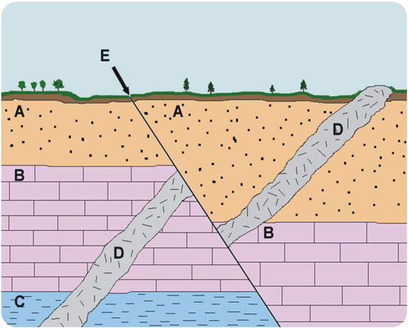
PUTTING IT ALL TOGETHER…
Understanding….
Original Horizontality
Superposition
Cross Cutting Relationships
Unconformities
We can interpret the geologic history.
What order did these events occur? (Oldest to youngest)

Slide 21
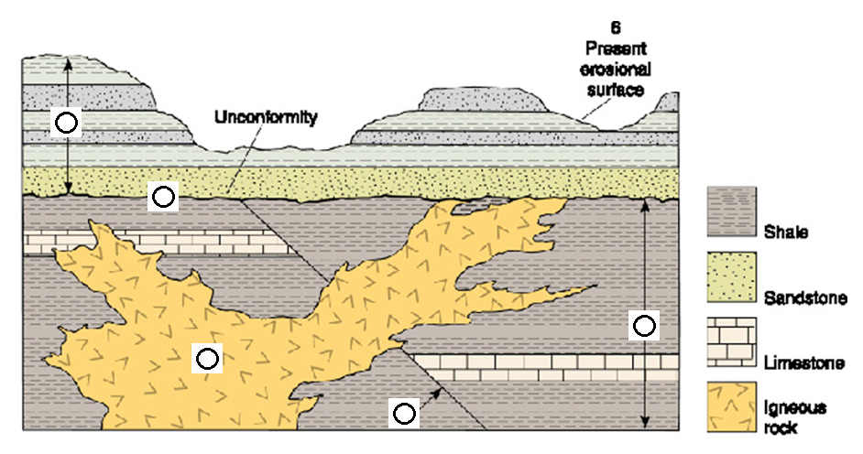
PRACTICE
Put the events in order – oldest to youngest
How does the information about the type of rock help explain past events?

Slide 22
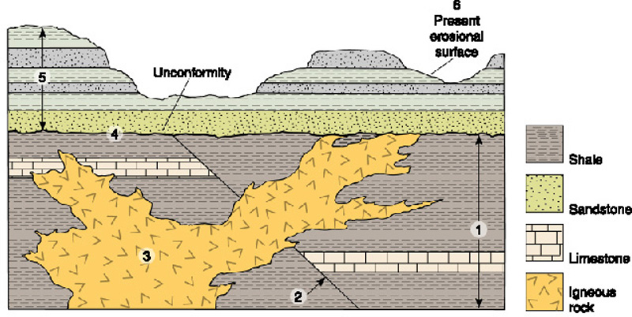
PRACTICE
Put the events in order – oldest to youngest
How does the information about the type of rock help explain past events?

Slide 23
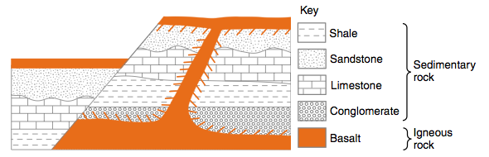
PRACTICE
Which type of rock is the youngest? How do you know?
How can you tell that crust movement has taken place?
What do the rock types tell you about the geologic history?
A
B
D
C
E
F
G

Slide 24
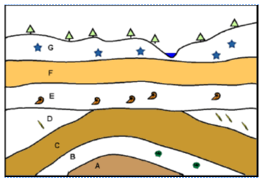
STRATIGRAPHY
Stratigraphy is the analysis of different rock formations through time and changing environments. The sequence of both the rocks and fossils provides information on changing environments through time.

Slide 25
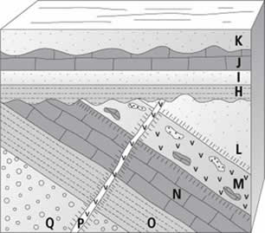
REVIEW
What is the correct sequence – oldest to youngest?
A. Q - P – M – H - K
B. Q – P – N – H – J
C. P – Q – M – J - K
D. Q – N – P – H - J

Slide 26
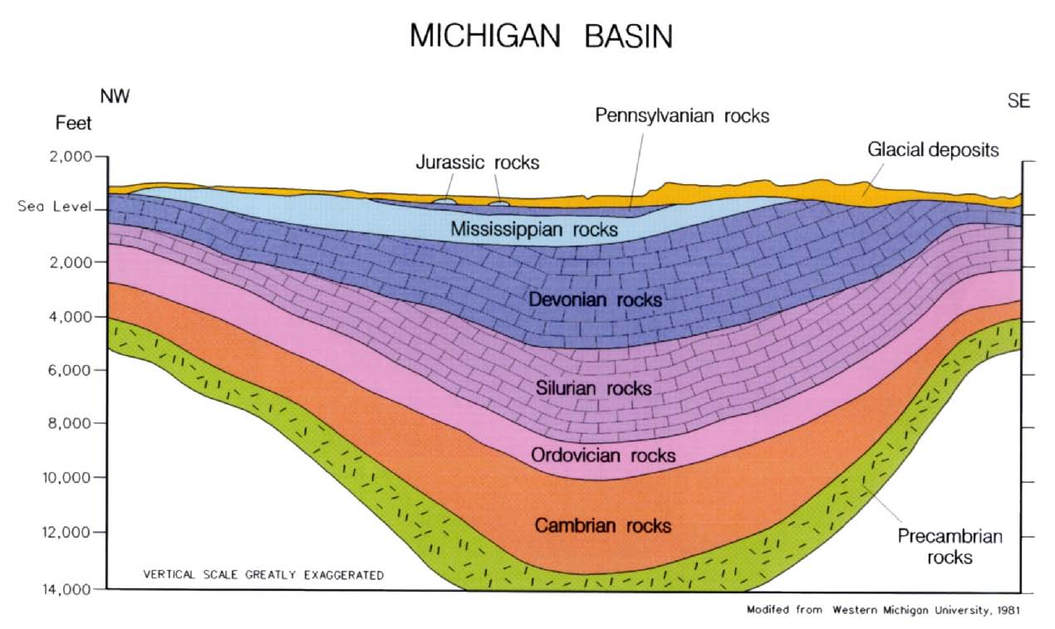
TO DO
Look at the Michigan Basin. Answer the questions.
Review #8 due tomorrow.

