Slide 1
DO NOW
Pick up notes and Review #29.
Did you finish your lab – turn it in.

Slide 2
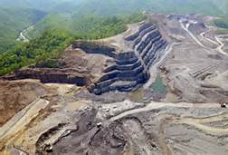
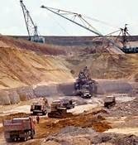
REVIEW
We talked about mining for mineral resources.
What are the environmental impacts of mining?
Why is reclamation important?
Mining wastes can end up in local streams and rivers
Reclamation allows the habitat to come back and not be completely destroyed.

Slide 3
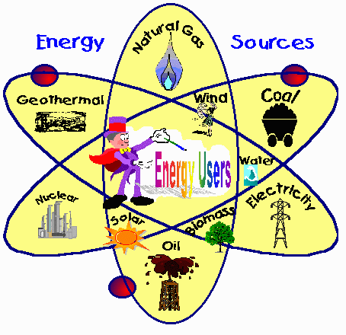
ENERGY RESOURCES:
Fossil Fuels
SES6. Students will explain how life on Earth responds to and shapes Earth systems.
c. Explain how geological and ecological processes interact through time to cycle matter and energy, and how human activity alters the rates of these processes (e.g., fossil fuel formation and combustion).

Slide 4
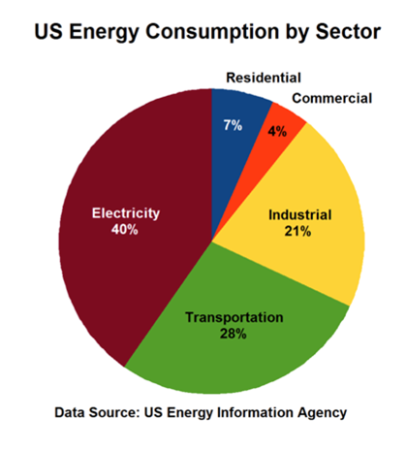
NEED FOR ENERGY
What we use energy for:
Electricity 40%
  consumes primary energy to generate most of the electricity consumed by the other four sectors.
Transportation 28%
  includes vehicles that transport people or goods, such as cars, trucks, buses, motorcycles, trains, aircraft, boats, barges, and ships.

Slide 5
NEED FOR ENERGY
Industrial 21%
  includes facilities and equipment used for manufacturing, agriculture, mining, and construction.
Residential 7%
  consists of homes and apartments.
Commercial 4%
  includes offices, malls, stores, schools, hospitals, hotels, warehouses, restaurants, and places of worship and public assembly.

Slide 6
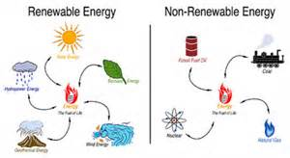
TYPES OF
ENERGY RESOURCES
FOSSIL FUELS
ALTERNATIVE
Limited resources
Nonrenewable
Cannot be replaced quickly.
Being depleted faster than they are forming!
Nuclear – energy released during nuclear fission – nonrenewable
Renewable: Can be replaced within a human life span OR as they are used. Includes:
  Geothermal
  Solar
  Water
  Biomass
  Wind

Slide 7
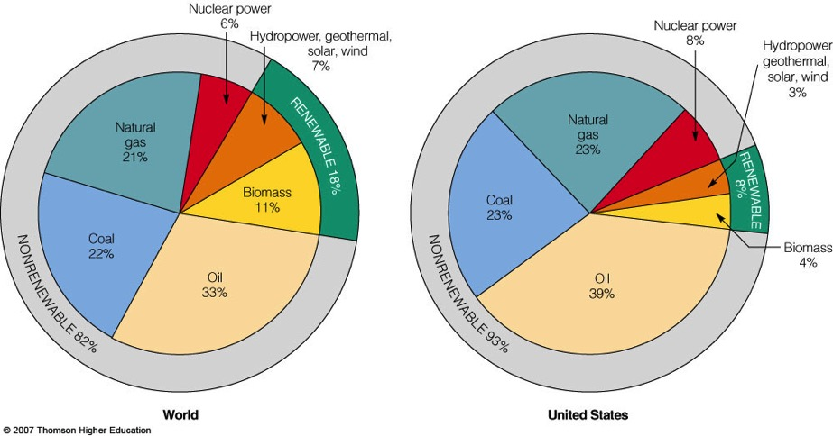
WHERE DOES OUR ENERGY COME FROM?

Slide 8

Fossil Fuels
Nonrenewable natural resources formed from the remains of living things (organic).
Consist of hydrocarbons – carbon and hydrogen compounds.
Stored energy – burning breaks chemical bonds and releases energy.
NOT from remains of dinosaurs – what we use today formed millions of years before dinosaurs.

Slide 9
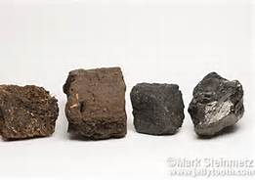
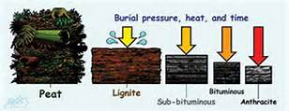
COAL FORMATION
Coal is a solid fossil fuel that is formed in several stages as the buried remains of land plants that lived 300-400 million years ago.
Formed in process of carbonization – plant debris buried in swamps or mud, becomes peat.
Chemical reactions under right conditions – carbon becomes coal.

Slide 10
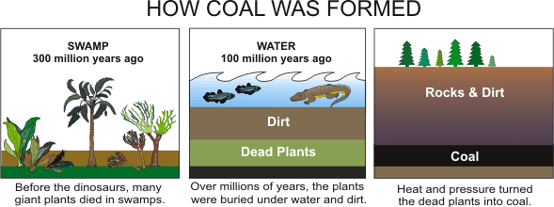
Coal Formation
Before the dinosaurs, many giant plants died in swamps.
Over millions of year, the plants were buried under water and dirt.
Heat and pressure turned the dead plants into coal.

Slide 11
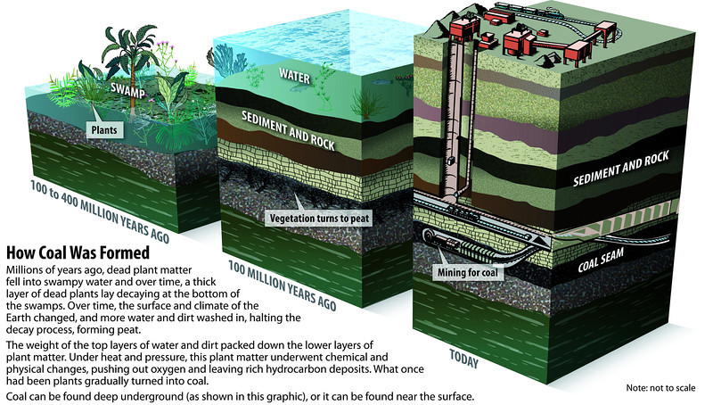

Slide 12
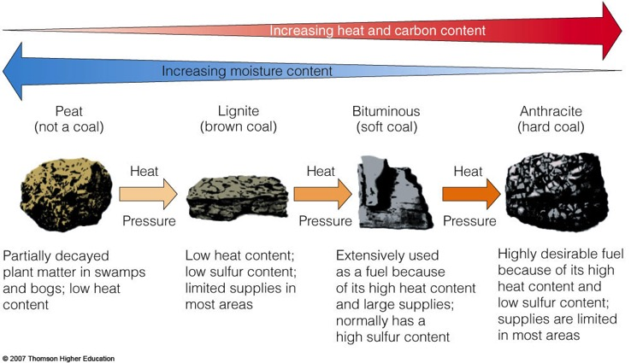
Coal Formation
Process – plants – peat – lignite – bituminous coal (soft coal) – anthracite.
Highest quality coal is Anthracite – metamorphic rock.

Slide 13
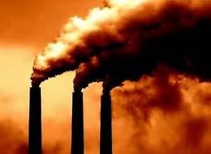
COAL GENERATES ELECTRICITY
Burning high-sulfur coal releases CO₂ (carbon dioxide) into air.
Coal reserves estimated to last 200 years.

Slide 14
COAL RANK
Lignite
Soft, brown,
Carbon content more than 55%
9-17 million BTU/ton
Sub-Bituminous
Dull, black
Carbon content 55 – 60%
16-24 million BTU/ton
Bituminous
Soft, dark, dense
Carbon content 60-50%
19- 32 million BTU/ton
Anthracite
Shiny, hard - Metamorphic
Carbon content more than 85%
20-28 million BTU/ton
Difficult to ignite
Burns cleanly - smokeless
9300 BTU/lb
11-14,000 BTU/lb
14,000 BTU/lb
7000 BTU/lb
Increasing Energy Efficiency and Quality

Slide 15
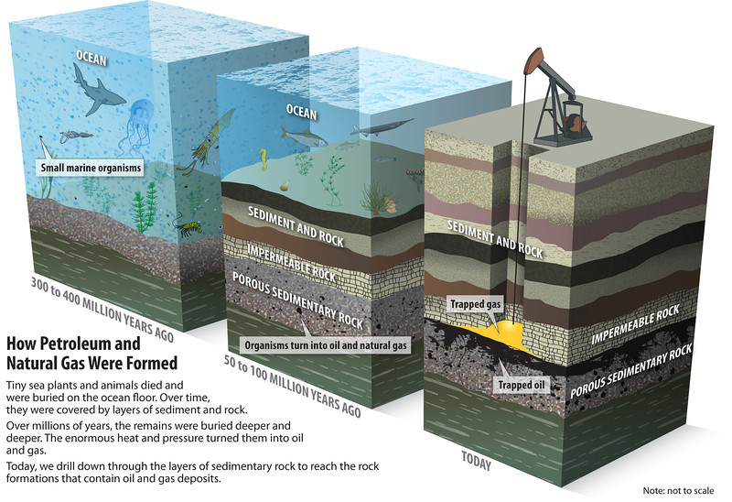
PETROLEUM (OIL) AND NATURAL GAS
Petroleum is another word for crude oil.
Crude oil used to produce plastics, fabrics, medicine, etc.
Formed from remains of marine organisms and plants.
Accumulate on lake and ocean floor and buried by sediment.

Slide 16
PETROLEUM (OIL) AND NATURAL GAS
Heat and pressure cause chemical change.
Environmental concerns include oil spills.
Oil burns cleaner than other fossil fuels – less CO₂, SO₂ and NO_{x} emissions.

Slide 17
PETROLEUM (OIL) AND NATURAL GAS
Natural gas consists mostly of methane, along with some other gases which has no odor or color.
Natural gas does not contain carbon monoxide. The by-products of burning natural gas are primarily carbon dioxide and water vapor.

Slide 18
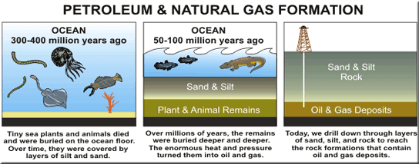
OIL AND GAS FORMATION
Tiny sea plants and animals died and were buried on the ocean floor. Over time, they were covered by layers of silt and sand.
Over millions of years, the remains were buried deeper and deeper. The enormous pressure and heat turned them into oil and gas.
Today, we drill down through layers of sand, silt, and rock to reach the rock formations that contain oil and gas deposits.

Slide 19
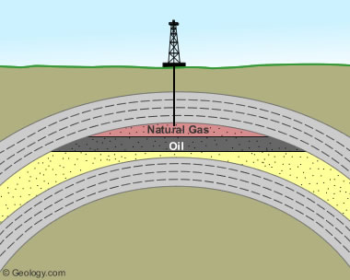
LOCATING GAS AND OIL
Three conditions must be present for reservoirs to form:
Hydrocarbon material buried deep enough for heat and pressure to have transformed it over a long period of time.
Porous, permeable reservoir rock to accumulate in.
Non-porous, non-permeable cap rock that seals the deposit.

Slide 20
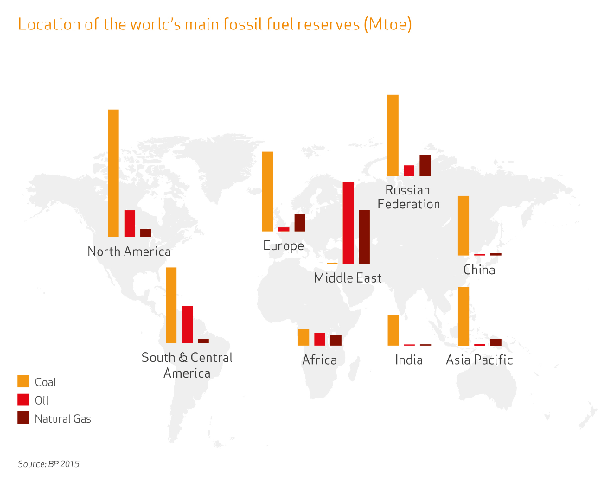
FOSSIL FUEL RESERVES
Because the United States has so much in coal reserves, it is inexpensive and widely used!

Slide 21
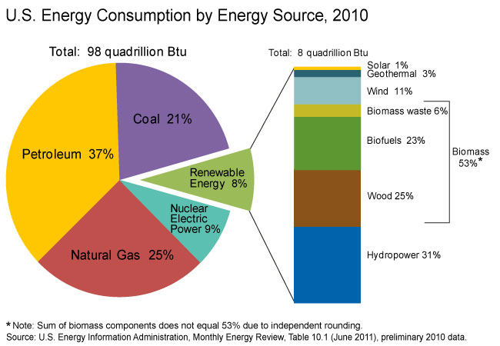
ENERGY USE IN THE UNITED STATES
U. S. Energy Consumption
Petroleum 37%
Natural Gas 25%
Coal 21%
Nuclear 9%
Renewable 8%
  Hydropower, wood, biofuels, biomass waste, wind, geothermal, solar

Slide 22
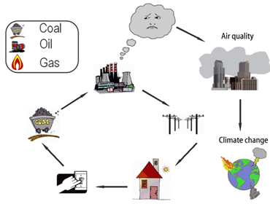
CONCERNS OVER USING FOSSIL FUELS
Obtaining and Processing
  Land disruption from mining
  Oil Spills contaminate waterways
  Groundwater contamination
Combustion
  Coal ash contaminates land and surface water.
  Air pollution - CO2, VOCs, SO2 and NOx – from emissions
    Greenhouse gases

Slide 23
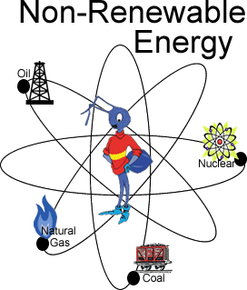
REVIEW
Which energy resource is considered the most inexpensive:
Oil
Coal
Natural Gas
Nuclear
However, since natural gas has become so cheap, it may soon pass coal.

Slide 24
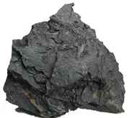
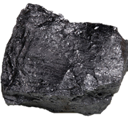
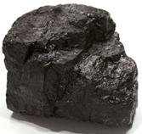
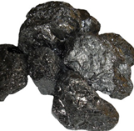
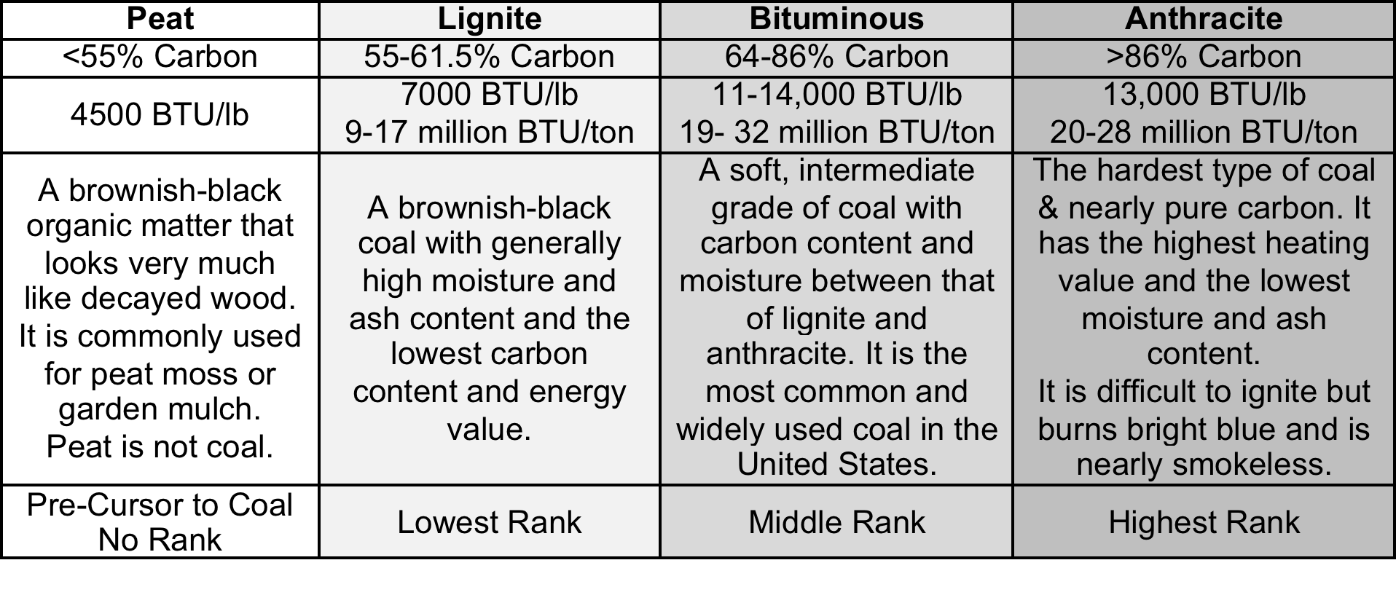
LAB: EXPLORING GRADES OF COAL
Draw and Describe - Answer Questions

Slide 25
TO DO
Review #29 due tomorrow.
Coal lab due by Tuesday.

