Slide 1
DO NOW
Pick up notes.
Get out Boyle’s, Charles’, and Gay-Lussac’s handout.
Turn in Gas Pressure lab – each person turns in his/her own.
Big Chill Project Due TOMORROW!

Slide 2
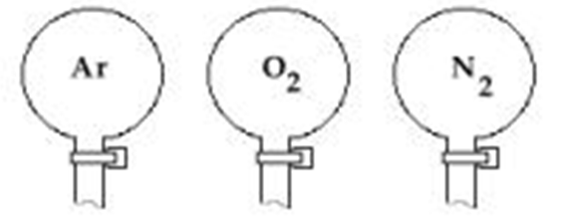
AVOGADRO’S PRINCIPLE
Particles of different gases vary greatly in sizes. Since the gas particles are so far apart, size is not a factor when determining volume if you are talking about a fixed number of particles.
Volume: 22.4L 22.4L 22.4L
Mass: 39.95g 32.00g 28.02g
Quantity: 1 mol 1 mol 1 mol
Pressure: 1 atm 1 atm 1 atm
Temperature: 273K 273K 273K

Slide 3
AVOGADROS’S PRINCIPLE
The Law: Avogadro’s Principle states that equal volumes of gases at the same temperature and same pressure contain equal number of particles. In gas law problems, moles is designated by an “n”. One mole of a gas has a volume of 22.4L (dm³) at STP which is standard temperature and pressure. It also has 6.02 x 10²³ particles of that gas.
V₁n₂ = V₂n₁

Slide 4
AVOGADROS’S PRINCIPLE
Practice:
The volume of a sample of gas is 2.0L. There are 10.0mol of the gas. What will the new volume of the gas be if the moles of gas are raised to 25.0mol?
V₁ = V₁n₂ = V₂n₁
n₁ =
V₂ =
n₂ =

Slide 5
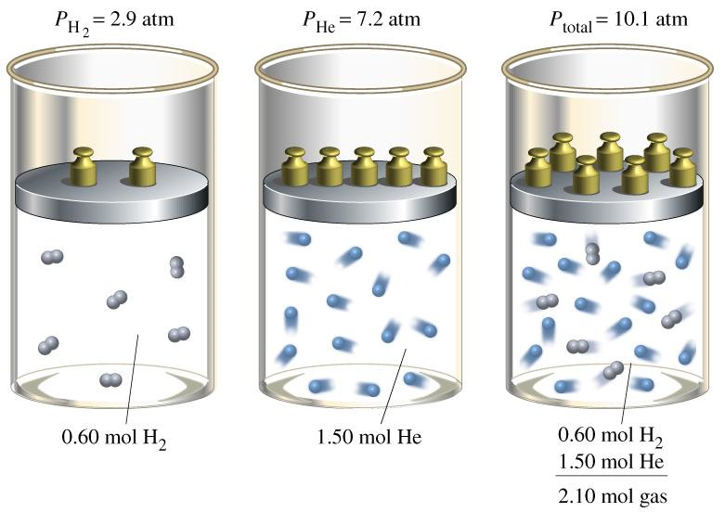
DALTON’S LAW OF PARTIAL PRESSURES

Slide 6
DALTON’S LAW OF PARTIAL PRESSURES
THE LAW: The sum of the partial pressures of all components of a gas mixture is equal to the total pressure of the gas mixture.
P_{total} = P₁ + P₂ + P₃ + P₄ +.....
PRACTICE (Easy Type):
What is the atmospheric pressure if the partial pressures of nitrogen, oxygen, and argon are 604.5mm Hg, 162.8mm Hg, and 0.500mm Hg, respectively?
P_{total} = P₁ + P₂ + P₃
P_{total} =

Slide 7
COMBINING THE LAWS
From the Boyle’s, Charles’, and Gay-Lussac’s laws, we can derive the
Combined Gas Law:
P₁V₁T₂ = P₂V₂ T₁
Mnemonic: Potato and Vegetable on top of the Table

Slide 8
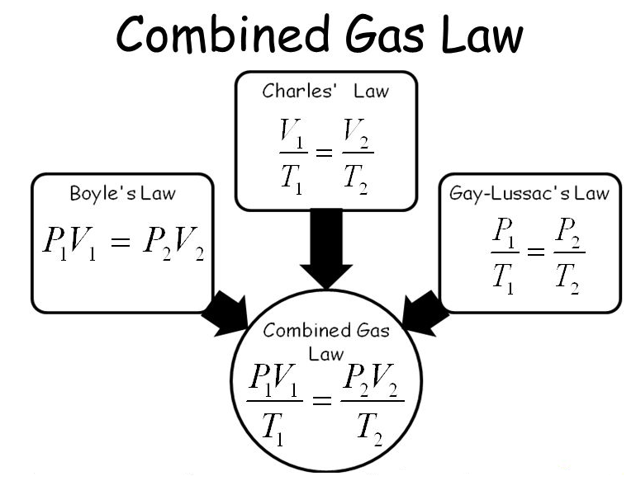

Slide 9
COMBINED GAS LAW
WHY? Laboratory experiments are almost always made at pressures and temperatures other than the standard. Because this affects volume, it is necessary to correct the laboratory volumes of gases for both temperatures and pressures.
STANDARDS
Temperature = 0°C = 273K
Pressure = 1.00atm = 101.3kPa
= 760.0mmHg = 760.0torr
Volume = 22.4L @STP

Slide 10
STANDARDS
T = 0°C = 273 K memorize
V = 22.4 L (at STP) memorize
P = 1.00 atm = 101.3 kPa
= 760.0 mm Hg = 760.0 torr
Remember kPa and 22.4L have limited significant figures.

Slide 11
COMBINED GAS LAW
PRACTICE:
The volume of a gas measured at 75.6kPa pressure and 60.0°C is to be corrected to correspond to the volume it would occupy at STP. The measured volume of the gas is 0.0100L.
P₁ = 75.6 kPa P₂ = 101.3 kPa P₁V₁T₂= P₂V₂ T₁
V₁ = 0.0100 L V₂ = ?
T₁ = 333.0K T₂ = 273 K
V₂ = P₁V₁T₂ = ___________________________
T₁P₂

Slide 12
COMBINED GAS LAW
PRACTICE:
Correct the volume for a gas at 7.51dm³ at 5.0°C and 59.9kPa to STP.
P₁ =
V₁ =
T₁ =
P₂ =
V₂ =
T₂ =

Slide 13
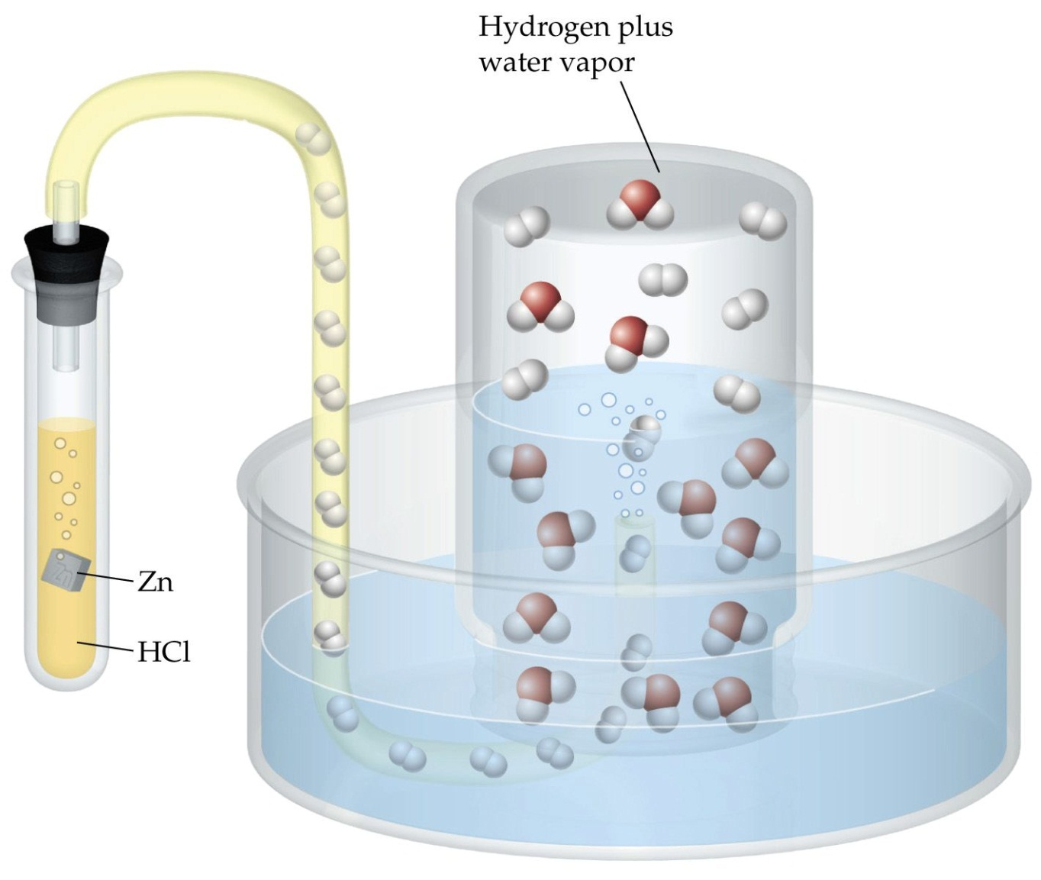
DALTON’S LAW OF PARTIAL PRESSURES

Slide 14
DALTON’S LAW OF PARTIAL PRESSURES
PRACTICE (Combined too!)
A quantity of oxygen gas is collected over water at 8°C in a 0.353L vessel. The pressure is 84.5kPa. What volume would the DRY oxygen gas occupy at standard atmospheric pressure (101.3kPa) and 8°C. (The dry gas pressure of water at 8°C is 1.1kPa)
T₁ = 8ºC T₂ = 8ºC
V₁ = 0.353L V₂ = ?
P₁ = 84.5 kPa – 1.1 kPa = 83.4 kPa P₂ = 101.3kPa
You must correct the pressure so that you can have the DRY gas without the water pressure added in.
P₁V₁ = P₂V₂ V₂ = P₁V₁ =
P₂

Slide 15
TO DO
Handout due tomorrow.
Big Chill project due tomorrow. You can bring it in before school.
Playing with Cans and Balloons lab is due Monday.

