Slide 1
DO NOW
Pick up notes.
You need a calculator today.
Get out your handout from yesterday.
Properties of Acids and Bases lab is due tomorrow.

Slide 2
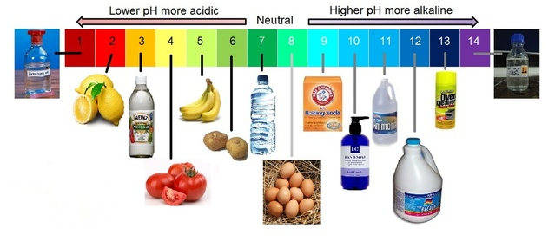
pH SCALE

Slide 3
pH SCALE
The ionization of water into H₃O ⁺ ions is very slight. Knowledge of this helped scientists build an acidity scale.
The pH scale is the measure of hydronium ion concentration, and thus, acidity.
The concentration of H₃O⁺ is expressed in powers of 10, from 10¹⁴ to 10⁰.

Slide 4
pH SCALE
For convenience, scientists use:
pH = -log[H₃O⁺]
We use the negative log so pH is always positive.

Slide 5
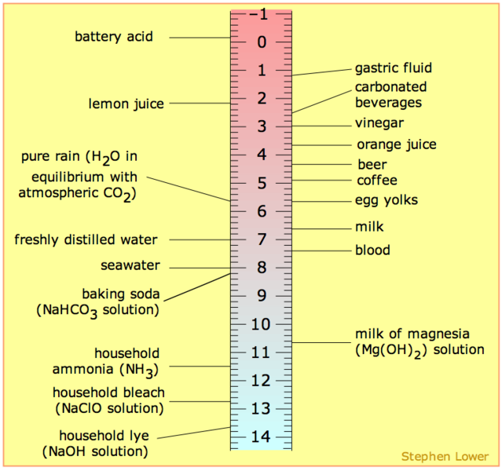

Slide 6
pH SCALE
Examples:
[H₃O⁺] = 1 x 10⁻³ [H₃O⁺] = 6.3 x 10⁻⁸
pH = -log[1 x 10⁻³] pH = -log[6.3 x 10⁻⁸]
pH = 3.0 pH = 7.20

Slide 7
pH SCALE
The smaller the pH, the more acidic the solution.
A solution with a [H₃O⁺] = 10⁻¹M - a strongly acidic solution - pH = 1.
A solution with a [H₃O⁺] = 10⁻⁷M - a neutral solution - pH = 7.
A solution with a [H₃O⁺] = 10⁻¹³M - a strongly basic solution - pH = 13.
Remember that the pH scale is logarithmic. Each one-unit change on the scale represents a 10-fold change in the concentration of H₃O⁺ ions.
As the hydronium ion concentration increases, does pH increase or decrease?

Slide 8
pH SCALE – SIGNIFICANT FIGURES
For any logarithm, the number of digits after the decimal point should equal the number of significant digits in the original number.
The total number of significant digits in the concentration should equal the number of digits past the decimal point in the pH number.
[H₃O⁺] = 1 x 10⁻³ [H₃O⁺] = 6.3 x 10⁻⁸
pH = 3.0 pH = 7.20

Slide 9
pH SCALE – Significant Figures
Examples:
[H₃O⁺] = 1 x 10⁻³ [H₃O⁺] = 6.3 x 10⁻⁸ pH = -log[1 x 10⁻³] pH = -log[6.3 x 10⁻⁸]
pH = 3.0 pH = 7.20
1 total sf in [H₃O⁺] so 2 total sf in [H₃O⁺] so
1 behind decimal pt 2 behind decimal pt
in pH in pH

Slide 10
pH SCALE - PRACTICE
1. [H₃O⁺] = 5.0 x 10⁻² M 3. [H₃O⁺] =6.23 x 10⁻⁴ M
What is the pH? What is the pH?
2. [H₃O⁺] = 7.3 x 10⁻⁵ M
What is the pH?

Slide 11
pH SCALE
Going Backwards:
If given pH, you can calculate [H₃O⁺].
Example: Find the concentration of a solution with a pH of 9.0
pH = -log [H₃O⁺]
9.0 = -log[H₃O⁺]
antilog (-9.0) = [H₃O⁺]
1 x 10⁻⁹ = [H₃O⁺]
[H₃O⁺] = antilog (-pH)

Slide 12
pH SCALE - PRACTICE
1. The pH is 3.57. 2. The pH is 12.32.
What is the [H₃O⁺]? What is the [H₃O⁺]?

Slide 13
pH SCALE
Other ways to calculate pH:
If given [OH⁻], you can calculate pH. [OH-] [H₃O⁺] = 1 x 10⁻¹⁴
Example: Find the pH of a solution with an [OH⁻] = 1.00 x 10⁻⁹ M.
[OH⁻][H₃O⁺] = 1 x 10⁻¹⁴ [H₃O⁺] = 1.00 x 10⁻⁵
pH = -log[1.00 x 10⁻⁵]
[H₃O⁺] = 1 x 10⁻¹⁴ = 1 x 10⁻¹⁴
[OH⁻] [1.00 x 10⁻⁹] pH = 5.000
[OH-] [H₃O⁺] = 1 x 10⁻¹⁴

Slide 14
pH SCALE - PRACTICE
[OH⁻] = 3.5 x 10⁻⁵ M. 2. [OH⁻] = 9.65 x 10⁻¹¹ M
Find the pH. Find the pH

Slide 15
pH SCALE
Going Backwards again:
pOH is a scale to measure alkalinity.
Example: Find the pOH of an [OH⁻] of 1 x 10⁻⁹
pOH = -log[OH⁻]
pOH = -log[1 x 10⁻⁹]
pOH = 9.0
pH + pOH = 14
pOH = -log[OH⁻]

Slide 16
pH SCALE - PRACTICE
1. The pOH is 3.57. 2. The pOH is 12.32.
What is the [OH⁻]? What is the [H₃O⁺]?

Slide 17
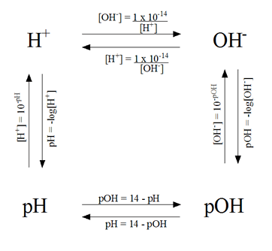
pH SCALE - PRACTICE

Slide 18
TO DO
pH Problem Set handout is due tomorrow– you must write the formula and show all work.

