Slide 1
Do now
Turn in Phases of Matter homework from Thursday.
Pick up the notes.
Chillin’ Out lab is due Wednesday.

Slide 2
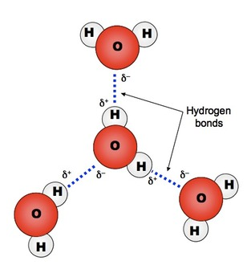
Water – a special case
Water’s unique properties are a result of hydrogen bonding.

Slide 3
Water – a special case
Phases of Water:
Solid: Each hydrogen is bonded to four other water molecules in a open crystalline shape.
Liquid: The solid crystal lattice collapses; the liquid molecules flow closer to each other and the liquid is more dense than ice as a result. Ice floats!

Slide 4
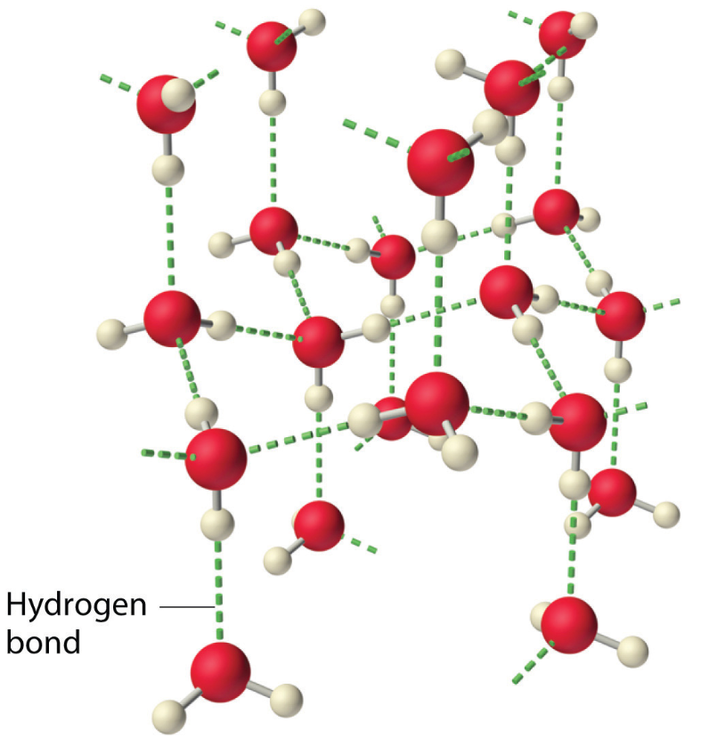
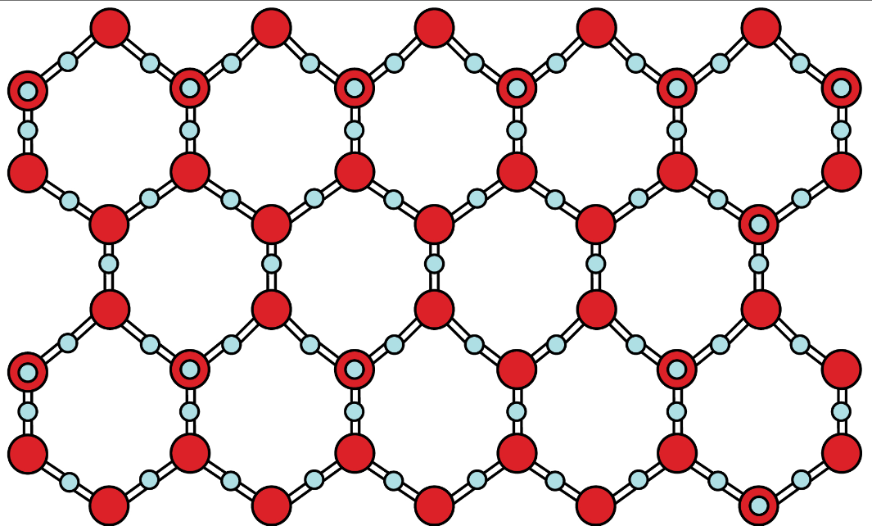
Solid AND LIQUID water
A. Solid water’s open structure
B. Liquid water’s collapsed structure

Slide 5
Water – a special case
Surface Tension:
Particles in the interior of the liquid are subjected to attractive forces in all directions.
Molecules at the surface have a new inward attraction that results in surface tension. Liquids form spheres when dropped because spheres have the least amount of surface area.

Slide 6
Water – a special case
Capillary Rise (action):
This is the rise of a liquid in a tube of small diameter. An attractive force, adhesion, between the tube wall and the liquid will cause the liquid to rise.
The same process is the reason why water is taken up by a paper towel.

Slide 7
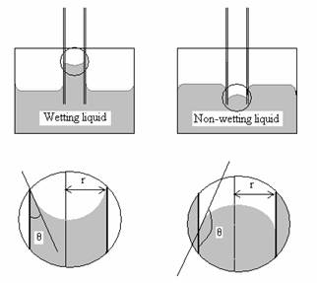
Capillary action

Slide 8
Boiling points of various liquids
Diethyl ether 34.6°C 74.12g/mol
Acetone 52.6°C 58.09g/mol
Methanol 64.5°C 32.05g/mol
Ethanol 78.3°C 46.08
Water 100.0°C 18.02g/mol
Mercury 356.6°C 200.59 g/mol
Notice that water has an extremely high
boiling point for its mass….

Slide 9
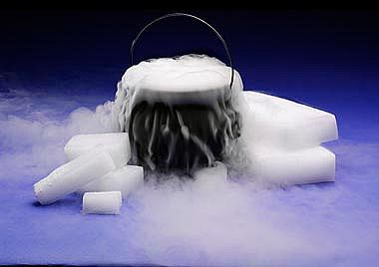
Phase changes
Liquefaction of carbon dioxide

Slide 10
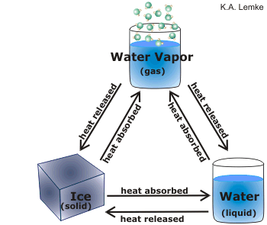
Phase changes
Heat is energy that causes the particles of matter to move faster and further apart. Therefore, the particles can then change phases of matter.
Adding heat increases the temperature.

Slide 11
Phase changes
Phase changes are accompanied by a change in heat energy, but not temperature.
Heat energy is used to overcome forces that hold the particles together.
Phase changes produce changes in physical properties only.

Slide 12
Phase changes
Phases Changing | Phase Change Name | Energy Change
Solid → Liquid | melting | endothermic
Liquid → Gas | vaporization | endothermic
Solid → Gas | sublimation | endothermic
Gas → Liquid | condensation | exothermic
Liquid → Solid | freezing | exothermic
Gas → Solid | deposition | exothermic
Substances are made to change phase by adding or taking away energy.
When undergoing a phase change, the mass remains constant and volume changes. Thus, density changes.

Slide 13
VAPOR PRESSURE
Vapor pressure is the pressure exerted by a vapor (gas) in equilibrium with its liquid.
The vapor pressure is caused by the gas molecules hitting the top of the liquid.
Intermolecular forces (IMF) determine vapor pressure. (Remember IMF - the forces of attraction between neighboring molecules).

Slide 14
VAPOR PRESSURE
The lower the vapor pressure, the stronger the IMF.
The stronger the IMF, the harder it is for the liquid to become a gas, therefore the vapor pressure is lower.
What is a vapor? How does a vapor differ from a gas?

Slide 15
Vaporization and condensation
Vaporization is the change in state from a liquid to a gas.
Includes evaporation and boiling.
Evaporation occurs when a liquid molecule gets enough kinetic energy to leave the surface of a non-boiling liquid. It gets enough energy to overcome the IMFs within the liquid. Example: leaving a glass of liquid water out on a counter top and it eventually all turns into a gas.

Slide 16
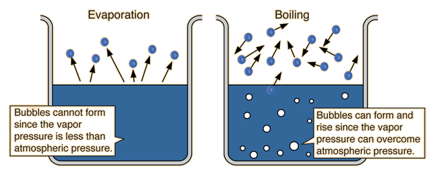
Vaporization and condensation
Vaporization – liquid → gas
  Endothermic
  Two types: boiling and evaporation; one requires additional energy and the other does not.

Slide 17
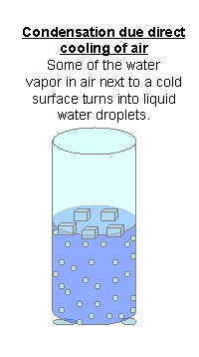
Vaporization and condensation
Condensation is the change in state from a gas to a liquid.
The IMF traps any particle colliding with the surface of a liquid.
Condensation – gas → liquid
  exothermic

Slide 18
DEMOS
Evaporation is a cooling process
  Evaporative Cooling video
  Drops of alcohol and water
Drinking Bird
Zeer pot

Slide 19
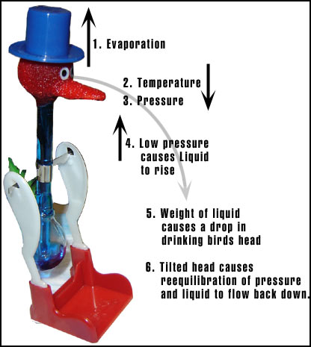
Drinking bird

Slide 20
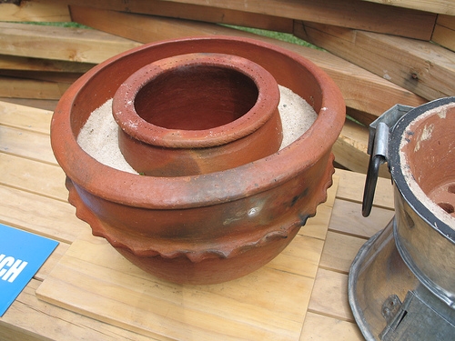
Zeer pot
Soak the sand with water which as it evaporates, chills the inner container so effectively that food that would normally spoil in two days can last two weeks.

Slide 21
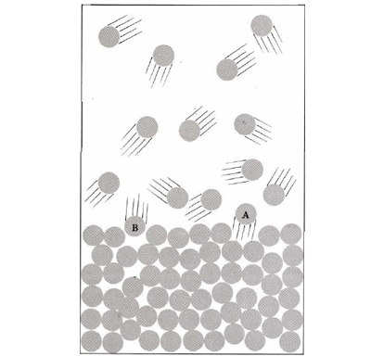
Liquid-Vapor Equilibrium
In a closed container half-filled with a liquid, the liquid will evaporate into the space above the liquid. Soon, molecules will also condense back to the surface of the liquid.
In this case the vapor pressure is constant because every molecule which escapes (like A) is immediately replaced by another molecule (like B) reentering from the vapor. Any given molecule spends some of its time as vapor and some time as liquid.

Slide 22
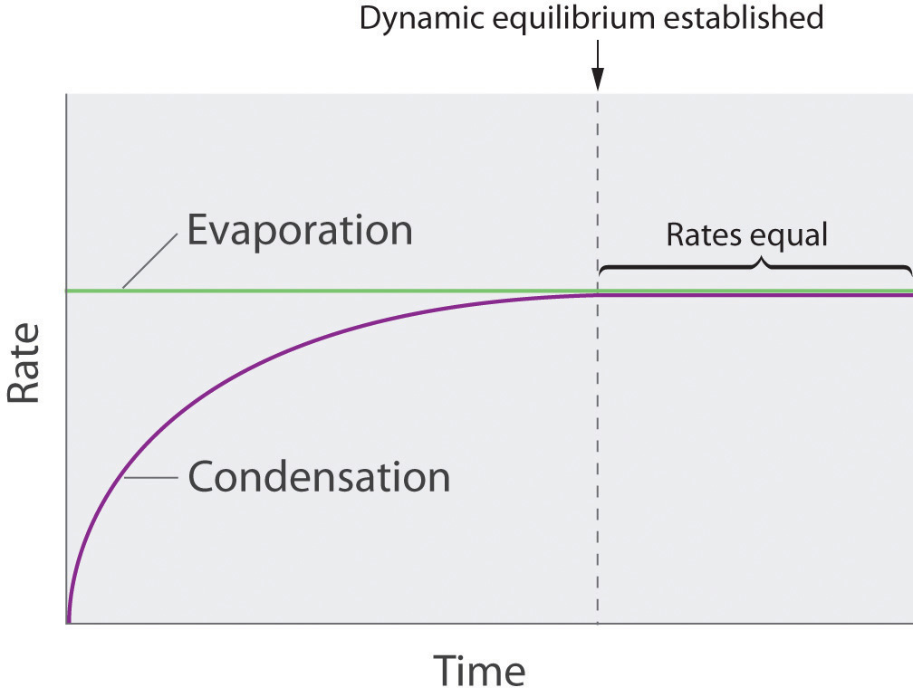
Liquid-Vapor Equilibrium
In a closed system, a liquid and its vapor will reach an equilibrium at a specific pressure for a particular temperature.
The rate of vaporization is equal to the rate of condensation. A state of dynamic equilibrium is reached.

Slide 23
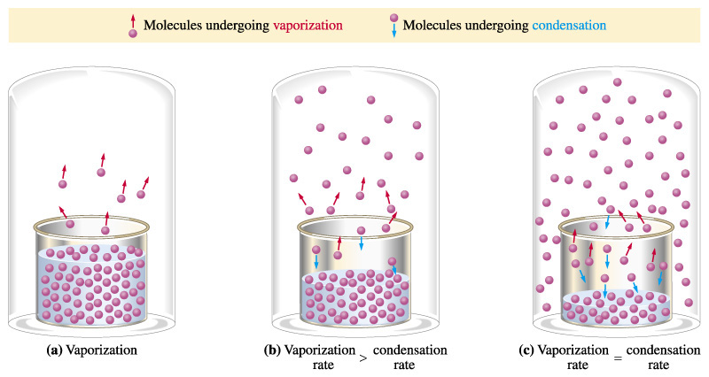
Liquid-vapor equILIbrium
Change is still going on, but the overall effect does not change.

Slide 24
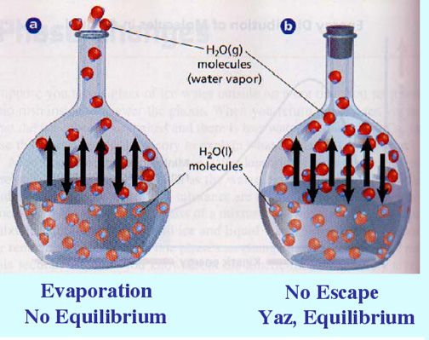
Liquid-vapor equILIbrium
Can’t reach equilibrium unless you have a closed container.
How is the equilibrium dynamic?

Slide 25
QUESTION
Why is it called dynamic equilibrium?

Slide 26
Equilibrium vapor pressure
The molecules in dynamic equilibrium exert a pressure called equilibrium vapor pressure - the pressure exerted by a vapor in equilibrium with its liquid.
Vapor pressure will increase steadily as temperature increases.
this indicates there are a greater number of molecules present as a vapor.

Slide 27
Equilibrium vapor pressure
Initial vapor pressure is determined by the intermolecular forces. Examples of substances’ initial vapor pressure are: Mercury - 0.0002 kPa, Water - 3.167 kPa, Acetone - 30.8 kPa.
Substances with low vapor pressures have strong IMF. (Ionic compounds have very low vapor pressures.)

Slide 28
Equilibrium vapor pressure
Substances with high vapor pressures have weak IMF.
Examples:
  Mercury is a very dense liquid with high IMFs. It has a very low initial vapor pressure.
  Acetone is a volatile liquid – it changes into a vapor very easily and has low IMF. Therefore, its initial vapor pressure is high (more molecules are in the vapor state).

Slide 29
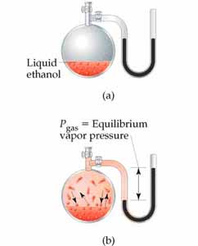
Equilibrium vapor pressure
RECAP
As temperature increases, more vapor is present. So, vapor pressure increases.
Initial vapor pressure is determined by IMFs.
Low vapor pressure means high IMFs.

Slide 30
Initial vapor pressures
Mercury – 0.0002 kPa
Water – 3.167 kPa
Acetone – 30.8 kPa
What does this say about these substances’ IMFs?
Know the word VOLATILE.

Slide 31
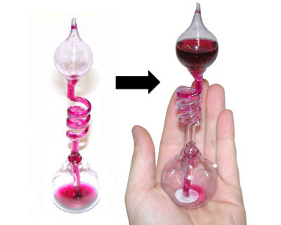
boiling
Hand boiler
- How does it work?
- Is that water inside it?

Slide 32
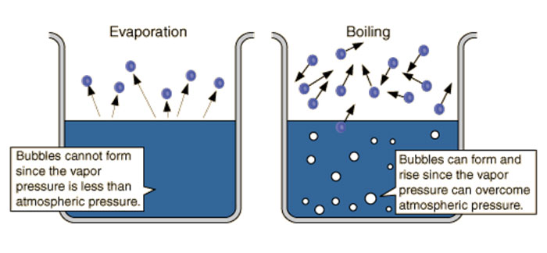
Boiling point
Vaporization = liquid → gas
Boiling point = when the vapor pressure is equal to atmospheric pressure, the liquid boils.

Slide 33
BOILING POINT
As temperature increases, the vapor pressure of the liquid increases because the kinetic energy of the molecules increases.
When Kinetic Energy increases enough to overcome the internal pressure of the liquid caused by the pressure of the atmosphere on the liquid’s surface, the molecules collide violently enough to push each other apart.

Slide 34
BOILING POINT
When the vapor pressure is equal to atmospheric pressure, the liquid boils.
Bubbles form due to this pushing apart and they rise to the surface. (They are less dense than the liquid) and the liquid boils. Boiling takes place throughout the liquid.

Slide 35
BOILING POINT
The NORMAL BOILING POINT is the temperature at which the vapor pressure is equal to one atmosphere (101.3 kPa).
Boiling point is a function of pressure. The lower the pressure is, the lower the boiling point is.

Slide 36
Boiling point
RECAP
You increase the temperature, which increases the vapor pressure, which increases the kinetic energy.
Boiling takes place throughout the liquid.
Remember: boiling is a function of pressure.

Slide 37
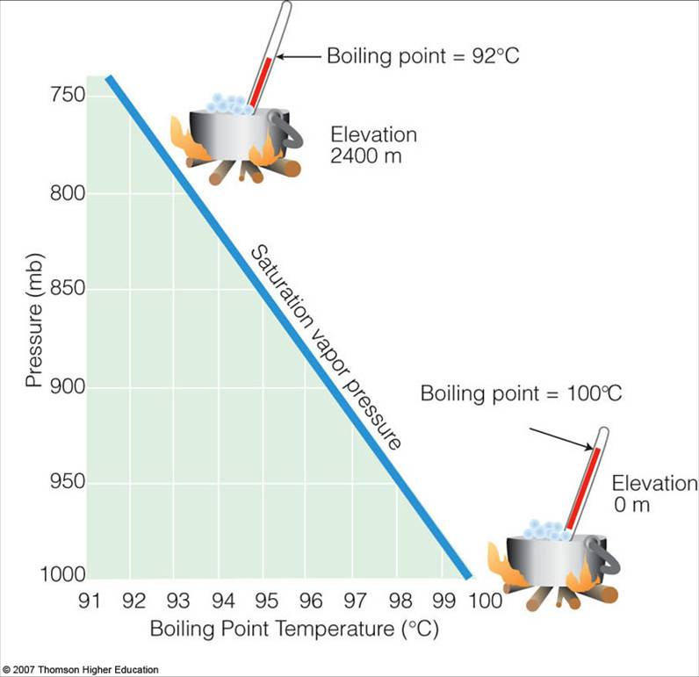
BOILING POINT IS A FUNCTION OF PRESSURE

Slide 38
BOILING POINT IS A FUNCTION OF PRESSURE
Altitude compared to Sea Level |  | Boiling Point
(ft) | (m) | (ºF) | (ºC)
-1000 | -305 | 213.9 | 101.1
-750 | -229 | 213.5 | 100.8
-500 | -152 | 213.0 | 100.5
-250 | -76 | 212.5 | 100.3
0 | 0 | 212.0 | 100.0
250 | 76 | 211.5 | 99.7
500 | 152 | 211.0 | 99.5
750 | 229 | 210.5 | 99.2
1000 | 305 | 210.1 | 98.9
1250 | 381 | 209.6 | 98.6
1500 | 457 | 209.1 | 98.4
1750 | 533 | 208.6 | 98.1
2000 | 610 | 208.1 | 97.8
2250 | 686 | 207.6 | 97.6
2500 | 762 | 207.2 | 97.3
2750 | 838 | 206.7 | 97.1
3000 | 914 | 206.2 | 96.8
3250 | 991 | 205.7 | 96.5
3500 | 1067 | 205.3 | 96.3
3750 | 1143 | 204.8 | 96.0
4000 | 1219 | 204.3 | 95.7
4250 | 1295 | 203.8 | 95.5
4500 | 1372 | 203.4 | 95.2
4750 | 1448 | 202.9 | 94.9
5000 | 1524 | 202.4 | 94.7

Slide 39
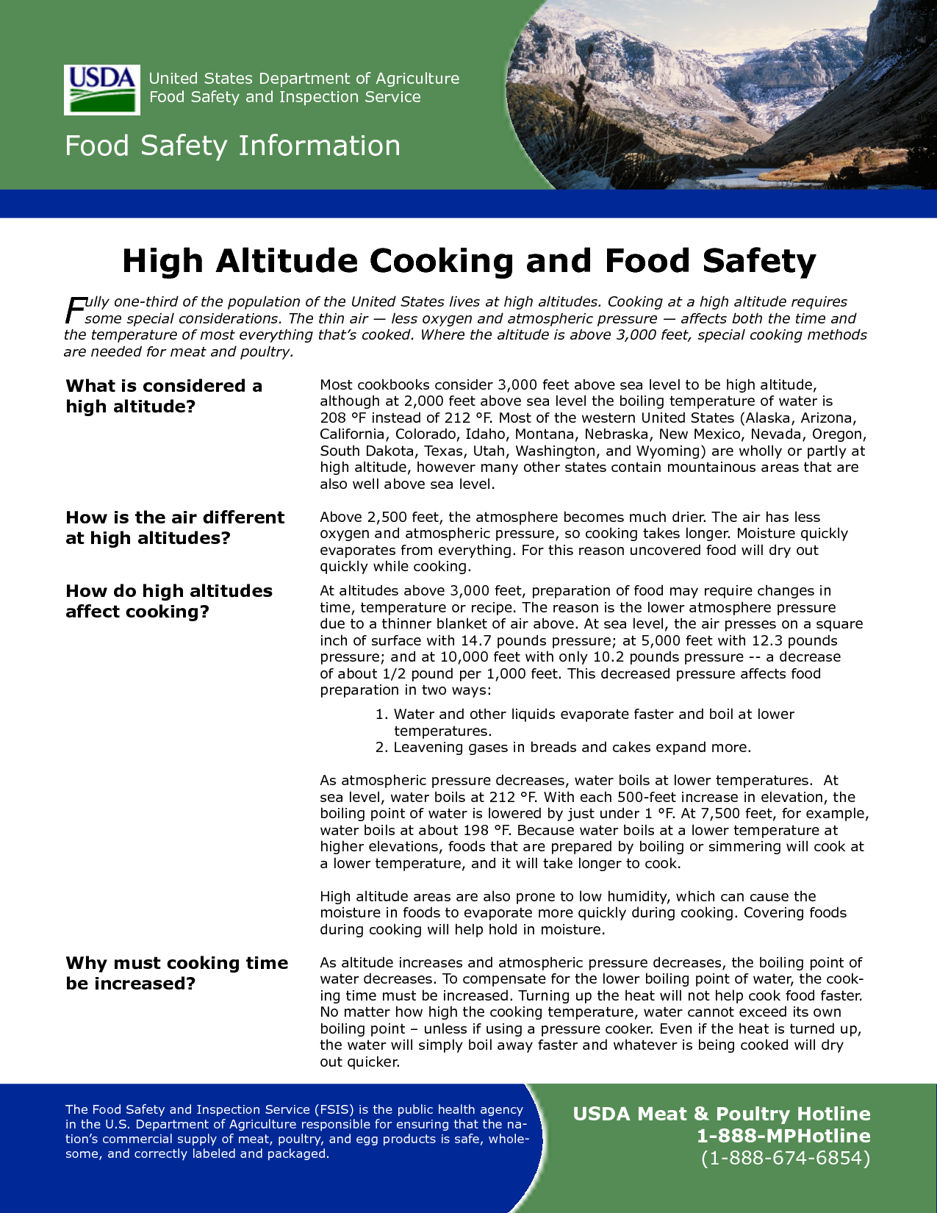
High altitudes

Slide 40
Melting and freezing
Freezing and melting require less change in energy than vaporization and condensation.
WHY? The atoms/molecules are already close together.
The Freezing point/Melting point is the temperature at which the vapor pressure of the solid and the vapor pressure of the liquid are equal.
It is not affected much by a change in external pressure.

Slide 41
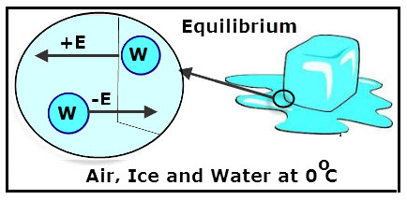
Melting and freezing
It is dependent upon the IMFs of the substance. A weak IMF means a low melting point.

Slide 42
Melting and freezing
RECAP
Melting: solid → liquid; endothermic
Freezing: liquid → solid; exothermic
Less energy change is required to make the molecules change in these phases.
Very dependent upon IMFs

Slide 43
SUBLIMATION AND DEPOSITION
Solids with a high vapor pressure (at room temperature) go straight from solid to gas, bypassing the liquid phase. This is called sublimation.
The opposite change from a gas to a solid is called deposition.
Give three examples of substances that sublime readily.

Slide 44
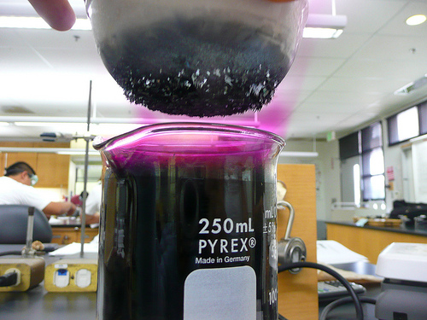
Sublimation and deposition
RECAP
Sublimation: solid → gas; endothermic
Deposition: gas → solid; exothermic
Bypass the liquid phase

Slide 45
SUMMARY
Strong IMFs
nonvolatile
low evaporation rates
high boiling point
low vapor pressure at room temperature
Example:

Slide 46
summary
Weak IMFs
volatile
high evaporation rates
low boiling point
high vapor pressures at room temperature
Example:

Slide 47
TO DO
Changes of State handout is due Tuesday.
Chillin’ Out lab is due Wednesday.

