Slide 1
DO NOW
Pick up notes and Review #23.
Turn in Review #22.

Slide 2
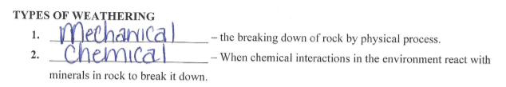


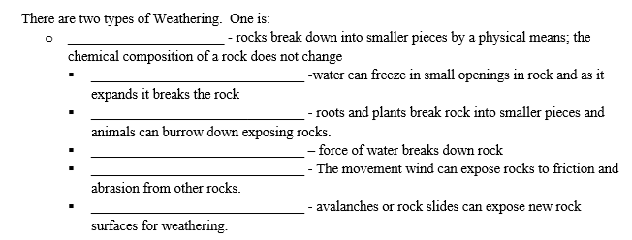
REVIEW #21

Slide 3
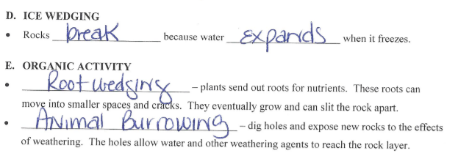
REVIEW #21

Slide 4

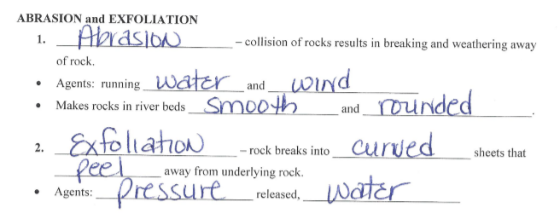
REVIEW #21

Slide 5
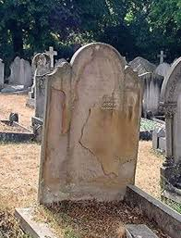
REVIEW
How does acid rain weather rocks?
What are some of the other effects of acid rain on the environment?
When acids in the environment react with the minerals in rocks and break them down.
Acid rain can hurt plants, acidify water in likes and streams, and then hurt aquatic life.

Slide 6

Rates of Weathering
What factors might affect the rate at which rock weathers?

Slide 7
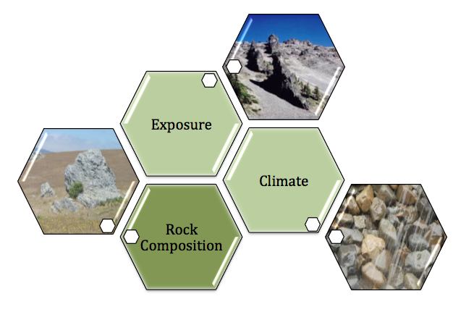
Major Factors Affecting Weathering

Slide 8
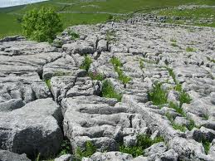
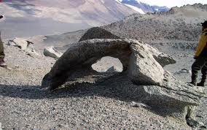
FACTOR: ROCK COMPOSITION
  Differential Weathering:
  Softer, less weather-resistant rock wears away faster.
  Harder, more resistant rock is left behind.
Cave carving sandstone (video).

Slide 9
FACTOR: ROCK COMPOSITION
  Rocks weather at different rates due to chemical composition.
  Quartz is resistant to weathering.
  Limestone and other sedimentary rocks containing calcite weather most rapidly due to carbonization.
  Shales and sandstones are not firmly cemented together and break up easily.

Slide 10
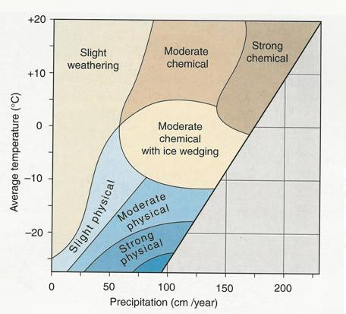
FACTOR:
CLIMATE
Precipitation and temperature of an area are both part of climate.
Chemical weathering is most rapid in hot, wet climates.
The slowest weathering occurs in cold, dry climates.

Slide 11
FACTOR: EXPOSURE
  Surface Area – the part of a rock that is exposed to air, water and other agents of weathering.
  Most weathering occurs on exposed surfaces of rocks and minerals.
  Surface area increases as rock breaks into smaller pieces.
  More Surface area = more exposure and greater rate of weathering.
  Mechanical weathering makes chemical weathering faster by breaking rock into smaller pieces and exposing more surface area.

Slide 12
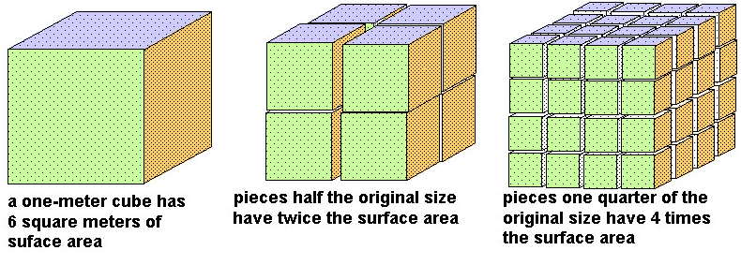
FACTOR: EXPOSURE
  Exposed rock on a slope is most likely to weather quickly.

Slide 13
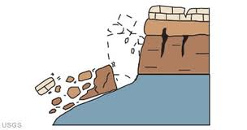
OTHER FACTORS
Rainfall, temperature, organic activity plus….
Topography and Elevation – Gravity
  Land – slope affects water movement – pulled downhill by gravity.
  Weathered rock fragments on steep slopes are pulled downhill by gravity and washed out by rain.

Slide 14
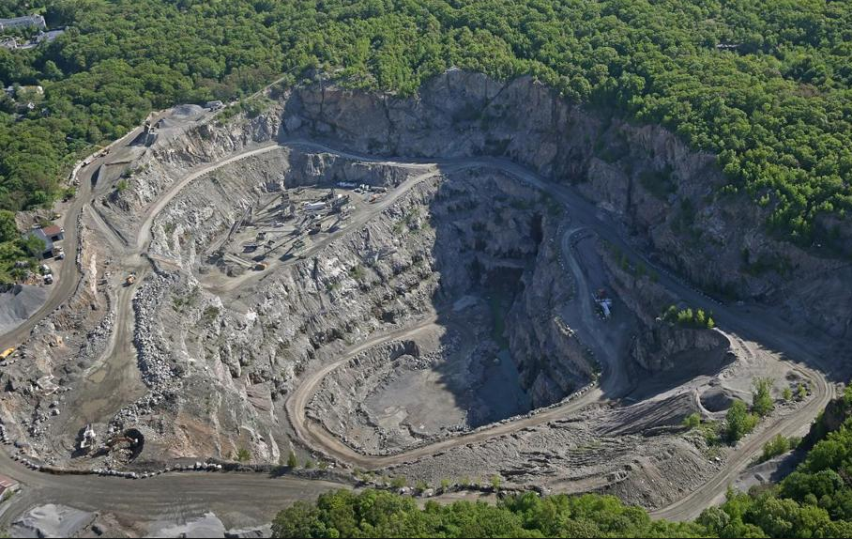
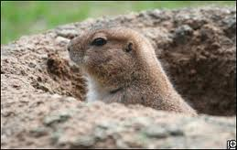
OTHER FACTORS
Human Activity
  Mining, constructions, anything that clears surface
Plant and Animal Activity
  Digging, biological wastes

Slide 15
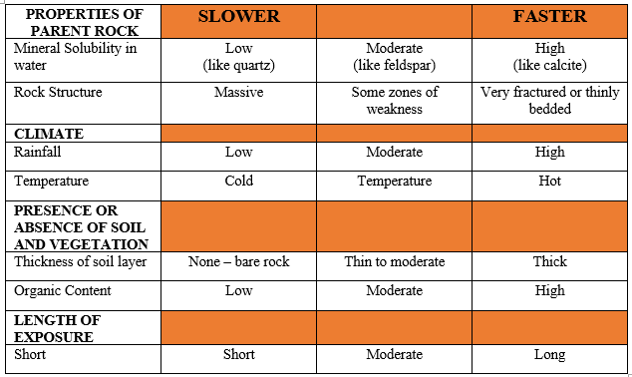
WEATHERING RATE

Slide 16
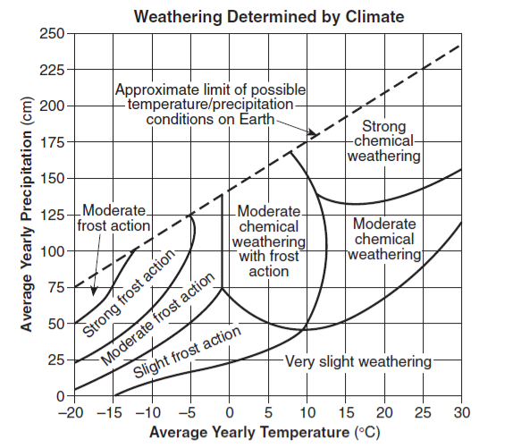
REVIEW
What type of climate will have least amount of weathering?
Hot and wet
Cold and wet
Hot and dry
Cold and dry

Slide 17

LAB
Surface area is the measure of how much exposed area an object has. When physical weathering breaks down rock, a larger surface area of the rock is exposed, and the more weathering (physical and chemical) can occur. In this lab you will model the chemical weathering process and observe how the rate of weathering changes when surface area is increased.

Slide 18
LAB
Determine how surface area (exposure) affects the rate at which materials weather
Compare rates of “weathering”:
  Whole tablet
  Broken tablet
How does surface area affect the rate of weathering?
What are some of the physical processes that can increase surface area?

Slide 19
LAB
Materials:
    Graduated cylinder
    Cup
    2 Alka-Seltzer tablets
    Room temperature water
    Index card
    Timer

Slide 20
LAB
Procedures:
Pour 50 mL of water into your cup.
Get your timer ready. You will need to record the time it takes for each Alka-Seltzer tablet to completely dissolve.
Place the first tablet in the water. Measure the time it takes to COMPLETELY react. You will know it has completely reacted because there will be no more bubbling. Record the time in the data table.
Empty the cup, rinse it and refill with 50 mL of water.
Break up the second tablet on the index card.
Pour the broken tablet into the cup. Measure the time it takes to COMPLETELY react. Record the time in the data table.
Obtain data from two other teams.
Average the results to find out the average time for the broken and whole tablets to dissolve.

Slide 21
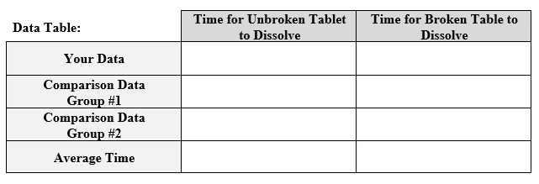
LAB

Slide 22
LAB
Analysis:
What differences in reaction rates did you observe between the two samples?
How did your data compare to the two other groups’ data?
Which tablet had the greatest surface area exposed to the water, the unbroken one or the broken up one?
What type of weathering did breaking up the tablet represent, mechanical or chemical? Explain!
What type of weathering did the tablet in the water represent, mechanical or chemical? Explain!
What is the relationship between surface area and reaction time?

Slide 23
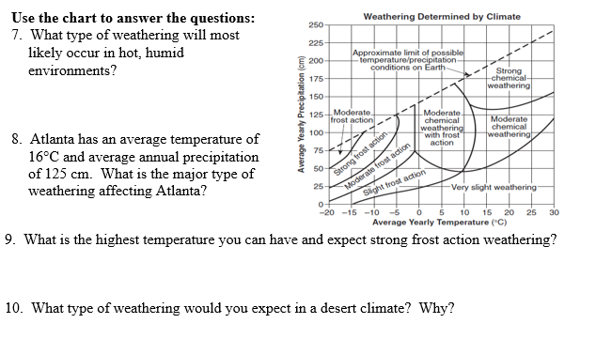
LAB

Slide 24
QUESTIONS?

