Slide 1
DO NOW
Pick up notes and Review #30.
Have your turned your lab in?

Slide 2
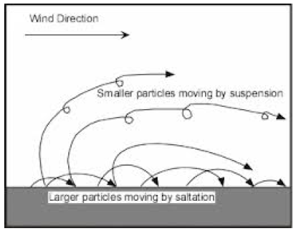
REVIEW
In wind erosion, why are smaller particles carried higher and further than larger ones? How do you think particles are carried in water?
Smaller particles are lighter so they are easily lifted into the air.

Slide 3
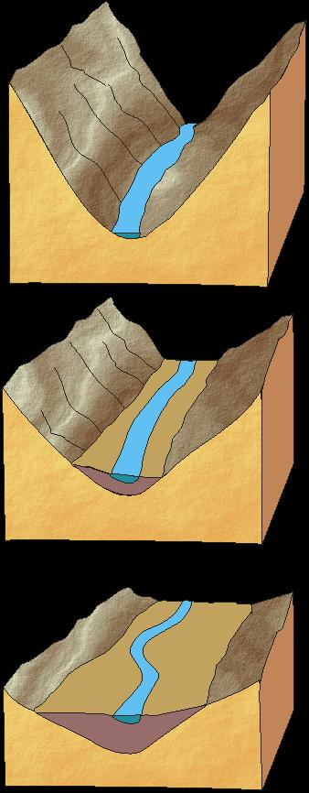
STREAM EROSION
SES3. Students will explore the actions of water, wind, ice, and gravity that create landforms and systems of landforms (landscapes).
e. Explain the processes that transport and deposit material in terrestrial and marine sedimentary basins, which result, over time, in sedimentary rock.

Slide 4
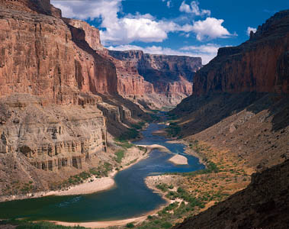
MOVING WATER TRANSPORTS SEDIMENT
Erosion is the process by which weathered materials are carried away.
Moving water picks up and transports sediment.
Over time a large amount of material can be moved creating new landforms.

Slide 5
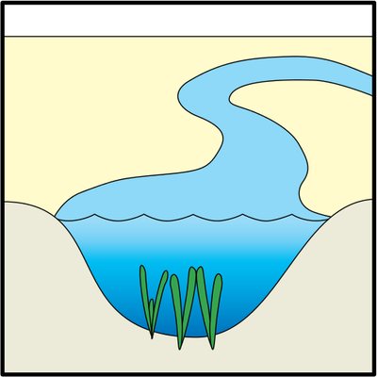
PARTS OF A RIVER SYSTEM
  Main stream and tributaries.
  Divides separate watershed.
  Channels - narrow depressions that streams follow as they flow downhill.
  Streambed – part of channel below the water level.

Slide 6
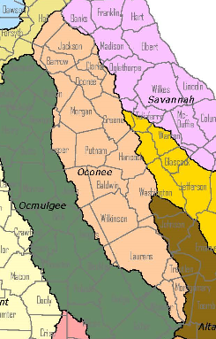
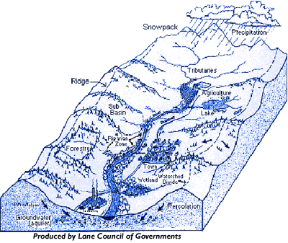
WATERSHEDS
A watershed is the area of the land that is drained by a river system.
Gravity is the force that causes water to move.
Our watershed: Upper Oconee

Slide 7

STREAMFLOW VELOCITY
Streamflow velocity = how fast water is moving.
Sediment transport depends on velocity of the water in the stream.
  Slower moving water:
    Holds less and smaller sediments.

Slide 8
STREAMFLOW VELOCITY
Sediment transport depends on velocity of water in stream.
  Faster moving water:
    Transports more and bigger sediments.
    Erodes the river channel more quickly than slower water.

Slide 9
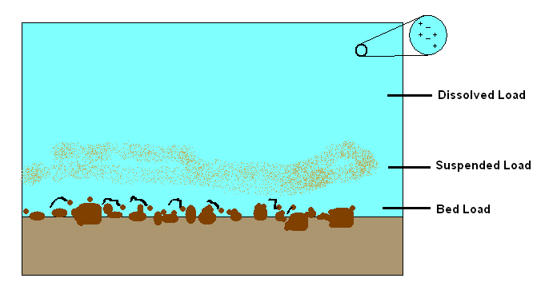
STREAM LOAD
Stream Load is the materials carried by a stream.
Suspended load – particles of sand and silt – carried by velocity.

Slide 10
STREAM LOAD
Bed load – larger sized sediment – gravel and pebbles – moves by sliding and jumping.
Dissolved load – transported in liquid solution.

Slide 11
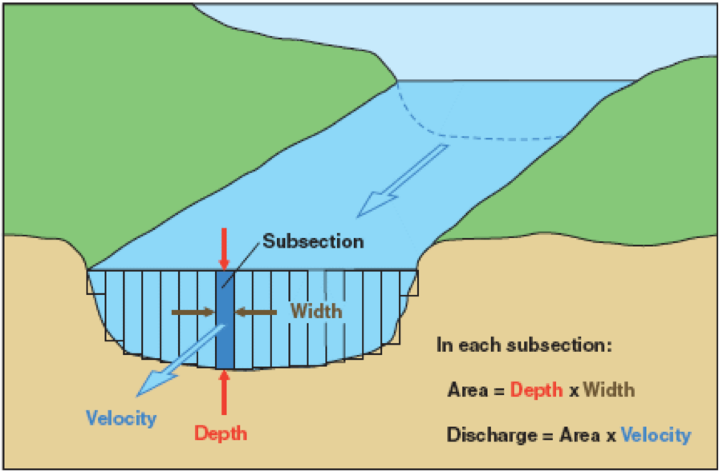
STREAM DISCHARGE
Stream Discharge is the volume of water moved by a stream in a given time.
Constant in all sections of a stream or river.
  Same amount of water flows through narrower and shallower sections in same time as through deeper and wider sections.
Stream Cross Section:
the shape of a ‘slice’ cut vertically across a stream at a particular point

Slide 12
STREAM DISCHARGE
  So the stream must move faster in narrow, shallow sections.
  When more material carried in a stream, erosion increases.

Slide 13
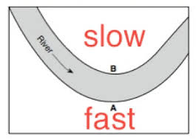
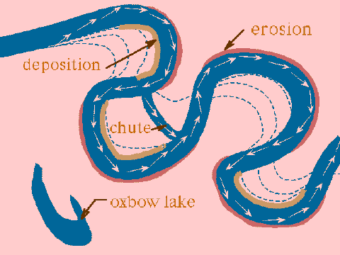
WINDING STREAM EROSION
Streams DEPOSIT material on the INSIDE of bends or curves in streams where water must move faster to keep up.
Faster water has more energy, carries larger, more particles.

Slide 14
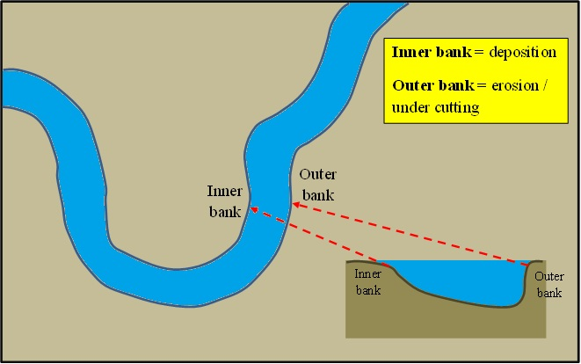
WINDING STREAM EROSION
Streams ERODE material on the OUTSIDE of bends or curves in streams where water can move slower.
Slow water has less energy, drops its load.

Slide 15
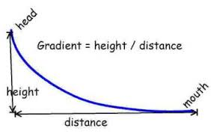
STREAM GRADIENT
The stream gradient is the change in elevation of a stream over a given horizontal distance.
Greater gradients = greater gravity = faster velocity.

Slide 16
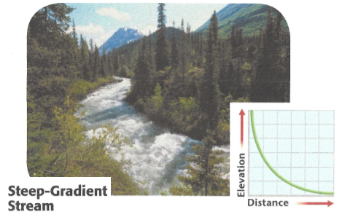
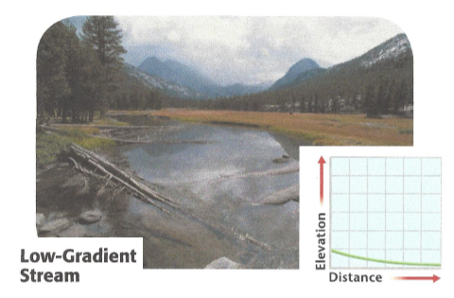
STREAM GRADIENT
Headwater – beginning of gradient – generally steep – higher velocity – causes rapid channel erosion.
Mouth – where stream enters larger body of water – generally flatter – less erosion.

Slide 17
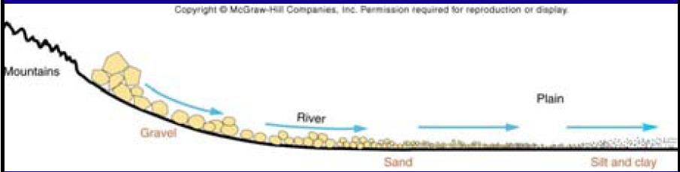
SEDIMENTATION AND SORTING
Rivers deposit sediment along banks and in lakes.
As water slows down, largest particles/sediment dropped first.
Sorting: process by which particles having a particular size or characteristic are concentrated.

Slide 18
SEDIMENTATION AND SORTING
Role of ENERGY
  High energy – carries large sediment.
  As energy is reduced (speed slower), particles begin to drop – big first, then smaller and smaller.

Slide 19
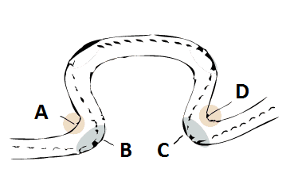
REVIEW
Where is water moving the fastest?
Slowest?
Where will sediment be deposited?
Where will the greatest erosion occur?
What might this meander eventually form?
B, C
A, D
A, D
B, C
Oxbow Lake

Slide 20
TO DO
Do Review #30.
Work on
  Wind Erosion Lab
  Sand Dune lab
  Sorting and Sedimentation lab

