Slide 1
DO NOW
Turn in Review #14.
Pick up notes and Review #15.

Slide 2
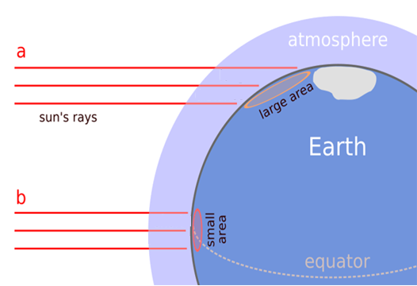
REVIEW
When you changed the angle of your flashlight, did the brightness of the light rays coming from the flashlight change?
How does the area covered by a ray of light change as the angle of sunlight gets smaller?

Slide 3
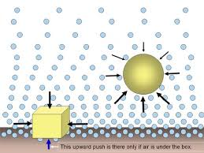

AIR PRESSURE AND CLOUDS
SES5c. Relate weather patterns to interactions among ocean currents, air masses, and topography.

Slide 4
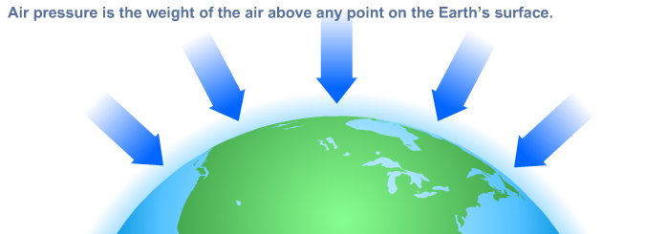
ATMOSPHERIC PRESSURE
Air pressure is the force exerted by the weight of air molecules.

Slide 5
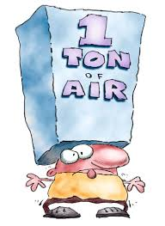
ATMOSPHERIC PRESSURE
Earth's atmospheric pressure is 14.7 psi (pounds per square inch) or one atm (atmosphere).
The force on 1,000 square centimeters (a little larger than a square foot) is about a ton!

Slide 6
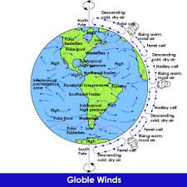
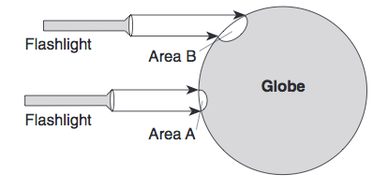
DIFFERENCES IN AIR PRESSURE
Uneven heating of Earth’s surface causes differences in air pressure.
  Equator heats more than poles.
  Creates wind belts.
Remember that Latitude affects the angle at which the sun's rays hit Earth.

Slide 7
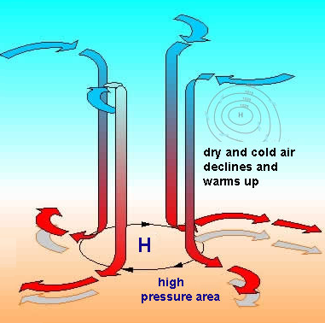
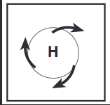
HIGH PRESSURE
Air that rises in atmosphere is cooled.
Air is dry.
The air cools and condenses.
It then descends or sinks.
It creates area of high pressure.
CLOCKWISE
DOWN
OUT

Slide 8
HIGH PRESSURE
Moves out at the surface.
  Spins clockwise due to Coriolis.
Brings cool, clear, dry weather at surface.
CLOCKWISE
DOWN
OUT

Slide 9
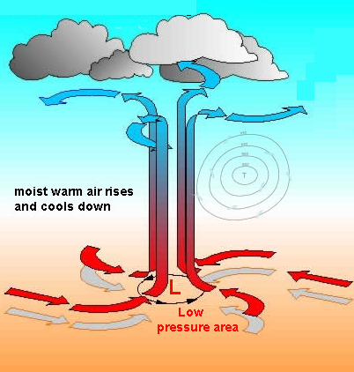
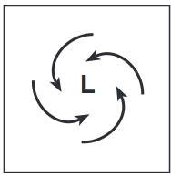
LOW PRESSURE
Air warms.
Warm air expands
Air becomes less dense and rises.
This pulls in air at surface to replace rising air.
  Air coming into Low spins counter-clockwise due to Coriolis.
COUNTERCLOCKWISE
IN
UP

Slide 10
LOW PRESSURE
Air cools as it rises.
Clouds form.
Moves outward at top of Troposphere.
Brings warm, wet weather at surface
COUNTERCLOCKWISE
IN
UP

Slide 11
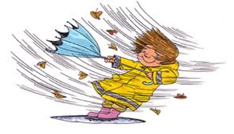
WIND
Wind is air movement due to pressure differences.
Air moves from high to low pressure – WIND!
Atmosphere is attempting to balance – equilibrium

Slide 12
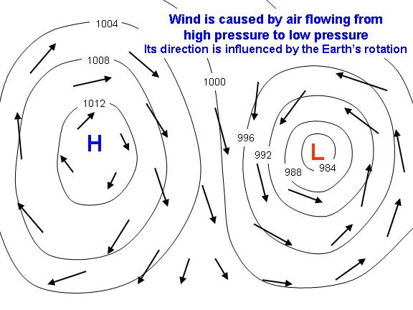
WIND
Motor Memory:
Hand Motions!
High Pressure – down, out, clockwise.
Low Pressure – in, up, counterclockwise

Slide 13
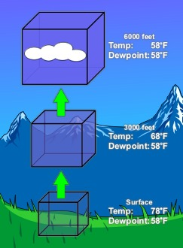
RISING AIR
Adiabatic cooling is the process of reducing heat through a change in air pressure caused by volume expansion.
Air is heated and rises – energy input at time of heating only.

Slide 14
RISING AIR
Temperature drops because of less pressure from air expanding – NOT gain or loss of energy.
Clouds form when rising air mass temperature equals dew point and water vapor condenses.
Adiabatic Cooling

Slide 15
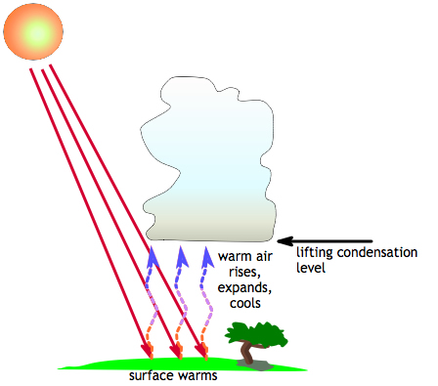
CLOUD FORMATION
MUST HAVE
  Low Pressure and Warm, moist air
Rising air cools.
Water vapor in air condenses.
Clouds form with low pressure - when warm, moist air rises

Slide 16
CLOUD FORMATION
Condensation nuclei – solid particles (dust, etc.) in the atmosphere – must be present.
Water vapor condenses on surface of nuclei.
Clouds form with low pressure - when warm, moist air rises

Slide 17
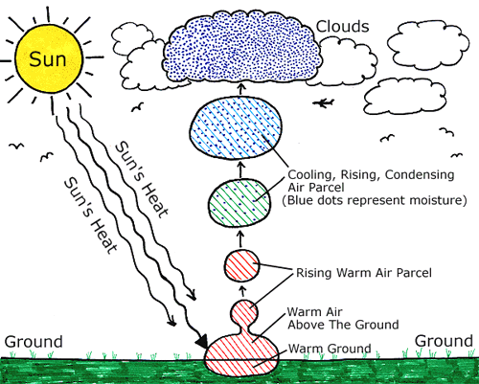

Slide 18
CLOUD FORMATION RELEASES HEAT
Latent heat is the energy that is absorbed in a phase change.
Evaporation at the surface USES heat energy
Condensation in clouds RELEASES heat energy
Energy is transferred from the surface to the atmosphere as water evaporates at the surface then condenses to form clouds.

Slide 19
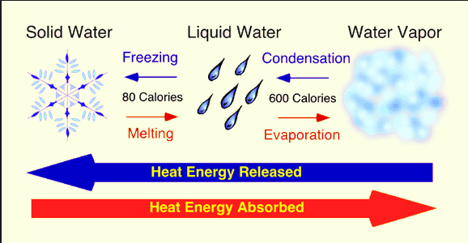
CLOUD FORMATION RELEASES HEAT

Slide 20
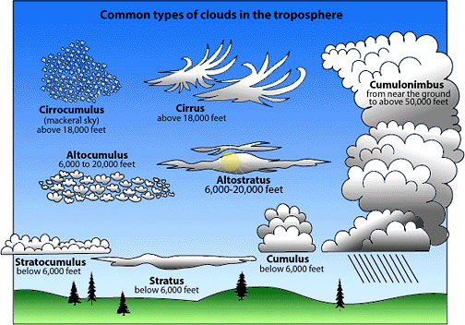
CLOUD TYPES
Cirrus
High, thin, light
Stratus
Flat, low, sheet-like
Ice Crystals
Warm, moist air above cold

Slide 21
CLOUD TYPES
Cumulus
much larger,taller than cumulus
Cumulo-nimbus
Rising, moist air cools
Puffy, billowy
Thunderstorm clouds

Slide 22
REVIEW
Air in a Low Pressure Systems:
Rises
Expands
Forms clouds
All the above

Slide 23
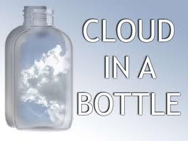
LAB: CLOUD IN A BOTTLE
When you squeeze the bottle, the air is under HIGH pressure.
When you release the bottle, the air is under LOW pressure
When do clouds form?

Slide 24
LAB: CLOUD IN A BOTTLE
Purpose:
When warm air rises, it expands and the temperature decreases. When the temperature decreases below the dew point, clouds form on condensation nuclei. In this activity you will create a cloud in a bottle and explore adiabatic cooling rates.

Slide 25
LAB: CLOUD IN A BOTTLE
Materials:
Empty 2 liter soda bottle
Beaker
Cold water
Matches

Slide 26
LAB: CLOUD IN A BOTTLE
Procedure:
1. Get 250 mL of cold water from the back desk in your beaker and then pour it into the plastic bottle. Firmly screw on the lid.
2. Shake the bottle vigorously for 30 seconds. Watch the clock.
3. Then, squeeze the bottle and hold this squeeze for several seconds to increase the pressure, and then release it to allow the air inside to expand and decrease the pressure. Squeeze and release several times as you watch the air in the bottle.

Slide 27
LAB: CLOUD IN A BOTTLE
4. Unscrew the cap from the bottle. Take your bottle to your teacher who will light a match and hold it over the bottle opening. Blow it out into the bottle, and then hold it there for about two seconds. Quickly replace the cap. Squeeze and release several times again. Make observations.
5. Empty the cold water from the bottle, and get 300 mL of hot water from the back desk in your beaker. Replace the cap, and shake the bottle for 30 seconds. Squeeze, release, and observe just like you did in step 3.
6. Unscrew the cap, and again take your bottle to the teacher who will hold a match into the bottle as you did in step #4. Quickly replace the cap, and then squeeze, release several times. Make observations.

Slide 28
LAB: CLOUD IN A BOTTLE
Analysis:
1. Which step resulted in the best cloud formation, Step 3, 4, or 6? ______________________
2. Was cloud formation more impressive when smoke particles were present in the bottle?
3. Did the cloud appear when you caused high pressure on the air in the bottle by squeezing or when you caused low pressure by releasing?
4. Which provided more vapor in the bottle . . . the hot water, or the cold water? WHY?
5. In your experiment, what served as the “condensation nuclei”? ________________________
6. Why did the cloud disappear when you squeezed the bottle? You must use the terms evaporate and dew point in your answer.

Slide 29
TO DO
Do Cloud in a Bottle due Friday
Review #15 due tomorrow.

