Slide 1
DO NOW
Pick up handout.
Get out Concept Review handout.

Slide 2
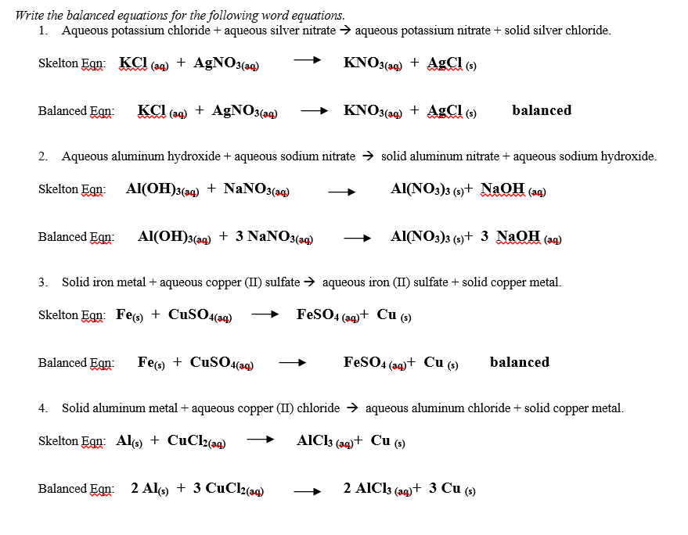

Slide 3
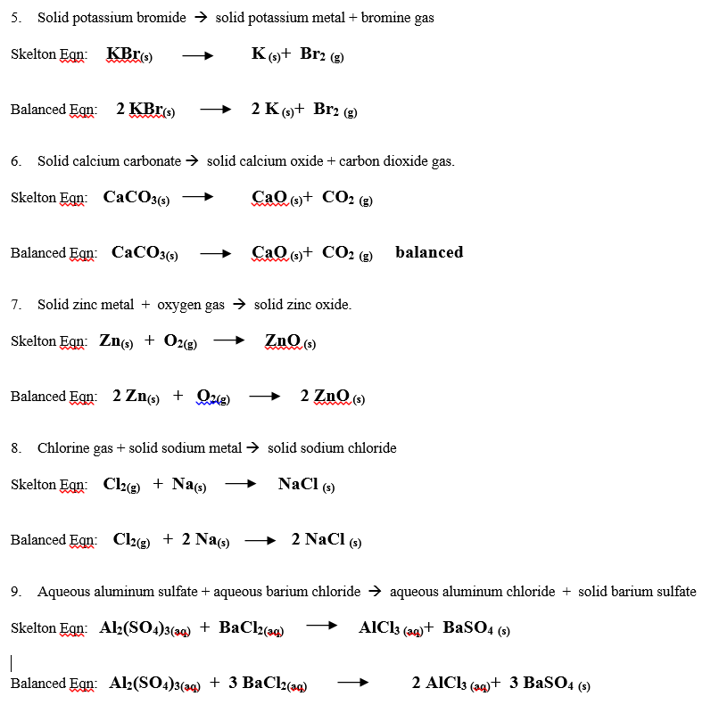

Slide 4
TO DO
Do Balancing Chemical Reactions – Word Equations. Due Monday for a grade.

