Slide 1
DO NOW
Turn in Review #23
Pick up notes and Review #24.

Slide 2
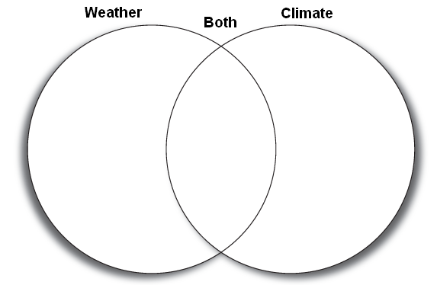
REVIEW
Long term average
Today
Air pressure
Temperature
Snow
Cloud cover
Monsoon
Latitude
Elevation
Humidity
Wind belt
Wind
Precipitation
El Nino
Warm front
How are weather and climate alike?
How are they different?
Place the words where they belong on the Venn Diagram.

Slide 3

Climate Zones
SES5. Students will investigate the interaction of insolation and Earth systems to produce weather and climate.

Slide 4
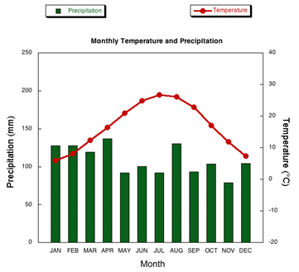
CLIMATE:
TEMPERATURE AND PRECIPITATION
Climates are chiefly described by using average temperature and precipitation data.

Slide 5
CLIMATE:
TEMPERATURE AND PRECIPITATION
Monthly and yearly averages for temperature and precipitation are calculated.
Differences between high and low averages are noted:
  Example: mild winter and mild summer versus cold winter and hot summer

Slide 6
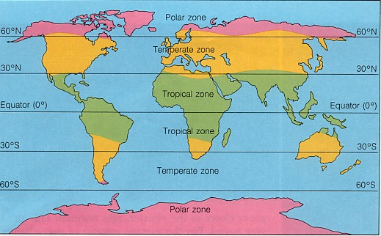
CLIMATE ZONES
Three Major Climate Zones:
Tropical
Mid-latitude (Temperate)
Polar

Slide 7
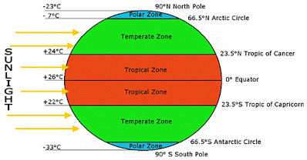
CLIMATE ZONES
Characteristics:
Distinct temperature characteristics
Specific temperature range
Varying climates due to precipitation
Climate Zones based on Abiotic factors only – Biomes include biotic factors.

Slide 8
TROPICAL CLIMATES
Desert is the climate zone that has the least annual rainfall
RAIN FOREST
Humid
Warm – small temperature range
Annual Rainfall = 200 cm per year
Dense vegetation
SAVANNAH
Wet summers, dry winters
Small temperature ranges
Annual rainfall = 50 cm per year
Open grasslands
DESERT
Dry
Hot days, cold nights
Annual Rainfall < 25 cm per year
Little to no vegetation

Slide 9
MID-LATITUDE CLIMATES
MARINE WEST COAST
Low temperature range – mild winters & summers (7°C to 10°C)
Frequent rainfall – 60 to 150 cm. annual precipitation
STEPPE
Large temp range – cold dry winter, warm wet summer (-1°C to 23°C)
Low precipitation - < 40 cm annually
HUMID CONTINENTAL
Large temp range - Northeastern US
Annual precipitation > 75 cm annually

Slide 10
MID-LATITUDE CLIMATES
HUMID SUBTROPICAL
Large temp range – Southeastern US
Annual Precipitation – 75 – 165 cm per year
MEDITERRANEAN
Mild, low temperature range
Annual Precipitation about 40 cm per year

Slide 11
POLAR CLIMATES
SUBARCTIC
Large difference between summer and winter temperature – up to 63°C
Annual precipitation 25 – 50 cm per year
TUNDRA
Colder than Subarctic Average temp < 4°C
Precipitation about 25 cm per year
POLAR ICECAPS
Icy region
Average temperature < 0°C
Low precipitation

Slide 12
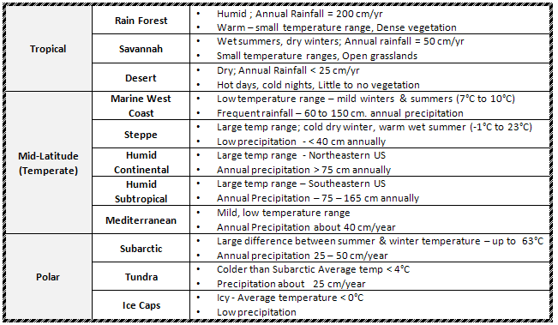
CLIMATE SUMMARY CHART

Slide 13
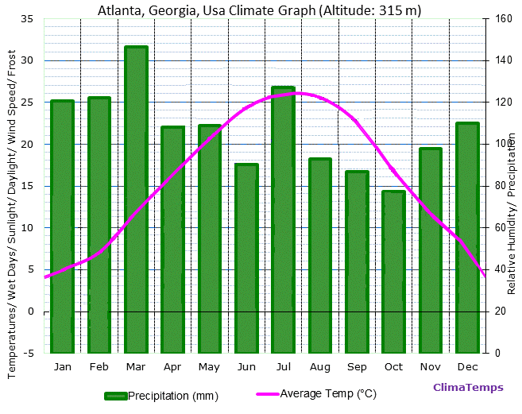
CLIMATOGRAPHS
Climatographs are used to show the precipitation and the temperature of a region.
Both sets of data are put onto the same graph.

Slide 14
CLIMATOGRAPHS
The bar graph along the bottom shows the average monthly precipitation.
The top line graph shows the average monthly temperature.

Slide 15
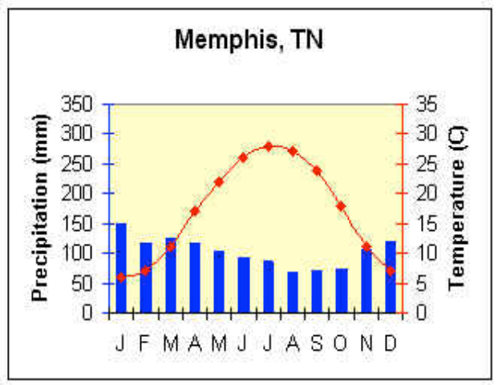
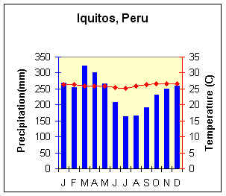
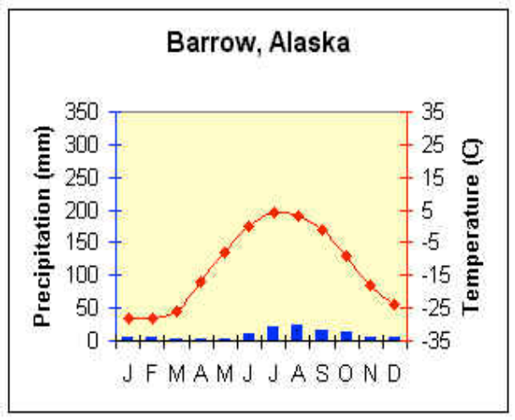
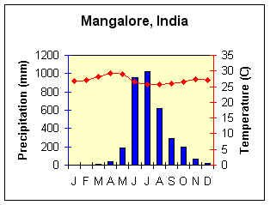
WHAT DOES THE GRAPH TELL YOU?
Note the Y-Axis:
All precipitation on left starts with ZERO.
The temperatures do not all start at zero!

Slide 16
WHAT DOES THE GRAPH TELL YOU?
Which is:
Polar/Tundra?
Mid- Latitude?
Tropical?
Monsoon?

Slide 17
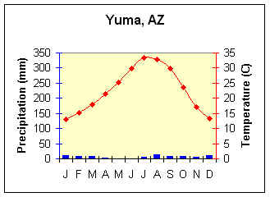
REVIEW
What type of climate is shown on the graph?
Rainforest
Tundra
Desert
Temperate Forest

Slide 18
LAB: CLIMATOGRAPHS
Read and interpret graphs
Make a climatograph from given data.

Slide 19
TO DO
Work on Climatographs Practice with a partner or by yourself.
Review #24 due tomorrow.

