Slide 1
DO NOW
Pick up notes sheet.

Slide 2
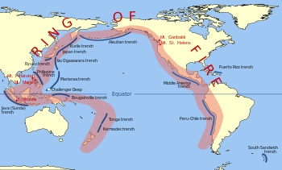
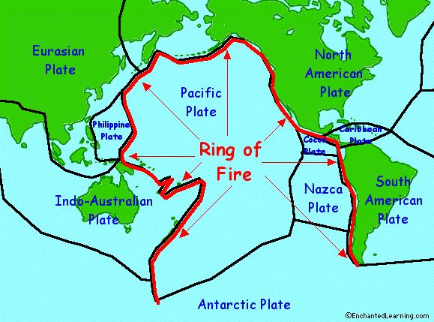
Looking Back…
The area around the Pacific Ocean is known as the “Ring of Fire.”
Why do you think it is called that?

Slide 3
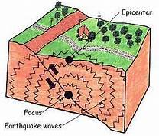
EARTHQUAKE DEPTH

Slide 4
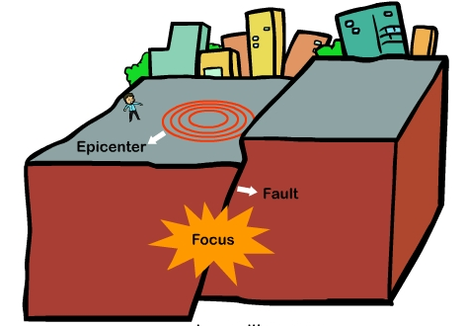
LOCATION TERMINOLOGY
Earthquakes occur in the Earth’s crust.
Focus: location along a fault where the first motion occurs.
Epicenter: point on Earth’s surface directly above focus.

Slide 5
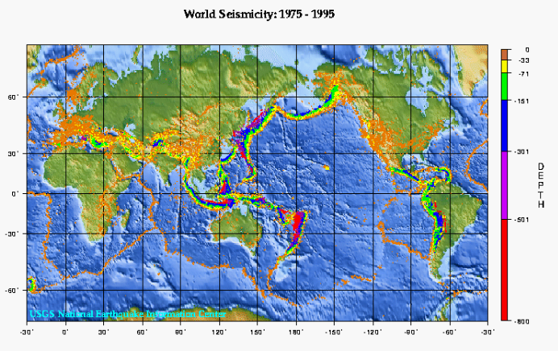
EARTHQUAKE DEPTH
Earthquakes occur along 3 types of plate boundaries:
Convergent, Divergent, and Transform

Slide 6
CONVERGENT BOUNDARY
Convergent boundaries occur where two plates come together or converge.
Associated with convergent boundaries are subduction zones, where one plate dives (subducts) beneath another towards the deeper interior regions of the earth.
Shallow to Deep earthquakes are associated with this type of plate boundary.

Slide 7
DIVERGENT BOUNDARY
Divergent boundaries occur in areas where molten materials rise usually along extensive underwater mountain chains known as ridges and rises.
The rising material results in the production of new crust.
Shallow earthquakes occur along these boundaries.

Slide 8
TRANSFORM BOUNDARY
Transform boundaries occur where plates slide past one another.
The classic example of this type of boundary is the San Andreas Fault, which marks the boundary between the southward moving North American Plate and the northward moving Pacific Plate.
Transform boundaries are marked by mostly shallow earthquakes.

Slide 9
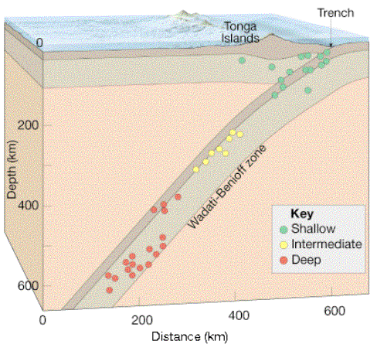
EARTHQUAKE DEPTH
Earthquakes usually occur below the Earth’s surface.
Shallow
Intermediate
Deep
Did you determine if there is a relationship between earthquake magnitude and depth?

Slide 10
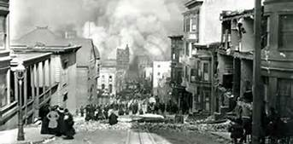
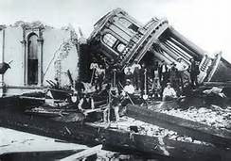
SHALLOW EARTHQUAKES
less than 70 km of surface – more common.
Most damage
Closest to the surface.
All boundaries have shallow earthquakes.
1906 San Francisco earthquake was shallow.

Slide 11
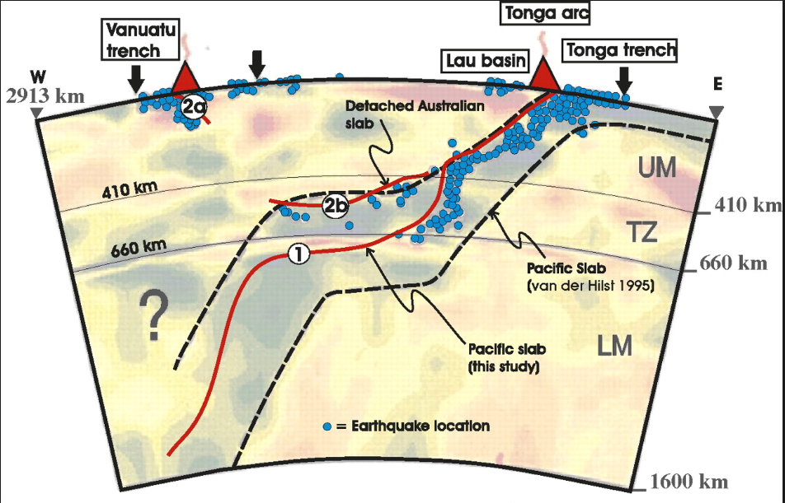
INTERMEDIATE EARTHQUAKES
70 – 300 km deep.
Occur at convergent boundaries.

Slide 12
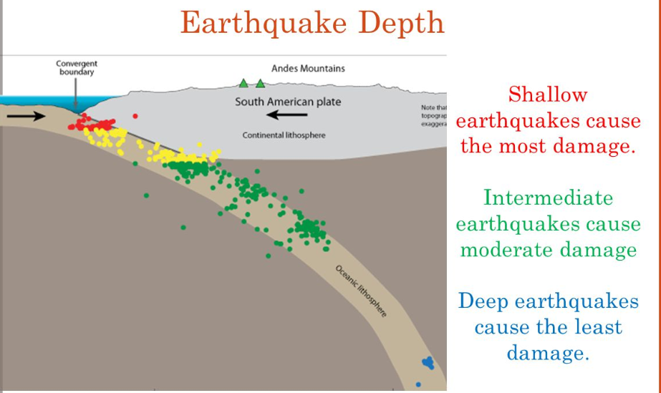
DEEP EARTHQUAKES
Over 300 km
usually at subduction zones (convergent boundaries).
Deeper earthquakes dissipate energy before they reach the surface.

Slide 13
EARTHQUAKE DEPTH
Looking at Earthquake Depth

Slide 14
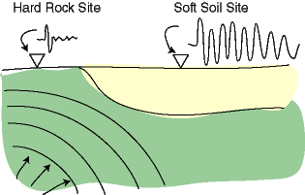
AMPLIFICATION
As the earthquake travels through the lithosphere, the type of material affects its intensity.
Soft soils amplify ground shaking.
Soft sandy soils can be liquefied by strong ground motion.
Damage usually is more severe on soft soils.

Slide 15
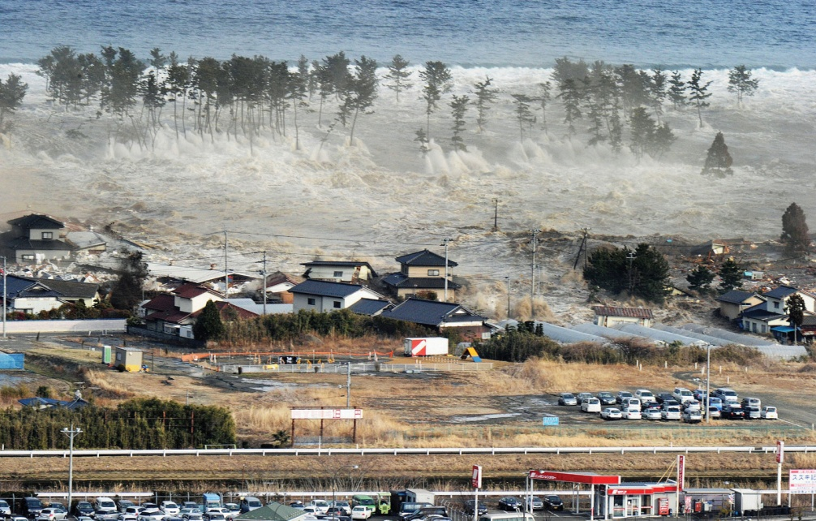
TSUNAMIS
Formed following earthquakes in subduction zones (deep).
Gigantic ocean waves formed after a volcanic eruption, submarine earthquake or landslide.

Slide 16
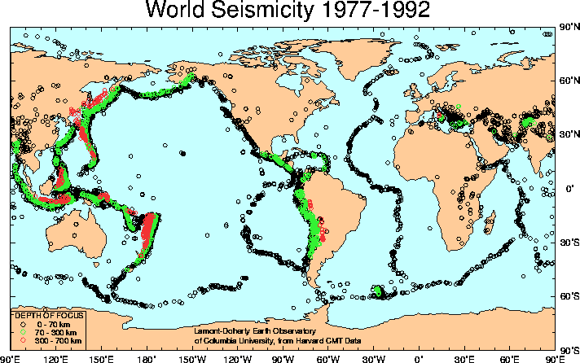
REVIEW
Deeper Earthquakes are often associated with:
A. Transform Boundaries
B. Divergent Boundaries
C. Convergent Boundaries
D. All of them

Slide 17
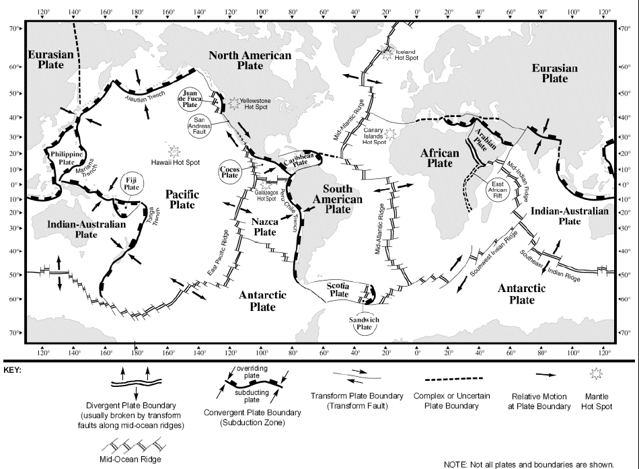
ACTIVITY:
COMPARING EARTHQUAKE DEPTH
How does earthquake depth compare at two different areas where subduction is currently occurring?

Slide 18
ACTIVITY:
COMPARING EARTHQUAKE DEPTH
The vast majority of earthquakes occur at plate boundaries. The deepest earthquakes occur at subduction boundaries where lithosphere is plunging down into the mantle. Deep focus earthquakes are defined as those with foci occurring deeper than 300 kilometers. Shallow earthquakes have foci less than 70 km deep, while intermediate focus earthquakes occur at depths between 70 and 300 km.

Slide 19
ACTIVITY:
COMPARING EARTHQUAKE DEPTH
The behavior of the subducting plate is determined by the age of the rocks comprising the plate. Older crust is cooler and denser than younger crust and subducts faster and at a steeper angle than younger, warmer and less dense crust. In this activity you will plot and compare actual earthquake foci data from two areas where subduction is occurring. One area includes the Tonga Islands in the southwest Pacific Ocean, the other is along the coastline of Chile in South America.

Slide 20
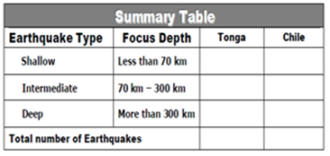
ACTIVITY:
COMPARING EARTHQUAKE DEPTH
Look at the Earthquake Data Table (right). Determine the number of shallow (<70 km), intermediate (70-300 km) and deep (>300 km) earthquakes and record them all on the summary table below for both the Tonga and Chile Trench.
Add the numbers in both columns of the Summary Table. Totals should equal the total number of quakes.

Slide 21
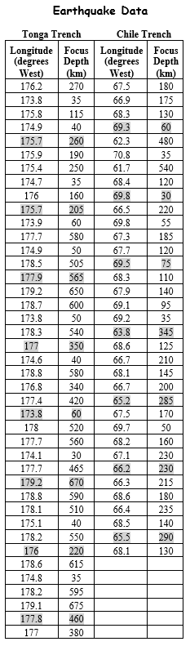
ACTIVITY: COMPARING EARTHQUAKE DEPTH
3. On the graph on the next page, plot the highlighted pieces of data for the Tonga Trench from the table. Do NOT connect the dots.
4. Complete the second graph for the Chile Trench. Do NOT connect the dots.
*One person will do Tonga and the other will do Chile data.

Slide 22
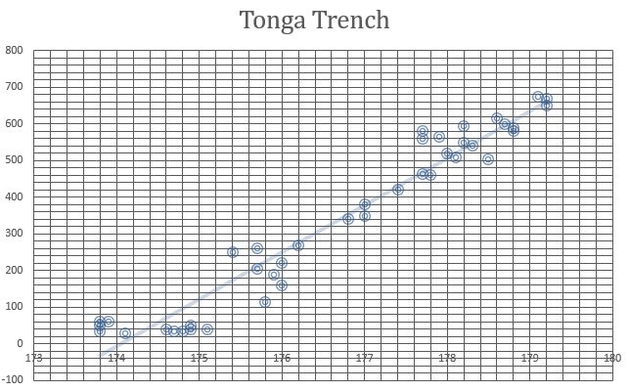
ACTIVITY:
COMPARING EARTHQUAKE DEPTH
5. Draw a “best fit” trend line for the data points. A “best fit” line does not go through the points, but shows the trend of the data. This trendline will represent the upper surface of a subducting plate.

Slide 23
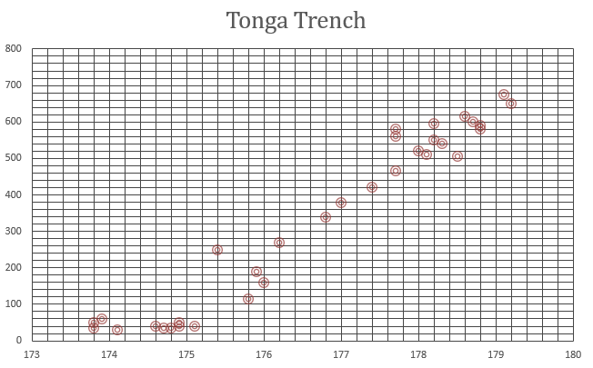
ACTIVITY:
COMPARING EARTHQUAKE DEPTH
6. Using the tectonic map, label the name of the two converging plates on each graph.
7. Using the map, draw arrows to show the relative movement of each plate on both graphs.

Slide 24
ACTIVITY:
COMPARING EARTHQUAKE DEPTH
Answer the questions on the last page.

