Slide 1
DO NOW
Pick up notes and Review #31
Turn in Review #30

Slide 2

REVIEW
Determine the correct order for the formation of an Oxbow lake.
A B C D
2
3
1
4

Slide 3
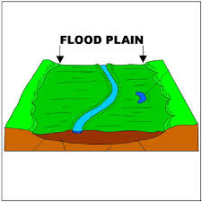
RIVERS AND FLOOD CONTROL

Slide 4
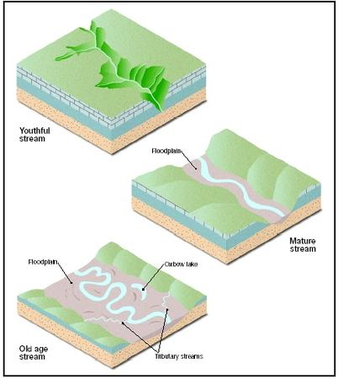
FLOODPLAINS
Floodplains form alongside shallow, meandering rivers.
A floodplain is a valley floor around rivers that floods.

Slide 5
FLOODPLAINS
Over time, a river changes its course.
  Erosion changes the riverbed.
Floodplains are formed by MATURE rivers.

Slide 6
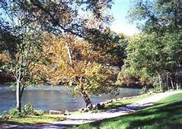
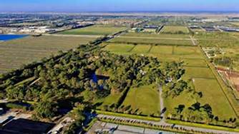
LIVING ON A FLOODPLAIN
Advantages:
good farming
rich soil
convenient river access

Slide 7
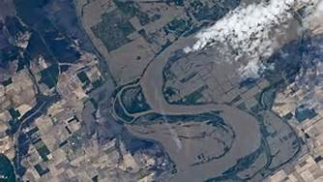
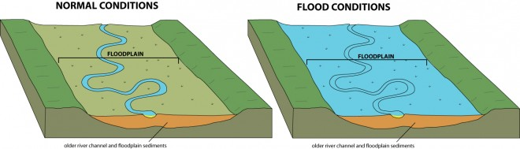
DISADVANTAGES:
Easily Flooded
During times of excess precipitation, water leaves the banks of the river, but remains confined to the floodplain.
Area is likely to experience repeated flooding.

Slide 8
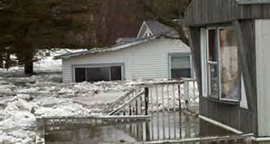
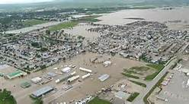
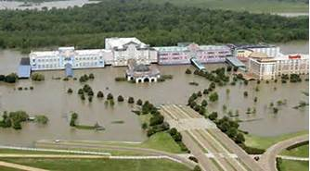
FLOOD DAMAGE
The #1 natural disaster in the United States.
Leading cause of weather-related deaths in the United States.
Approximately 200 deaths per year due to flooding.

Slide 9
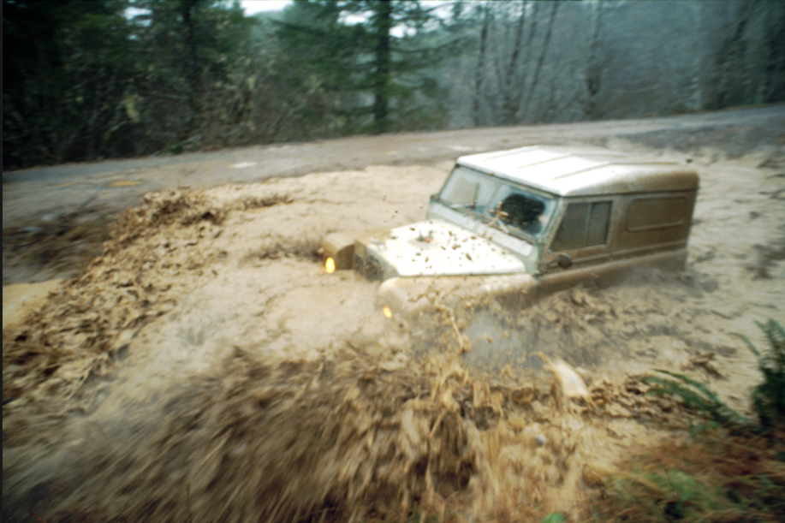
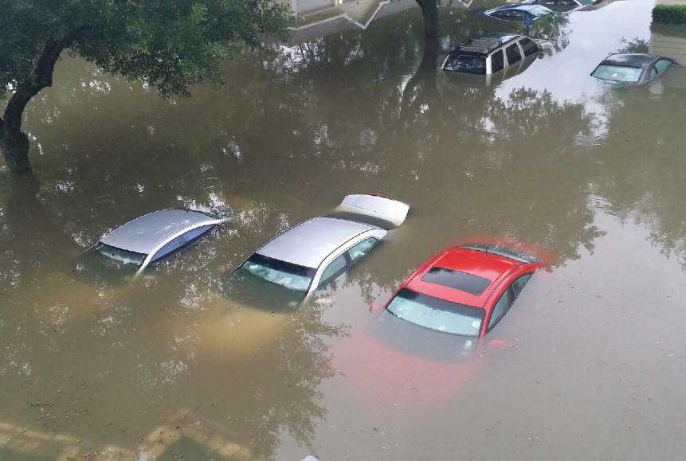
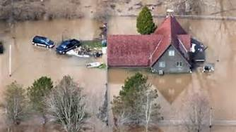
FLOOD DAMAGE
Over 50% of flood-related drownings are vehicle-related.
2003 to 2012, flood claims averaged nearly $4 billion per year

Slide 10
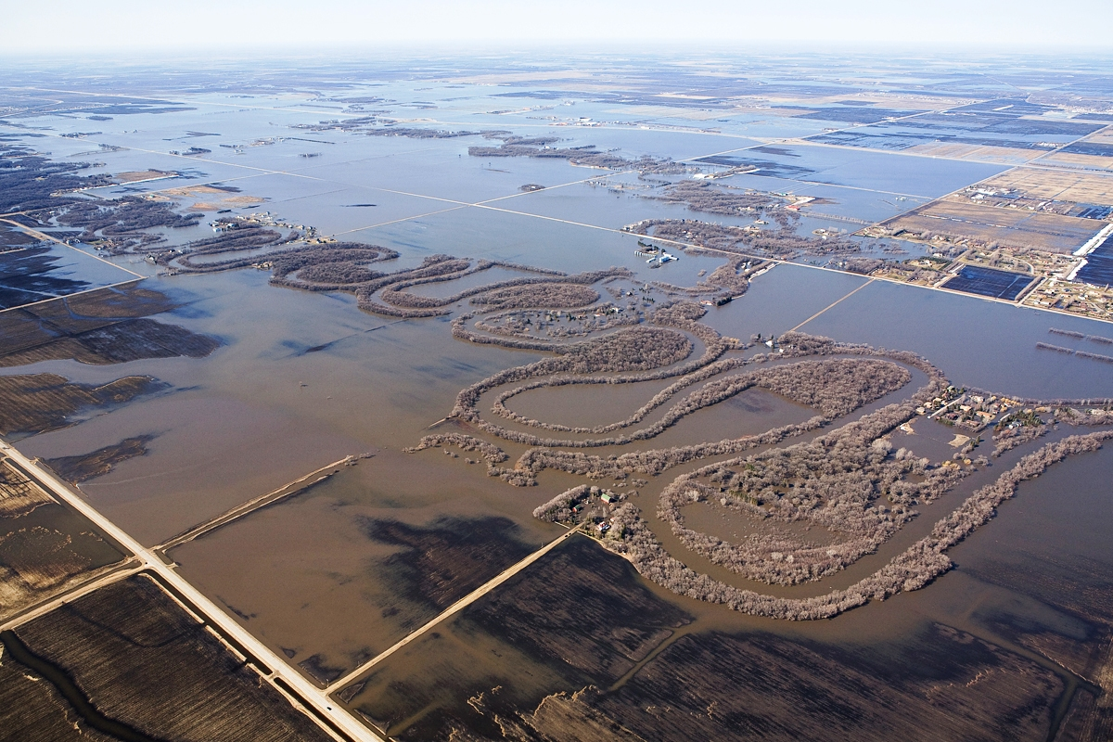
FLOOD CONTROL
Direct Methods of Control:
  Dams
  Artificial levees
  Overflow channels
Indirect Method of Control:
    Soil conservation
    Forest Conservation
    Run-off Prevention

Slide 11
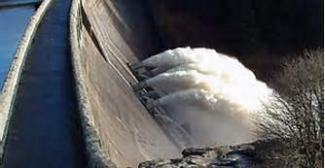
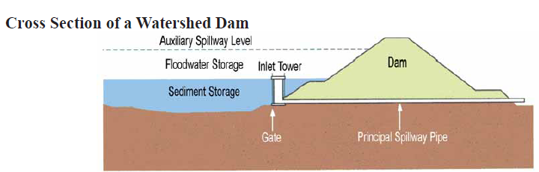
DAMS
Holds excess runoff.
Slowly releases the water for several days through a pipe in the dam.
Reduces the amount of water that reaches the riverbed immediately after a rain.

Slide 12
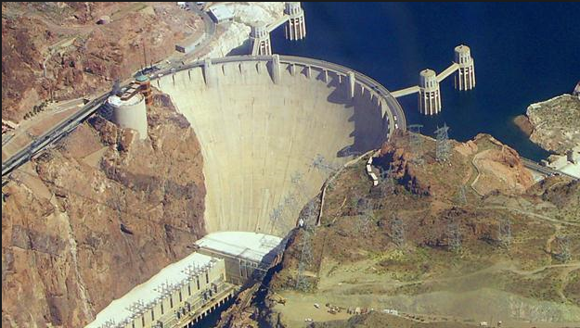
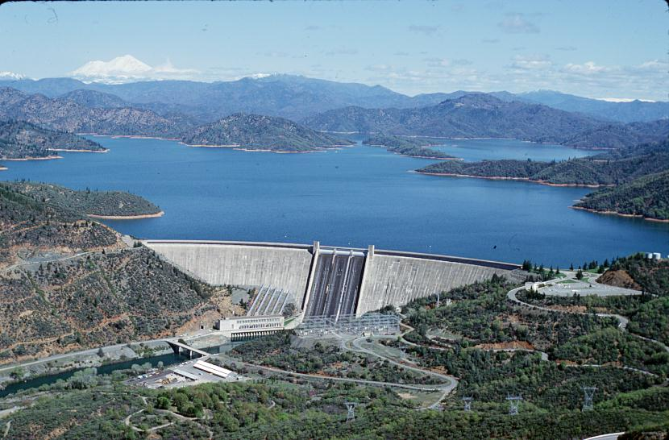
ADVANTAGE OF DAMS
Storage of water for public use.
Recreational use – boating, fishing, parks.
Stores water for agricultural use.
Prevents flooding down stream.
Hydroelectric power generation.
Cooling for nuclear power plants.

Slide 13
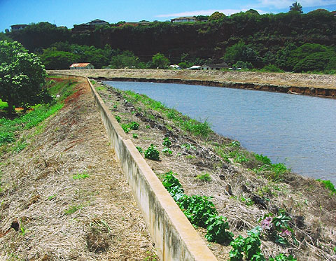
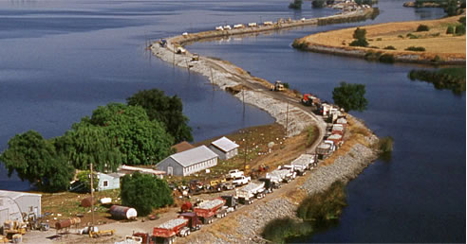
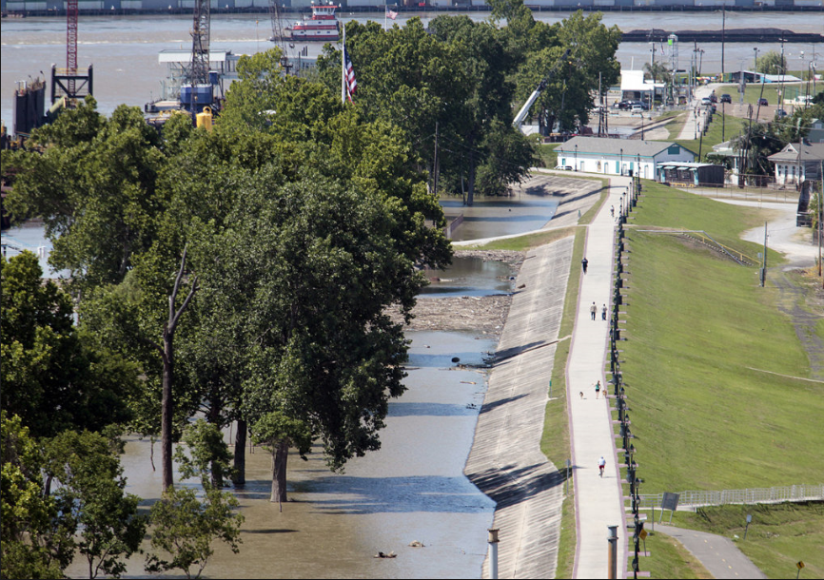
LEVEES
  Natural Levees:
  Sediment deposits along banks of a river.
  Raised banks.
Artificial levees:
Constructed for flood control.

Slide 14
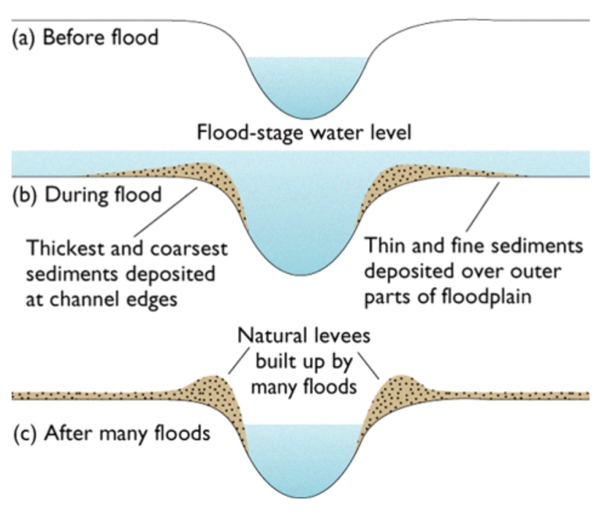
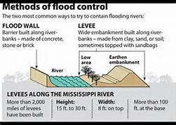
LEVEES

Slide 15
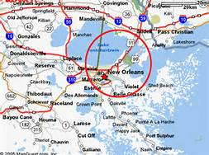
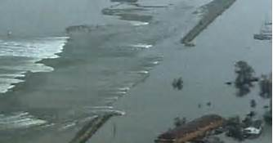
WHEN THINGS GO WRONG:
Katrina - August 29, 2005
Levees and flood walls failed or were breached in more than 50 locations.
First time in history that an engineering failure has brought about the destruction or near-destruction of a major U.S. city.

Slide 16
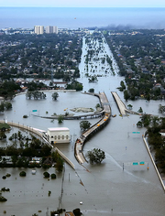
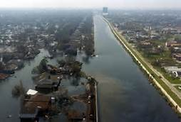
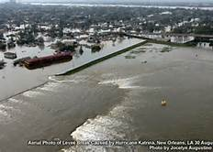
WHEN THINGS GO WRONG:
Katrina - August 29, 2005
80% of New Orleans was flooded to a depth of more than 3 meters (10 ft) in some neighborhoods.
1,118 dead people and 135 missing.

Slide 17
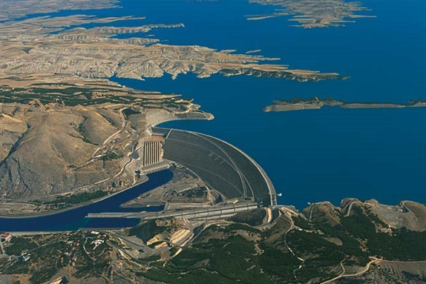
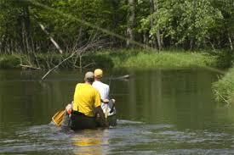
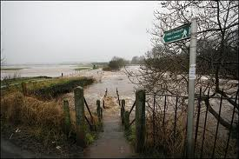
HOW PEOPLE USE RIVERS
Power – electric and nuclear
Recreation
Fishing
Water resource
Sewage treatment
Farming and irrigation

Slide 18
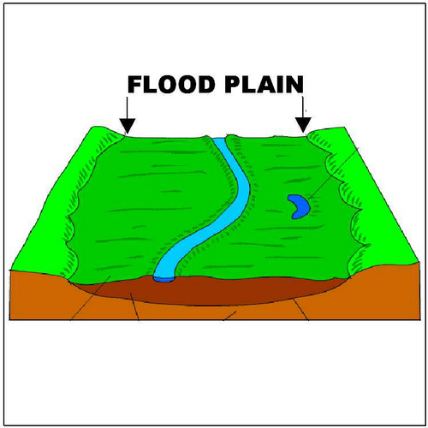
REVIEW
Floodplains form at which stage of a river’s life?
Youthful
Beginning Mature
Mature
Old Age

Slide 19
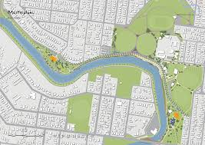
ACTIVITY: PLANNING ALONG A RIVER
Cut out the puzzle pieces.
Place the SOURCE piece near the top of the sheet of construction paper, and the MOUTH piece near the bottom of the sheet.
Sort the other puzzle pieces, and arrange them in a way that you think is the best arrangement for the pieces.
When planning your river, consider how each activity or use along a river could affect people, animals, and plants downstream. Every river has a beginning and an end, but a lot of different things can go on in between!

Slide 20
ACTIVITY: PLANNING ALONG A RIVER
Questions to consider include:
What are some ways that people use rivers?
What can happen to a river when a factory is nearby?
What can happen when a town is close to a river?
Where along a river would water be clean for swimming or fishing?
Could building a dam change a watershed?
Does farming affect the water in a river?
After you are sure of your placement, glue the river sections down on your paper.

Slide 21
ACTIVITY: PLANNING ALONG A RIVER
Draw an arrow that shows the direction your river flows (Source to Mouth)
Beside THREE SECTIONs (not the MOUTH or the SOURCE), write a sentence that explains:
  Why you placed it there.
  How it is affected by activities that occur upstream –OR- affects activities that are downstream.

Slide 22
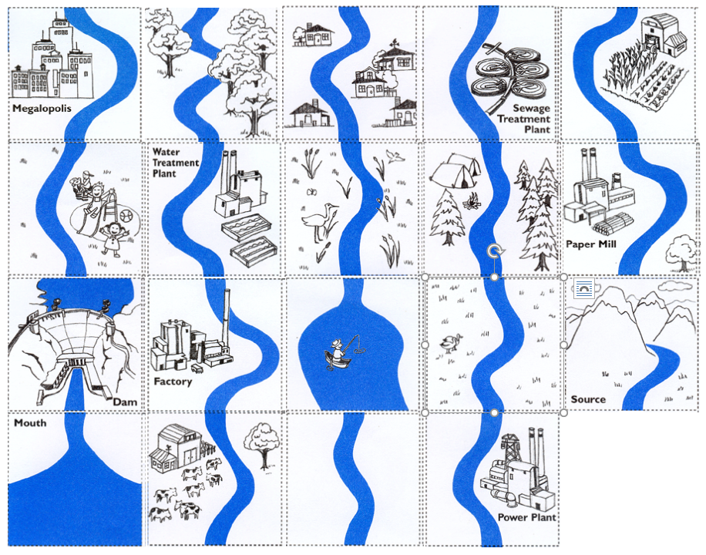
ACTIVITY: PLANNING ALONG A RIVER

Slide 23
TO DO
Complete the River Planning Activity.
Review #31 due tomorrow.

