Slide 1
DO NOW
Pick up notes and Review #5.
Turn in Review #4.

Slide 2
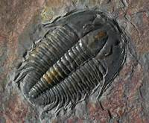
REVIEW
What can fossils tell us about the age of the rocks they are found in?
If you found a rock with a trilobite fossil, what would you conclude about the age of the rock?

Slide 3
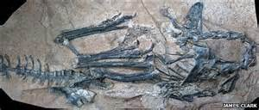
FOSSILS AND PAST ENVIRONMENTS
SES4. Students will understand how rock relationships and fossils are used to reconstruct the Earth’s past.
c. Apply the principle of uniformitarianism to relate sedimentary rock associations and their fossils to the environments in which the rocks were deposited.

Slide 4
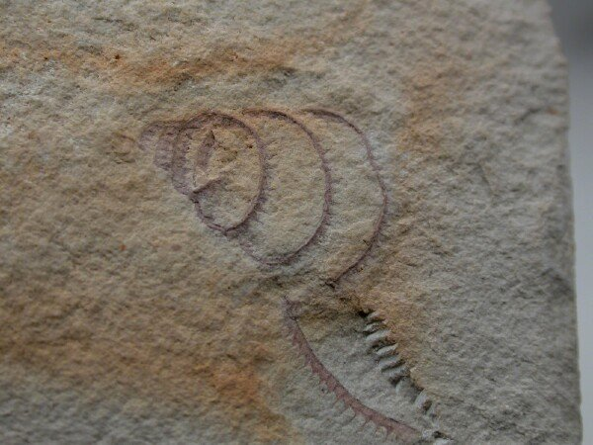
FOSSILS AND THEIR ENVIRONMENTS
Fossils show how organisms have changed over time.
Can also be useful for telling us about the environment they lived in.
The type and distribution of fossils is the best indicator of an area's ancient environmental conditions and climates!

Slide 5
FOSSILS AND THEIR ENVIRONMENTS
Clues about their environment include:
Comparing to the nearest living relative
Adaptations (ex: fins? wings?)
Abundance of certain fossils
Plants:
  Leaf analysis
  Pollen
  Tree rings

Slide 6
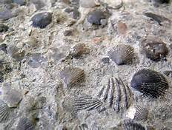
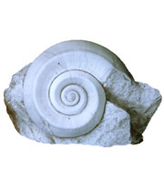
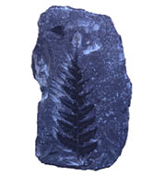
LIVING RELATIVES AND ADAPTATIONS
Appearance:
Some fossils look like living organisms.
Some fossils are ancestors of living organisms.
Structure:
Thin-shelled fossils more often live in deep water; thick-shelled fossils are more common in shallow water.

Slide 7
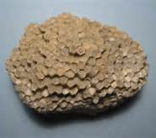
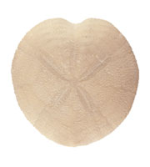
LIVING RELATIVES AND ADAPTATIONS
Structure:
Corals are typically grow in shallow water.
Adaptations:
Algae or seaweed would be found in shallow water rocks, because they are photosynthetic and need sunlight to grow.

Slide 8
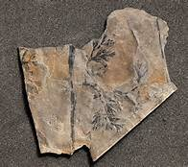
CLUES FROM PLANTS
Usually found on land.
Pollen:
Abundance – lots? Little?
Ratio of pollen types
Similar structures and adaptations:
Wet regions – large leaves
Dry areas – small leaves

Slide 9
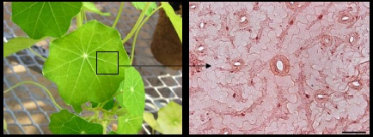
CLUES FROM PLANTS
Similar structures and adaptations:
Pine needles - shape and coating reduces evaporation.
Thick coating on leaves (cuticle) protects against water loss .
Plants in very windy conditions have a high density of pores (stomata), but are pores are small.

Slide 10
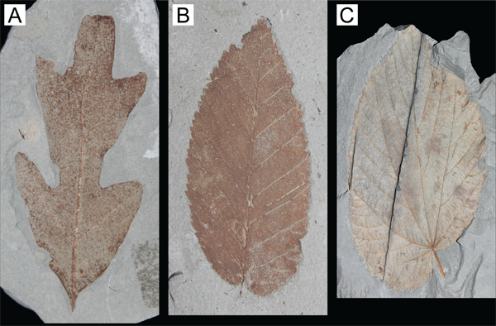
LEAF MARGIN ANALYSIS
A way of telling average temperature by looking at the shape of leaves:
Warm tropical areas have a higher PERCENT of plants with smooth edges.
Cooler environments have a higher PERCENT of plants with leaves with more toothed edges.

Slide 11
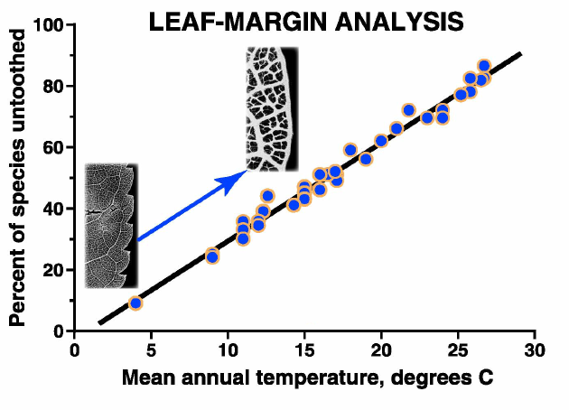
LEAF MARGIN ANALYSIS
Why?
Toothed edges (margins) increases surface area, allows for more transpiration and greater photosynthesis.
  Colder climates have shorter growing seasons – need greater ability.
  Warmer climates – same structures lead to dehydration, need less ability.

Slide 12
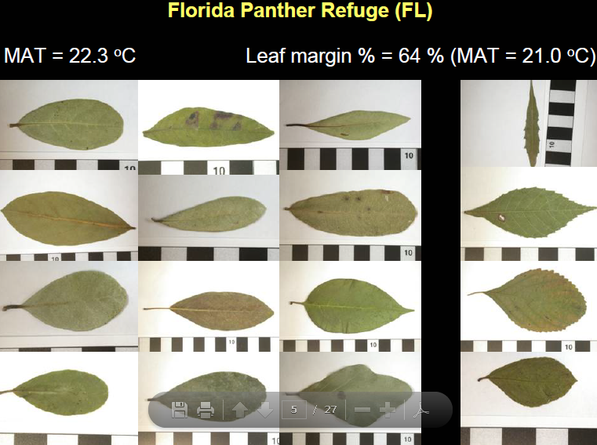
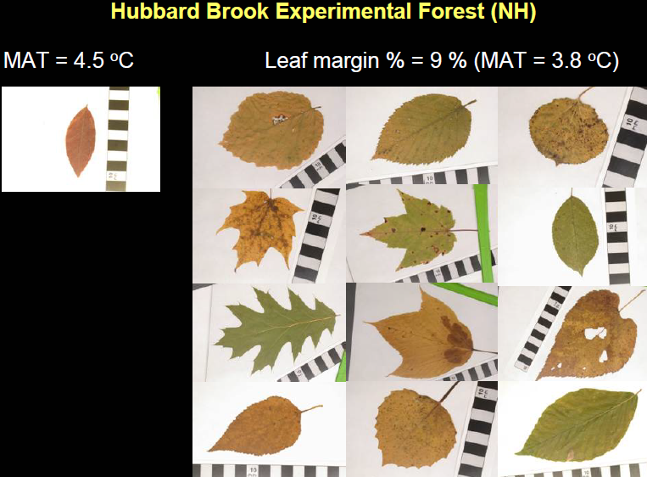
COMPARISON
Greater percentage of smooth leaves = warmer temperatures

Slide 13
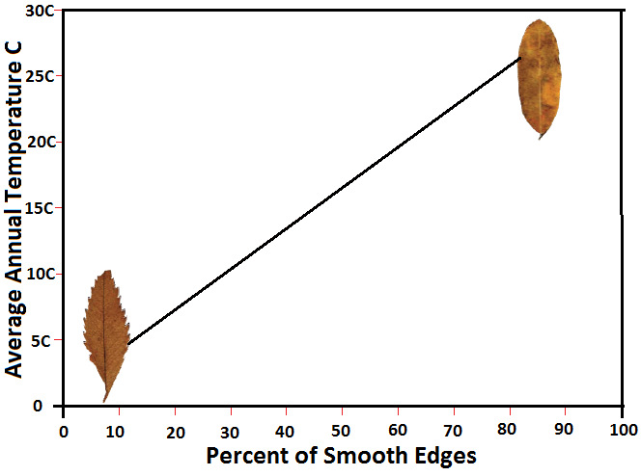
REVIEW
If 25% of all fossil leaves found in an area are smooth and 75% are toothed, the past climate was most likely about:
5°C
10°C
15°C
20°C

Slide 14
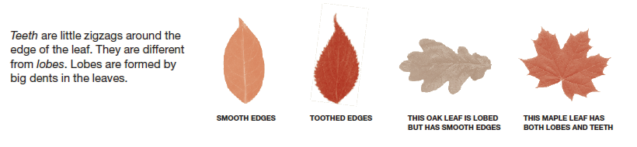

Activity:
Leaf Margin Analysis – Site A & B
Determine average temperature for each site
Compare results

