Slide 1
DO NOW
Pick up notes and Review #11.
Turn IN Review #10.
Turn in “Examining a Cross Section” is you have completed it.

Slide 2
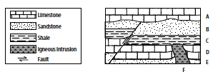
REVIEW
List events A – F in the order in which they occurred, first to last.
Between which events did the faulting occur?

Slide 3
GEOLOGIC MAPS
SES4d: Explain how sedimentary rock units are correlated within and across regions by a variety of methods (e.g., geologic map relationships, etc.).

Slide 4
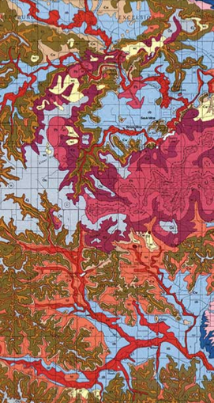
WHAT ARE GEOLOGIC MAPS?
Geologic maps:
Provide information about the rocks that are on or near the earth’s surface.
Help to explain the series of geologic events.
Used to understand and interpret geologic history.

Slide 5
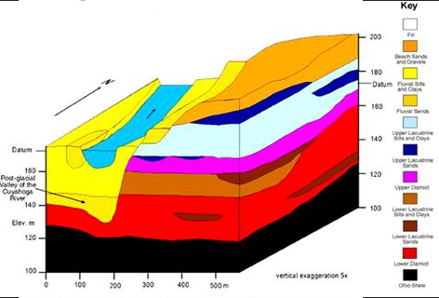
Maps That Show the Top Layer of Geologic Columns

Slide 6
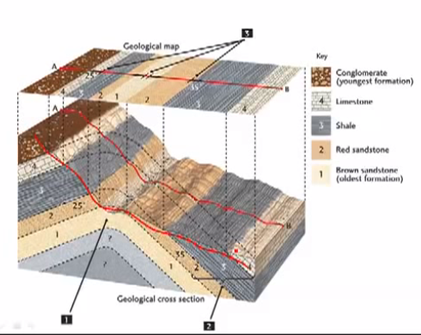
2-D VIEW OF A 3-D SURFACE

Slide 7
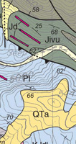
WHO USES THEM?
Used by:
Geologists
Engineers
Planners
Mineral Industry
Construction Companies
County
Local Governments
Land owners
Used for:
Mineral Resources
Water supply
Construction siting
Utility routing
Waste disposal

Slide 8
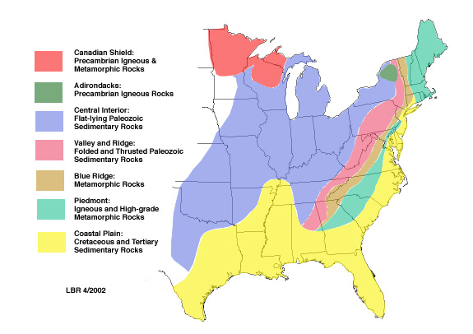
WHAT DO YOU SEE?

Slide 9
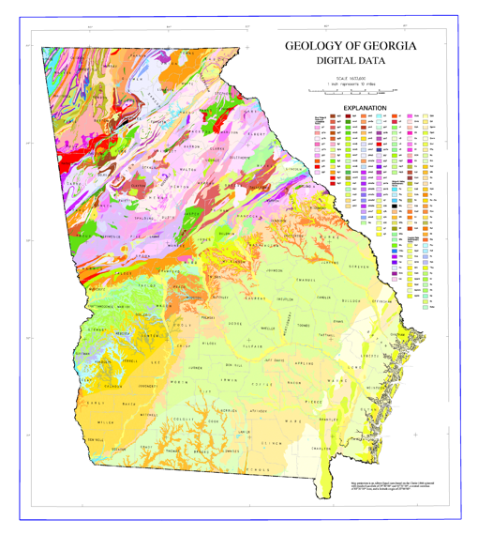
WHAT DO YOU SEE?

Slide 10
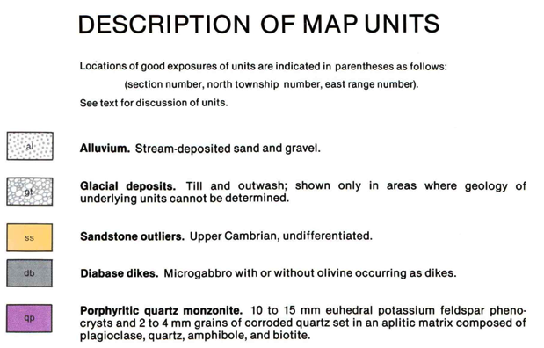
WHAT THE COLORS MEAN
Colors often show rock type and geologic time.

Slide 11
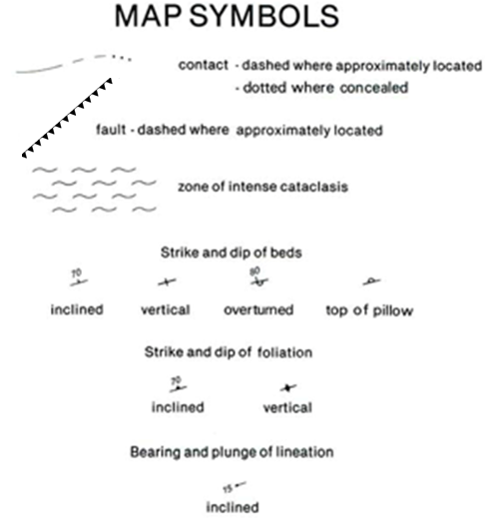
MAP SYMBOLS
Symbols often show faults, folds and inclines.

Slide 12
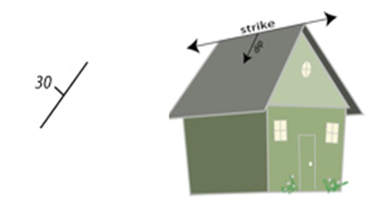
STRIKE AND DIP
Strike and dip symbols show the orientation of rocks and fault planes.
The strike, the long line, shows the direction the rocks point.
The dip, designated by the short line and number, indicates the direction and angle that the rocks are tilted (90 degrees would mean that the rocks are completely vertical).

Slide 13
STRIKE AND DIP
Another way of remembering strike and dip is to think of the roof of a house.
“Strike” is the direction the ridge of the house points, while “dip” measures the slope of the roof.

Slide 14
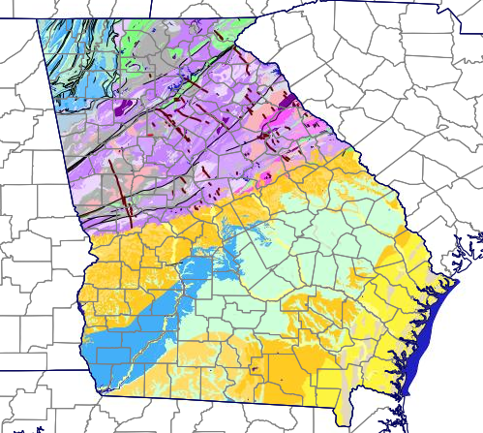
GEORGIA
Explore the USGS Geologic Map of Georgia

Slide 15
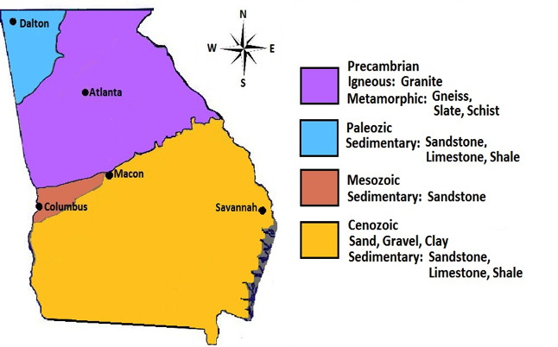
COMPLICATED?
LET’S SIMPLIFY IT!

Slide 16
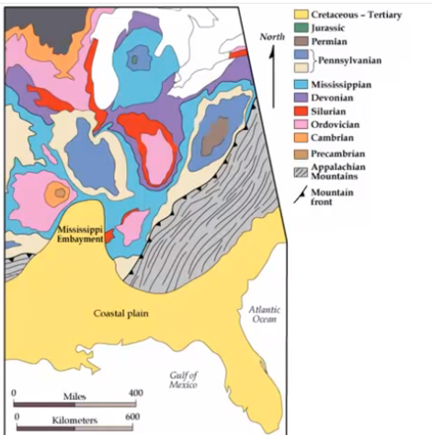
GEOLOGIC STRUCTURES:
HOW CAN YOU TELL?
VIDEO LINK

Slide 17
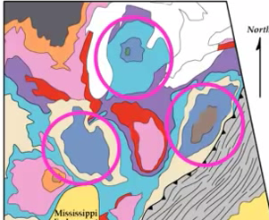
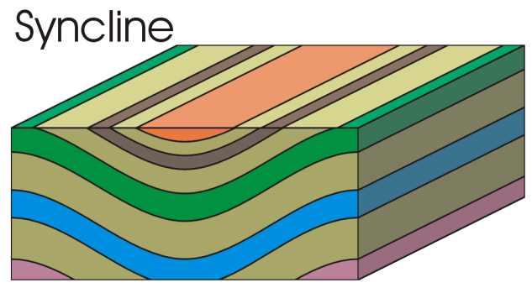
GEOLOGIC STRUCTURES:
HOW CAN YOU TELL
Syncline: a fold of rock layers that slopes upward on both sides of a common low point;
if it is circular, it is called a basin.
Younger rock in middle.

Slide 18
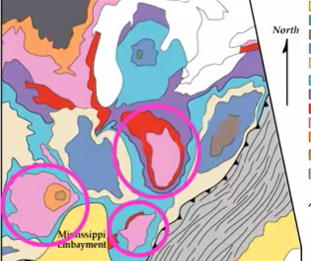
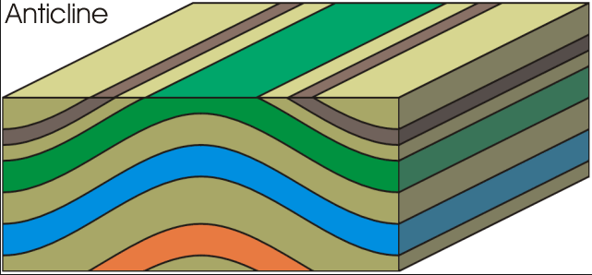
GEOLOGIC STRUCTURES:
HOW CAN YOU TELL
Anticline: a formation of stratified rock raised up, by folding into a broad arch so the layers slope down on both sides of a common crest;
if it is circular, it forms a dome.
Older rock in the middle.

Slide 19
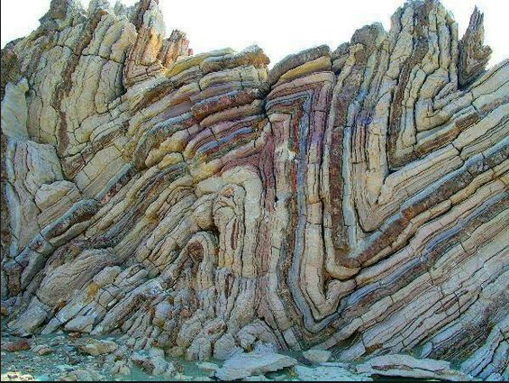
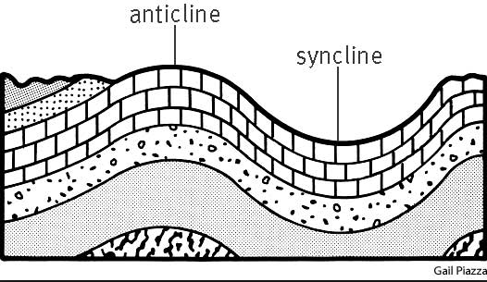
GEOLOGIC STRUCTURES:
HOW CAN YOU TELL

Slide 20
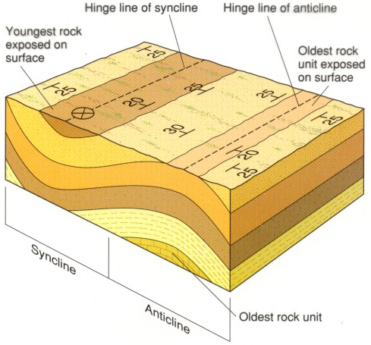
WHAT DOES THE MAP SHOW?

Slide 21
REVIEW
The Geologic Map of Georgia shows older rock in the middle section surrounded by younger rock on both sides. This is evidence of:
A Dome
Uplifting
Subsidence
A Basin

Slide 22
TO DO
Do Reading a Geologic Map – with your lab partner. Turn in ONE copy.
Work on Review #11.
Complete How do they Stack Up lab.
Complete Unconformities practice handout.

Slide 23
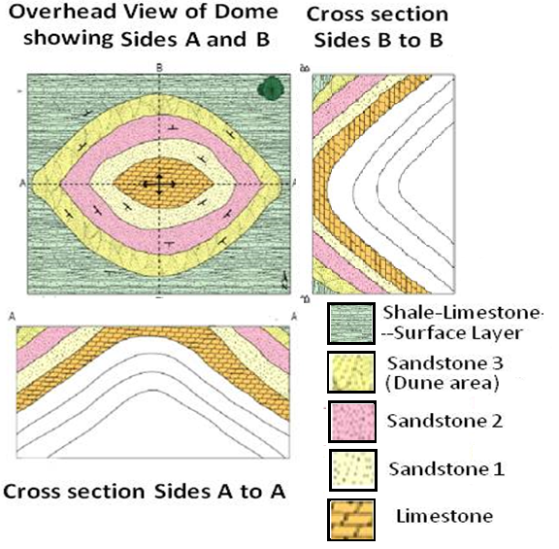
READING
MORE ROCKS
Which is the oldest rock layer?
How can you tell?
How do you know it is a dome in the center and not a basin?
TEST QUESTIONS COME FROM HERE!

Slide 24
WHAT DID THEY TELL YOU?
Which is the oldest rock layer: The limestone
How can you tell: the cross section shows it on the bottom
How do you know it is a dome in the center and not a basin: younger rock on both sides, older in the middle

Slide 25
READING
MORE ROCKS
Why do you think there are two different sandstones shown? How would you know the difference?
What would the presence of fossils tell you in each layer?
Why are the layers sloped?
How were they originally deposited?

Slide 26
WHAT DID THEY TELL YOU?
Why do you think there are two different sandstones shown: different parent rock, different fossils – may be from different geologic periods
How would you know the difference: fossils
What would the presence of fossils tell you in each layer: more about the climate
Why are the layers sloped: Uplifting
How were they originally deposited: Horizontally – Law of Original Horizontality

Slide 27
Reading
Some Rocks
Which is the oldest rock layer?
How can you tell?
How do you know it is a dome in the center and not a basin?
TEST QUESTIONS COME FROM HERE!

Slide 28
Reading
Some Rocks
Why do you think there are two different sandstones shown? How would you know the difference?
What would the presence of fossils tell you in each layer?
Why are the layers sloped?
How were they originally deposited?

