Slide 1
Do now
Pick up notes.
Get out Changes of State homework.
Chillin’Out lab is due tomorrow.

Slide 2
Phase changes
Two Ways to Show Them:
1. Heating Curve
2. Phase Diagram

Slide 3
PHASE CHANGES
A HEATING CURVE shows how temperature and energy are related.
A PHASE DIAGRAM shows how temperature and pressure are related.

Slide 4
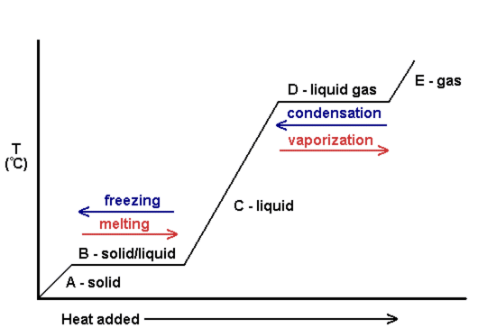
HEATING CURVE
A graph of temperature and energy
Depicts four phase changes – melting, freezing, vaporization, and condensation.

Slide 5
HEATING CURVE
As heat is supplied, the heat increases the Kinetic Energy of the molecules.
When the substance reaches the melting point, all heat being supplied is used to change the phase (potential energy change). Temperature will not change until the phase is complete.

Slide 6
HEATING CURVE
C. When the phase change is complete, heat again raises the kinetic energy of the molecules, temperature changes and increases to the boiling point.
D. All heat is used the change the phase. Same as B.
E. The phase is changing temperature. Same as A and C.

Slide 7
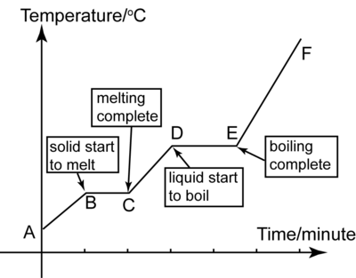
Heating curve

Slide 8
Heating curve
Diagonal: phase is warming or cooling
Plateau: all heat energy is being used the change the phase; to weaken the IMFs.
THERE IS NO TEMPERATURE CHANGE DURING A PHASE CHANGE.

Slide 9
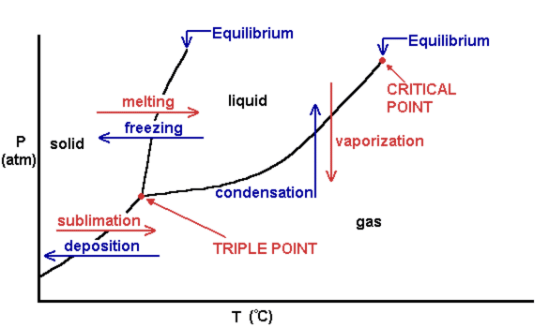
PHASE DIAGRAM
A graph of temperature and pressure.
Depicts six phase changes – melting, freezing, vaporization, condensation, deposition, and sublimation.
Phase diagram for a substance other than water.

Slide 10
PHASE DIAGRAM
Triple Point - all three phases are at equilibrium
T_{m} - normal melting / freezing point at STP
T_{b} - normal boiling point at STP
STP stands for Standard Temperature and Pressure.

Slide 11
PHASE DIAGRAM
Critical Point – the highest temperature for a vapor and liquid at equilibrium; the intersection of critical pressure (D) and critical temperature. At the critical point, particles of water in the gas phase are moving very, very rapidly. At any temperature higher than that, the gas phase cannot be made to liquefy, no matter how much pressure is applied to the gas.
Solid lines are the equilibrium lines between phases. Both phases can exist on the lines.

Slide 12
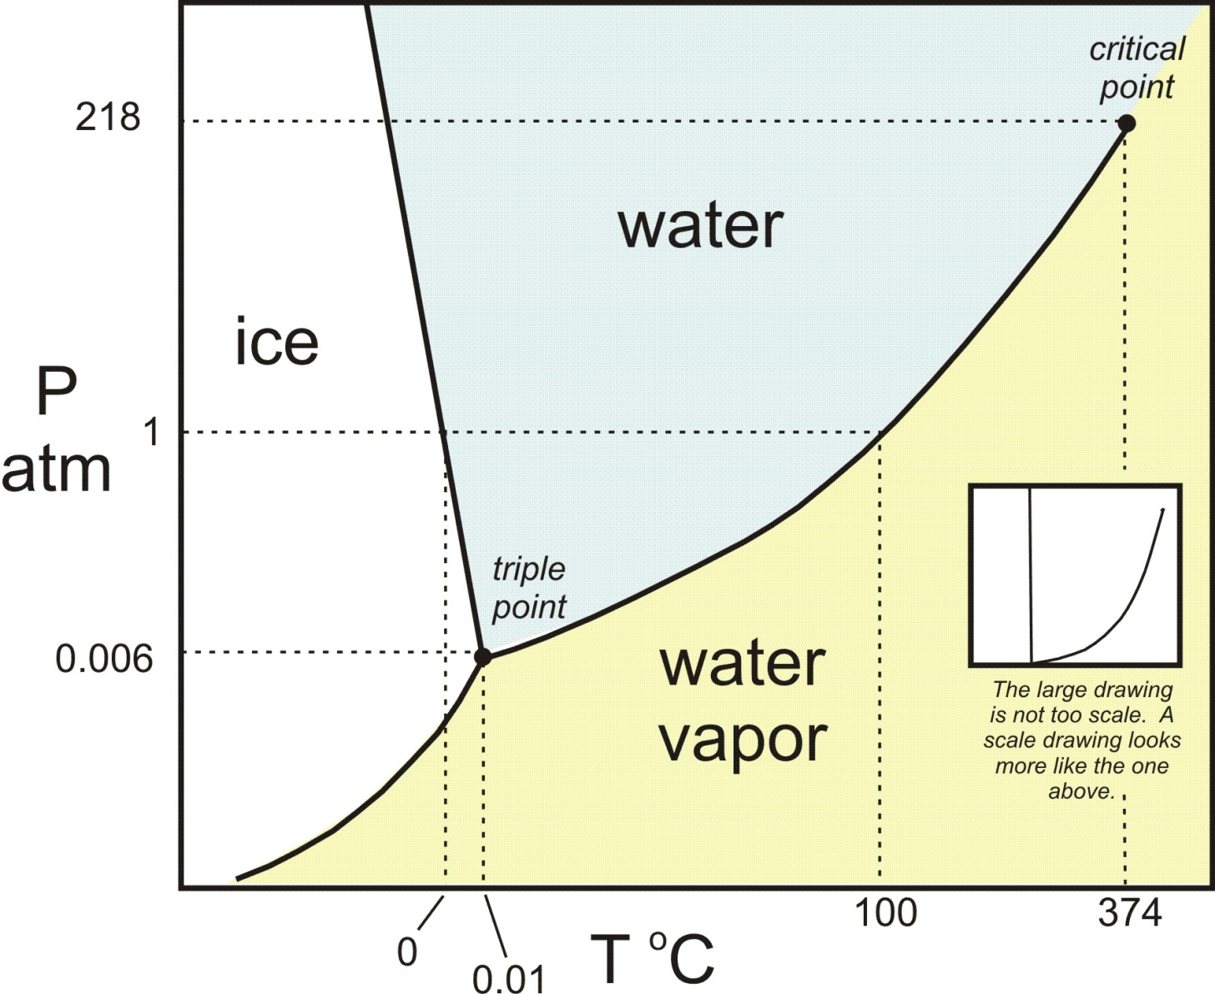
Phase diagram
Note: The vapor pressure of water ice never rises about 0.006 atm (0.61 kPa).
Above the critical point (critical temperature), there is no distinction between a liquid and a gas.

Slide 13
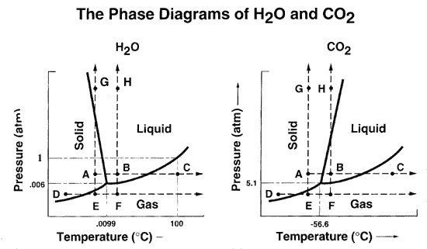
Phase diagrams

Slide 14
PHASE diagram vs. heating curve
Phase diagram
Heating curve
Pressure – y axis
Temperature – x axis
Shows all 6 phase changes
Shows equilibrium temperatures and pressures for all phase changes
Temperature – y axis
Heat over time – x axis
Shows only 4 phase changes
Shows plateaus for the phase changes and diagonals for the changes in temperature.

Slide 15
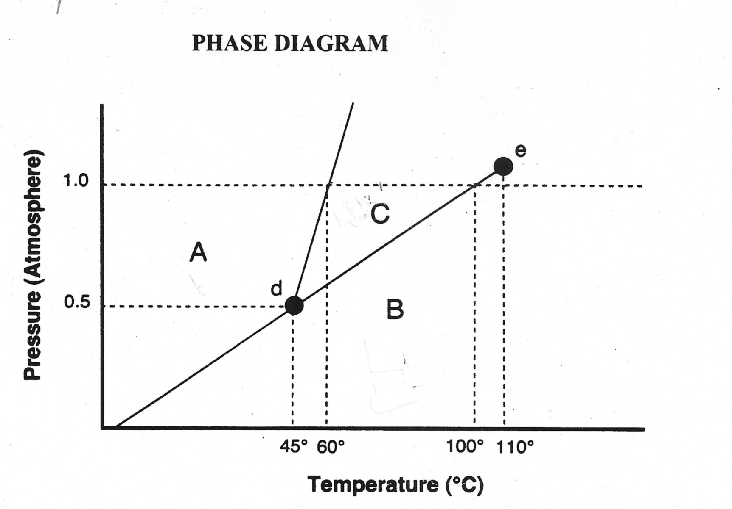
Phase diagram questions

Slide 16
TO DO
Work on Phase Diagram and heating Curve handout – due tomorrow.
Work on Chillin’ Out lab – due tomorrow.

