Slide 1
DO NOW
Pick up notes.
Get out homework, calculator, and green periodic table.

Slide 2
WHITEBOARD
With your lab partner, get a whiteboard and a marker and do the problem from Mole City, Part One that matches your lab desk. Group #11 does #1 and Group #12 does #2.
Return to your seat when you are finished.

Slide 3
MASS AND MOLE AND PARTICLE
1 mole 1 mole
PARTICLES MOLE MASS
(atoms or 6.02 x 10²³ molar molecules mass (from
or ions, or periodic table)
formula units

Slide 4
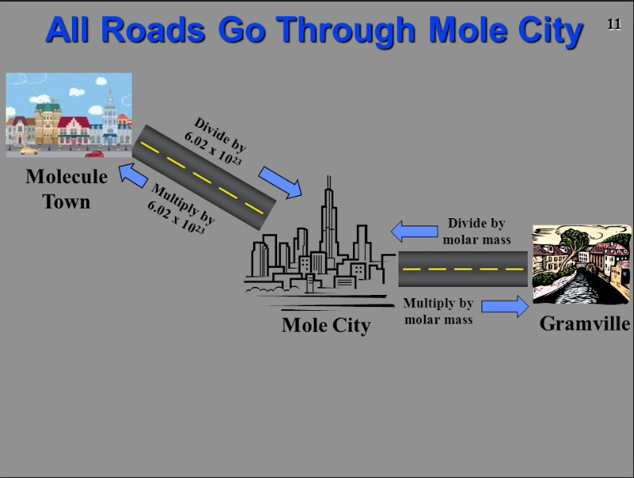
MOLE CITY

Slide 5
practice
A. Determine the number of atoms in 16.0 g of sulfur.
?? atoms
= 16.0 g S 1 mol S 6.02x10²³ atoms S 32.06 g S 1 mol S
= atoms S

Slide 6
practice
B. Calculate the number of formula units in 80.0 grams of calcium chloride.

Slide 7
PRACTICE
C. Calculate the mass in grams in 2.33 x 10¹⁷ atoms of lead, Pb.

Slide 8
PRACTICE
D. Calculate the mass in grams of 4.8 x 10²⁵ molecules H₂.

Slide 9
TO DO
Work on Mole City Part Two handout due tomorrow.

