Slide 1
DO NOW
Pick up notes and Review #24.
Turn in Review #23.

Slide 2
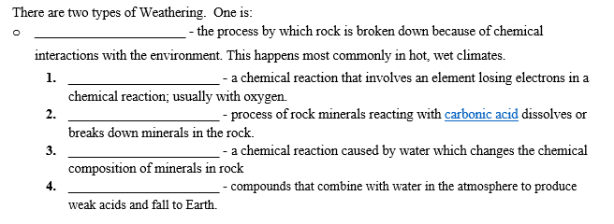
REVIEW #22

Slide 3
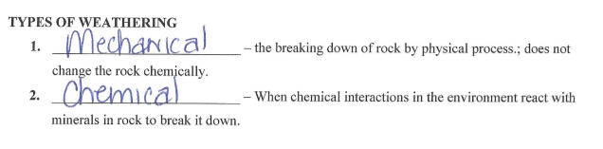


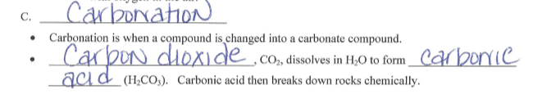

REVIEW #22

Slide 4
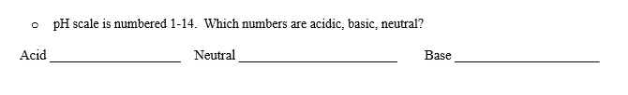
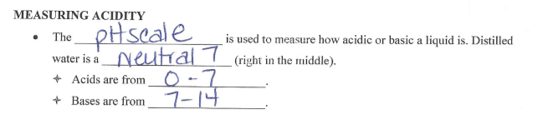
REVIEW #22

Slide 5
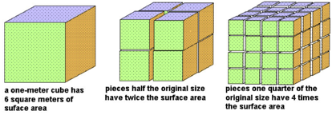
REVIEW
How does surface area affect weathering?
WHY?
It increases it.
More surface area give more places to weather.

Slide 6
SOIL
SES3: Students will explore the actions of water, wind, ice, and gravity that create landforms and systems of landforms.
b. Explain how soil results from weathering and biological processes acting on parent rock.

Slide 7
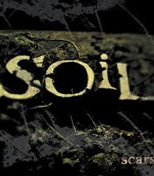
WEATHERED ROCK BECOMES SOIL
Sediment from weathered rock mixes with water, air and organic material to form soil.
Soil: A mixture of minerals, water, gases, and remains of dead organisms

Slide 8
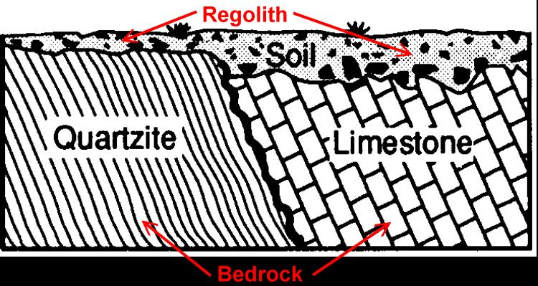
JUST THE ROCK PART….
Regolith:
Layer of weathered rock fragments.
Result of weathering

Slide 9
JUST THE ROCK PART….
  Bedrock:
  Solid un-weathered rock that lies beneath soil and regolith.

Slide 10
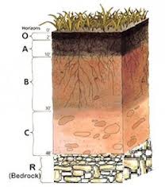
SOIL PROFILE
Horizons – layers of soil
  O Horizon – includes humus – dark, organic material from decayed remains plants/animals - is not always present in soil.
  A Horizon – topsoil – mixture of organic materials, living organisms and small rock particles – source of leached materials.

Slide 11
SOIL PROFILE
Horizons – layers of soil
  B Horizon – subsoil – minerals leached from topsoil, clay, some humus – larger rock particles with organic matter and inorganic compounds.
  C Horizon – Weathered bedrock .
  Bedrock - at the bottom

Slide 12
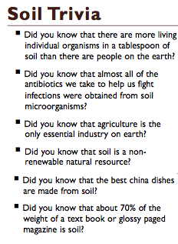
IMPORTANCE OF SOIL
Soil’s importance:
Provides ecosystem services critical for life.
Provides nutrients for crops and vegetation.
Acts as a water filter and a growing medium.
Provides a habitat for billions of organisms.

Slide 13
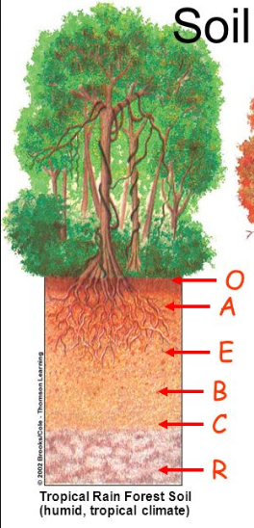
SOIL AND CLIMATE
Tropical Soils
  Heavy rain, chemical weathering causes thick soils to develop rapidly
  A horizon – topsoil thin due to leaching from heavy rain

Slide 14
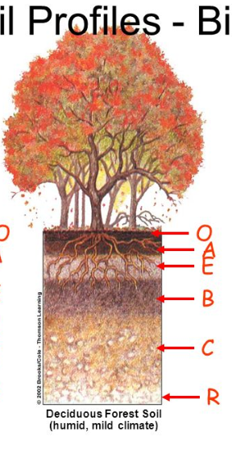
SOIL AND CLIMATE
Temperate Soils
  All horizons thick.
  The deep red color of soils found in Georgia and other warm, humid regions in caused by iron oxides (from chemical weathering - oxidation).

Slide 15
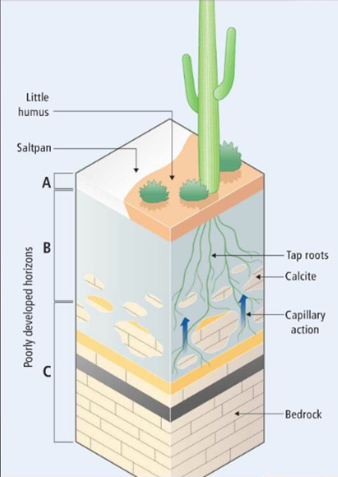
SOIL AND CLIMATE
Desert and Arctic Soils
  Minimal rainfall – slow weathering.
  Soil thin and mostly regolith – less organic matter and humus.

Slide 16
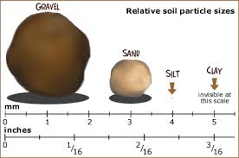
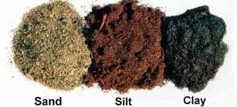
SOIL TYPE AND TEXTURE
Particle sizes:
Clay – diameter < 0.004 mm
Silt – diameter .004 to .06 mm
Sand – diameter .06 to 2 mm
The texture of a soil affects the water infiltration rates and the movement of water through the soil.

Slide 17
SOIL TYPE AND TEXTURE
Soils that are best for gardens and growing plants are loams.
Loams are a fertile soil of clay and sand containing humus.
It has roughly equal parts of sand, silt, and clay.

Slide 18
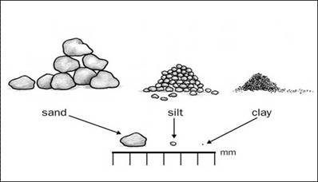
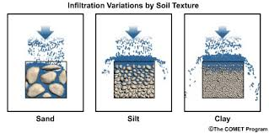
SAND
Largest of the three types of particles.
Between 2 and 0.06 mm.
Feels gritty.
Porous - water runs quickly through sand.
Doesn’t hold nutrients.
Particles do not stick together.
Warms and cools quickly.
Used to make glass.

Slide 19
SILT
Medium sized particles.
Between 0.06 and 0.002 mm.
Feels soapy or silky.
Doesn’t hold easily together.
Holds water better than sand.
Can become difficult to drain.
Holds nutrients.
Makes fertile soil.
Warms and cools slower than sand, but faster than clay.

Slide 20
CLAY
Smallest of the soil particles.
Less than .002 mm.
Feels smooth and sticky when wet when wet.
Very little space between particles - non porous.
Particles stick together easily.
Holds water well that it can easily become waterlogged.
Heats and cools very slowly.
Used to make bricks or pottery.

Slide 21
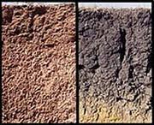
CHARACTERISTICS OF SOIL
  - Depends on parent rock - rock from which the soil was weathered .
  - Parent rock has greatest impact on soil composition.
    Example: Parent rock rich in feldspar or aluminum-rich minerals creates soil with a lot of clay. This is what we have in Georgia.

Slide 22
CHARACTERISTICS OF SOIL
  Soil Composition:
Sandy soils – contain large amounts of quartz.
Color related to composition – can be used as a clue to mineral content .
  Black – rick in organic material.
  Red – from iron-rich parent rocks.

Slide 23
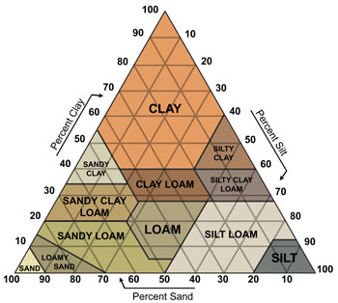
SOIL TEXTURES
Most soils are mixtures.
12 Major soil classes.
Determine soil type using percentages.
Video:
Soil Mixtures

Slide 24
SOIL CLASSIFICATION
Soils found in the Piedmont area of Georgia:
Ultisols: strongly leached, acid forest soils with relatively low native fertility.
2. Inceptisols: relatively new, forest origin and characterized by weak appearance of horizons (From Latin word meaning “beginning”).
3. Alfisols: moderately leached soils that have relatively high fertility.

Slide 25
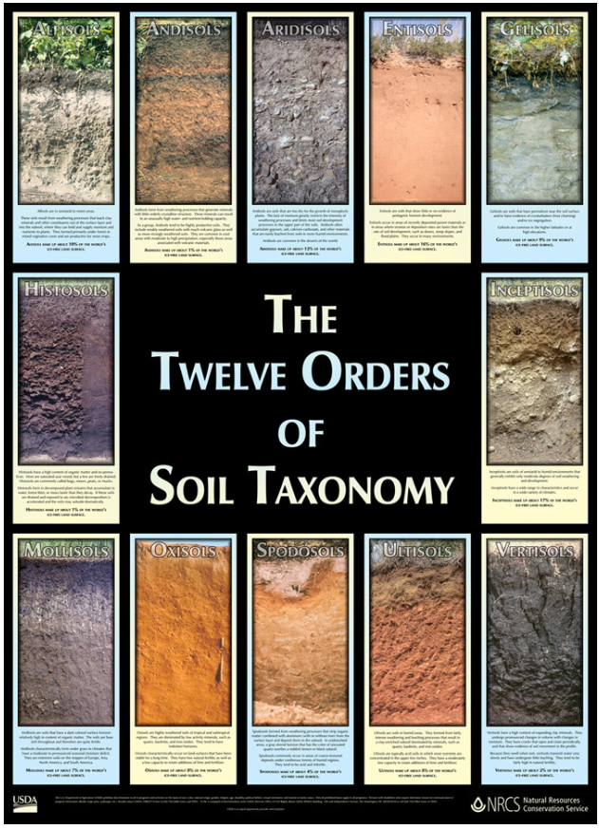

Slide 26
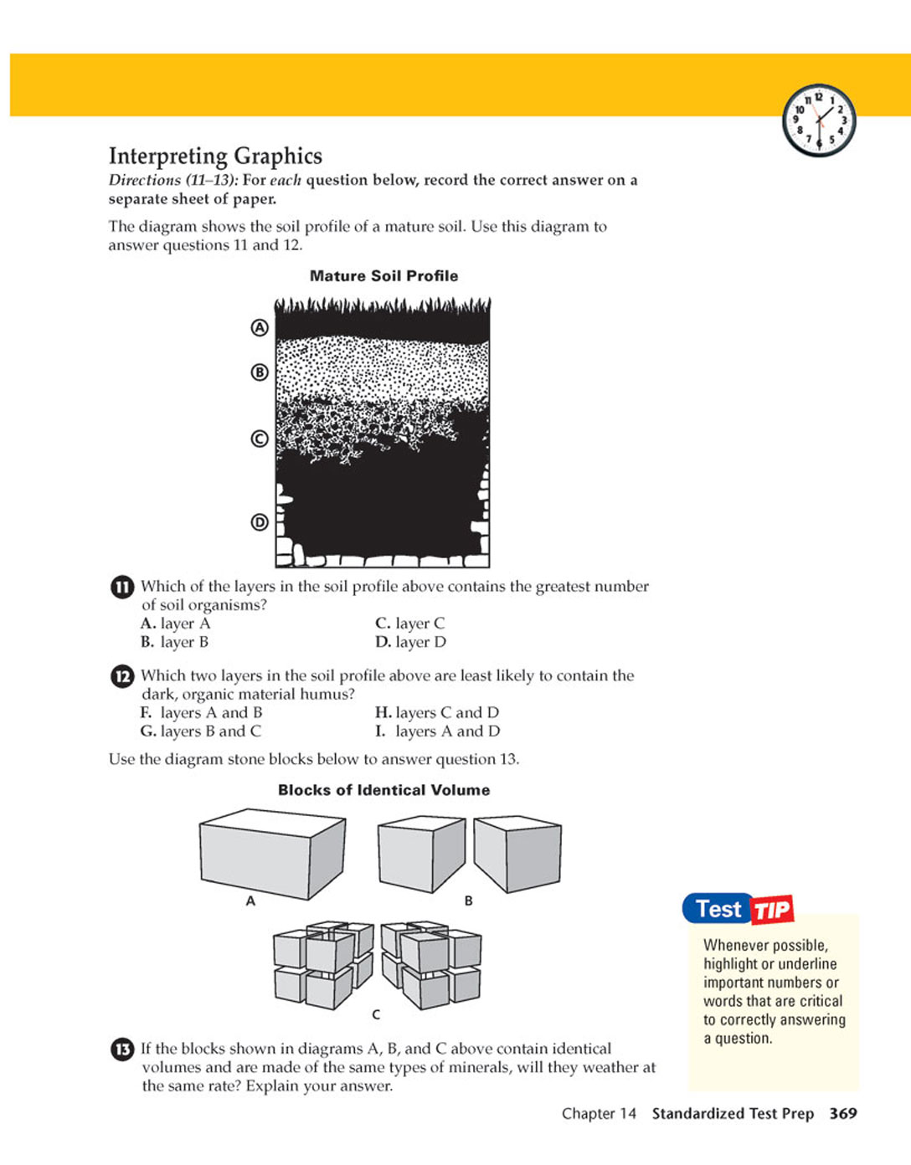
REVIEW
Which layer contains the greatest number of soil organisms ?
A
B
C
D

Slide 27
TO DO
Soil Textures: Practice with Soil Triangle

Slide 28
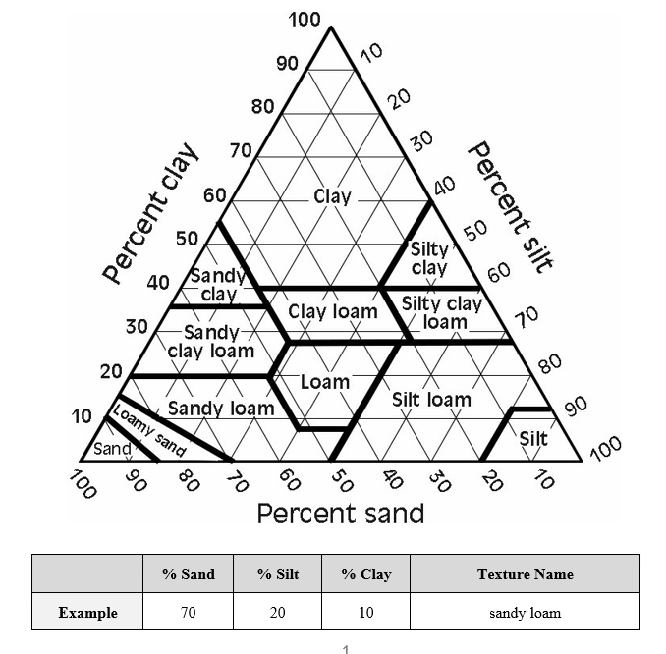

Slide 29
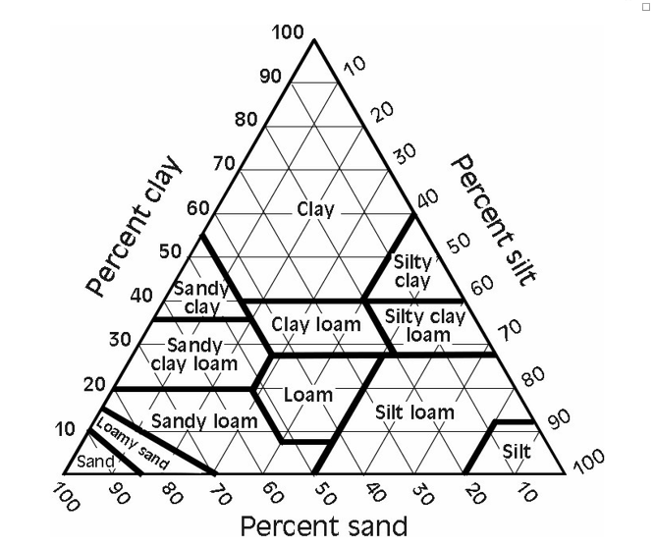
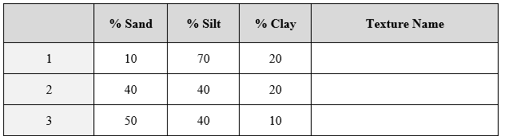

Slide 30
TO DO
Finish Soil Texture handout.
Work on Review #24

