Slide 1
DO NOW
Pick up handout.
Get out Concept Review handout.

Slide 2
Types of Chemical Reactions
There are five basic types of chemical reactions.
Not all reactions will take these five forms.
Other classes of reactions can include.
  net ionic
  oxidation-reduction
  neutralization

Slide 3
SYNTHESIS Reaction
sometimes called Combination
two or more simple substances combine to form a new, more complex substance.
What to look for: one product
Examples: 2 Mg _{(s)} + O_{2 (g)} → 2 MgO _{(s)}
4 Fe _{(s)} + 3 O_{2 (g)} → 2 Fe₂O_{3 (s)}
metal corrosion due to oxidation

Slide 4
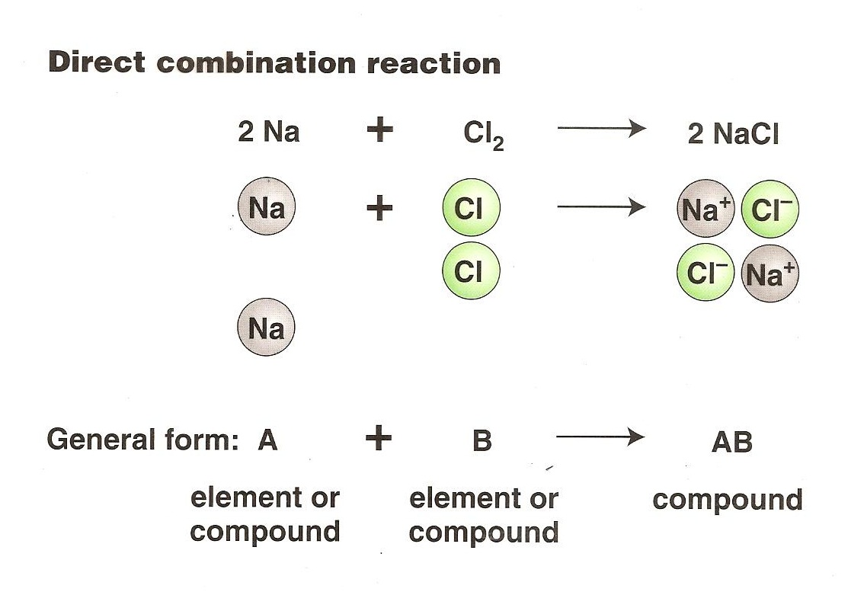
SYNTHESIS Reaction

Slide 5
DECOMPOSITION Reaction
a complex substance breaks down into two or more simpler substances.
What to look for: one reactant
H₂SO₄
Ex. H₂CO_{3(aq)} H₂O_{(l)} + CO_{2(g)}
carbonic acid → water and carbon dioxide
2H₂O_{2(aq)} 2H₂O_{(l)} + O₂
hydrogen peroxide → water and oxygen gas
I⁻

Slide 6
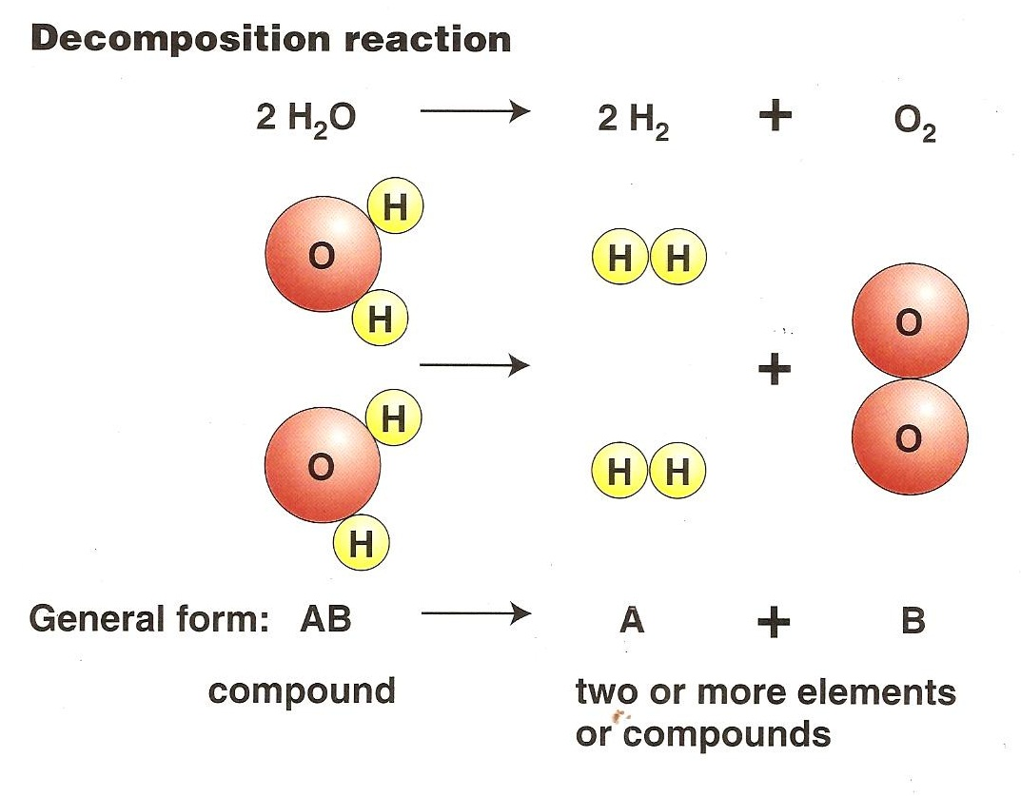
DECOMPOSITION Reaction

Slide 7
COMBUSTION reaction
When compounds react with oxygen.
What to look for: a compound and oxygen which should yield two compounds, usually carbon dioxide and water.
Example: Hydrocarbon + O₂ → water + carbon dioxide
CH_{4 (g)} + 2O_{2 (g)} → CO_{2 (g)} + 2H₂O _{(g)}

Slide 8
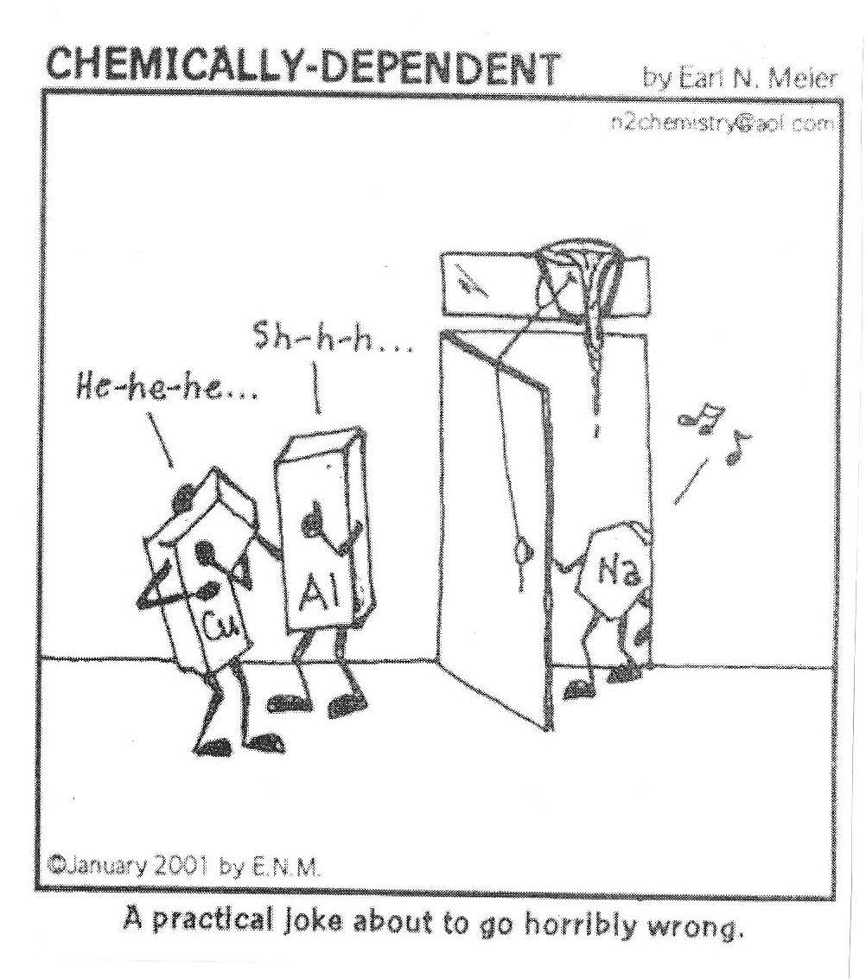

Slide 9
SINGLE REPLACEMENT Rxn
Also called single displacement reaction.
one element replaces another element in a compound.
Use the activity series of metals to determine if the metal can be replaced or not.
What to look for:
uncombined elements on both sides of the arrow

Slide 10
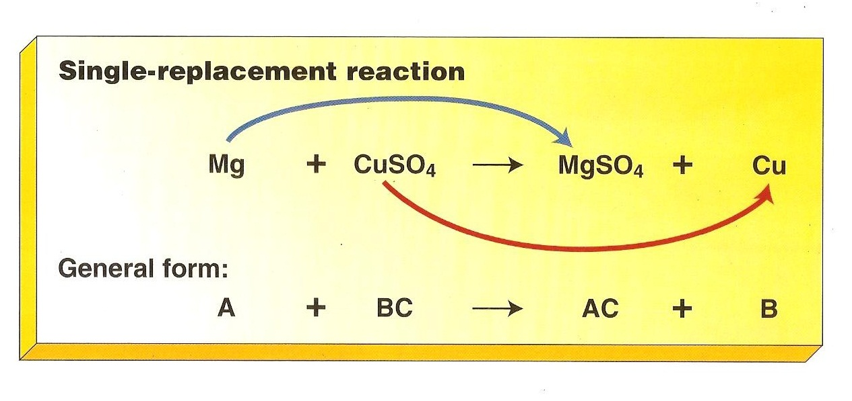
SINGLE REPLACEMENT Rxn

Slide 11
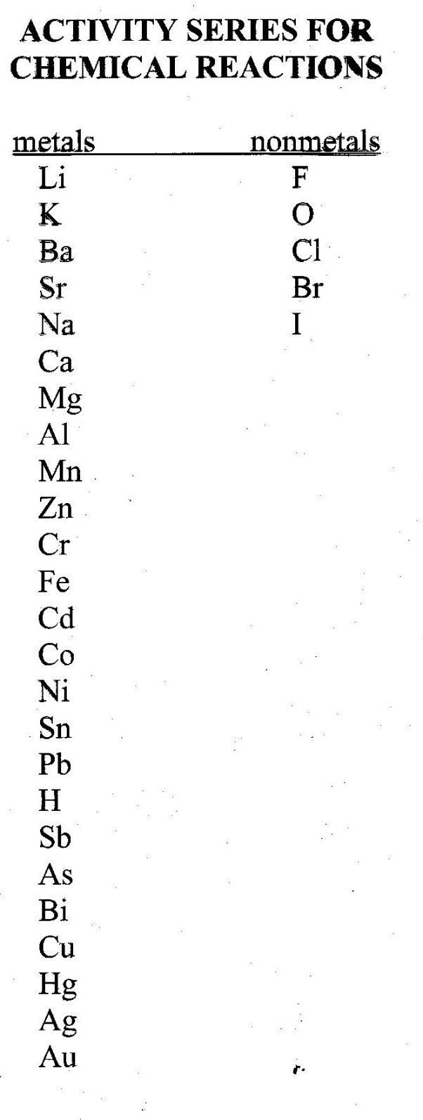
ACTIVITY SERIES

Slide 12
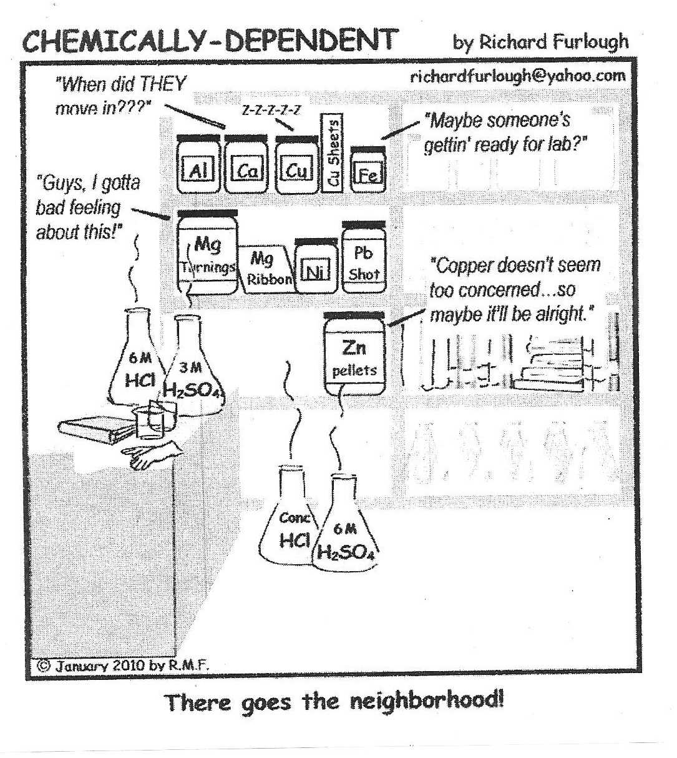

Slide 13
SINGLE REPLACEMENT
A. An active metal will displace the metallic ion in a compound of a less active metal or the hydrogen in water or an acid. Need to look at activity series.
EX. Cu _{(s)} + AgNO_{3 (aq)} → Cu(NO₃) _{2 (aq)} + Ag _{(s)}
EX. 2 Na _{(s)} + 2 H₂O _{(l)} → 2 NaOH _{(aq)} + H_{2 (g)}
EX. Mg _{(s)} + 2 HCl _{(aq)} → MgCl_{2 (aq)} + H_{2 (g)}

Slide 14
SINGLE REPLACEMENT
B. Halogens (active nonmetals) will displace less active halogens. Fluorine is the most reactive, iodine is the least.
EX. Cl_{2 (g)} + 2 NaBr _{(aq)} → 2NaCl _{(aq)} + Br_{2 (g)}

Slide 15
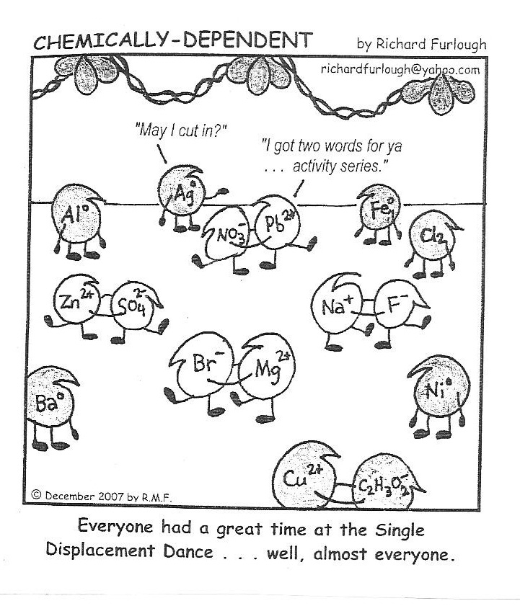

Slide 16
DOUBLE REPLACEMENT Rxn
Also called double displacement reaction
different atoms in two different compounds replace each other.
two compounds react to form two new compounds – either a gas, precipitate, or water
What to look for: two compounds on each side
Ex. HCl _{(aq)} + NaOH _{(aq)} → NaCl _{(aq)} + H₂O _{(l)}
NaCl _{(aq)} + AgNO_{3 (aq)} → 2 NaNO_{3 (aq)} + AgCl _{(s)}

Slide 17
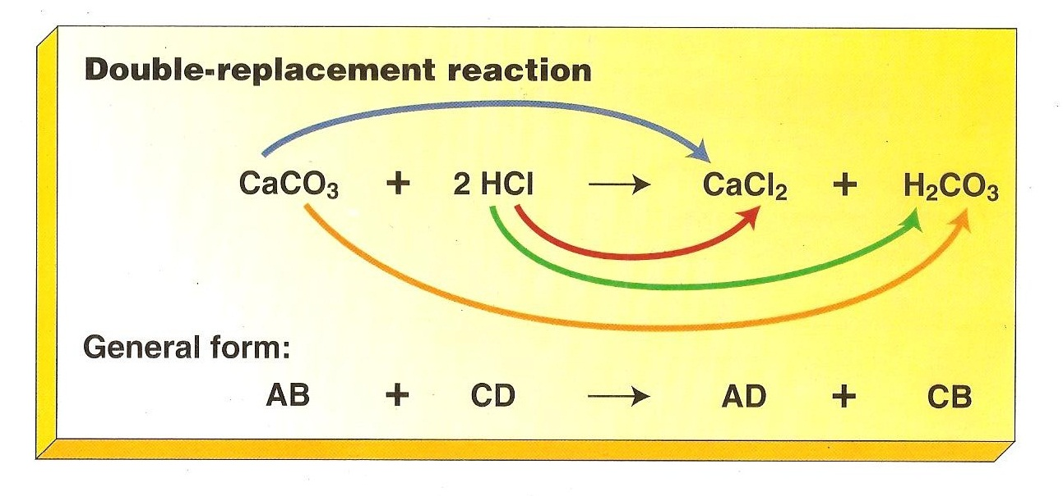
DOUBLE REPLACEMENT Rxn

Slide 18
PRACTICE
1. Br₂ + NaI → NaBr + I₂
2. SO₃ + H₂O → H₂SO₄
3. Zn + HCl → ZnCl₂ + H₂
4. Ga₂O₃ → Ga + O₂
5. H₂O₂ → H₂O + O₂
6. Ba(NO₃) ₂ + Na₂SO₄ → BaSO₄ + NaNO₃
7. P₂O₅ + BaO → Ba₃(PO₄) ₂
8. C₄H₈ + O₂ → CO₂ + H₂O
9. PdCl₂ + HNO₃ → Pd(NO₃)₂ + HCl
10. C₂H₆ + O₂ → CO₂ + H₂O

Slide 19
PRACTICE ANSWERS
1. Single replacement Br₂ + NaI → NaBr + I₂
2. Synthesis SO₃ + H₂O → H₂SO₄
3. Single replacement Zn + HCl → ZnCl₂ + H₂
4. Decomposition Ga₂O₃ → Ga + O₂
5. Decomposition H₂O₂ → H₂O + O₂
6. Double replacement Ba(NO₃) ₂ + Na₂SO₄ → BaSO₄ + NaNO₃
7. Synthesis P₂O₅ + BaO → Ba₃(PO₄) ₂
8. Combustion C₄H₈ + O₂ → CO₂ + H₂O
9. Double replacement PdCl₂ + HNO₃ → Pd(NO₃)₂ + HCl
10. Combustion C₂H₆ + O₂ → CO₂ + H₂O

Slide 20
TO DO
Balancing and Classifying Chemical Equations – due tomorrow.

