Slide 1
DO NOW
Pick up notes.
Get out Molarity/Molality handout.

Slide 2
COLLIGATIVE PROPERTIES
“colligative” – depending upon the collection
These are properties that depend on the concentration (the number of) of the solute particles. They are independent of the type of solute particle.
Three Factors:
Vapor pressure reduction
Boiling Point Elevation
Freezing Point Depression

Slide 3
VIDEO
Colligative Properties
Support one of the following hypotheses about why it helps to add salt to the water before cooking the pasta: a) The salt brings the water to a boil sooner; or b) The salt brings the water to a boil at a higher temperature.
Which antifreeze solution boils at the highest temperature? Which solution would you want in your car on a hot summer day? Explain your reasoning.
On cold winter days, unprotected radiator water can freeze and expand, which can ruin an engine by cracking the engine block. Which antifreeze mixture would you want in your car on a cold winter day?

Slide 4
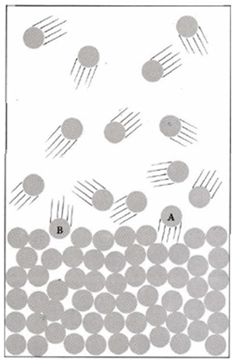
VAPOR PRESSURE: A REVIEW
A Review:
Vapor pressure arises because some molecules of pure liquid leave the liquid surface and enter the gas phase.
At the same time, condensation occurs.
If the rate of condensation and the rate of vaporization are equal, then the system is in equilibrium.
The gas pressure resulting from the vapor molecules over the liquid is VAPOR PRESSURE.

Slide 5
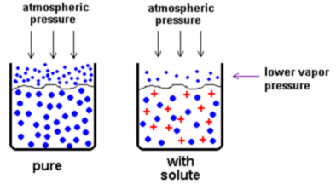
VAPOR PRESSURE REDUCTION

Slide 6
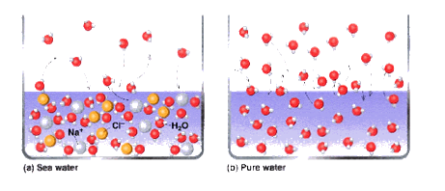
VAPOR PRESSURE REDUCTION

Slide 7
VAPOR PRESSURE REDUCTION
The vapor pressure of a solvent containing a non-volatile solute is LOWER than the vapor pressure of the pure solvent. It is NOT dependent upon the type (identity) of the solute.
WHY: The solute takes up space at the surface of the liquid and prevents some solvent molecules from evaporating. Now, more molecules leave the gas phase than enter it and therefore, the vapor pressure is lower.

Slide 8
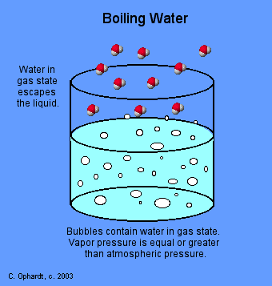
BOILING POINT REVIEW
A REVIEW:
The boiling point of a substance is the temperature at which the vapor pressure of a liquid is equal to the external pressure on its surface (usually atmospheric pressure).

Slide 9
BOILING POINT ELEVATION
A solution has a higher boiling point than the pure solvent.
WHY: An addition of solute lowers that vapor pressure, therefore a higher temperature is necessary to get the vapor pressure up to the external (atmospheric) pressure so that the solution will boil.

Slide 10
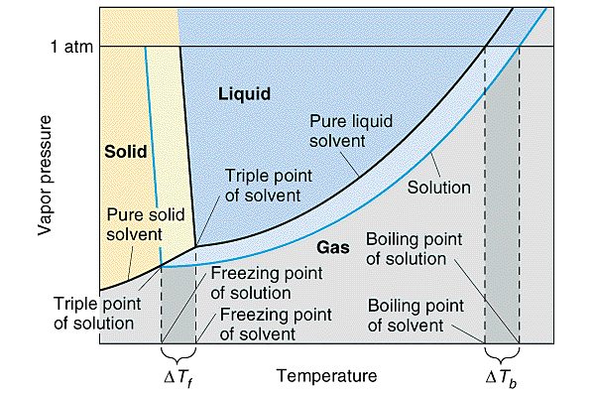

Slide 11
FREEZING POINT: A REVIEW
The freezing point of a substance is the temperature at which the vapor pressure of the solid and liquid phases are the same.

Slide 12
FREEZING POINT ELEVATION
A solution has a lower freezing point than the pure solvent.
WHY: An addition of solute lowers that vapor pressure, therefore a lower temperature is necessary to get the vapor pressure of the liquid to equal the vapor pressure of the solid. When a dissolved solute lowers the freezing point of its solution, you have freezing point depression.

Slide 13
FREEZING POINT DEPRESSION
Club Soda demo
Animation for Freezing Point depression

Slide 15
THE CALCULATION
Dissociation factor molality
ΔT = (K)(df)(m)
constant (molal freezing pt or boiling pt)

Slide 16
THE CALCULATION
∆T is directly proportional to the molality of the solution.
ΔT_{bp} is the difference between the boiling point of the solution and the boiling point of the pure solvent. It is directly proportional to the number of solute particles per mole of solvent particles.
ΔT_{fp} is the difference between the freezing point of the solution and the freezing point of the pure solvent. It is directly proportional to the number of solute particles per mole of solvent particles.

Slide 17

THE CALCULATION
The dissociation factor, df, is how many particles the solute breaks up into.
For a non-ionic compound (nonelectrolyte, organic compound), the df = 1.

Slide 18
CHEMICALS USED TO MELT ICE
Formula | Lowest Temp | Pros | Cons
(NH₄)₂SO₄ | -7.0°C | fertilizer | Damages concrete
CaCl₂ | -29.0°C | Melts ice faster than NaCl | Attracts moisture; surfaces can be slippery
MgCl₂ | -15.0°C | Melts ice faster than NaCl | Attracts moisture
CH₃COOK | -9.0°C | biodegradable | corrosive
KCl | -7.0°C | fertilizer | Damages concrete
NaCl | -9.0°C | Keeps sidewalks dry | Corrosive; damages concrete and vegetation
CMA | -9.0°C | Safest for concrete and vegetation | Works better at preventing re-icing

Slide 19
CALCULATIONS: NON-IONIC
Determine the freezing and boiling point for 85.0g of sugar (C₁₂H₂₂0₁₁) in 392g water.
Need these things:
1. Molality, m – need moles solute and kilograms of solvent
2. Number of particles (should be one)
3. Change in temperature

Slide 20
CALCULATIONS: NON-IONIC
Molality
392 g H₂O 1 kg = 0.392Kg 1000 g
m = 85.0 g C₁₂H₂₂0₁₁ 1 mol C₁₂H₂₂0₁₁ 0.392 Kg H₂O 342.34 g C₁₂H₂₂0₁₁
=
df = 1 (non-ionic solute)

Slide 21
CALCULATIONS: NON-IONIC
Change in Freezing point temperature:
ΔT_{fp} = (K_{fp})(df) (m) = 1.853°C 1 0.633 m m
=
New Freezing Point:
0.00°C –
Freezing point of pure water

Slide 22
CALCULATIONS: NON-IONIC
Change in boiling point temperature:
ΔT_{bp} = (K_{bp})(df) (m) = 0.515°C 1 0.633 m m
=
New Boiling Point:
100.000°C +
Boiling point of pure water

Slide 23
PRACTICE
What is the freezing point for a solution of 210.0g of glycerol dissolved in 350.0g of water? (The molecular mass of glycerol is 92.11 g/mol)
FP = ?
Solute = 210.0g glycerol
Solvent = 350.0g H₂O

Slide 24
PRACTICE
What is the freezing point for a solution of 210.0g of glycerol dissolved in 350.0g of water? (The molecular mass of glycerol is 92.11 g/mol)
1. m = 210.0g gly 1 mole gly 1000g
350.0g H₂O 92.11 g gly 1 kg
= 6.51395 = 6.514m
2. Df = 1
3. ΔT_{f} = (K_{f})(df)(m) = (1.853ºC/m)(1)(6.514m)
= 12.070 = 12.07ºC
New FP = 0.000ºC – 12.07ºC = -12.07ºC

Slide 25
CALCULATIONS: IONIC
Determine the freezing and boiling point for 21.6 g NiSO₄ in 100.0 g water.
Need these things:
1. Molality
2. Number of ions
3. Change in temperature

Slide 26
CALCULATIONS: IONIC
Calculate molality:
100.0g H₂O 1 kg = 0.1000 Kg
1000 g
m = 21.6 g NiSO₄ 1 mol NiSO₄
0.1000 Kg H₂O 154.76 g NiSO₄
=

Slide 27
CALCULATIONS: IONIC
Determine the number of ions:
Substance is NiSO₄
There are two ions, Ni⁺² and SO₄⁻²,
so the df is

Slide 28
CALCULATIONS: IONIC
Calculate the change in temperature and the new freezing point.
ΔT_{fp} = 1.853°C 2 1.40 m = m
0.00°C –

Slide 29
CALCULATIONS: IONIC
ΔT_{bp} = 0.515°C 2 1.40 m =
m
100.00°C +

Slide 30
CALCULATIONS: IONIC
What is the boiling point of a solution containing 34.3 g of Mg(NO₃)₂ dissolved in 0.107 kg of water? (The formula mass of magnesium nitrate is 148.32 g/mol.)
Bp = ?
Solute 34.3g Mg(NO₃)₂
Solvent 0.107kg

Slide 31
CALCULATIONS: IONIC
1. m = 34.3g Mg(NO₃)₂ 1 mole Mg(NO₃)₂
0.107kg 148.32 g Mg(NO₃)₂
= 2.16127796 = 2.16m
2. Df = 3 Mg⁺² NO₃⁻¹ NO₃⁻¹
3. ΔT_{b} = (K_{b})(df)(m) = (0.515ºC/m)(3)(2.16m)
= 3.3372 = 3.34ºC
New BP = 100.0000ºC + 3.34ºC = 103.34ºC

Slide 32
RECAP
A solution reduces the vapor pressure of the pure solvent.
Vapor pressure reduction results in freezing point depression (lowering) and boiling point elevation.
To solve these problems, you need:
  Molality
  Dissociation factor (Number of ions)
  Molal BP/FP constant (given to you)

Slide 33
RECAP
Calculating freezing point change:
Δ T_{fp} = (K_{fp})(df)(m)
Calculating boiling point change:
ΔT_{b} = (K_{b})(df)(m)
Final step is to subtract from true freezing point or add to true boiling point.

Slide 34
DETERMINING MOLAR MASS
Colligative properties provide a useful means to experimentally determine the molar mass (molecular mass in one mole) of an unknown substance.
Steps:
1. Solve for molality.
2. Solve for moles of solute.
3. Solve for molar mass
This is basically going backwards.

Slide 35
DETERMINING MOLAR MASS
A 10.0 g sample of an unknown organic compound is dissolved in 0.100 kg water. The boiling point of the solution is elevated to 0.433ºC above the normal boiling point of water. What is the molar mass?
solute = 10.0g
Solvent = 0.100kg water
ΔT_{bp} = 0.433ºC
df = 1

Slide 36
DETERMINING MOLAR MASS
Step One: determine molality
ΔT_{bp} = K_{bp} df m
m = ΔT_{bp} = 0.433ºC = 0.841 m (mol/kg)
K_{bp} 0.515ºC/m
Assume df = 1 because it is an unknown ORGANIC compound (not ionic).

Slide 37
DETERMINING MOLAR MASS
Step Two: Determine moles of solute
m = mol solute
Kg solvent
mol solute = m x kg solvent
= 0.841 mol/kg x 0.100 kg
= 0.0841 mol

Slide 38
DETERMINING MOLAR MASS
Step Three: Determine Molar Mass
mol solute = mass solute
molar mass solute
molar mass = mass solute = 10.0 g mol solute 0.0841 mol
= 118.90606 = 119 g/mol

Slide 39
DETERMINING MOLAR MASS
PRACTICE:
A solution of 3.39 g of an unknown in 10.00 g of water has a freezing point of –7.31ºC. The solution is a nonelectrolyte. What is the molar mass of the compound? (The molal freezing point constant of water is 1.853°C/m.)
Mass solute = 3.39g
Mass solvent = 10.00g
FP = –7.31ºC
ΔT_{fp} = 7.31ºC
df = 1

Slide 40
DETERMINING MOLAR MASS
PRACTICE:
A solution of 3.39 g of an unknown in 10.00 g of water has a freezing point of –7.31ºC. The solution is a nonelectrolyte. What is the molar mass of the compound? (The molal freezing point constant of water is 1.853°C/m.)
Step One: determine molality
ΔT_{fp} = K_{fp} df m
m = ΔT_{fp} = 7.31ºC = 3.94m
K_{bp} df (1.853ºC/m)(1)

Slide 41
DETERMINING MOLAR MASS
PRACTICE:
A solution of 3.39 g of an unknown in 10.00 g of water has a freezing point of –7.31ºC. The solution is a nonelectrolyte. What is the molar mass of the compound? (The molal freezing point constant of water is 1.853°C/m.)
Step Two: Determine moles of solute
m = mol solute
Kg solvent
mol solute = m x kg solvent
= 3.44 m x 0.01000 kg
= 0.0394 mol

Slide 42
DETERMINING MOLAR MASS
PRACTICE:
A solution of 3.39 g of an unknown in 10.00 g of water has a freezing point of –7.31ºC. The solution is a nonelectrolyte. What is the molar mass of the compound? (The molal freezing point constant of water is 1.853°C/m.)
Step Three: Determine Molar Mass
mol solute = mass solute
molar mass solute
molar mass = mass solute = 3.39g mol solute 0.0394 mol
= 86.040609 = 86.0g/mol

Slide 43
TO DO
Handout due tomorrow.
Solubility of KNO₃ lab due tomorrow.

