Slide 1
DO NOW
Pick up the notes.
Get out yesterday’s notes and turn to Periodic Trends.

Slide 2
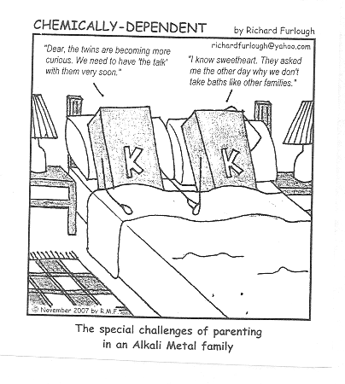
THE ELEMENT FAMILIES

Slide 3
HYDROGEN – a special case
No Family
s¹; +1 or -1 ion; 1 valence electron
Considered a nonmetal;
acts as a metal and a nonmetal;
Not part of group 1
most abundant element in the universe;
flammable

Slide 4
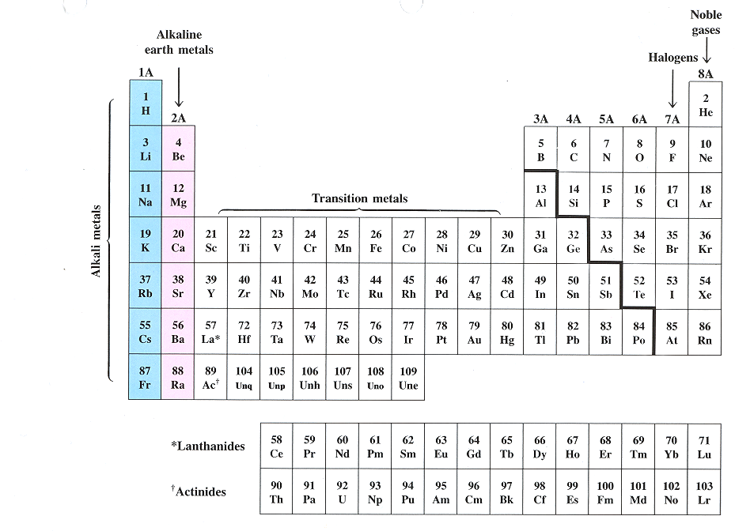
ALKALI METALS – group 1(1A)

Slide 5
ALKALI METALS – group 1(1A)
Early in human history, people discovered that ashes mixed with water produced a slippery solution useful for removing grease.
By the Middle Ages, such mixtures were described as alkaline, a term derived from the Arab word for ashes, al-qali.
Alkaline mixtures found many uses, particularly in the preparation of soaps.
This is why they are called alkali metals.
We now know that alkaline ashes contain compounds of Group 1 elements, most notably potassium carbonate (potash).

Slide 6
ALKALI METALS – group 1(1A)
s¹; form 1+ ions; 1 valence electron;
very reactive, lose their electron more easily as you go down the family. Most reactive is francium;
not found in nature by themselves;
low ionization energy, low electron affinity, low electronegativity;
SODIUM, POTASSIUM important to body functions
LITHIUM is exceptional due to its small size; more like magnesium due to diagonal trend
FRANCIUM – most reactive metal, but extremely rare

Slide 7
ALKALINE EARTH METALS – group 2(2A)

Slide 8
ALKALINE EARTH METALS – group 2(2A)
Elements in group 2 also form alkali solutions when placed in water.
Medieval alchemists noted that certain minerals do not melt or change when put into fire – we know these as group 2 elements.
These fire-resistant substances were known to alchemists as earth. As a holdover from these ancient times, group 2 elements are known as alkaline earth metals.

Slide 9
ALKALINE EARTH METALS – group 2(2A)
s²; forms 2+ ions, 2 valence electrons;
less reactive, but similar to alkali metals;
low ionization energy, low electron affinity, low electronegativity
CALCIUM – 5th most abundant element on earth (lime, calcium chloride, body functions)

Slide 10
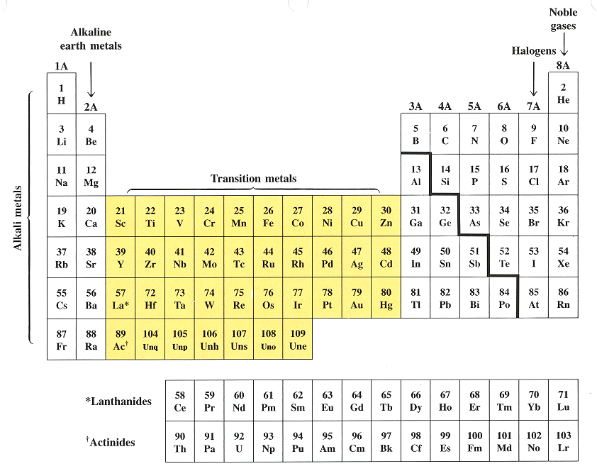
TRANSITION ELEMENTS – groups 3-12 (1B-10B)

Slide 11
TRANSITION ELEMENTS – groups 3-12 (1B-10B)
The elements in groups 3-12 are all metals that do not form alkaline solutions with water.
These metals tend to be harder than alkali metals and less reactive with water.
They are used for structural purposes.
Their name – transition metals – denotes their central position in the periodic table.

Slide 12
TRANSITION ELEMENTS – groups 3-12 (1B-10B)
d block; form positive ions; 2, 3, or 4 valence e-;
They all have properties similar to one another and to other metals: resistant to corrosion, high melting points, brittle
These metals are less reactive than Group 1 or 2, and are harder.
They chemically combine with oxygen to form oxides.
Include IRON (steel), CADMIUM (batteries), COPPER (wiring), COBALT (magnets), SILVER (dental fillings), ZINC (paints), GOLD (jewelry)

Slide 13
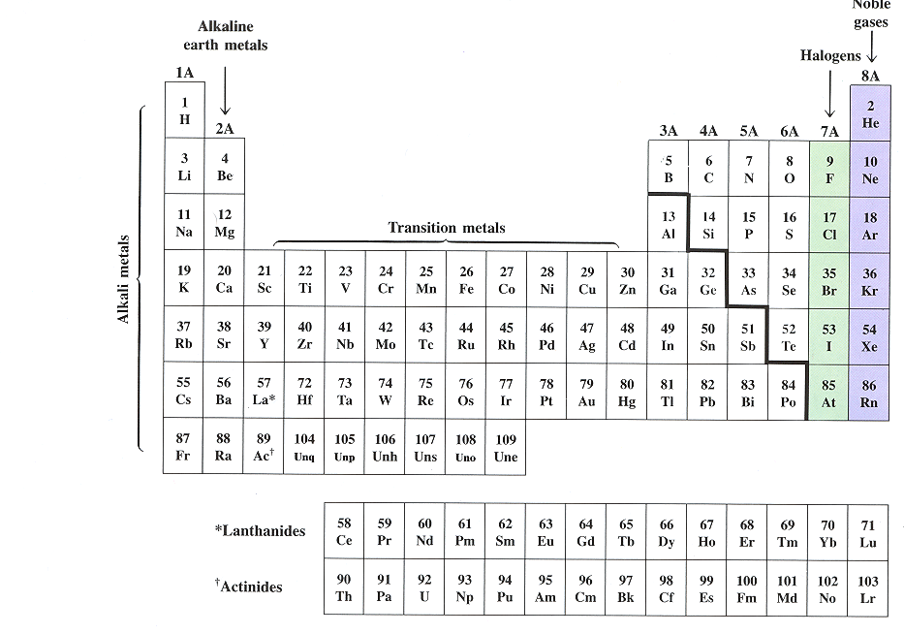
Boron Family – group 13 (3A)

Slide 14
Boron Family – group 13 (3A)
s²p¹; +3 ions; 3 valence electrons
includes a metalloid and metals
BORON – metalloid; more like silicon, then its own family
ALUMINUM – most plentiful metal in the earth's crust, has the most practical uses
GALLIUM – low melting point, component of blue lasers.

Slide 15
CARBON FAMILY – group 14 or 4A

Slide 16
CARBON FAMILY – group 14 or 4A
s²p²; is a 4+ or 2+ ion; 4 valence electrons;
generally react by sharing electrons,
Consists of a nonmetal, metalloids, and metals;
CARBON – most versatile element can form millions of compounds; field of organic chemistry; has several allotropes: graphite, diamond, fullerene, carbon black
SILICON – second most plentiful element in the earth’s crust (quartz); many industrial uses.
LEAD – toxic; used to be in paint, plumbing, gasoline

Slide 17
NITROGEN FAMILY – group 15 (5A) also Pnictogen Family

Slide 18
NITROGEN FAMILY – group 15 (5A)
s²p³; -3 ion; 5 valence electrons;
Consists of nonmetals, metalloids, and a metal.
Sometimes will share its five electrons.
NITROGEN – found in fertilizers, TNT, medicines, proteins
PHOSPHORUS – compounds found in laxatives, cheese, and baking powders

Slide 19
OXYGEN FAMILY – group 16 (6A) – also Chalcogens

Slide 20
OXYGEN FAMILY – group 16 (6A)
s²p⁴; -2 ion; 6 valence electrons;
Consists of nonmetals and metalloids.
OXYGEN - very reactive; most plentiful element in the earth’s crust; forms compounds with practically every element (except neon, argon, and helium); has two allotropes, O₂ and O₃.

Slide 21
HALOGEN FAMILY – group 17 (7A)

Slide 22
HALOGEN FAMILY – group 17 (7A)
Called Halogens because this is Swedish for “salt-forming”;
s²p⁵; -1 ion; 7 valence electrons
Reacts with Alkali Metals to form salts (KCl).
high ionization energy, high electron affinity, high electronegativity
FLUORINE - most reactive nonmetal (element) due to its size; most electronegative element; reacts with all elements but neon, helium, and argon.
CHLORINE – deadly gas; compounds act as bleaching agents and disinfectants
IODINE – used to disinfect water and wounds (tincture of iodine)

Slide 23
NOBLE GAS FAMILY – group 18 (8A)

Slide 24
NOBLE GAS FAMILY – group 18 (8A)
This is a group of unreactive gases that tend not to combine with other elements
They are called the Noble gases, presumably because the nobility of early times were above interacting with the common people.

Slide 25
NOBLE GAS FAMILY – group 18 (8A)
s²p⁶; no ion formed; 8 valence electrons except helium which has two.
has stable outer electron configurations and all electron energy levels are full;
high ionization energy, low electron affinity, low electronegativity;
HELIUM – used in scuba diving; balloons
NEON, ARGON – lighting

Slide 26
INNER TRANSITION ELEMENTS – no group number

Slide 27
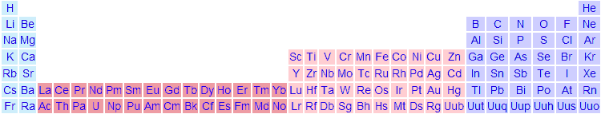
INNER TRANSITION ELEMENTS – no group number

Slide 28
INNER TRANSITION ELEMENTS – no group number
In the sixth and seventh periods, there are a subset of 28 metallic elements that are quite unlike any of the other transition elements.
Inserting the inner transition elements into the main body of the periodic table results in a long and cumbersome table, so these elements are pulled out below the table so it can fit nicely on a 8.5” x 11” piece of paper.
These two rows have no group number.

Slide 29
INNER TRANSITION ELEMENTS – no group number
The elements in each subset have properties that are so similar to one another that each subset can be viewed as a group.
All elements are in the f block.
Include the Lanthanides and the Actinides, names after the first element in each group.

Slide 30
INNER TRANSITION ELEMENTS – no group number
Lanthanides:
silvery metals with high melting points
high luster and conductivity
Tend to be mixed together in the same geologic zones and are hard to separate since they are so similar;
Unusually hard to purify
used in making high quality glass, television screens, lasers, tinted sunglasses, LEDs

Slide 31
INNER TRANSITION ELEMENTS – no group number
Actinides:
Have similar properties and are not easily purified. This is a problem for the nuclear industry as it requires purified samples of uranium and plutonium.
all are radioactive.
93-103 are synthetic (called transuranium elements); are created in particle accelerators
Most Common are URANIUM and PLUTONIUM - used as nuclear fuel.

Slide 32
TO DO
Element Families handout due tomorrow.
Lab tomorrow - Where are the Halides?.

