Slide 1
Do now
Turn in Chillin’ Out lab.
Get out Heating Curve and Phase Diagram handout.
Pick up notes for today. You need a calculator.

Slide 2
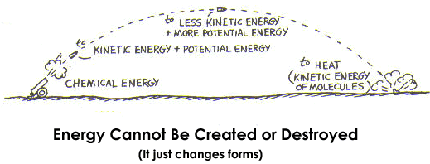
energy
Energy is the ability to do work or produce heat.
There is potential energy and kinetic energy.
Potential energy is stored energy and kinetic energy is the energy of motion.
Remember that energy is conserved – it can be converted from one form to another, but cannot be destroyed.

Slide 3
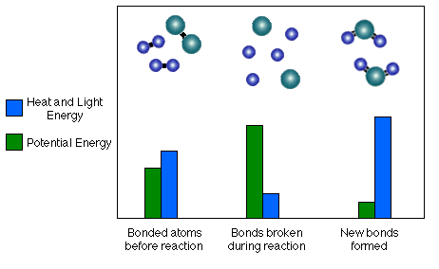
energy
The energy stored in a substance because of its composition is CHEMICAL POTENTIAL ENERGY. Chemical potential energy plays an important role in chemical reactions. In a chemical reaction, the potential energy can be released as heat.

Slide 4
energy
HEAT is the energy that flows from a warmer object to a colder object.
Heat is measured using the SI unit JOULE, J. (The other unit is calorie. One calorie = 4.184 joules.)

Slide 5
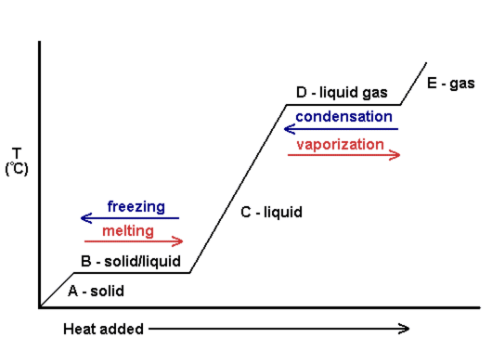
Heating curve

Slide 6
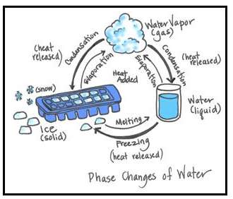
ENERGY AND CHANGES OF STATE
When heat is added to a solid, the kinetic energy, KE, of the molecules increases.
When the melting point is reached, the added energy (heat) increases the KE of the molecules.
The positions of the molecules are changed.

Slide 7
ENERGY AND CHANGES OF STATE
An equation to determine the amount of heat is the following:
q = (m) (∆T) (C_{p})
“q” is heat,
“m” is mass,
“∆T” is change in temperature, and
“C_{p}” is the specific heat of the substance you are measuring.

Slide 8
ENERGY AND CHANGES OF STATE
Specific heat, C_{p}, of any substance is the amount of heat required to raise the temperature of one gram of that substance by one degree Celsius.
The number will always be given to you. Examples:
  Cp_{ice} - 2.06 J/g•C°
  Cp_{water} - 4.18 J/g•C°
  Cp_{vapor} - 2.02 J/g•C°

Slide 9
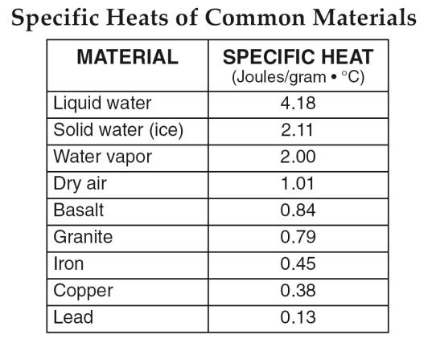
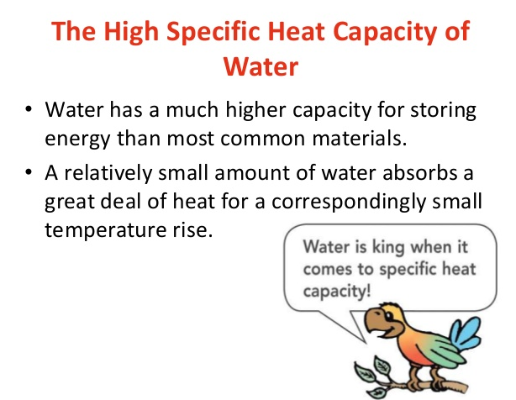
ENERGY AND CHANGES OF STATE

Slide 10
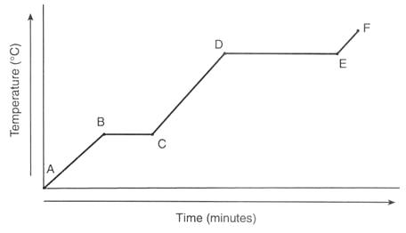
Calculating heat
Sample Problem
Calculate the amount of energy in joules needed to raise 100.0 g of ice from –75.0°C to 0.00°C.
q = (m)(∆T)(Cp_{ice})
q = (100.0 g)(75.0°C)(2.06 J)
g • C°
= 15,450 joules
= 15,500 J

Slide 11
Calculating heat
Calculate the amount of energy in joules needed to raise 100.0g of water from 25.0°C to 75.0°C.

Slide 12
enthalpy
Enthalpy, H, is a measure of the total energy in a system.
ΔH is equal to the change in the internal energy of the system, plus the work that the system has done on its surroundings.
This means that the change in enthalpy under such conditions is the heat absorbed or released by a chemical reaction.

Slide 13
Enthalpy (heat) of fusion
Energy required to melt one gram of a specific substance at its melting point.
The energy of melting.
Formula:
Q = (m)(ΔH_{fus})
ΔH_{fus} of water = 334 J/g

Slide 14
Enthalpy (heat) of vaporization
Energy required to vaporize one gram of a specific substance at its boiling point.
The energy of boiling.
Formula:
Q = (m)(ΔH_{vap})
ΔH_{vap} of water
= 2260J/g

Slide 15
Enthalpy (heat) of vaporization
This is directly related to the strength of the intermolecular forces that exist in the liquid.
High IMFs means low vapor pressure and high ΔH_{vap.}
This is because much energy is needed to increase the kinetic motion of individual molecules to free them from intermolecular attraction.

Slide 16
Enthalpy (heat) of vaporization
The ΔH_{vap} for a substance is ALWAYS larger than the ΔH_{fus} for the same substance.
Constants:
  ∆H_{fus} of water - 334 J/g
  ∆H_{vap} of water - 2260 J/g

Slide 17
Calculating enthalpy
Sample Problem:
How much heat is required to melt 5.67 g of iron (II) oxide, FeO, if its enthalpy of fusion is 450.0 J/g?
q = m • ∆H_{fus}
q = (5.67 g) (450.0 J)
(g)
= 2551.5 = 2.55 x 10³ J = 2550J

Slide 18
Calculating enthalpy
Practice Problem:
How much heat is required to melt 50.0g of water at its melting point?

Slide 19
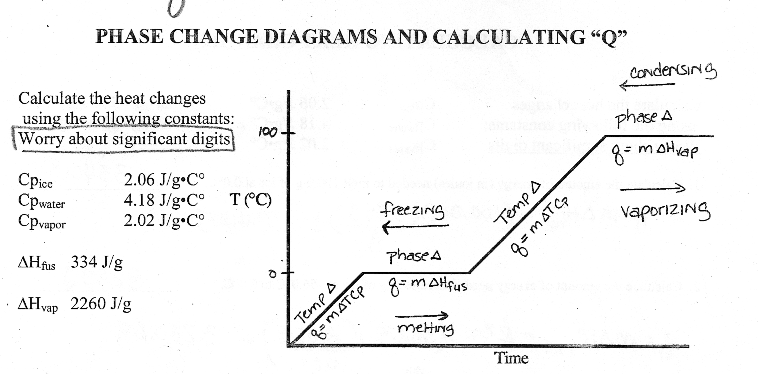
Calculating heat

Slide 20
TO DO
Handout due Thursday.
Doing labs tomorrow and Friday.

