Slide 1
DO NOW
Pick up notes and Review #16
Turn in Review #15
Turn in Clouds in a Bottle lab from yesterday if you did not already.

Slide 2
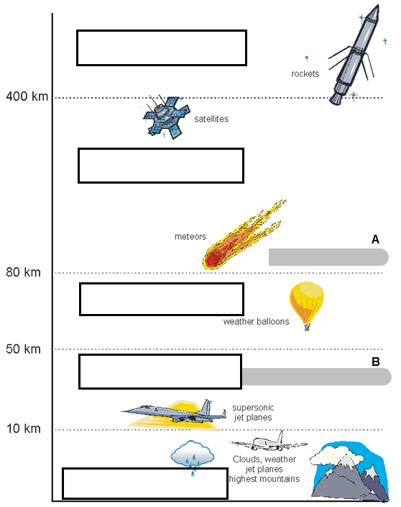
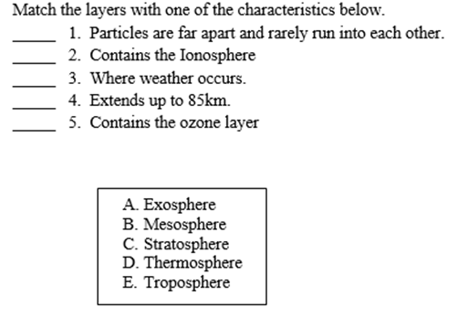
REVIEW #13

Slide 3
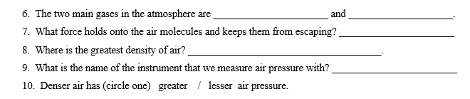
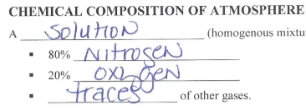
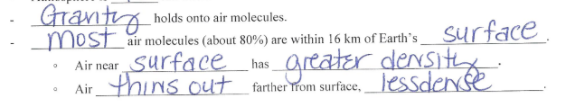
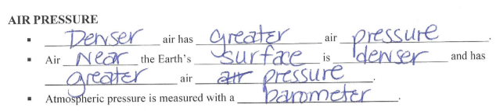
REVIEW #13

Slide 4
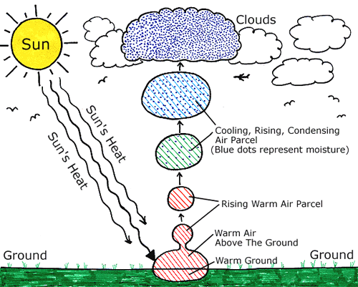
REVIEW
Do clouds form under high or low pressure?
What is latent heat?
  When is it absorbed?
  When is it released?
LOW
Latent heat is the energy that is absorbed in a phase change.
Evaporation at the surface USES heat energy
Condensation in clouds RELEASES heat energy

Slide 5
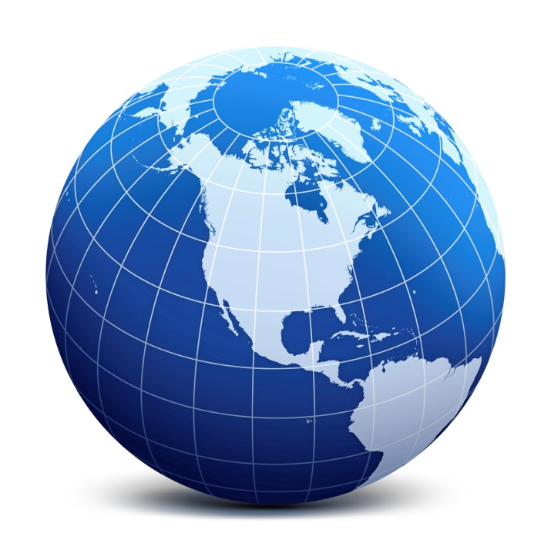
GLOBAL CIRCULATION
SES5. Students will investigate the interaction of Earth systems to produce weather and climate.
a. Explain how latitudinal variations in solar heating create atmospheric and ocean currents that redistribute heat globally.

Slide 6
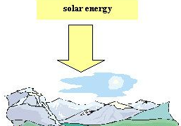
SOURCE OF ENERGY: SUN
Uneven heating caused by:
Earth’s shape – sunlight spread out over larger area away from equator.
  Latitude has greatest effect on the angle at which the sun's rays hit Earth.
Earth’s tilt causes seasonal variations in incoming solar radiation (insolation).

Slide 7
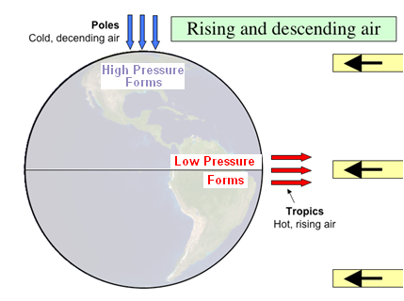
HOT AIR RISES AT THE EQUATOR
Air at the equator is heated:
Less dense
Rises
LOWER surface pressure
Air at the poles is cooler:
Becomes more dense
Sinks
HIGHER surface pressure

Slide 8
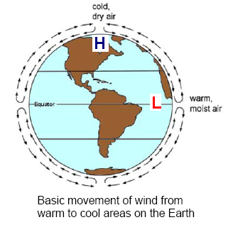
ATTEMPT AT EQUILIBRIUM
Air moves from HIGH to LOW pressure.
Surface winds blow into areas of low pressure (poles to equator).
At the top of the troposphere this air spreads out from equator towards the poles.

Slide 9
ATTEMPT AT EQUILIBRIUM
CONVECTION current results:
Warm air near the equator rises.
It cools as it rises.
It eventually descends back toward Earth near the poles.

Slide 10
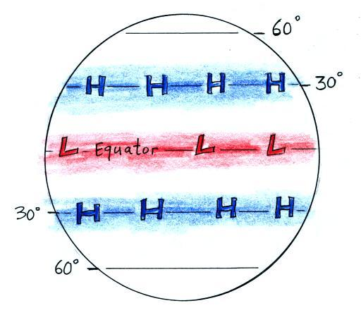
CIRCULATION BELTS
It isn’t QUITE that simple!
Because of the size of the Earth, there are three separate circulation belts.
Spaced out at about 30 degree intervals .
Creates regions of high and low pressure.
Both the northern and southern hemispheres.

Slide 11
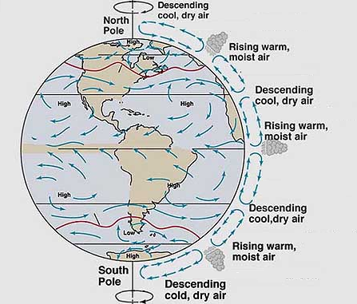
CIRCULATION BELTS
Warm air rises, cools and sinks, in belts.
The belts are at 30 degree intervals extending north and south from the equator to the poles.

Slide 12
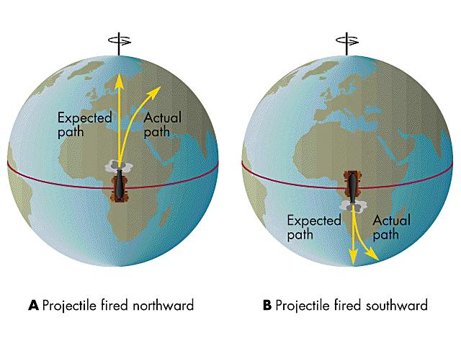
CORIOLIS EFFECT
As Earth rotates, winds are deflected, or turned.
Circulating air is deflected:
To the left in the Southern Hemisphere.
To the right in the Northern Hemisphere.
Similar to what is experienced when throwing a ball on a Merry-go-Round.
NOVA - The Coriolis Effect

Slide 13
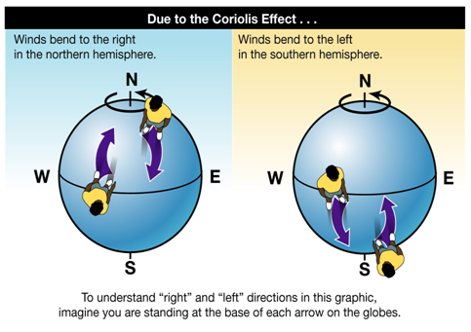
CORIOLIS EFFECT
Because of the Coriolis Effect, an object that travels north from the equator will curve to the east.
In general, the Coriolis Effect is noticeable only on objects that move very fast or travel long distances.

Slide 14
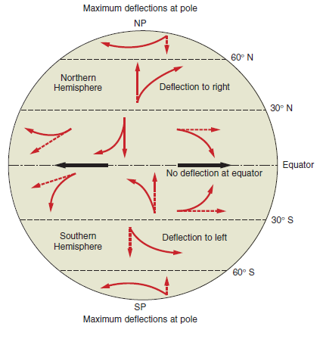
CORIOLIS EFFECT

Slide 15
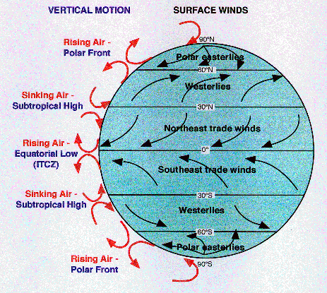
WIND BELTS
Circulation belts are deflected.
Equator (air rises):
Winds from the east to the west.
NE or SE Trade Winds
Mid latitudes
Air sinks at 30 degrees.
Rises at 60 degrees.
Winds from the west to the east.
Westerlies

Slide 16
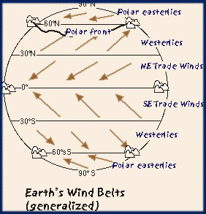
WIND BELTS
Northern latitudes:
Air rises at 60 degrees.
Air sinks at poles.
Winds from east to west
Polar Easterlies
Prevailing winds that blow throughout the contiguous United States are called Westerlies.

Slide 17
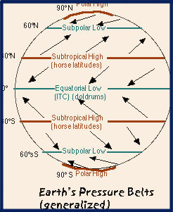
PRESSURE BELTS
Calm regions between the belts.
Air is rising or sinking – not moving along the surface.
At the equator these calm areas are referred to the Doldrums.
Between the Trade Winds and Westerlies are called the Horse Latitudes.

Slide 18
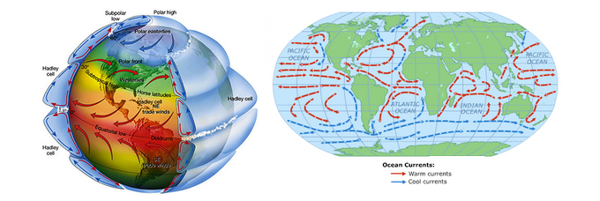
ATMOSPHERE AND OCEAN:
FLUIDS RESPOND THE SAME

Slide 19
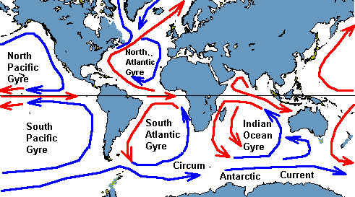
CURRENTS AND CORIOLIS
Ocean water also moves from warm (less dense) to cool (denser) regions
Land masses deflect currents.
Also deflected due to Coriolis.

Slide 20
CURRENTS AND CORIOLIS
Currents in Northern Hemisphere flow clockwise.
Currents in Southern Hemisphere flow counterclockwise.

Slide 21
CURRENTS AND CORIOLIS
Warm water carried from equator to poles.
  Typically EAST Coast
Cold water carried from poles to equator.
  Typically WEST Coast

Slide 22
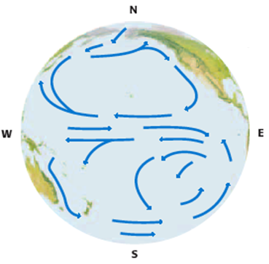
OCEAN CURRENTS
Critical role in regulating Earth’s climate by storing and transporting heat.
Stream-like water movements.
Currents controlled by:
Air currents – prevailing winds (Trades, Westeries, etc.)
Earth’s rotation – Coriolis creates gyres (circle motion)
Location of continents - land masses act as barriers

Slide 23
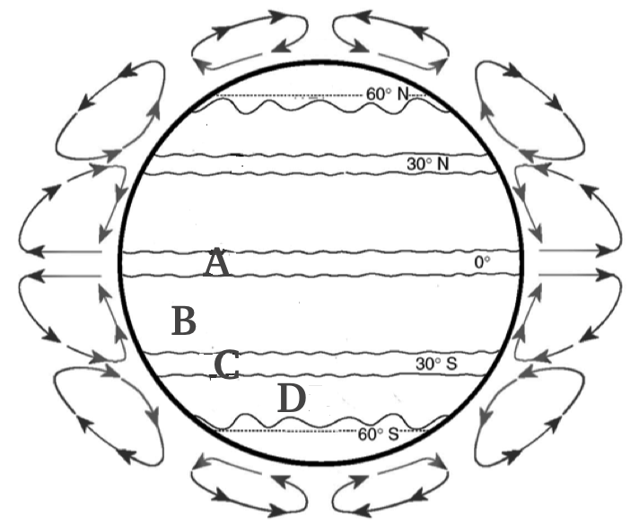
REVIEW
Which location is:
S.E. trade winds?
Doldrums?
Horse Latitudes?
Prevailing Westerlies?

Slide 24
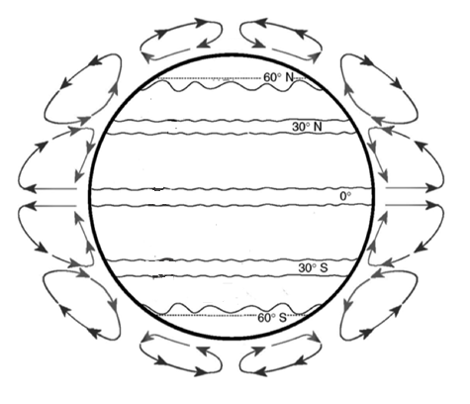
TO DO
Doldrums
Equator
Southern Horse Latitudes
Northern Horse Latitudes
Northern Polar Easterlies
Southern Polar Easterlies
Northeast Trade Winds
Southeast Trade Winds
Northern Westerlies
Southern Westerlies

Slide 25
LAB
Analyzing Ocean and Atmospheric Circulation
You need blue, yellow, red, orange, green, and purple colored pencils.
First, color the wind belts on your map LIGHTLY with the given color.
Second, draw arrows showing the direction the winds blow for each belt on the left side.
Third, fill in the table as completely as possible.

Slide 26
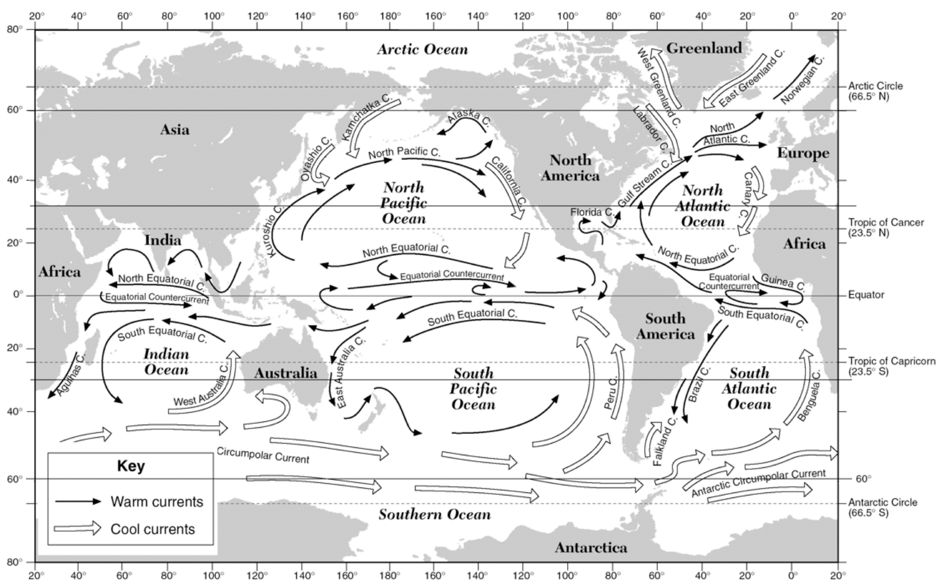
LAB

Slide 27
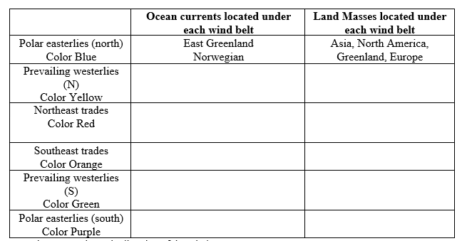
LAB
Fourth, then answer the questions.
Do Review #16 – due tomorrow.

Slide 28
