Slide 1
DO NOW
Pick up notes.

Slide 2
REVIEW
pH = -log [H₃O⁺]
[H₃O⁺] pH
[H₃O⁺] = antilog -pH
[H₃O⁺] [OH⁻] = 1.00x 10⁻¹⁴ pH + pOH = 14.00
pOH = -log [OH⁻]
[OH⁻] pOH
[OH⁻] = antilog -pOH

Slide 3
Measuring pH
THREE METHODS:
Litmus paper, indicators - usually measure a range and are not as accurate.
pH paper – measure within a number or two and more accurate than litmus.
pH meter – electronically measures pH

Slide 4
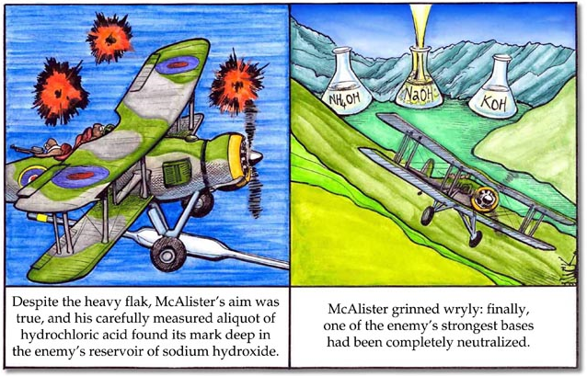

Slide 5
NEUTralization reactions
A neutralization reaction is the reaction of an acid and an hydroxide base to form a salt and water.
HClO_{3(aq)} + NaOH_{(aq)} → H₂O_{(l)} + NaClO_{3(aq)}
Acid base water salt
Not all neutralization reactions form water. If the base is a hydroxide, it will.
Not all neutralization reactions form a neutral solution. It is possible to get acidic or basic salts, if the salt still has an ionizable hydrogen atom.

Slide 6
titrations
To measure the concentration of an acid or base in solution, a titration can be performed.
A TITRATION is a carefully controlled neutralization reaction. A standard solution is used to determine the concentration of another solution. The concentration of the standard solution is known.
By adding an indicator, the point at which complete neutralization occurs can be determined.

Slide 7
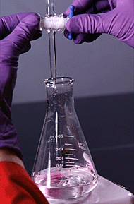

Slide 8
titration
HOW TO DO A TITRATION
1. Measure a standard volume of the acid or base with the known concentration.
2. Fill the buret with the solution of unknown concentration.
3. Slowly add the unknown and mix until the equivalence point is met.
The equivalence point is where the moles of H⁺ equal the moles of OH⁻ in both solutions.

Slide 9
titration
NaOH + HCl → NaCl + H₂O
Na⁺ + OH⁻ + H⁺ + Cl⁻ → Na⁺+ Cl⁻ + H₂O
1 mole H⁺ and 1 mole OH⁻
A chemical dye called an indicator is used instead of a pH meter. The equivalence point, or end point, is where the indicator changes color.

Slide 10
DVD – Rainbow indicators
1. What is a universal indicator?
2. So where did the stain go? (Squirt bottle contains dilute ammonia.)
3. What indicator was used to treat his shirt?

Slide 11
indicators
An indicator is a weak acid or base that undergoes a color change when it gains or loses an H⁺ ion.
Each indicator has its own equilibrium constant and thus a different color range for different pH.
Because they are viewed by sight and thus subjective, they cannot be used to measure precise pH changes.
DEMOS

Slide 12
indicators
HOW THEY WORK:
HIn + H₂O ↔ H₃O⁺ + In⁻
When you add an acid, you add H₃O⁺ ions. This shifts the equilibrium to the left, increasing [HIn].
In litmus, HIn is colored red.
Adding a base, which removes H₃O⁺ ions, shifts the equilibrium to the right, increasing [In⁻]. For litmus, In⁻ is colored blue.
Examples are listed in your notes.

Slide 13
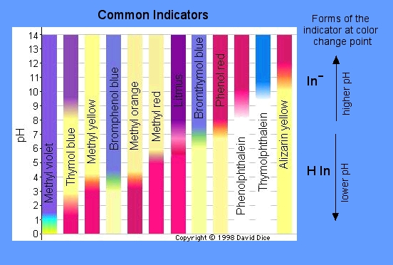
indicators
Each indicator has its own equilibrium constant and thus a different color range for different pH.

Slide 14
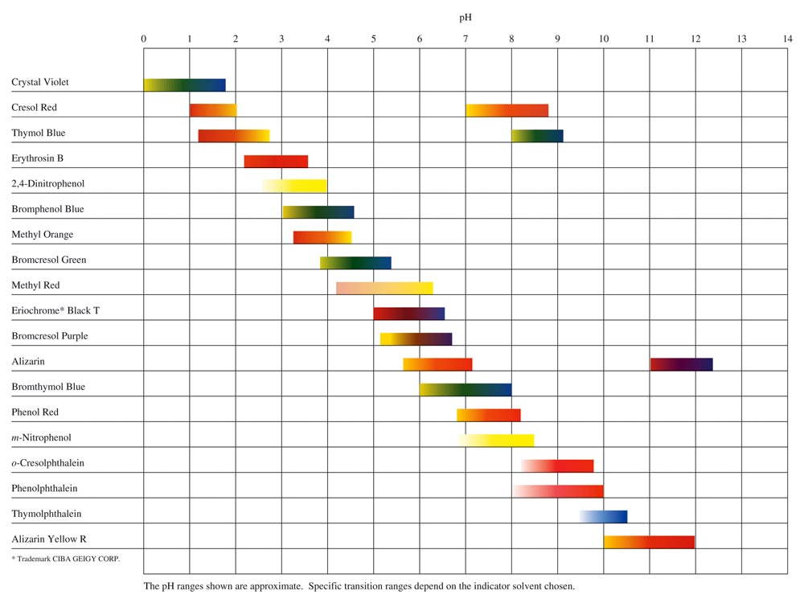
INDICATORS

Slide 15
BUFFERS
pH must, at times, be controlled within very narrow limits. One way to do this is with a buffer.
A BUFFER is a solution that is able to release or absorb H+ ions, keeping a solution’s pH constant. It resists a change in pH.
The mixture of ions and molecules in a buffer solution resists change in pH by reacting with any H⁺ or OH⁻ added to the solution.
The most common buffers are mixtures of weak acids and their conjugate bases or vice versa.

Slide 16
buffers
HOW THEY WORK:
Consider a buffer of acetic acid and the acetate ion:
H₃O⁺ + C₂H₃O₂⁻ ↔ H₂O + HC₂H₃O₂
Adding an acid [H₃O⁺] reacts with the acetate ion to form acetic acid. Almost all react and it forms mostly product. Because very little are left in solution, pH changes only slightly. The same is true if a base is added:
OH⁻ + HC₂H₃O₂ ↔ H₂O + C₂H₃O₂⁻

Slide 17
buffers
All buffers have a limited capacity to neutralize added H₃O⁺ ions or OH⁻ ions.
The amount of acid or base that a buffer can neutralize is called the buffer capacity.
The greater the concentration of buffering molecules, the greater the buffering capacity.

Slide 18
Buffers in the blood
A pH of 7.4 must be maintained in the bloodstream. It can deviate only within narrow limits, 0.3 pH units up or down.
Acidosis occurs if the blood pH falls below 7.1.
Alkalosis occurs when the blood pH rises above 7.7 (Some experience cramping due to lactic acid build-up in muscles.)
The body maintains pH in a variety of ways:
1. Excess acids and bases are excreted in the urine.
2. Carbon dioxide is eliminated by breathing.

Slide 19
Buffers in the blood
The buffers H₂CO₃ and HCO₃⁻ are used. The reaction is as follows:
CO₂ + H₂O ↔H₂CO₃ ↔ H⁺ + HCO₃⁻
    If the acid level rises, equilibrium shifts left to consume H⁺ and we breathe more to get rid of the excess carbon dioxide.
    If the base level rises, equilibrium shifts right and breathing slows down to slow down the removal of carbon dioxide. (This is also what we are doing when we ask hyperventilators to breathe in a bag – so they do not eliminate the CO₂ so fast!)

Slide 20
TO DO
Handout due tomorrow
$1, bag, and 100% cotton white t-shirt due by class Thursday.

