Slide 1
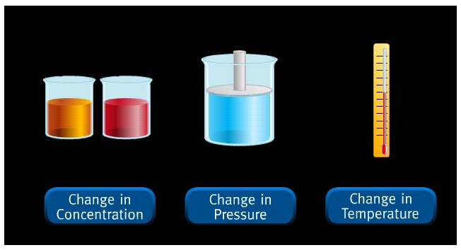
LECHATELIER’S PRINCIPLE

Slide 2
LECHATELIER’S PRINCIPLE
There are ways to control equilibrium to make reactions more productive.
If a change in conditions is imposed on a system at equilibrium, the equilibrium position will shift in the direction that tends to reduce that change in conditions.
A STRESS is any kind of change in a system at equilibrium that upsets the equilibrium.
A reaction system will shift in the forward or reverse direction to “undo” the altering factor.

Slide 3
LECHATELIER’S PRINCIPLE
STRESSES
Concentration Pressure
Temperature
ANIMATION

Slide 4
CONCENTRATION
If you add more of a reactant, the reaction will proceed to the right.
If you add more of a product, the reaction will proceed to the left.
If a substance is removed, its concentration decreases. The reaction will return to equilibrium by producing more of the substance that was removed.
**The position of equilibrium shifts, the equilibrium constant, K_{eq}, does not.

Slide 5
CONCENTRATION
WHY?
Adding a substance to a system at equilibrium drives the system to consume that substance.
Removing a substance from a system at equilibrium drives the system to produce more of that substance.

Slide 6
PRESSURE (AND VOLUME)
In gaseous systems, changing the pressure can shift the reaction backwards or forwards – it all depends on the number of moles on each side of the reaction.
If you increase the pressure of the system, the system will shift to reduce that pressure by proceeding in the direction that produces the fewer molecules.

Slide 7
PRESSURE
NH₄Cl _{(s)} ↔ NH₃ _{(g)} + HCl _{(g)}
Increased Pressure: There are 0 moles of gas on the left producing 2 moles of gas on the right.
The reaction will shift to the left in order to reduce the number of moles of gas produced.

Slide 8
PRESSURE
If there is the same number of moles on both sides of a reaction in equilibrium, there will be no shift in equilibrium if pressure is added.
Pressure only affects gases, not solids and liquids.
Remember, if you change volume, you change pressure.
**The position of equilibrium shifts, the equilibrium constant does not.

Slide 9
TEMPERATURE
The position of the equilibrium shifts AND K_{eq} changes in value.
When determining what the temperature will do, you have to know if the reaction is exothermic (gives off heat) or endothermic (takes in heat).
K_{eq} is a measure of the extent to which the reaction proceeds.

Slide 10
TEMPERATURE
H₂ _{(g)} + I₂ _{(g)} ↔ 2 HI _{(g)} + heat
K_{eq} (400ºC) = 54.5 K_{eq} (490ºC) = 45.9
In this example, raising the temperature causes the reaction to proceed less completely to products. Lowering the temperature would produce a higher yield.

Slide 11
TEMPERATURE
If heat is added to a system that is exothermic in the forward direction, the reaction tends to reestablish equilibrium by consuming the additional heat through the reverse (endothermic) reaction.
Heat + NH₄Cl _{(s)} ↔ NH₃ _{(g)} + HCl _{(g)}
In this reaction, raising the temperature will shift the reaction in the forward direction and lowering the temperature will shift it in the reverse direction.

Slide 12
PRACTICE
Use the equation to solve the problems:
4 HCl + O₂ + heat ↔ 2 Cl₂ + 2 H₂O
A. Temperature increases. The reaction will shift _______ and favor the formation of _________
B. Cl₂ is removed as it is formed. The reaction will shift _______ and favor the formation of _________
C. The pressure is increased. The reaction will shift _______ and favor the formation of _________
D. H₂O is added. The reaction will shift _______ and favor the formation of __________.

Slide 13
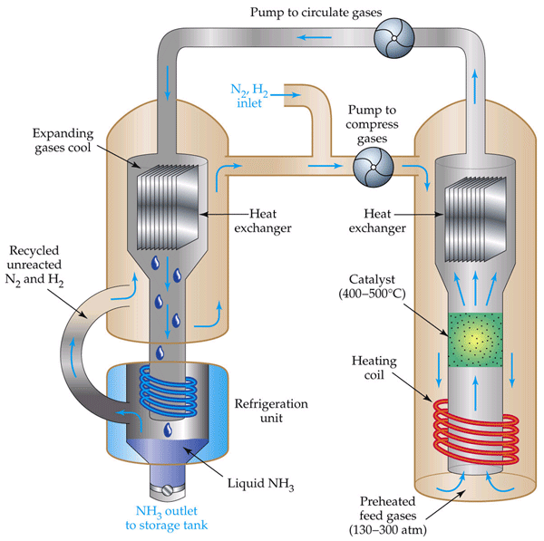
THE HABER PROCESS
Fritz Haber studied the reaction of gaseous nitrogen and gaseous hydrogen to form ammonia.
3 H₂ _{(g)} + N₂ _{(g)} ↔
NH₃ _{(g)} + heat

Slide 14
THE HABER PROCESS
In reality, the reaction reached equilibrium before any sizable amount of ammonia could be formed.
Haber studied the reaction and determined the pressure and temperature of the reaction to maximize the yield of ammonia.
His work was important, but controversial, for the Germans used it in World War II to produce explosives and poison gas.

