Slide 1
DO NOW
Pick up notes and Review #16.

Slide 2
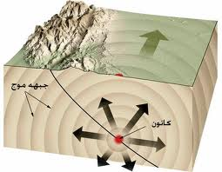
Seismic Waves
Energy in Motion

Slide 3
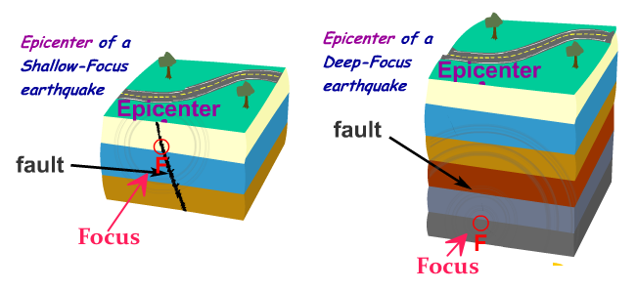
REVIEW
Which earthquake depth is associated with convergent plate boundaries?
All three depths:
shallow, intermediate, and deep

Slide 4
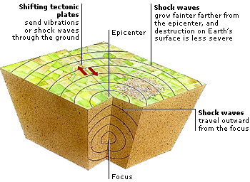
TRANSFER OF ENERGY
Seismic waves: When rocks along a fault slip into new positions – energy is released.
Waves transfer energy.
Waves travel outward in all directions from the focus.
The composition of the material the waves pass through affects the speed and direction of the waves.

Slide 5
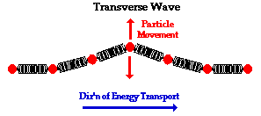
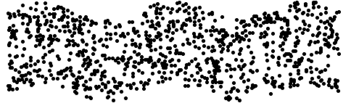
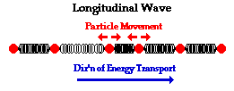

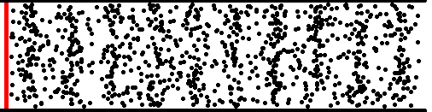
TYPES OF WAVES
PHYSICAL SCIENCE REVIEW
Longitudinal or Compression Waves:
Particles of the medium move in a direction parallel to energy movement.
Transverse Waves:
Particles of the medium move in a direction perpendicular to energy movement.

Slide 6
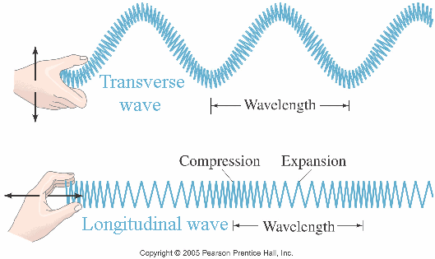
Parts of a Wave
Transverse Waves:
Crest: highest point or peak of a wave
Trough: the lowest point, or valley of a wave
Longitudinal Waves:
Compression: where waves bunched up
Rarefaction: where waves farthest apart
Wavelength of a wave is the distance between:
Crest to crest or trough to trough in a transverse wave OR
Compression to compression in a longitudinal wave

Slide 7
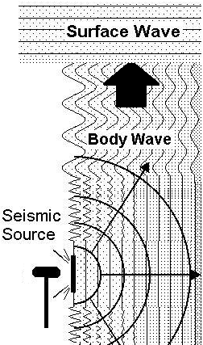
Types of Earthquake Waves
Body Waves
Travel through the Earth.
“P” (primary) and “S” (secondary) waves.
Surface Waves
Travel along Earth’s surface.
“Rayleigh” and “Love” waves.
Compression or Longitudinal waves.
Transverse waves.
Starts at Focus.
Starts at Epicenter.

Slide 8
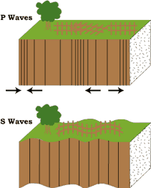
BODY WAVES
Primary (P) waves
Compression (longitudinal)
Fastest waves - Arrive first.
Travel through solids, liquids and gases.
Travel faster in more rigid material.

Slide 9
BODY WAVES
Secondary (S) waves
Transverse waves
Arrive second.
Travel through solids only – can’t go through liquids.

Slide 10
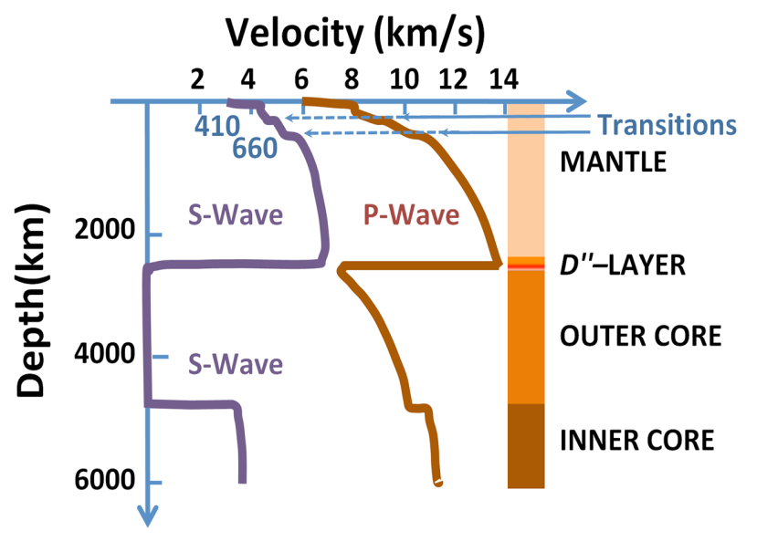
EARTHQUAKES
AND EARTH’S LAYERS
The speed of seismic waves depends on the composition of the material (density and elastic properties of the rocks and soil).
P-waves travel faster through rigid or denser material.
S-waves do not travel through liquid outer core.
Differences helped explain layers of Earth.

Slide 11
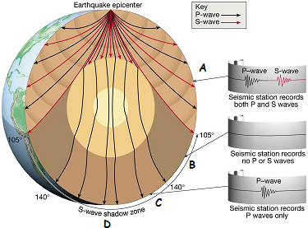
Waves Tell Us About Earth’s Layers
Location A:
P and S waves
Location B:
NO waves felt of any kind
P wave Shadow Zone
P waves deflected by liquid core
S waves stopped by liquid core
Location C:
S wave shadow zone
Only P waves felt
P waves bent in liquid core
S waves stopped by liquid core
Earthquake waves are not felt or recorded everywhere, every time.
What type of waves are received at location “D”?

Slide 12
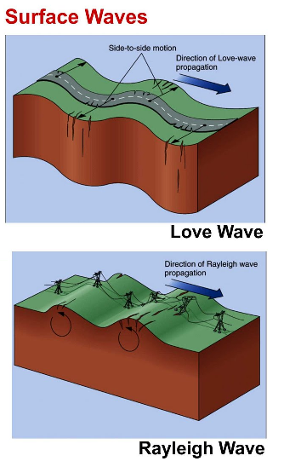
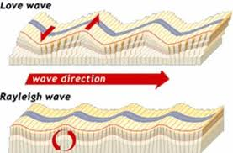
SURFACE WAVES
MOST DESTRUCTIVE
Move along surface.
Slowest moving; Greatest damage
Love waves
  Side-to-side - not vertical
  Ground twists
Rayleigh waves
  Rolling motion

Slide 13
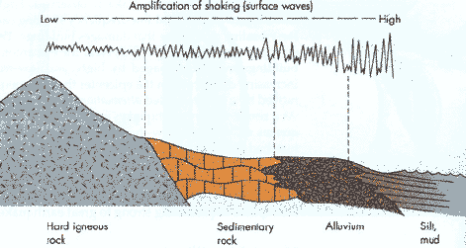
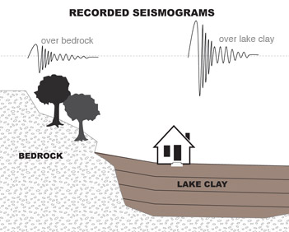
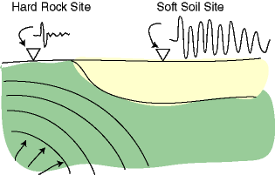
Materials Affect Surface Waves
As waves move from rock to soil, they get:
Slower and Bigger

Slide 14
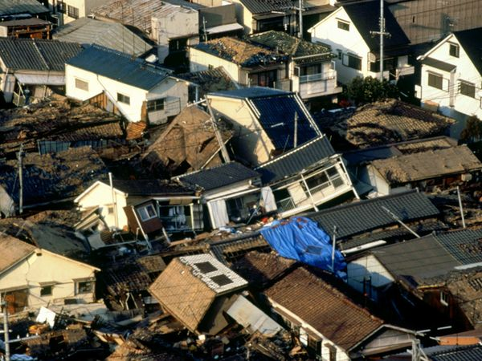
REVIEW
Which waves are the most destructive?
P and S waves
Body waves
Love and Rayleigh waves
All of them are equally destructive
C: Love and Rayleigh Waves because they are both Surface Waves which are the most destructive.

Slide 15
TO DO
Do Review #16

