Slide 1
DO NOW
Pick up copy of the lab and READ it.
Get out the Element Families handout.

Slide 2
THE ELEMENT FAMILIES

Slide 3
WHERE ARE THE HALIDES?
A Periodic Trends lab

Slide 4
QUESTION
Can an unknown halide be identified if the results of its tests with various substances are compared with the results of known halides with the same substances?

Slide 5
DISCUSSION
Members of a chemical family have similar chemical properties. However, do not be misled to believe that their properties are all the same. In this lab, we will use differences in the chemical properties of the halogens to identify their ions. When the halogens are combined with the alkali metals, they are called halides. You will first establish a set of criteria to identify each element. To do this, you will react known solutions with various test substances. You will then use this data to do an analysis of an unknown with one halide present. If you pay careful attention to the preliminary tests and take good notes, you will have little difficulty identifying your unknown.

Slide 6
SAFETY PRECAUTIONS
Wear goggles at all times.
You will be using poisonous chemicals.
Ammonia can give off noxious fumes. Keep the bottle capped.
Silver nitrate is on the back desk. It must remained capped and no liquid should be in the beaker holding the pipets.
Clean up all spills immediately.
Wash hands after performing the lab and clean up lab space.

Slide 7
PROCEDURE
Put on your goggles.
Place two drops of calcium nitrate, Ca(NO₃)₂, in each of the four wells in the first column of your 96 well plate. Add five drops of the following halide solutions, one to each of the wells: NaF, NaCl, NaBr, NaI. (Each well should now have 2 drops Ca(NO₃)₂ and five drops of the halide.) Record your results in the data table. If there is no visible reaction, you can write ‘NVR’.

Slide 8
PROCEDURE
3. Place one drop of silver nitrate (AgNO₃) in each of the first four wells in the second column. Add three drops of the following halide solutions to each of the wells: NaF, NaCl, NaBr, NaI. (You now have one drop of AgNO₃ and three drops of the halides in each well.) Record your results in the data table.
In the third column of your 96-well plate, repeat step #4. (You now have one drop of AgNO₃ and three drops of the halides in each well in column 3.)

Slide 9
PROCEDURE
5. To the second column of wells from procedure 3, add three drops of aqueous ammonia (NH₃). Observe the results and record them in your data table.
To the third column of wells from procedure 4, add three drops of sodium thiosulfate (Na₂S₂O₃ • 10 H₂O). Observe the results and record them in your data table.
To a fourth column of wells, add one drop of starch to the first four wells. Add three drops of the following halide solutions to each of the following wells: NaF, NaCl, NaBr, NaI. Record your results in the data table.

Slide 10
PROCEDURE
8. To the same wells in the fourth column, add one drop of bleach. Record your observations in your data table. (These wells now have starch, bleach, and the halides.)
To a fifth column of wells, add two drops of household bleach to each well. Finally, add five drops of each halide solution to each of the wells in the same sequence as before and stir. (These wells have just the bleach and the halides.) Observe and record the results in your data table.

Slide 11
PROCEDURE
10. Obtain an unknown from the desk which contains one of the halide solutions that you used in this experiment.
Using the data that you have collected, test the unknown with bleach, starch, silver nitrate, calcium nitrate, and sodium thiosulfate. Do all the tests. Just follow the procedure again, 1-9 using your unknown. Write the identity of the unknown in your data table.

Slide 12


Slide 13
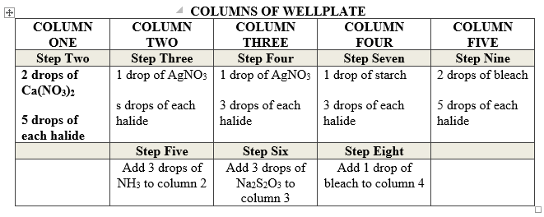
PROCEDURE

Slide 14
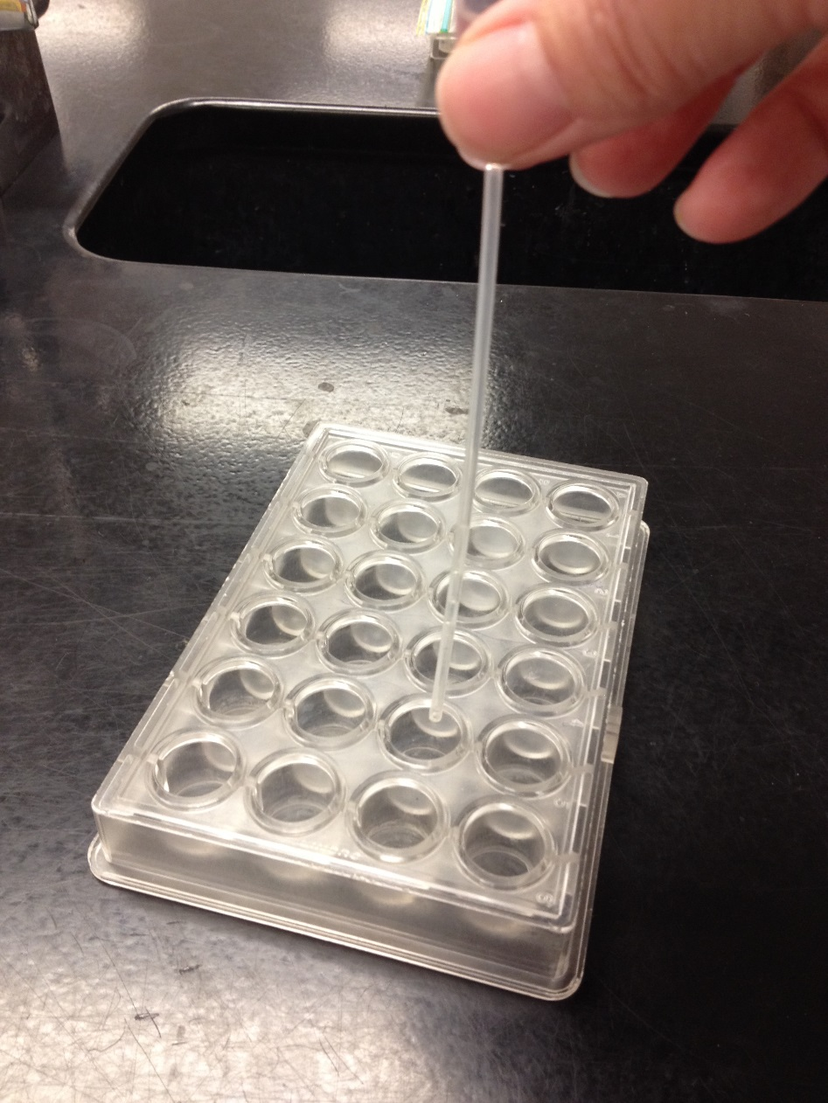
USING A PIPET
Hold it straight up and down and do not touch the surface of the plate or the liquid in it.

Slide 15
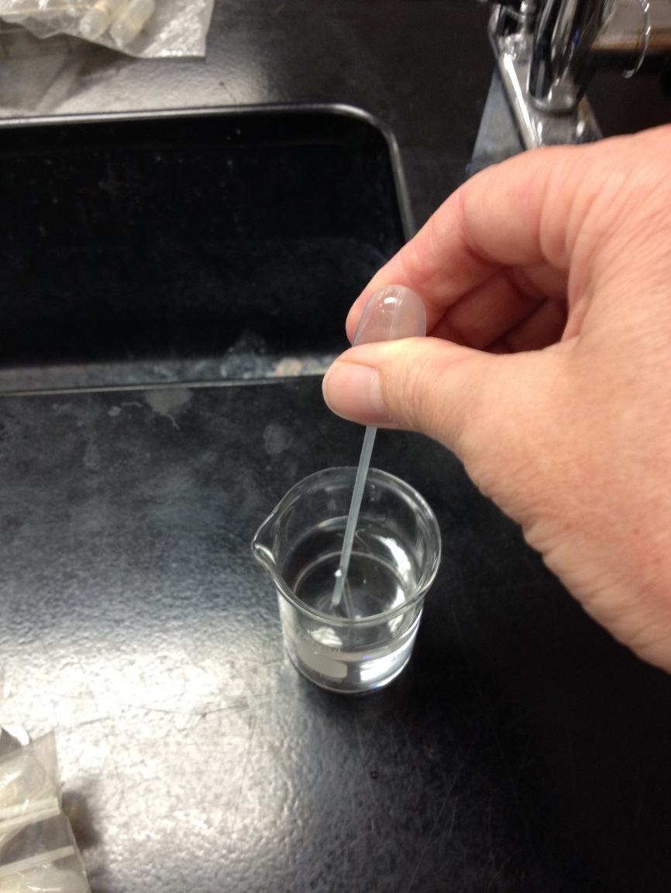
CLEANING A PIPET

Slide 16
DATA AND OBSERVATIONS
DATA TABLE OF HALIDES
Halide | Ca(NO₃)₂ | AgNO₃ | NH₃ | Na₂S₂O₃ | starch | starch + bleach | bleach
NaF
NaCl
NaBr
NaI
Unknown

Slide 17
CONCLUSION
What is the name of your unknown? List all the reactions which you used to determine the identity of your unknown in a complete sentence.
State the Periodic Law. Then explain how the halides fit within this definition?
List two consumer products that each of the halogens appears in. You must list the brand name. For example, sodium chloride can be found in Morton’s Table Salt (you now cannot use this example!). Try using your book, a reference book from the library and/or food labels for these.

Slide 18
FINAL THOUGHTS
Lab is due by the end of the period of Thursday.
You may want to work on Conclusion question #3 at home tonight.
Remember to clean and dry your pipets and clean and dry the well plate when you are finished. Bring me both by the end of the period.

Slide 19
DO NOW
Pick up handout – due Wednesday.
Remember to clean and dry your pipets and clean and dry the well plate when you are finished. Bring me both by the end of the period.
You can go ahead and get your goggles and get started.
Lab is due at the end of the period today.

