Slide 1
DO NOW
Pick up notes and Review #17.
Turn in Review #16.

Slide 2
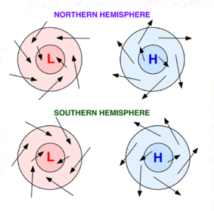
REVIEW
How do winds flow around areas of high and low pressure?
Why is the direction reversed in the Southern Hemisphere?
The Coriolis effect!
The Coriolis effect!

Slide 3
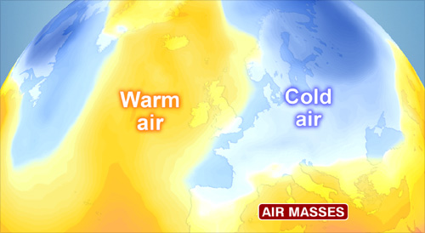
AIR MASSES AND FRONTS
SES5. Students will investigate the interaction of insolation and Earth systems to produce weather and climate.
b. Explain the relationship between air masses and the surfaces over which they form.
c. Relate weather patterns to interactions among ocean currents, air masses, and topography.

Slide 4
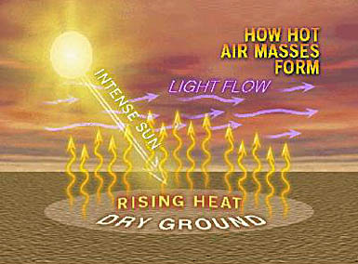
AIR MASSES
An air mass is a large body of air throughout which temperature and moisture content are similar.
Form when air remains stationary or moves slowly over region.
Air masses takes on the characteristics of the surface they form over.

Slide 5
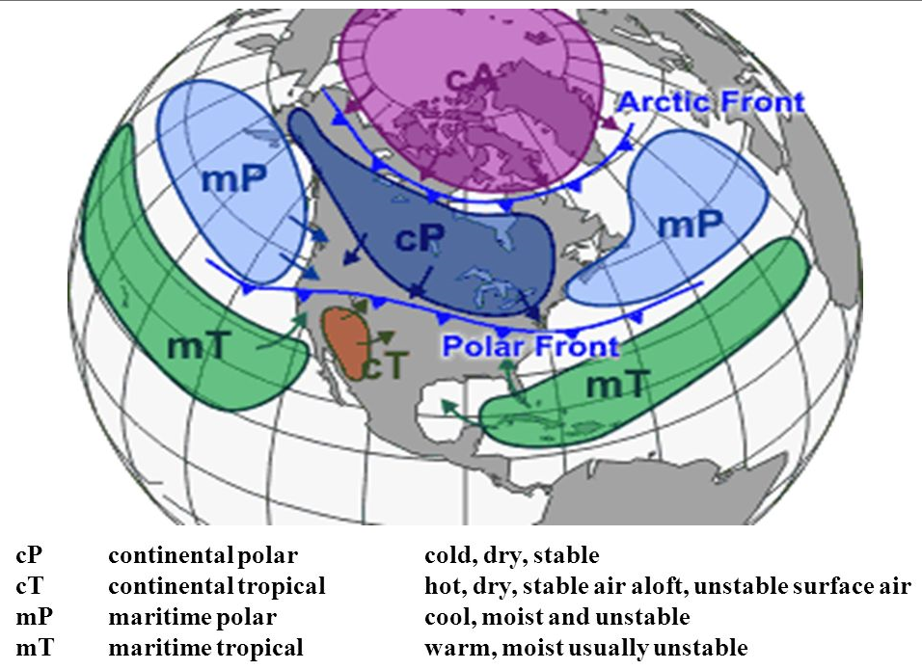
AIR MASSES CHARACTERISTICS
Air masses are named for BOTH temperature and moisture characteristics.

Slide 6
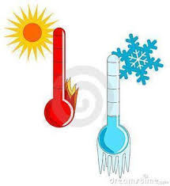

AIR MASSES CHARACTERISTICS
Temperature:
Tropical - warm
Polar – cold
Arctic - COLDER
Moisture:
Continental - dry
Maritime - wet

Slide 7
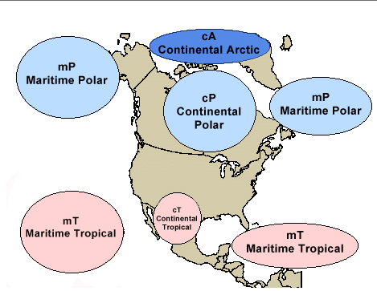
TYPE OF AIR MASSES
Continental Polar:
cold, dry
Continental Tropical:
warm, dry
Maritime Polar:
cold, wet
Maritime Tropical:
warm, wet

Slide 8
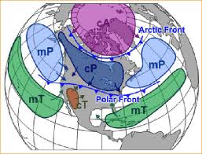
AIR MASSES ON THE MOVE
Prevailing winds put air masses in motion.
Air masses are affected by the surface they pass over – they gain and lose energy – and take on the characteristics of what they pass over.

Slide 9
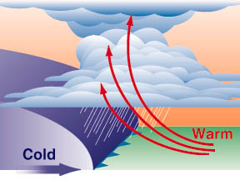
AIR MASSES ON THE MOVE
Air masses meet to form fronts.
When an air mass encounters a mountain range, the air mass rises and cools.

Slide 10
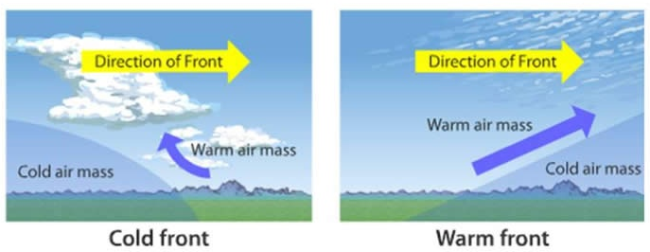
FRONTS
A front is the boundary where air masses collide.
Air masses have different characteristics.
Can be several hundred kilometers long.

Slide 11
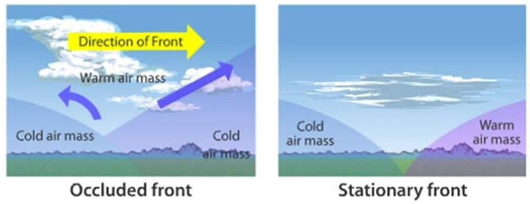
FRONTS
The kind of front is determined by how masses move in relation to each other.
Cold air moves faster than warm air.
Cold air is denser and moves under warm air.

Slide 12
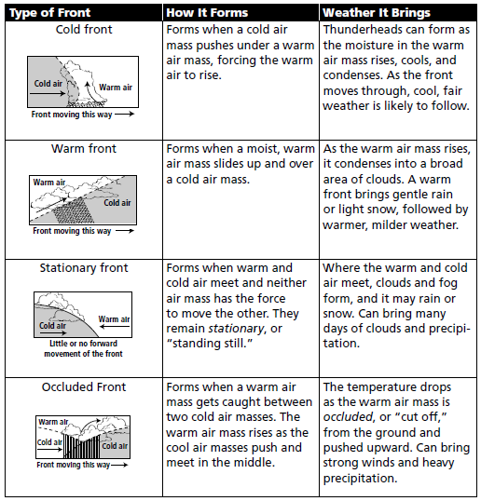
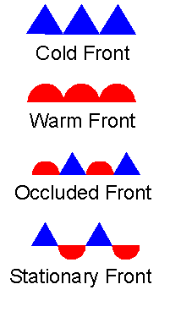
TYPES OF FRONTS

Slide 13
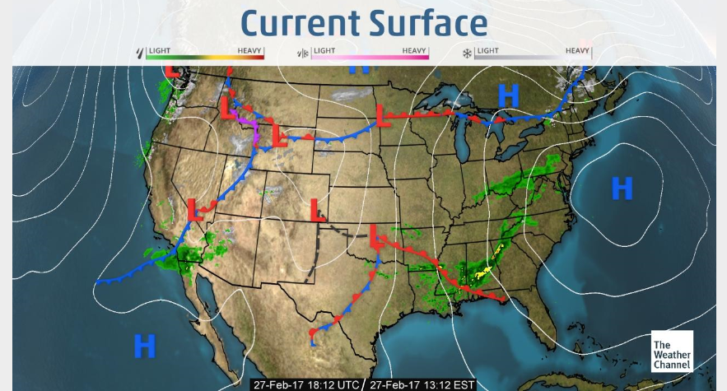
FEBRUARY 27, 2017

Slide 14
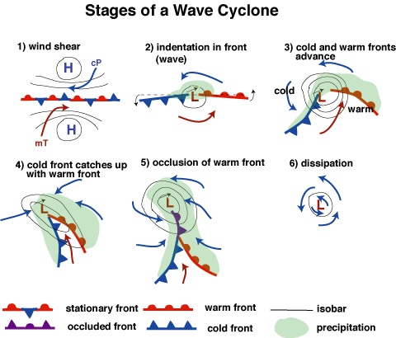
MIDLATITUDE CYCLONES
Cyclone
Low-pressure centers.
Counterclockwise winds that rise at the center.
Stormy
Can last for days.

Slide 15
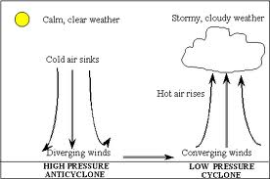
MIDLATITUDE CYCLONES
Anticyclone
High pressure center
Air sinks and flows outward from high pressure.
Dry weather.
If stationary, it can cause pollution problems.
Long term anticyclones can cause droughts.
Also the name for a weather event in which the air sinks and flows outward from a center of high pressure, and that brings dry weather.

Slide 16
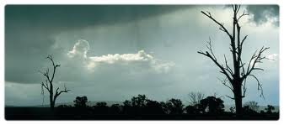
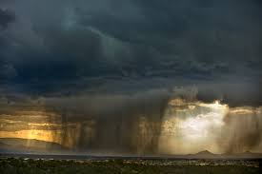
WHEN FRONTS COLLIDE
Warm air meets cold air.
Warm air and cold air don’t mix well, so when they meet they react as two big blocks of air.
Rain develops – sometimes storms.
The greater the temperature and moisture differences between two air masses, the greater the turbulence and instability, and the worse the weather can become!

Slide 17
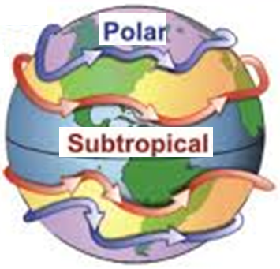
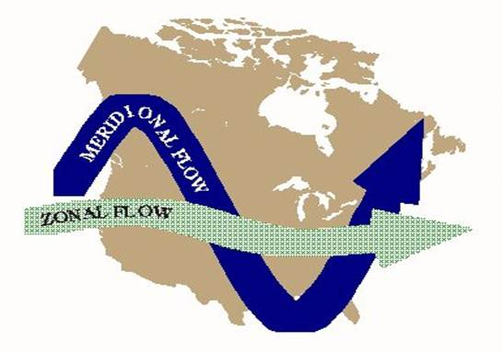
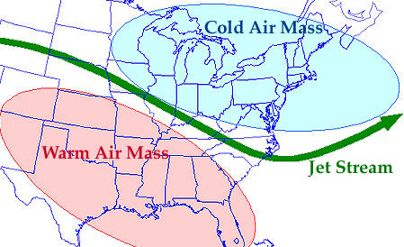
JET STREAM
Wind Currents
  Fast moving
  Narrow
  Polar and Subtropical
Found in the tropopause
  10 – 15 km high
Meridional flow (north to south or south to north.
Zonal flow (parallel to lines of latitude)

Slide 18
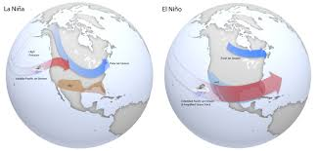
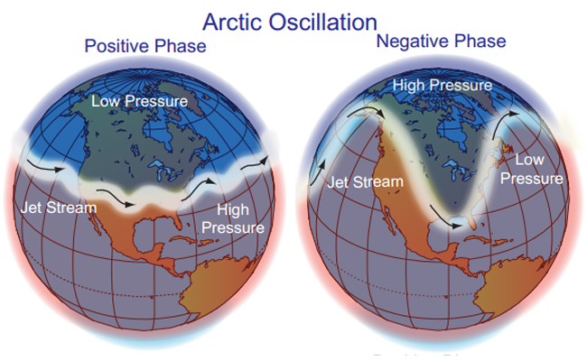
JET STREAM
Changes and varies:
  Arctic Oscillation
  El Nino, La Nina
Separates and drives weather systems.
Position and strength used for weather forecasting.

Slide 19
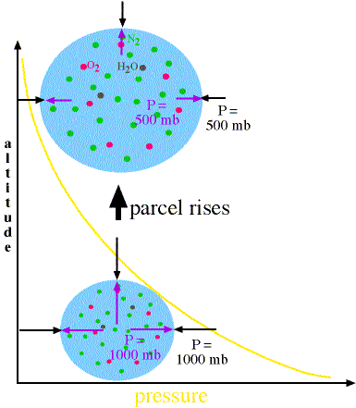
ABSOLUTE HUMIDITY
Absolute humidity is a measure of the actual amount of water vapor (moisture) in the air, regardless of the air's temperature.
Measured in grams of water vapor per cubic meter of air (g/m³).

Slide 20
ABSOLUTE HUMIDITY
Changes as the air mass changes.
  As air rises, it expands.
  Amount of moisture stays the same.
  Absolute humidity – g/m³ changes as air mass changes.

Slide 21
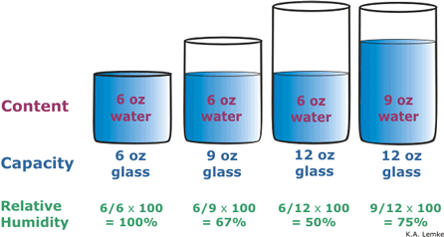
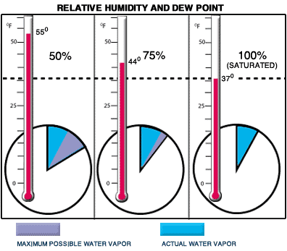
RELATIVE HUMIDITY
Relative humidity is the most common way to measure humidity.
Measures water vapor, but RELATIVE to the temperature of the air.
Shown as a percent.

Slide 22
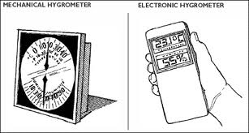
MEASURING HUMIDITY
Hygrometer – thin polymer film absorbs or releases water vapor – changes conductivity.

Slide 23
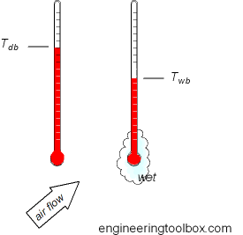
MEASURING HUMIDITY
Sling Psychrometer – differences in “dry” and “wet” bulb thermometers.
  Measures cooling effect of evaporation.
  Wet bulb is “slung” around.
  Lower humidity has greater evaporation so a wet thermometer cools more.

Slide 24
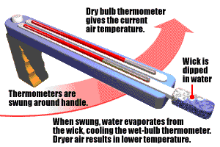
USING A SLING PSYCHROMETER TO MEASURE HUMIDITY
When water evaporates, heat is required to evaporate water.
Evaporation has a cooling effect.
Warm air holds more moisture than cool air.
A sling psychrometer has two thermometers. One is dry to record true temperature and the other is covered in water to measure cooling from evaporation.

Slide 25
USING A SLING PSYCHROMETER TO MEASURE HUMIDITY
The wet thermometer is swung around, causing some of the water to evaporate.
The lower the relative humidity, the more water that will evaporate and the more the wet thermometer will cool down.
When the humidity is higher, the surrounding air already has a lot of water in it - so less water will evaporate and there is less cooling.

Slide 26
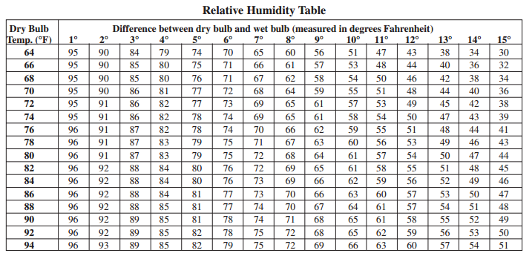
USING A SLING PSYCHROMETER TO MEASURE HUMIDITY
By comparing the temperature of the wet and dry bulb thermometer, you can determine the humidity.
The closer the two temperatures, the greater the humidity (more moisture in the air).
The greater the temperature difference, the drier (less humid) the air.

Slide 27
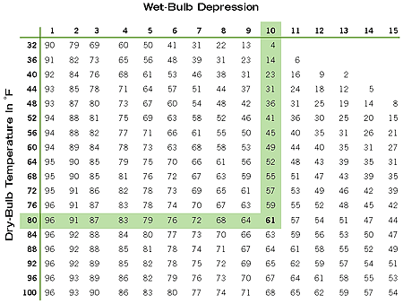

Slide 28
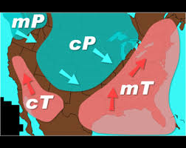
SOMETHING TO THINK ABOUT:
The map shows typical air masses that move through the US. Based on what we learned today, why does the Midwest often have strong storms associated with cold fronts?

Slide 29
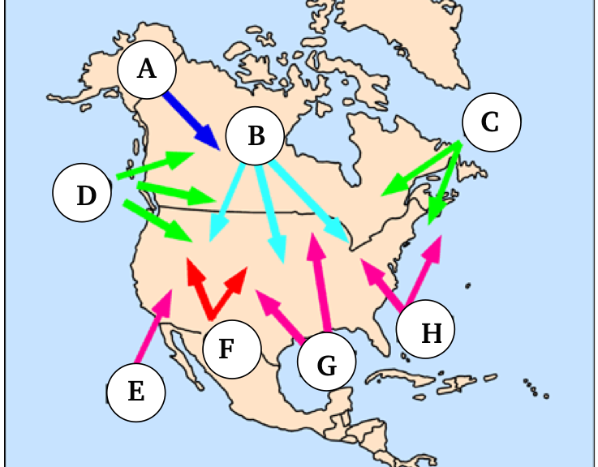
REVIEW
Use the terms To label each air mass:
Polar
Tropical
AND
Maritime
Continental
Continental Polar
Continental Polar
Maritime Polar
Maritime Polar
Maritime Tropical
Continental Tropical
Maritime Tropical
Maritime Tropical

Slide 30
HUMIDITY LAB
PURPOSE:
In this lab, you will use a Sling Psychrometer to measure the relative humidity of the air, both inside and out. The lower the relative humidity, the more water that will evaporate from the wet-bulb, and the more the wet bulb thermometer will cool down. When the humidity is higher, less water will evaporate and the wet bulb temperature will cool less.

Slide 31
HUMIDITY LAB
PROCEDURE:
Make sure the thermometers are reading the same initial temperature.
Wet the cloth covering one end of one thermometer.
Make sure that both thermometers are securely attached to the backing device, then carefully whirl the two thermometers in the air for 2 minutes. Use the stopwatch.
Immediately after whirling, record the temperatures indicated on both thermometers.

Slide 32
HUMIDITY LAB
Repeat steps 2 through 4 but this time, go outside.
Determine the difference between the dry-bulb and wet-bulb thermometers. Record the data in the data table.
Use the Relative Humidity Table on the back to determine the relative amount of humidity in the air.

Slide 33
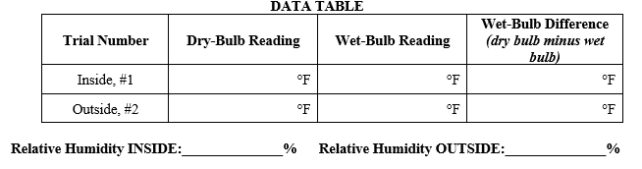
HUMIDITY LAB

Slide 34
HUMIDITY LAB
Then answer the five questions and turn in.
Work on other labs
Review #17 due tomorrow.

