Slide 1
DO NOW
Pick up notes.
Computer Half-Life Simulation is due tomorrow.

Slide 2

THE ELECTRON AND THE ATOMIC MODEL

Slide 3
WAVE NATURE OF LIGHT
Rutherford’s model of the atom did not explain how the electrons of an atom are arranged in the space around the nucleus.
His model did not take into account the chemical behavior among various elements.
In the early 1900’s it was observed that certain elements emitted visible light when heated in a flame. Analysis of the emitted light revealed that an element’s chemical behavior was related to the electron arrangement in the atom.

Slide 4
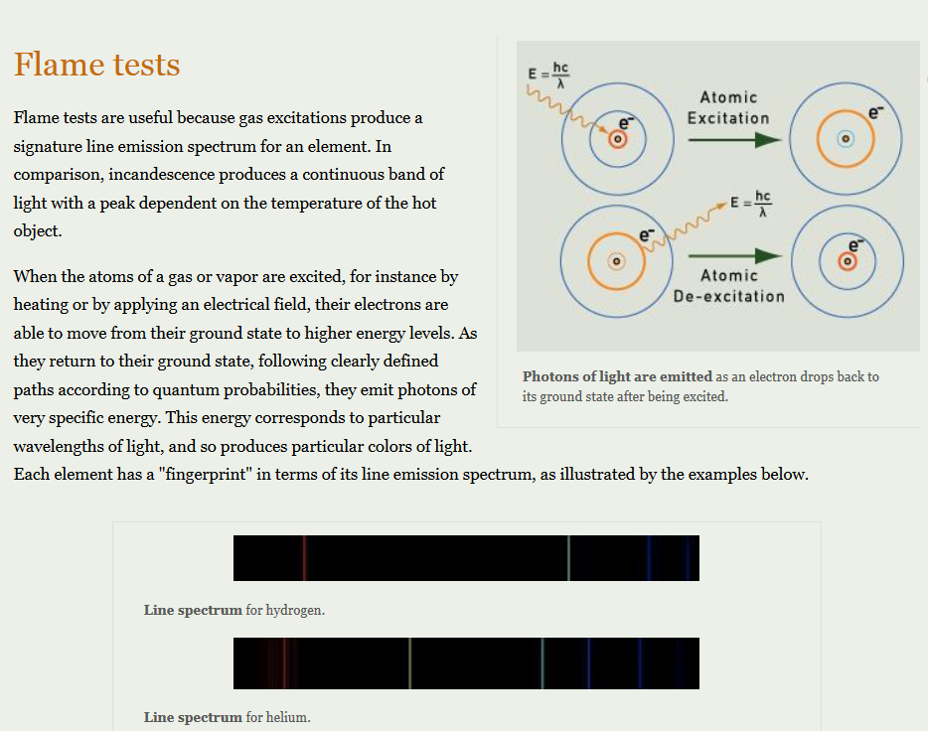
Some of the next part came from http://www.chemistryland.com/CHM130W/10-ModernAtom/Spectra/ ModernAtom.html

Slide 5
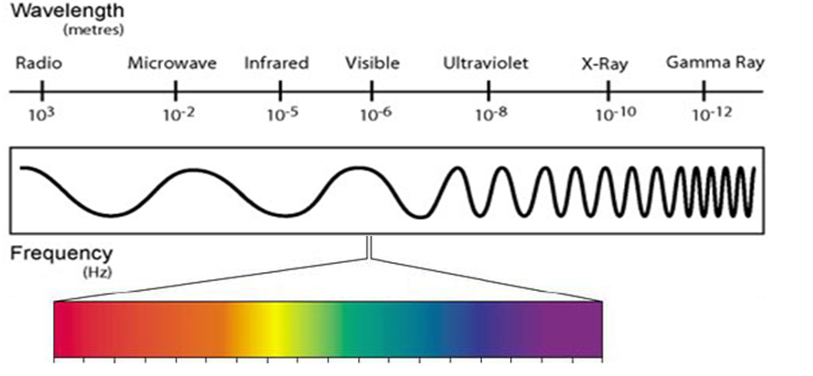
ELECTROMAGNETIC SPECTRUM
Longest wavelength
Shortest wavelength
Lowest frequency
Highest frequency

Slide 6

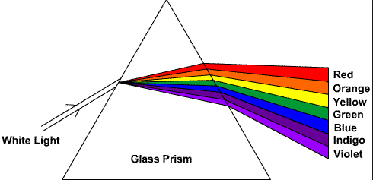
The Electromagnetic Spectrum
Electromagnetic radiation is a form of energy that exhibits wavelike behavior as it travels through space.
Radiant energy, which includes visible light, is shown in the electromagnetic spectrum.
White light can be refracted into its component colors and each color has its own wavelength.

Slide 7
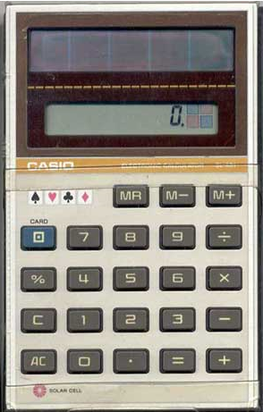

Particle Nature of Light
Not in Your Notes
Wave model of light cannot explain why heated objects emit only certain frequencies of light at a given temperature or why some metals emit electrons when colored light of a specific frequency shines on them.

Slide 8
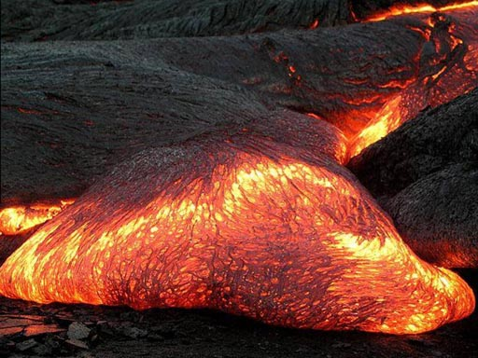
Max Planck found out that the color emitted by something hot tells us the temperature (energy output). For example, the yellow parts of the lava are hotter than the red parts. Remember that yellow light has more energy than red.

Slide 9
ELECTROMAGNETIC SPECTRUM
Less Energy
More Energy

Slide 10
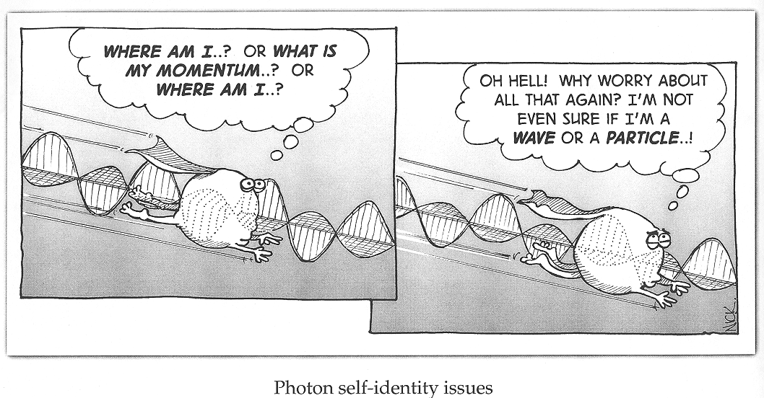
ATOMIC EMISSION SPECTRA

Slide 11
ATOMIC EMISSION SPECTRA
We talked before about flame tests and why the elements produce a color when heated. These elements produce a continuous emission of light.
A neon light works the same way.

Slide 12
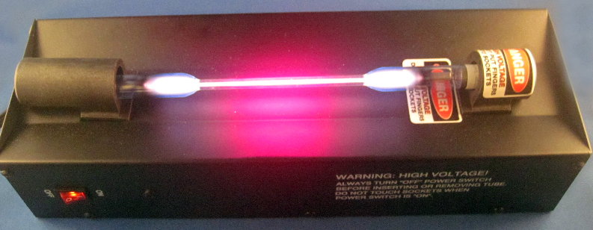
ATOMIC EMISSION SPECTRA
A neon light works because electricity is passed through the neon gas in the tube.
The gas absorbs energy and becomes excited.
Excited and unstable electrons then release energy by emitting light.
We can turn a continuous emission spectra into a discontinuous one by refracting the light.

Slide 13
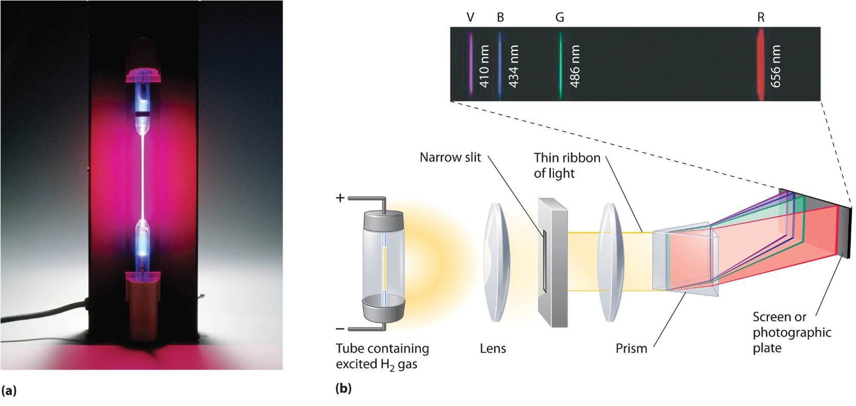
ATOMIC EMISSION SPECTRA
Atomic Emission Spectrum is a set of frequencies of electromagnetic waves emitted by atoms of the element. They are usually distinct color lines.
Each element’s atomic emission spectrum is unique, can be used to identify the element, and can be used to determine if the element is part of an unknown compound.

Slide 14
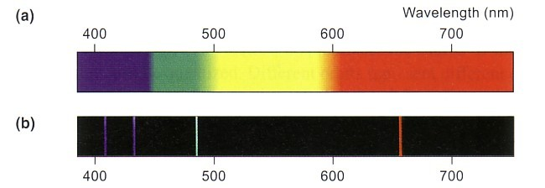
ATOMIC EMISSION SPECTRA - HYDROGEN
The emission spectrum of hydrogen’s one electron. Notice that it is discontinuous – it is made up of only certain frequencies of light – Figure (b).

Slide 15
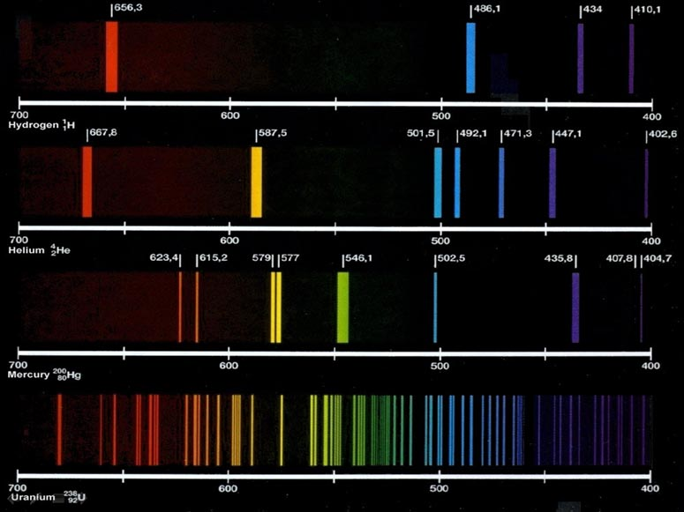

Slide 16
SPECTRA OF FOUR ELEMENTS
Hydrogen: which emits 4 colors of light that's in the visible light range. Note that other frequencies, such as UV light might be emitted, but we can't see them.
Helium: It has 2 electrons and we see 7 colors.
Mercury: spectra shows 8 colors. Mercury also produces a lot of UV light which in fluorescent bulbs is normally converted to visible light by the use of certain minerals that capture UV light and emit visible light.
Uranium: Uranium emits many frequencies of colors. It appears that the elements that have more electrons emit more colors. So there seems to be a connection.

Slide 17
BOHR’S THEORY
In 1913, Neils Bohr comes up with the quantum model of the hydrogen atom. He also correctly predicts the frequencies of the spectral lines in the hydrogen atomic emission spectrum. He said that:
The hydrogen atom has only certain allowable energy states.
The lowest is called the GROUND state.
When atoms gain energy, they are said to be in an EXCITED state.
Hydrogen has one electron, but can have different excited states.

Slide 18
BOHR’S THEORY
Bohr said that the electron moves around the nucleus in only certain allowable circular orbits.
The smaller the orbit, the lower the atom’s energy state or energy level.
Bohr said that hydrogen’s electron in the ground state did not radiate energy.
When excited, the electron moves up to another energy level.
Only certain atomic energies are possible and so only certain frequencies of electromagnetic radiation can be emitted.

Slide 19
HYDROGEN EMISSION SPECTRUM

Slide 20
QUANTUM HISTORY
Werner Heisenberg concluded that it is impossible to make any measurement on an object without disturbing the object.
It is fundamentally impossible to know precisely both the velocity and position of a particle at the same time.
In other words, the light used to measure the particle changes it.
Captain Quantum video.

Slide 21
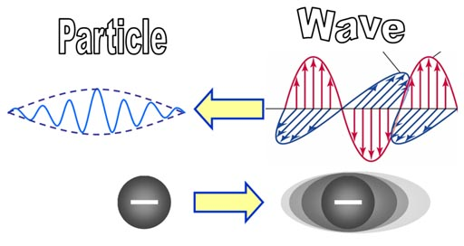
QUANTUM THEORY HISTORY
The spectra of elements showed that light waves also behaved like particles. Who was brave enough to ask, "If waves could behave like particles, can particles behave like waves?"

Slide 22
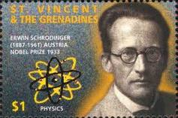
QUANTUM HISTORY
Erwin Schödinger developed an atomic model in which the electrons are treated as waves.
This model is called the quantum mechanical or wave mechanical model.

Slide 23
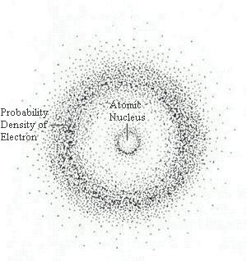
QUANTUM MECHANICAL MODEL
This model does not describe the path of the electron around the nucleus.
The three dimensional region around the nucleus called an atomic orbital describes the electron’s probable location.
The electron cloud has no definite boundary – it is arbitrarily drawn at 90%.

Slide 24
QUANTUM MECHANICAL MODEL
The atom has a dense, centrally located, positively charged nucleus full of protons and neutrons surrounded by mostly empty space where the electrons are.
The energy of electrons is quantized (Has only specific amounts of energy).
Electrons exhibit both wave and particle behaviors.
Rutherford
Bohr
De Broglie

Slide 25
QUANTUM MECHANICAL MODEL
4. The absolute location of an electron is impossible to determine – its location and velocity cannot be determined at the same time.
5. The electrons travel in orbitals that have characteristic sizes, shapes, and energies, but do not describe how the electrons move.
Heisenberg
Shrödinger

Slide 26
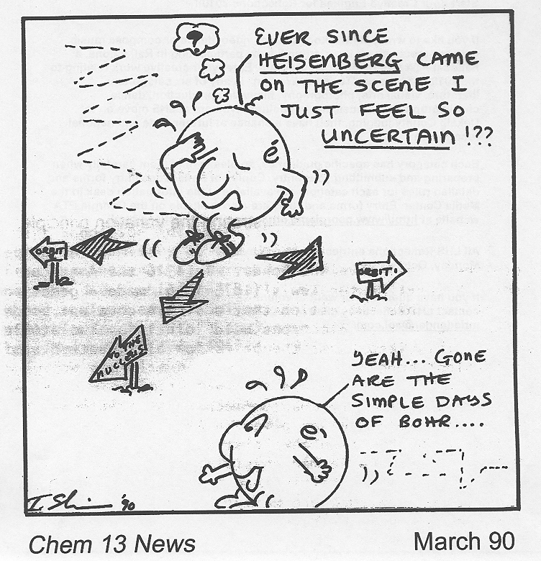

Slide 27
QUANTUM MECHANICAL MODEL
So how do electrons position themselves outside the nucleus?
As the progression of elements were built by adding one proton and one electron at a time, the position of the protons was always in the center of the atom in the nucleus.
However, electrons repelled each other, so as each electron got added for each new element, they would find a position and shape that maximized their distance from each other. Amazingly, the way they positioned themselves followed a fairly basic pattern.

Slide 28
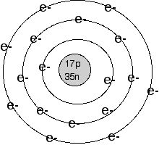
BOHR’S ATOM
- Provides a simplified way to draw the atom (and this pattern.
Nucleus is in the middle;
Indicate how many protons and how many neutrons.
- Draw concentric circles (rings) outside nucleus.
- Fill in the electrons.
Level 1: 2 e- total
Level 2: 8 e- total
Level 3: 8 e- total
What is the name of this element?

Slide 29
VALENCE ELECTRONS
These are electrons in the outermost energy level.
You can determine an atom’s valence electron number by:
  Group on the periodic table.
  Electron configuration (learning this later).
These are the electrons that are involved in chemical bonding.

Slide 30
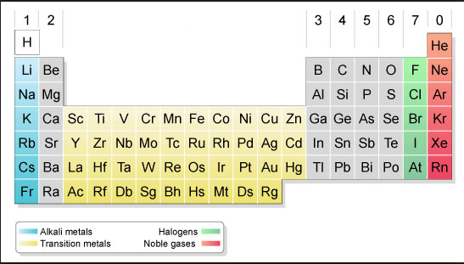
VALENCE ELECTRONS

Slide 31
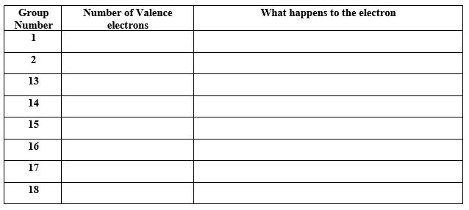
VALENCE ELECTRONS

Slide 32
TO DO
Complete the table on the backside of your notes.
Half-Life Computer Simulation is due tomorrow.

