Slide 1
DO NOW
Pick up notes.

Slide 2
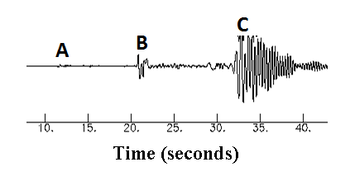
REVIEW
Which position indicates:
Surface waves?
2. P waves?
3. S waves?
C
A
B

Slide 3
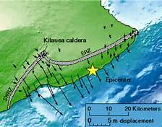
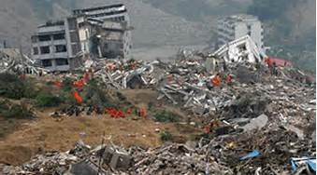
REVIEW
Magnitude is the measure of the strength of an earthquake and is measured by what two scales?
Intensity is the amount of damage caused by an earthquake and is measured by what scale?
Richter scale - old system based on ground motion.
Moment Magnitude scale - new system based on movement of fault block and rigidity of rocks.
Mercalli scale – uses Roman numerals to describe effects.

Slide 4
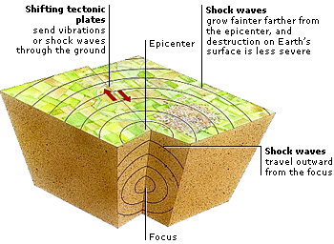
Finding the Epicenter of an Earthquake

Slide 5
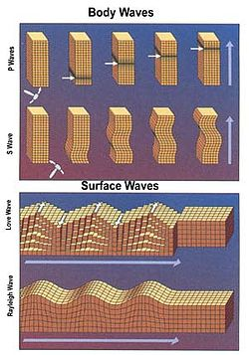
REVIEWING SEISMIC WAVES
Energy released (elastic potential) as fault blocks move.
Energy moves in vibrations called seismic waves.
Body waves:
P waves
  Arrive first; Compression waves
S waves
  Arrive second; Transverse waves
Surface waves:
Most damaging; Rayleigh and Love waves

Slide 6
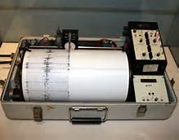
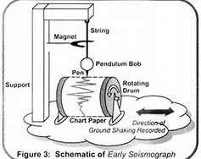
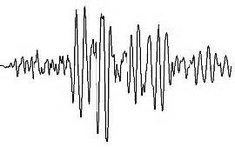
RECORDING EARTHQUAKES
Seismograph
Instrument that detects and records vibrations.
Traces or records the vibrations.
Can measure small changes in rock movement around the faults.

Slide 7
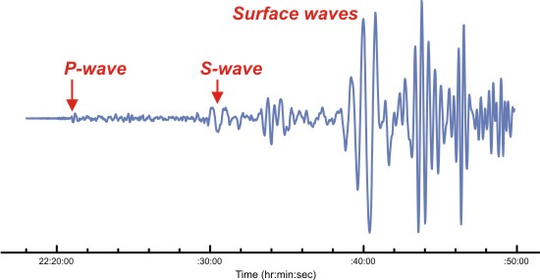
READING SEISMOGRAMS
Fast moving P-waves are first.
Slower, secondary S-waves appear next.
Slowest-moving Surface waves last.

Slide 8
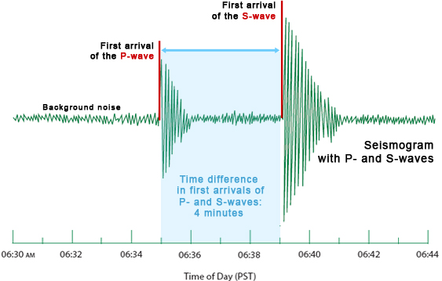
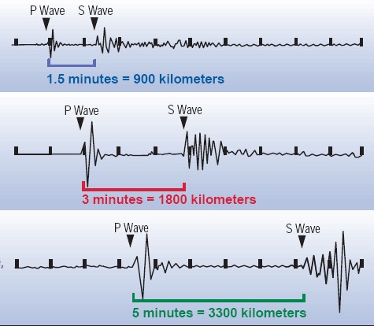
INTERPRETING SEISMIC WAVES
Seismic waves can be used to determine location of epicenter.
Longer time between P and S waves means the earthquake occurred farther away.
With any one reading you can tell the DISTANCE to epicenter.

Slide 9
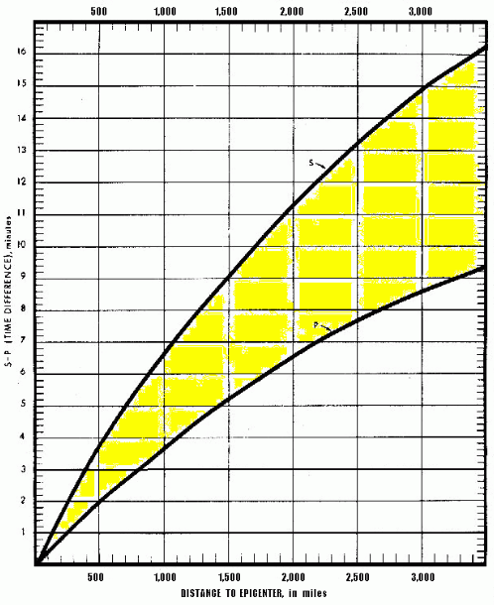
LAG-TIME GRAPH
A lag-time graph translates the difference in arrival times of the P waves and S waves into distance from the epicenter to each station.
You look up the time difference for s and p waves on the y axis.
Then read across to where that time crosses the line.
Read the x axis to get the distance.

Slide 10
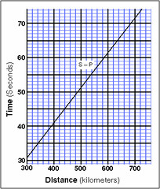
LAG-TIME GRAPH
The graph can be simplified from two lines to one.

Slide 11
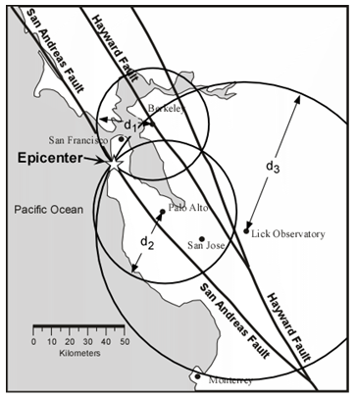
TRIANGULATING THE EPICENTER
Using the seismogram, calculate the distance from different stations.
Once you know the distance for each station draw a circle on a map that has a radius equal to the distance from the epicenter.
The three circles will intersect in a point that locates the epicenter of the earthquake.

Slide 12
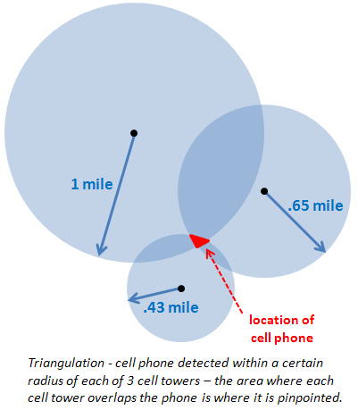
JUST LIKE YOUR CELL PHONE…
Triangulating the epicenter of an earthquake is just like triangulating the location of your cell phone.
It takes THREE data points for GPS to work.

Slide 13
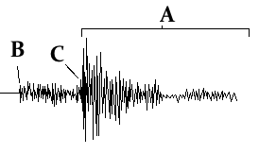
REVIEW….
Which are:
P waves?
Surface waves?
S waves?
B
A
C

Slide 14
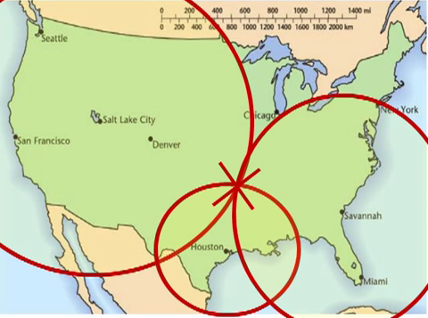
VIDEO INSTRUCTIONS
Youtube Video Link

Slide 15
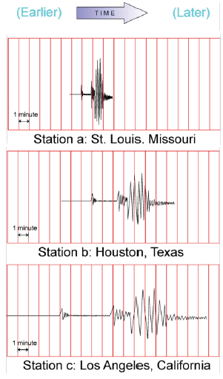
PRACTICE FINDING EPICENTER
What is the lag time for each city?
St. Louis
Houston
Los Angeles
1 Minute
2.5 Minutes
5 Minutes

Slide 16
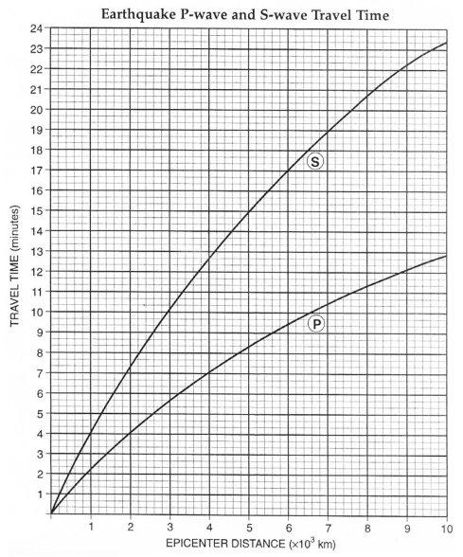
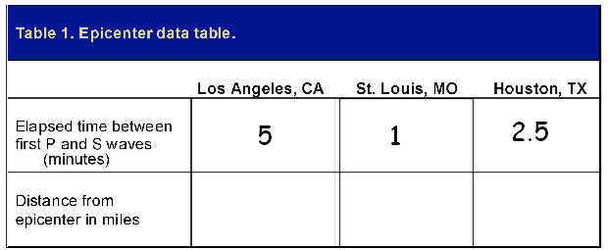
USE LAG TIME TO FIND DISTANCE
Distance from each location to epicenter:
2,000
300
750

Slide 17
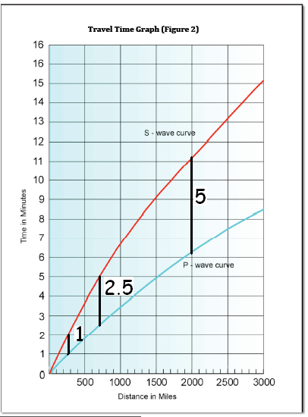
USE LAG TIME TO FIND DISTANCE
Distance from each location to epicenter:
2,000
300
750

Slide 18
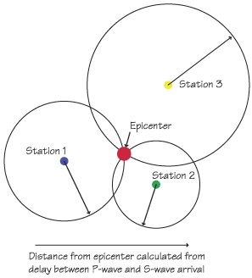
TRIANGULATE THE EPICENTER
Draw three circles using a compass.
The distance calculated is used to determine the radius of the circle.
Must have THREE circles.
Where they intersect is the epicenter.

Slide 19
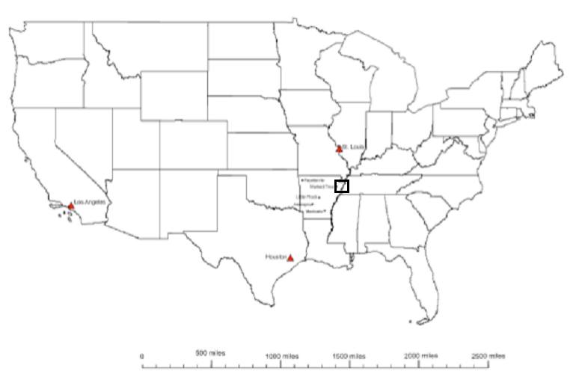
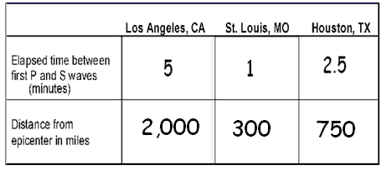
TRIANGULATE THE LOCATION

Slide 20
ACTIVITY - Find the Epicenter
Earthquakes are caused when accumulated stresses in the Earth’s crust causes it to rupture along a fault. Vibrations called seismic waves travel away from the focus (point of origin) in all directions. Two of the main kinds of seismic waves are called P and S waves. Due to the different properties of P and S waves, the distance to an earthquake epicenter can be calculated. In this lab you will use the seismic recording of P and S waves to determine the epicenter of an earthquake.

Slide 21
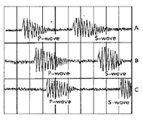
ACTIVITY - Find the Epicenter
Part 1: Practice Reading Seismograms:
To practice what seismologists do, estimate to the nearest half-minute the arrival times of the P- and S-waves, and then calculate the difference for each station. Each vertical line represents one minute.

Slide 22
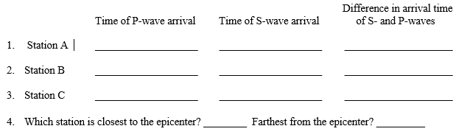
ACTIVITY - Find the Epicenter

Slide 23
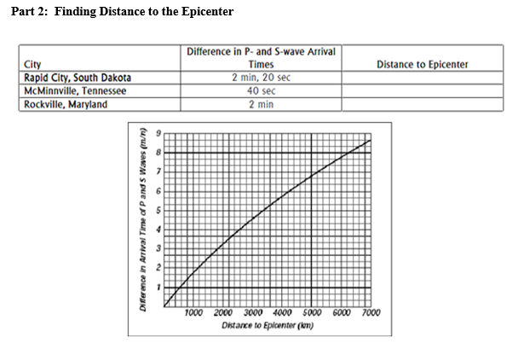
ACTIVITY - Find the Epicenter

Slide 24
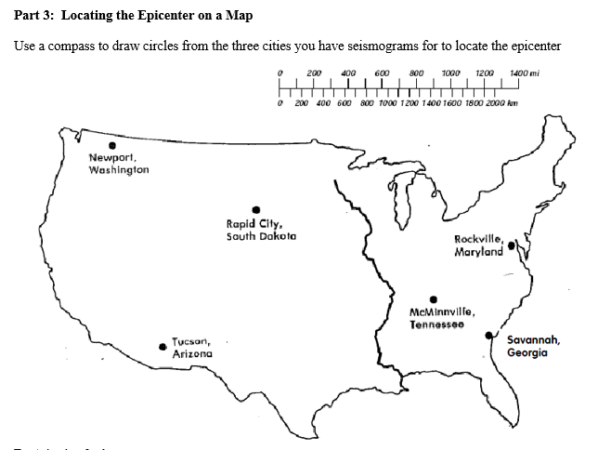
ACTIVITY - Find the Epicenter

Slide 25
ACTIVITY - Find the Epicenter
Which city on the map is closest to the earthquake epicenter?
How far, in kilometers, is this city from the epicenter?
In which of the three cities listed in the data table would seismographs detect the earthquake first?
In which of the three cities listed in the data table would seismographs detect the earthquake last?
When you are trying to locate an epicenter, why is it necessary to know the distance from the epicenter for at least three recording stations?
What happens to the difference in arrival times between P- and S-waves as the distance from the earthquake increases?

Slide 26
TO DO

