Slide 1
DO NOW
Turn in Gas Law Problems handout.
Pick up notes.
You need a calculator today.

Slide 2
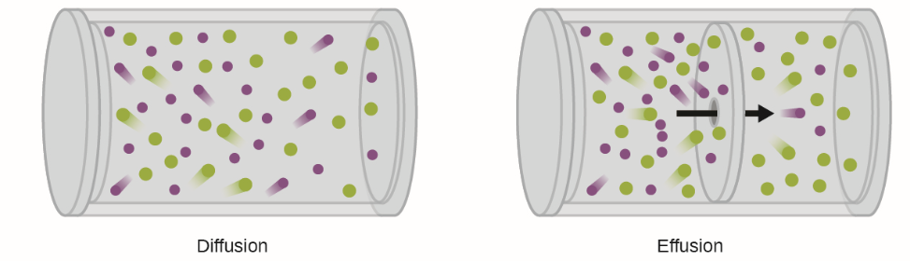
GRAHAM’S LAW OF EFFUSION or DIFFUSION
DIFFUSION:
random mixing of gas molecules due to kinetic properties – think of perfume
EFFUSION:
the process in which a gas escapes through a hole considerably smaller than the mean free path of the molecules.

Slide 3

GRAHAM’S LAW OF EFFUSION or DIFFUSION
The rate of diffusion/effusion is inversely proportional to the square root of its molar mass under identical conditions of temperature and pressure.
If two bodies of different masses have the same kinetic energy, the lighter body moves faster.

Slide 4
DEMO
Anise and Cinnamon
What can we assume about the temperatures of the two oils?
How is temperature related to kinetic energy?
How do the kinetic energy of the two oils compare?
The formula for determining KE is ½mv².

Slide 5
CALCULATIONS
KE = ½mv²
½ m_{a}v_{a}² = ½ m_{c}v_{c}²
½ m_{a}v_{a}² = ½ v_{c}²
m_{c}
½ m_{a} = ½ v_{c}²
m_{c} v_{a}²
m_{a} = v_{c}²
m_{c} v_{a}²

Slide 6
GRAHAM’S LAW OF EFFUSION or DIFFUSION
Rate (velocity) a = Formula mass b
Rate (velocity) b Formula mass a
Compare ammonia and hydrochloric acid:
velocity NH₃ = 36.46g/mol
velocity HCl 17.04g/mol
=
= NH₃ is _______ times faster than HCl

Slide 7
PRACTICE
If equal amounts of helium and argon gases are placed in a container and allowed to escape, which gas will escape faster and how much faster?

Slide 8
REAL vs. IDEAL GASES
The ideal gas equation, PV = nRT, is simple to use and accurately predicts gas behavior in many everyday situations.
However, it is an approximation and does not describe the behavior of real gases exactly.

Slide 9
REAL vs. IDEAL GASES
Under very high pressure, real gases have trouble compressing completely. The ideal gas law fails.
Ideal gases have no volume, but real gases do.
At very low temperatures, attractive forces between real gas molecules become significant and real gases liquefy.

Slide 10
REAL vs. IDEAL GASES
The ideal gas law can be used under ordinary conditions only.

Slide 11
GAS STOICHIOMETRY
We are now going to add to our MOLE CITY diagram, adding volume of a mole of gas.
VOLUME
1 mole 22.4 L @ STP
1 mole 1 mole
PARTICLES MOLE MASS
6.02 x 10²³ molar mass

Slide 12
GAS STOICHIOMETRY
PRACTICE
Determine the volume in 2.0 moles of H₂.
?? volume = 2.0 mol H₂ 22.4 L H₂ 1 mol H₂
      =

Slide 13
GAS STOICHIOMETRY
B. Determine the volume in 10.3 moles of CO₂.
?? volume =

Slide 14
GAS STOICHIOMETRY
C. Determine the moles in 251 L of O₂.
?? moles =

Slide 15
GAS STOICHIOMETRY
D. What volume of H₂ is needed for the complete reaction between N₂ and H₂ to produce NH₃ ? You are given 5.0L N₂.
WYK:
EQN: N₂ + 3H₂ → 2NH₃
SOLVE:

Slide 16
GAS STOICHIOMETRY
E. What volume of O₂ is needed for the complete reaction between O₂ and KCl to produce KClO₃? You are given 45.0g KCl.
WYK:
EQN: 2KCl + 3O₂ → 2KClO₃
SOLVE:

Slide 17

DETERMINING MOLAR MASS
We can use the ideal gas equation to calculate the molar mass of a gas from laboratory measurements.
To solve these problems, we do it one of two ways:
  Calculate moles using the ideal gas law equation and then divide the moles into the number of grams (the mass) given.
  Rewrite the ideal gas law equation to include molar mass and mass in place of moles:

Slide 18
DETERMINING MOLAR MASS
The molar mass formula is
Molar mass, MM = mass, m/moles, n
So, n (moles) is equal to:
moles, n = mass, m
Molar mass, MM
So, if n = m/M, substitute it in the Ideal Gas Law formula. The ideal gas equation can be written as
PV = mRT MM = mRT
MM or P V

Slide 19
PRACTICE
What is the molar mass, MM, of a gas if 100.0 dm³ has a mass of 98.68g at 110°C and 107.0 kPa?
m =
P =
R =
V =
T =

Slide 20
PRACTICE
Calculate the molar mass, MM, of a gas if 150.0 dm³ has a mass of 205g at 100°C and 95 kPa.
m =
P =
R =
V =
T =

Slide 21
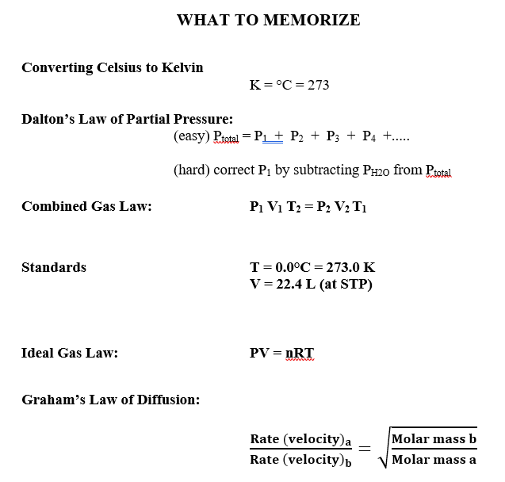

Slide 22
TO DO
Graham’s Law and Gas Stoichiometry handout due tomorrow.
We are going a lab Wednesday and another on Thursday.
Quiz on Friday.

