Slide 1
DO NOW
Pick up notes and Review #6
Turn in Review #5

Slide 2
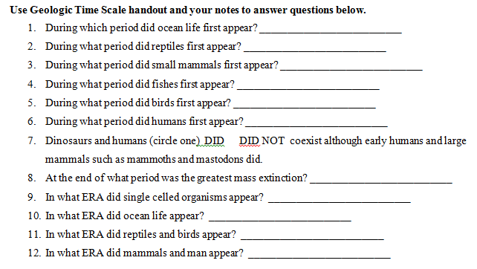
REVIEW #3

Slide 3
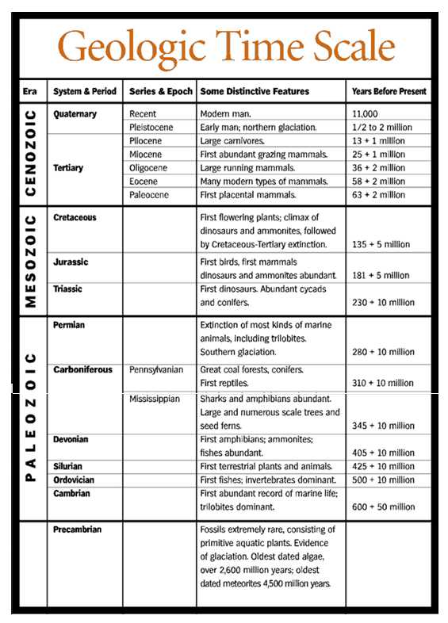

Slide 4
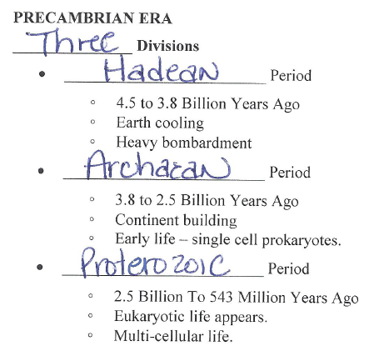
REVIEW #3

Slide 5
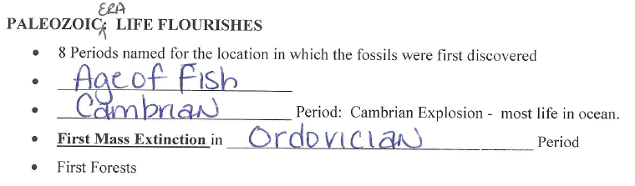
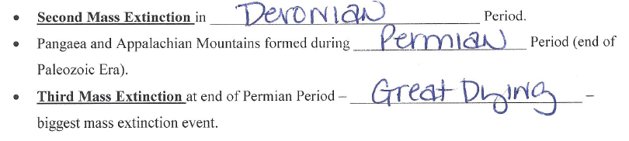
REVIEW #3

Slide 6
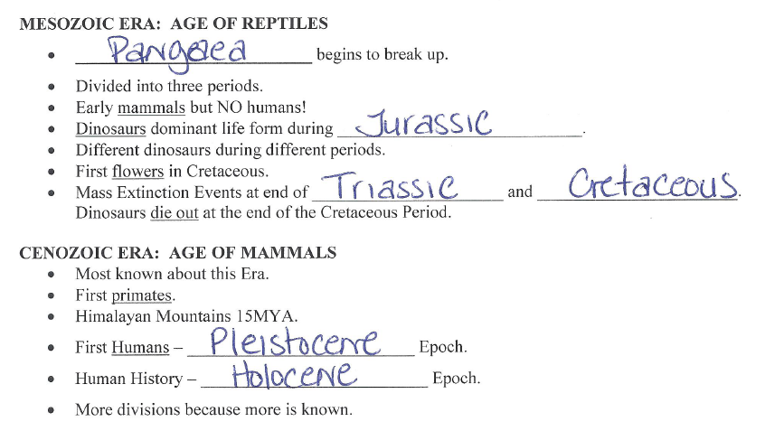
REVIEW #3

Slide 7
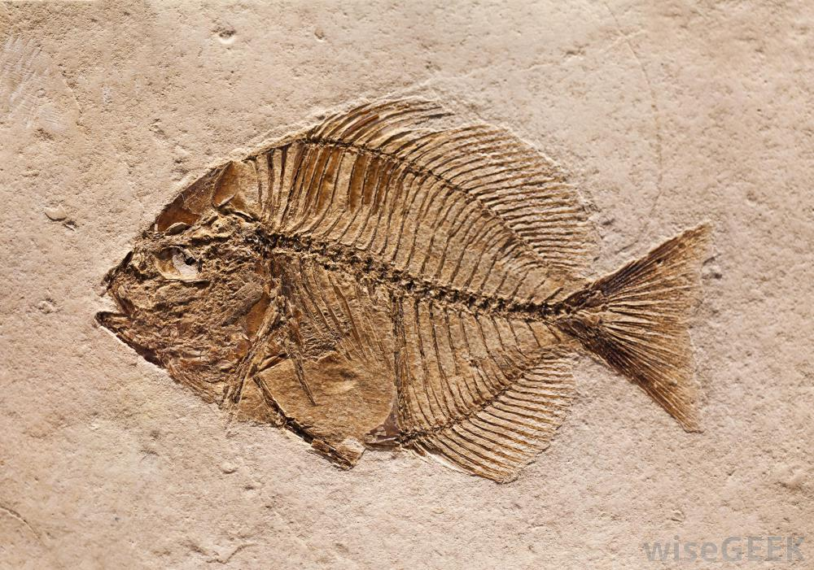
REVIEW
Fish fossils like the one shown have been found in the sedimentary rocks the Rocky Mountains.
What do these fossil finds suggest?

Slide 8
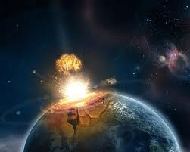
MASS EXTINCTION EVENTS
SES4. Students will understand how rock relationships and fossils are used to reconstruct the Earth’s past.

Slide 9
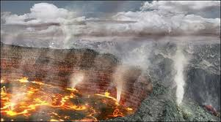
WHAT IS A MASS EXTINCTION EVENT (MME)?
A catastrophe for the world's living organisms.
A rapid event (shorter than 10,000 to 100,000 years).
A significant part of all life on Earth became extinct.

Slide 10
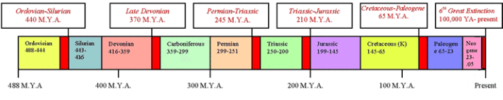
WHAT IS A MASS EXTINCTION EVENT (MME)?
Life forms must represent diverse species, lived in different habitats, spread over entire world.

Slide 11
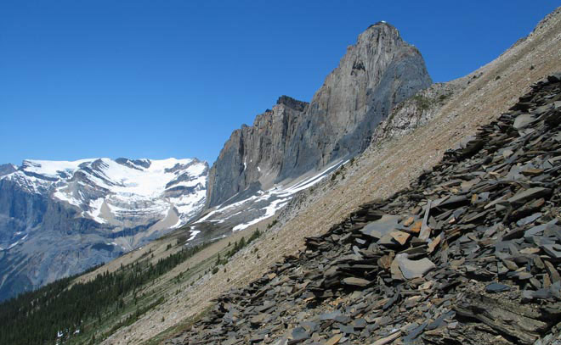
CAMBRIAN EXPLOSION
Precambrian Era:
Mostly bacteria, plankton, and multi-celled algae.
Beginning about 600 million years ago in the Precambrian, the fossil record provides evidence of more rapid change.

Slide 12
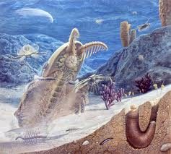
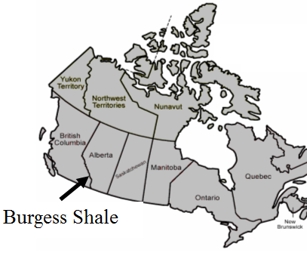
CAMBRIAN EXPLOSION
Cambrian period:
Between about 570 and 530 million years ago – sudden diversity appears.
Burgess Shale in British Columbia provides abundant evidence.
Increase in atmospheric oxygen believed to have been a factor.

Slide 13
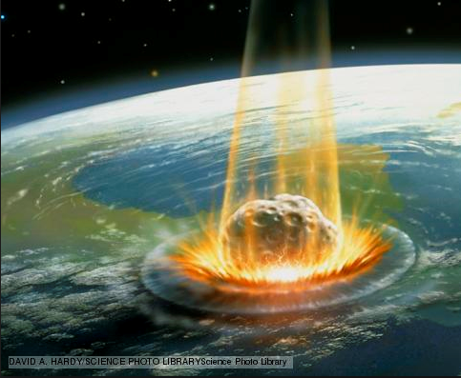
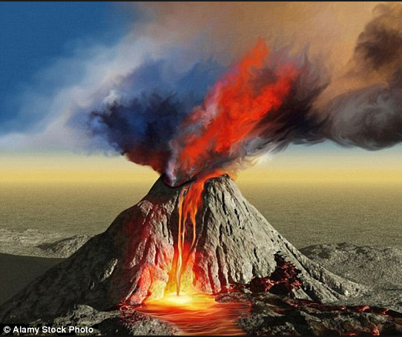
POSSIBLE CAUSES OF MEE
Meteorite Impact
Volcanoes
Climate Change
Changes in Atmosphere
Variations in Solar output
Changes in sea level

Slide 14
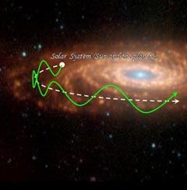
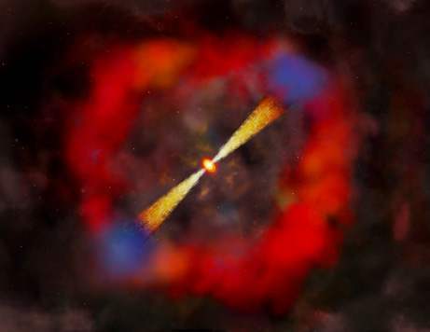
POSSIBLE CAUSES OF MEE
Changes in Orbit
Changes in Magnetic Field
Changes in solar orbit on galactic plane
Nearby Gamma Ray bursts
Most probably combination of events….

Slide 15
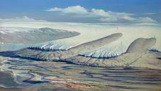
FIRST MASS EXTINCTION EVENT
End of the Ordovician, beginning of Silurian period.
440 million years ago
57-65%of all species exterminated.

Slide 16
FIRST MASS EXTINCTION EVENT
Two peak dying times separated by hundreds of thousands of years.
Thought to have been caused by extreme changes in sea levels due to glacial formation and then rise due to melt.

Slide 17
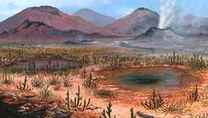
SECOND MASS EXTINCTION EVENT
Late Devonian period
365-375 million years ago .
57-72% of all species disappeared.

Slide 18
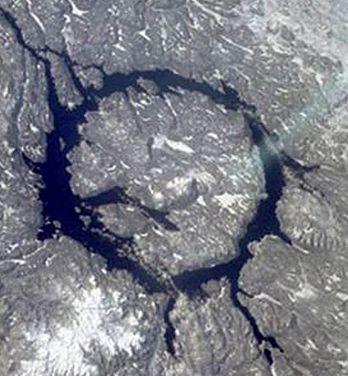
SECOND MASS EXTINCTION EVENT
May have been a series of extinctions over several million years, rather than a single event.
Shallow seas and coral reefs most affected.
Possible causes include:
  Siljan Crater - Sweden
  Climatic and sea level changes .
  Changes in available oxygen in the water.

Slide 19
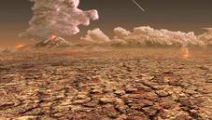
THIRD MASS EXTINCTION EVENT
Most devastating of mass extinctions.
‘The Great Dying’
End of Permian Period, Paleozoic Era.
250 million years ago.
Approximately 96% species go extinct.

Slide 20
THIRD MASS EXTINCTION EVENT
Possible causes include:
  Impact event, possibly Bedout Crater off Australia.
  Massive volcanic activity and depletion of ocean oxygen.
  Formation of super continent, Pangaea, caused a major disruption to the climate and habitats.

Slide 21
FOURTH MASS EXTINCTION EVENT
End of the Triassic period.
199-214 million years ago.
Several phases.
52-65% of all marine species vanished; not sure about land species.

Slide 22
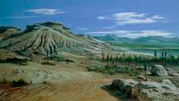
FOURTH MASS EXTINCTION EVENT
Possible causes include:
  Climate change
  Volcanic Eruptions
  Asteroid impact

Slide 23
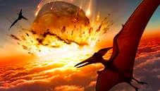
FIFTH MASS EXTINCTION EVENT
Cretaceous-Tertiary mass extinction (K/T extinction).
End of Mesozoic Era.
65 million years ago.
76% species disappeared.

Slide 24
FIFTH MASS EXTINCTION EVENT
Marine life worse hit.
End of the Dinosaurs.
Possible cause – meteor impact - Chixculub Crater, off the Yucatan Peninsula.

Slide 25
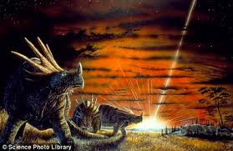
EVIDENCE FOR K-T EXTINCTION
Meteorite Theory:
Rock layers dating to about 65 million years old with iridium (consistent with asteroid composition), tsunami sediments, shocked quartz, carbon soots and extra terrestrial amino acids from over 200 extinction layer sites around the world.

Slide 26
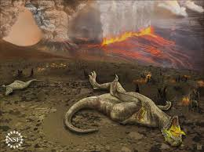
EVIDENCE FOR K-T EXTINCTION
Volcano Theory:
End of the Cretaceous was one of the most intense periods of volcanic activity in Earth's history - sulfur dioxide and carbon dioxide pumped into the air could cause catastrophic climate changes, including 'nuclear' winters, seasonal changes and global warming

Slide 27
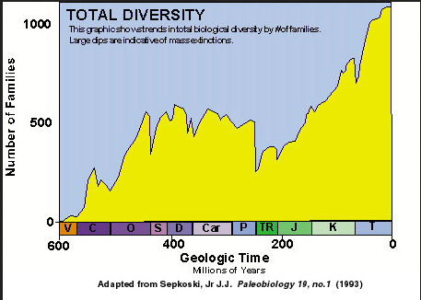
AFTER A MASS EXTINCTION
Surviving Species take over vacant habitats and resources.
New species develop.

Slide 28
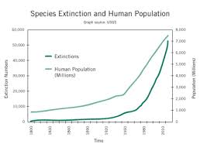
SIXTH MASS EXTINCTION EVENT
Holocene Extinction – Human caused.
Phase One began when the first modern humans began to disperse to different parts of the world about 100,000 years ago.
Extinction follows path of human migration.

Slide 29
SIXTH MASS EXTINCTION EVENT
Phase Two began about 10,000 years ago when humans turned to agriculture:
  transformation of the landscape
  overexploitation of species
  Pollution
  Introduction of alien (invasive) species
  Population increased from 1 to 10 million people on earth 10,000 years ago - now over 6 billion people (8 million by decade end).

Slide 30
SIXTH MASS EXTINCTION EVENT
Current species loss of between 17,000 and 100,000 species each year.
Estimated that half of all plants, animals and birds on the planet will die off before 2100.

Slide 31
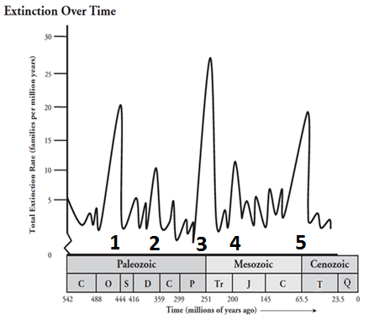
REVIEW
Which Mass Extinction event killed the dinosaurs?
2
3
4
5

Slide 32
TO DO
Review #6 due tomorrow.
Work on Geologic Timeline, Fossils: Reconstructing the Past, or Fossils: Past Environments.

