Slide 1
DO NOW
Pick up notes.
Get out Molecular Geometry sheet from yesterday.

Slide 2
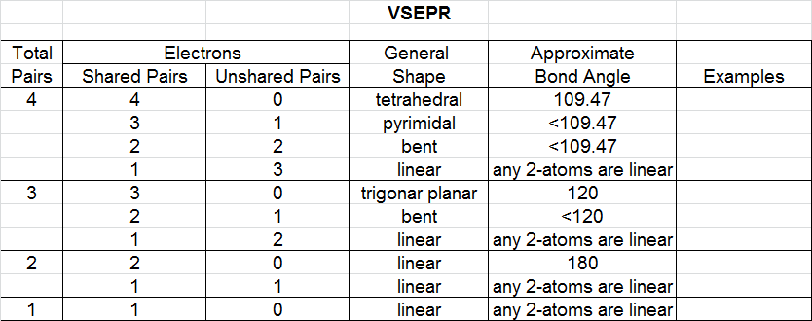
VSEPR TABLE
Look on the back of your Molecular Geometry worksheet

Slide 3
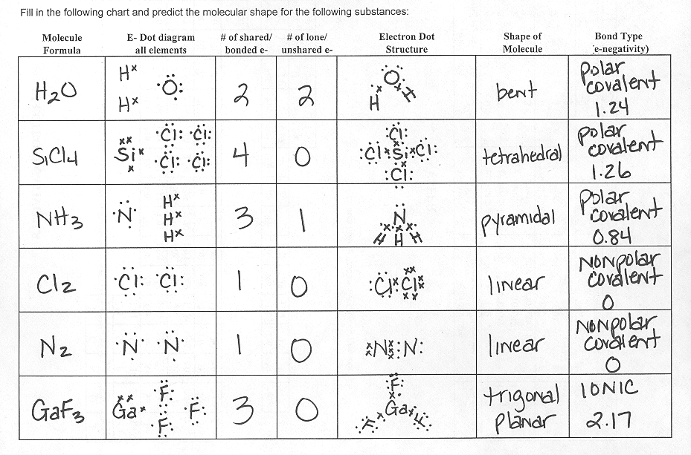
PRACTICE

Slide 4
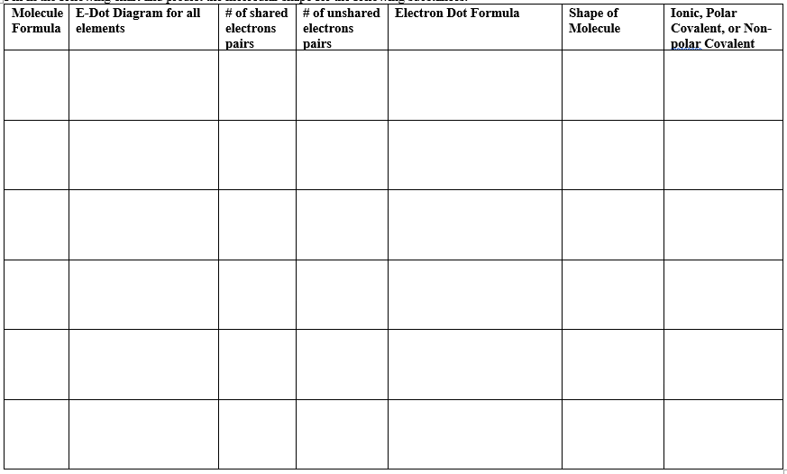
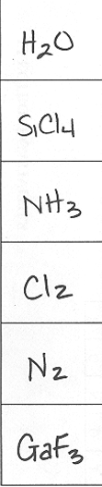
PRACTICE

Slide 5
PRACTICE

Slide 6
MOLECULAR POLARITY
This is a result of bond dipoles (areas of unequal polarity) that do not cancel each other out.
This is the polarity of the MOLECULE not the BOND.
For molecular polarity, the shape of the molecule must be considered.

Slide 7
REMINDER
This is not BOND polarity.
You can determine the polarity of BONDS by determining the electronegativity differences of the two atoms involved.
C – C nonpolar covalent diff = 0
Na – F ionic diff = 3.05
O - H polar covalent diff = 1.14

Slide 8
MOLECULAR POLARITY
Take those same molecules and the polarity of the molecule will depend on the whole molecule, not just the bond.
C – C nonpolar equal sharing
Na – F polar unequal sharing
C - H polar unequal sharing
For a molecule, you must consider the shape and the terminal atoms.

Slide 9
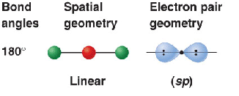
MOLECULAR POLARITY
LINEAR
If the terminal atoms are the same, there are equal forces, so it is NONPOLAR. If they are not the same, it is POLAR.
BeF₂ – nonpolar
HCl - polar

Slide 10
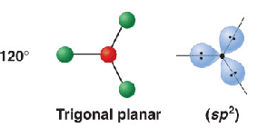
MOLECULAR POLARITY
TRIGONAL PLANAR
If the terminal atoms are the same, there are equal forces, so it is NONPOLAR. If they are not the same, it is POLAR.
BCl₃ – nonpolar
BHCl₂ - polar

Slide 11
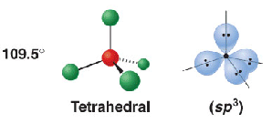
MOLECULAR POLARITY
TETRAHEDRAL
If the terminal atoms are the same, there are equal forces, so it is NONPOLAR. If they are not the same, it is POLAR.
CCl₄ – nonpolar
CHCl₃ - polar

Slide 12
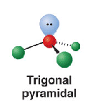
MOLECULAR POLARITY
PYRAMIDAL
Because of the unshared pair, there are unequal forces, so the molecule is POLAR.
NH₃

Slide 13
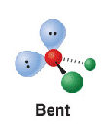
MOLECULAR POLARITY
BENT
Because of the two unshared pairs, there are unequal forces, so the molecule is POLAR.
H₂O

Slide 14
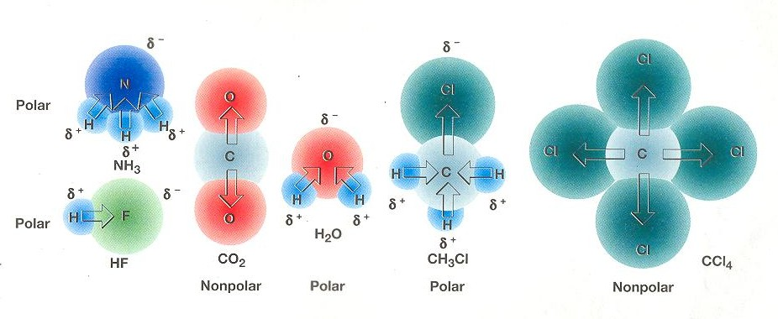
MOLECULAR POLARITY

Slide 15
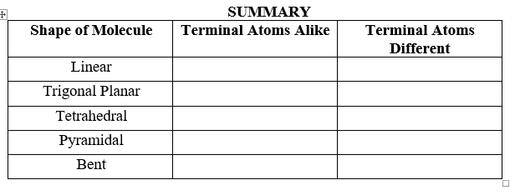
SUMMARY
NONPOLAR
POLAR
NONPOLAR
POLAR
NONPOLAR
POLAR
POLAR
POLAR
POLAR
POLAR

Slide 16
What is the Molecular Polarity for these molecules?
Molecular Polarity

Slide 17
REMEMBER!
To determine BOND POLARITY, calculate the electronegativity differences.
To determine MOLECULAR POLARITY, look at the shape of the molecule and the terminal atoms.

Slide 18
TRY THIS
Molecule Formula | E- Dot Diagram for all atoms | # shared/ bonded electrons | # lone/ unshared electrons | E- Dot Structure | Shape of molecule | Bond Type (electro-negativity)
AlH₃
PH₃
CS₂

Slide 19
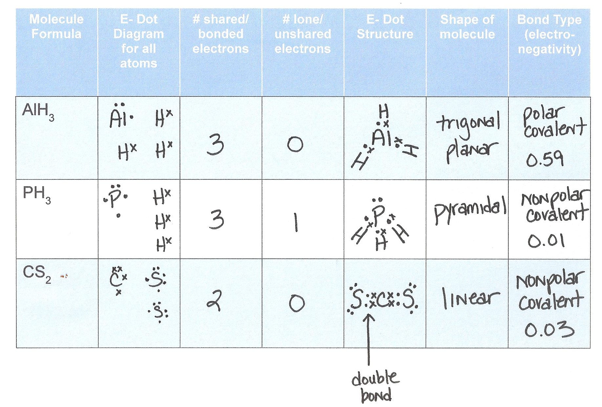

Slide 20
Molecular Polarity?

Slide 21
TO DO
Chemical Bonding handout due Thursday.
Lab tomorrow.

