Slide 1
DO NOW
Pick up notes.
Get out Stoichiometry of a Chemical Reaction lab and Off to the Races lab.
Get out calculator and green periodic table.

Slide 2
MOLE TEST
RETEST OPPORTUNITY:
Available to anyone.
Must attend TWO study sessions for the full time of each.
Must be prepared to take the test BEFORE or AFTER school on Wednesday, February 15 at 7:00 am or 3:15 pm.
Test cannot hurt your grade – only help.

Slide 3
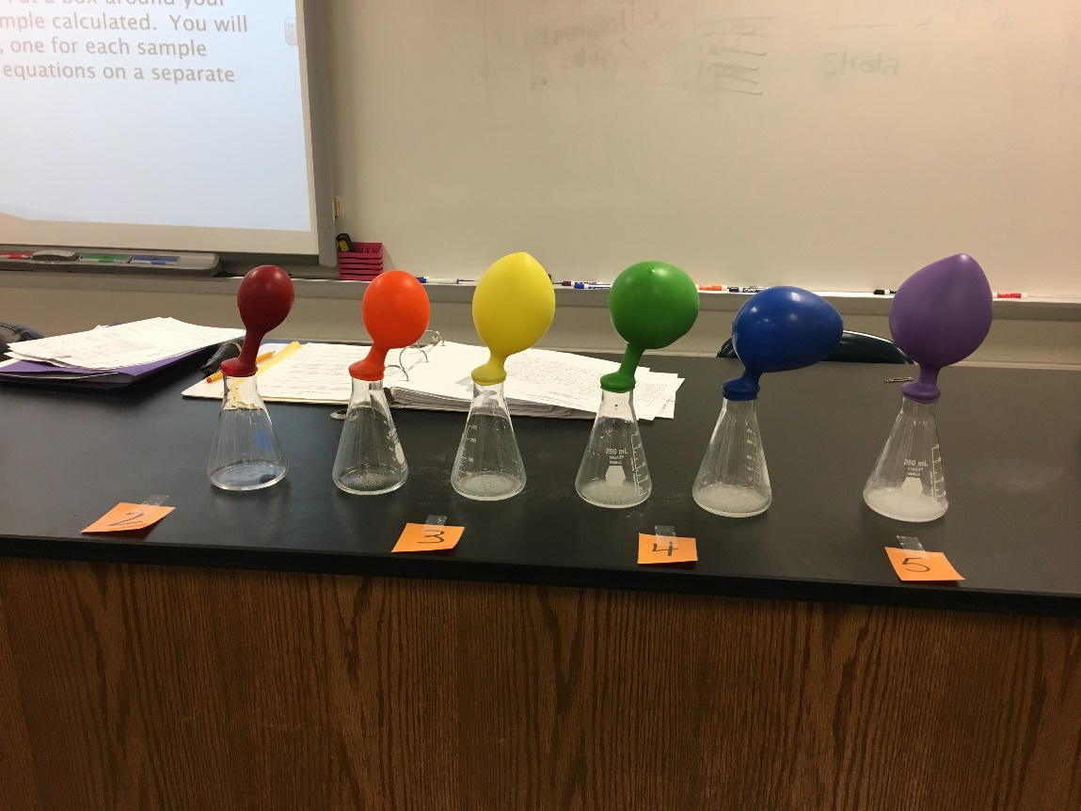
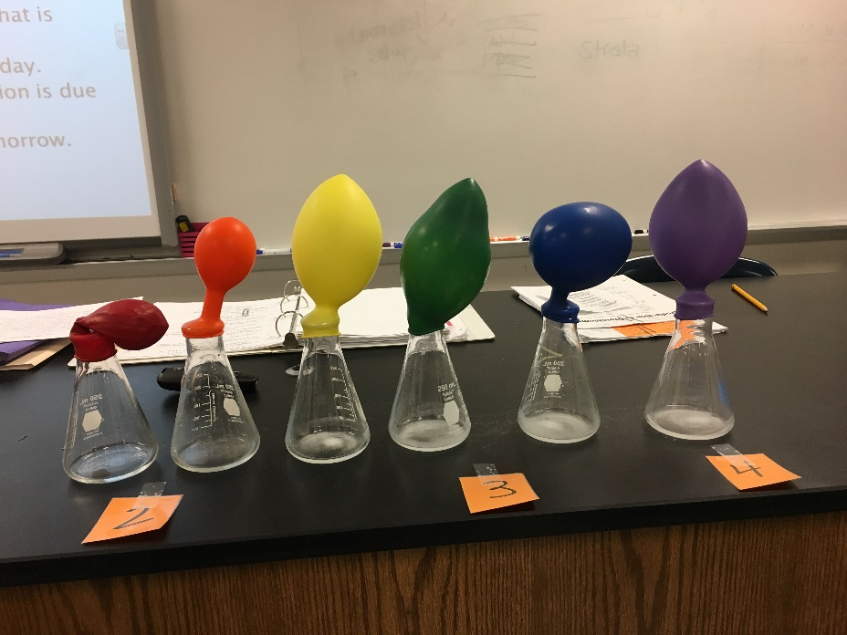
OFF TO THE RACES RECAP

Slide 4
OFF TO THE RACES
TABLE ONE
LAB DESK | SAMPLE | Mass NaHCO₃
1-2 | 1 | 0.50g
3-4 | 2 | 1.00g
5-6 | 3 | 1.50g
7-8 | 4 | 2.00g
9-10 | 5 | 2.50g
11-12 | 6 | 3.00g

Slide 5
OFF TO THE RACES
Your goal is to calculate the theoretical number of moles of gas produced in EACH reaction.
You have two reactants to work with - Sample grams #1-6 NaHCO₃ and 10.0 mL HC₂H₃O₂.
You will then identify the limiting reactant and the excess reactant in each case.
The balanced equation is: NaHCO_{3(s)} + HC₂H₃O_{2(aq)} → NaC₂H₃O_{2(aq)} + CO_{2(g)} + H₂O _{(l)}

Slide 6
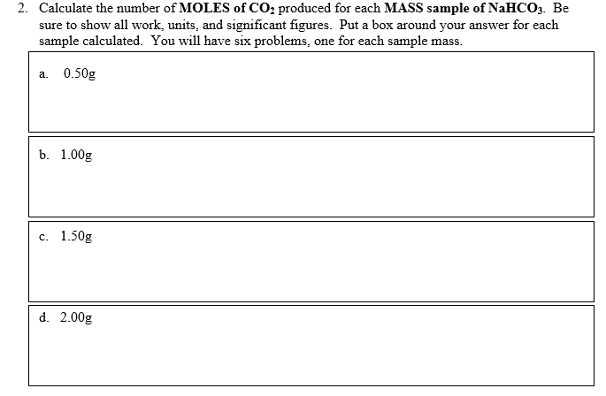
MOLES OF CO₂ PRODUCED

Slide 7
OFF TO THE RACES
Sample | Moles of CO₂ produced by NaHCO₃ | Moles of CO₂ produced by HC₂H₃O₂ | Moles of CO₂ theoretically produced | Limiting Reagent | Excess Reagent
0.50g (1)
1.00g (2)
1.50g (3)
2.00g (4)
2.50g (5)
3.00g (6)

Slide 8
QUESTIONS?

Slide 9
PERCENT YIELD
We can calculate theoretical amounts of chemicals produced in a chemical reaction by doing limiting reactant problems.
In reality, the actual experimental amounts yielded in the laboratory are much less due to human error or other factors.
Chemists want to compare the theoretical yield to the actual yield to see how efficient they are.

Slide 10
PERCENT YIELD
Percent Yield = actual amt of product x 100
theoretical amt
Theoretical amt – maximum amount of product that CAN be produced from a given amount of reactant.
Actual amt – amount of product actually produced when the chemical reaction is carried out (the experimental amount).

Slide 11
EXAMPLE
In the reaction of 1.75 g of salicylic acid, C₇H₆O₃ and methanol, CH₃OH, 1.42 g of oil of wintergreen, C₈H₈O₃, and water, H₂O, are actually produced. Theoretically, it should produce 1.93g of oil of wintergreen. What is the percentage yield?
Actual x100 = 1.42 g C₈H₈O₃ x 100
Theo. 1.93 g C₈H₈O₃
= ______________________%

Slide 12
PRACTICE
Gold is extracted from gold bearing rock by adding sodium cyanide in the presence of oxygen and water, according to the reaction:
4Au_{(s)} + 8NaCN_{(aq)} + O_{2(g)} + H₂O_{(l)} → 4NaAu(CN)_{2(aq)} + NaOH_{(aq)}
Determine the percent yield of NaAu(CN)₂ if 38.790g NaAu(CN)₂ is produced and the theoretical yield is 41.3g.

Slide 13
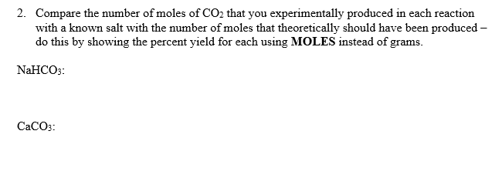
NOW – STOICHIO LAB
If you missed the explanation of #2 previously, you now know how to do Percent Yield. Finish and turn in the lab by the end of the period.

Slide 14
NOW
Work on the Limiting Reactant and Percent Yield handout – due tomorrow.
Off to the Races lab is also due tomorrow.

