Slide 1
DO NOW
Pick up notes and Review #25.
Get out Soil Texture Lab directions.

Slide 2
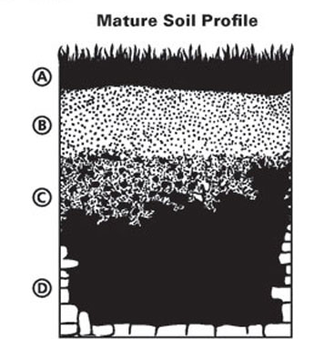
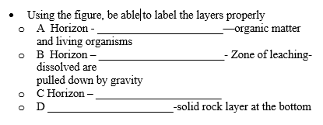
REVIEW

Slide 3
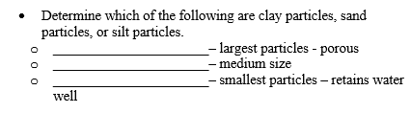
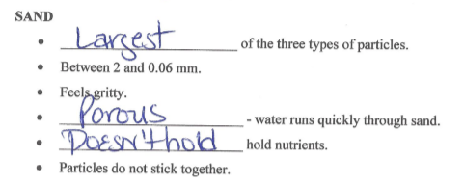
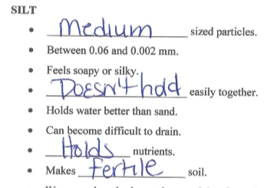
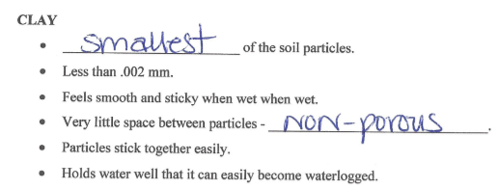
REVIEW

Slide 4
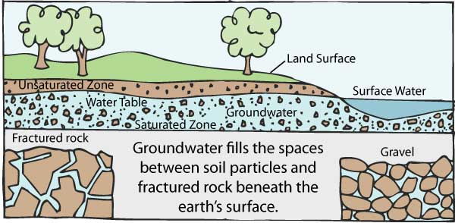
REVIEW
Water Cycle:
  What is groundwater?
  How is it transported below Earth’s surface?
Water under the surface of the ground.
Through cracks and spaces between rock particles.

Slide 5
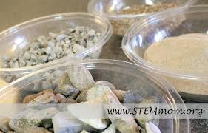
POROSITY AND PERMEABILITY
How water infiltrates and percolates through the ground

Slide 6
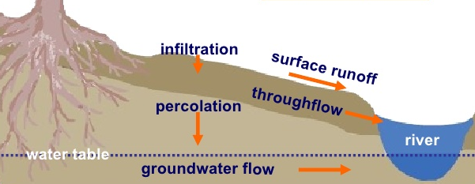
WATER FLOW IN GROUNDWATER
Infiltration – when the water enters the soil surface after falling from the atmosphere.
Percolation – the downward movement of water from the land surface into soil or porous rock.
What factors could affect the rate at which water infiltrates or percolates through the ground?

Slide 7
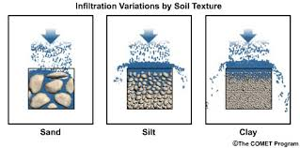
POROSITY
The percent of rock or sediment that consists of open space is porosity.
Groundwater moves through the spaces between soil particles.
These spaces are called pores.

Slide 8
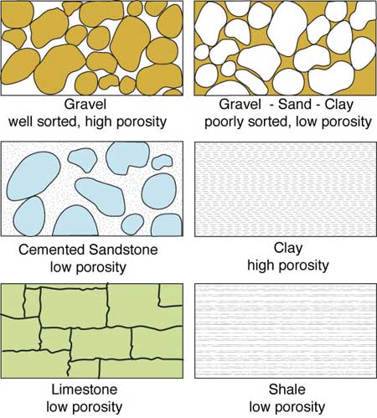
PORE SPACE
Porosity:
determines the total amount of water a material will hold.
depends on the number and size of pores in soil.
  Sandy soils drain well but do not retain water.
  Clay soils hold water but do not drain easily.

Slide 9
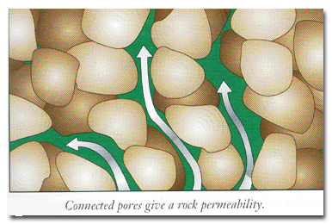
PERMEABILITY
The ease with which water passes through a porous material is permeability.
Factors affecting permeability include:
how large the pores in the substance are.
how well the particles fit together.
The size and sorting of the particles composing the rock or sediment will affect its permeability.

Slide 10
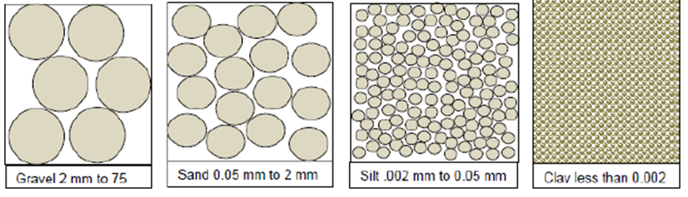
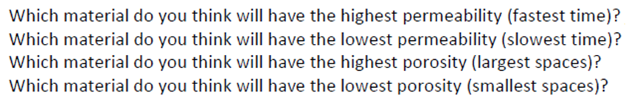
THINK ABOUT IT
Particle Size and Pore Space
A
B
C
D

Slide 11
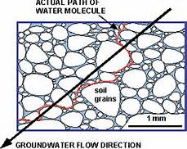
IMPORTANCE AND APPLICATION
Porosity and Permeability are important because they:
Determine how water flows through material.
Tell how water is stored in material.
Applies to rock and soil.

Slide 12
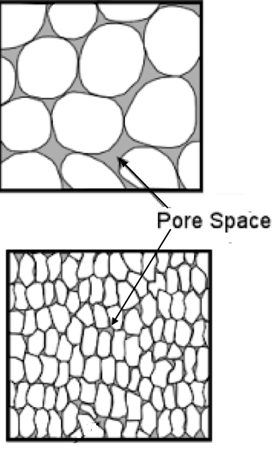
REVIEW
What is the relationship between POROSITY and PARTICLE SIZE?
As particle size INCREASES, porosity INCREASES.
As particle size INCREASES, porosity DECREASES.
As particle size DECREASES, porosity INCREASES.
There is NO RELATIONSHIP.
Which has the greatest porosity? Least?
Top
Bottom

Slide 13
SOIL TEXTURE LAB
DAY TWO
Each sample has different amounts of minerals (sand, silt, and clay) in it, but we did not know the amounts by simply looking at the soil. By putting water in with the soil, shaking the tube, and letting the soil settle, we can see the different types of textures in the soil. This occurs because of the heaviest particles (sand) settle first on the bottom of the jar. The next layer of soil is the silt because it has medium size particles. Silt is not as heavy as sand but is heavier than clay. The last layer to settle on the top is the clay. Clay particles are the lightest of all.

Slide 14
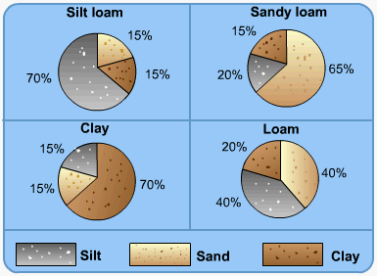
DAY 2:
SOIL TEXTURE LAB
Collect your test tubes and holder and carefully carry them back to your table so the particles will not be disturbed.
We have placed your test tubes at your desk.

Slide 15
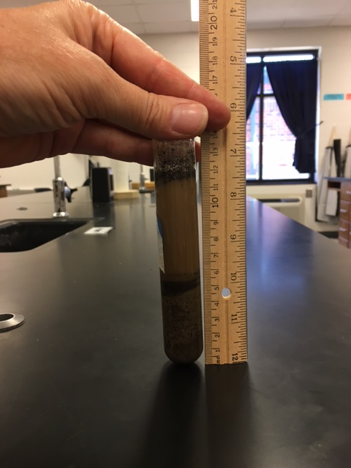
DAY 2:
SOIL TEXTURE LAB
Measure the TOTAL height of the soil and sediment in each test tube and record below.
Muddy water only
Top of the soil column.

Slide 16
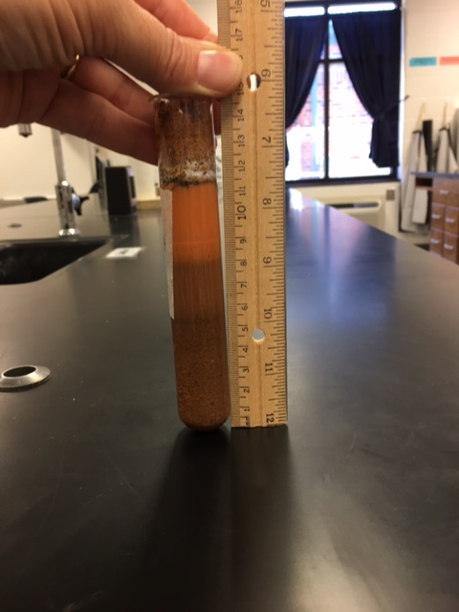
DAY 2:
SOIL TEXTURE LAB
Measure the Sand on the Bottom.

Slide 17
DAY 2:
SOIL TEXTURE LAB
Measure the Silt.

Slide 18
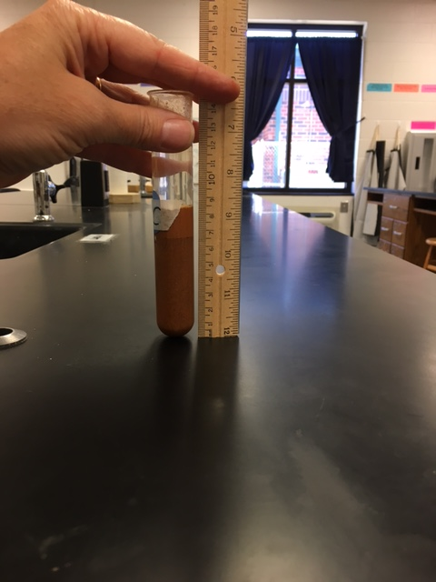
DAY 2:
SOIL TEXTURE LAB
Measure the Clay on the top.

Slide 19
SOIL TEXTURE LAB
6. Take your soil samples to one of your teachers and we will show you how to dispose of them.

Slide 20
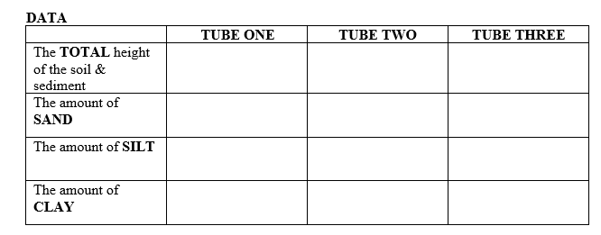
SOIL TEXTURE LAB
A
B
C
5.5cm
9.0cm
8.1cm
4.5cm
5.5cm
7.3cm
0.9cm
2.7cm
0.0cm
0.1cm
0.8cm
0.8cm

Slide 21
SOIL TEXTURE LAB
ANALYSIS
Take the measurements for the sand, silt and clay and turn them into percentages.
The percentages will tell you how much sand, silt or clay is present compared to the total amount of soil in the test tube.
To figure out the percentages of each, take your amount of sand (or silt or clay) in millimeters and divide by the total amount of soil in the test tube (in millimeters). Then, multiply this number by 100 to get the percentage of sand in your jar. Then, round your percentages to the nearest whole number.

Slide 22
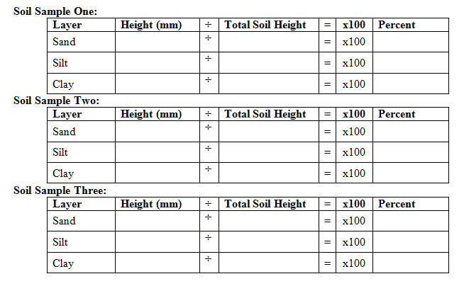
SOIL TEXTURE LAB
4.5cm
5.5cm

Slide 23
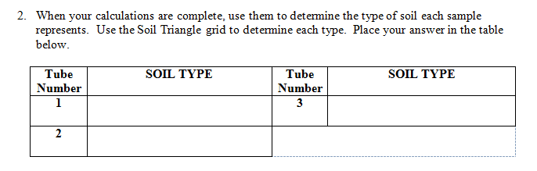
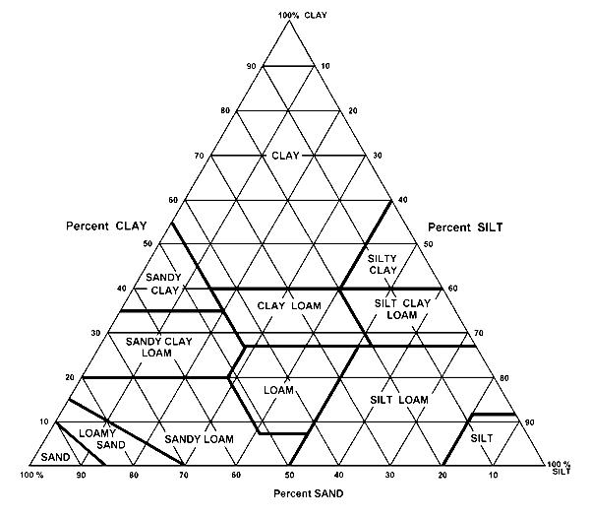
SOIL TEXTURE LAB

Slide 24
SOIL TEXTURE LAB
CONCLUSION
What type of soil settled first (bottom) in your jar?
What type of soil settled second (middle) in your jar?
What type of soil settled third (top) in your jar
What are the three types of grains in soil?
How are these three grains different? Be specific about each one.

Slide 25
REMINDERS
Do not jiggle your test tubes or you will lose your data.
Bring your test tubes to one of your teachers for clean up.
Leave your lab desk clean and work on the questions

