Slide 1
REVIEW-ACIDS and BASES

Slide 2
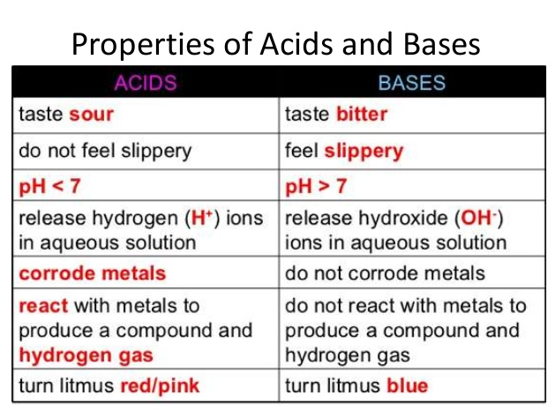
REVIEW OBJECTIVES
Describe the properties of acids and bases.

Slide 3
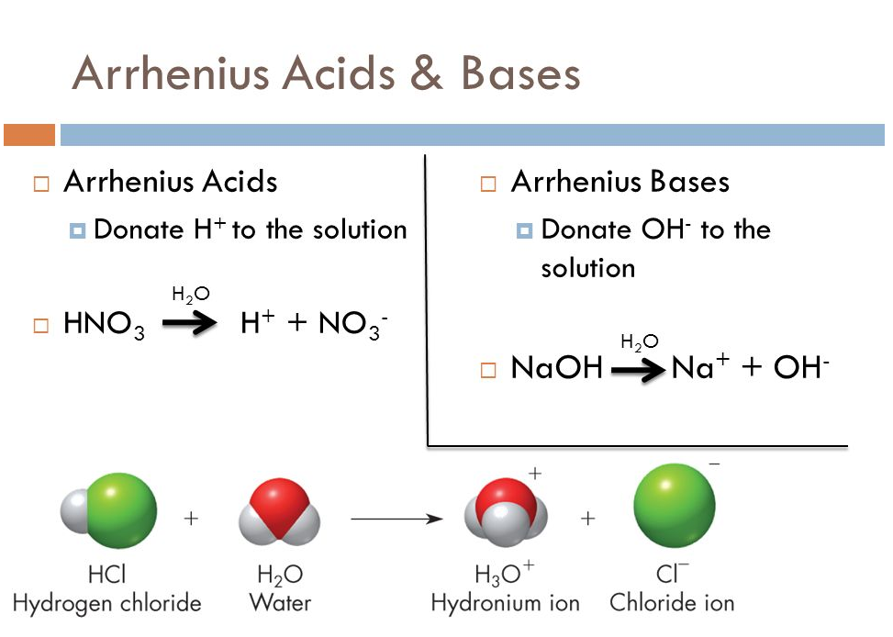
REVIEW OBJECTIVES
Define an Arrhenius acid and base.

Slide 4
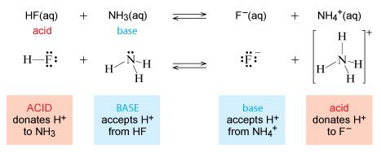
REVIEW OBJECTIVES
Define a Bronsted-Lowry acid and base.

Slide 5
REVIEW OBJECTIVES
Compare and contrast Arrhenius’ and Brønsted-Lowry definitions.
- Acids have the same definition in both theories – donate an H⁺
- Brønsted-Lowry is more inclusive, including all bases which Arrhenius only includes bases that are hydroxides.

Slide 6
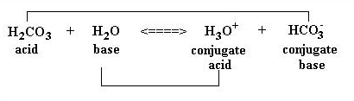
REVIEW OBJECTIVES
Describe and identify conjugate acids and bases.
A conjugate acid is the substance formed when a Brønsted-Lowry base accepts a hydrogen ion.
A conjugate base is the substance formed when a Brønsted-Lowry acid donates a hydrogen ion.

Slide 7
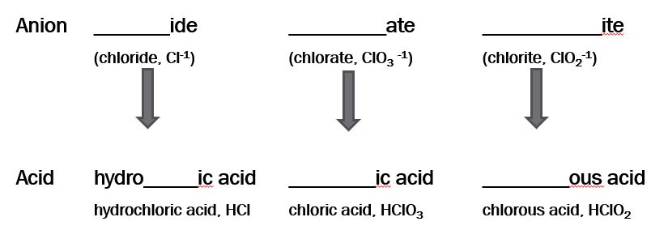
REVIEW OBJECTIVES
Write the name of an acid from its formula and vice versa.

Slide 8
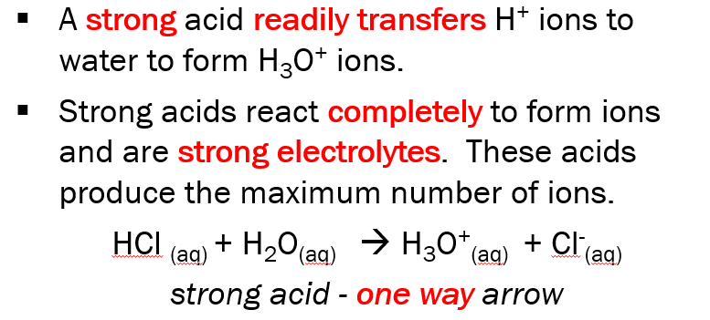
REVIEW OBJECTIVES
Describe how strong acids and weak acids differ.

Slide 9
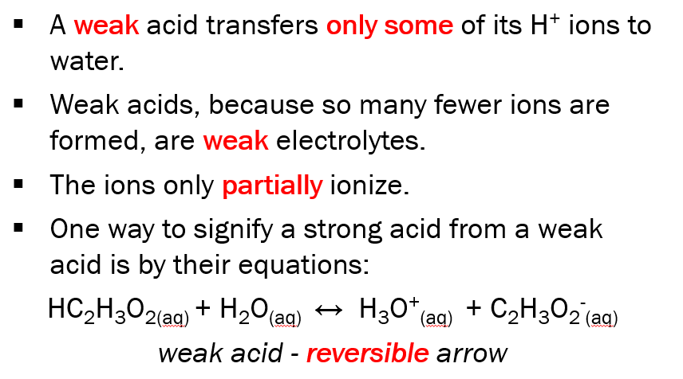
REVIEW OBJECTIVES
Describe how strong acids and weak acids differ.

Slide 10
REVIEW OBJECTIVES
Define pH.
pH = -log[H₃O⁺]
Potential hydrogen
Remember that the pH scale is logarithmic. Each one-unit change on the scale represents a 10-fold change in the concentration of H₃O⁺ ions.

Slide 11
REVIEW OBJECTIVES
Calculate pH if given [H₃O⁺] or [OH⁻].
Calculate [H₃O⁺] if given pH or pOH.
Acids pH < 7 and pOH > 7
pH = -log [H+] [H+] = 10^{x} -pH
Bases pH > 7 and pOH < 7
pOH = -log [OH-] [OH-] = 10^{x} -pOH
pH + pOH = 14
[H+][OH-]=1.0x10⁻¹⁴M

Slide 12
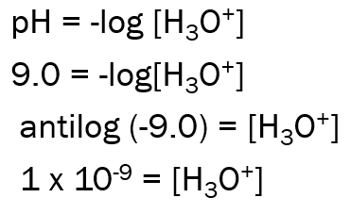
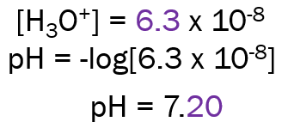
REVIEW OBJECTIVES
Calculate pH if given [H₃O⁺] or [OH⁻].
Calculate [H₃O⁺] if given pH or pOH.

Slide 13
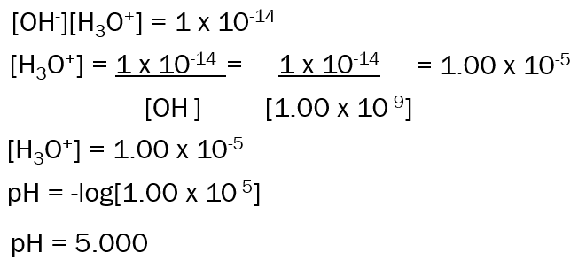
REVIEW OBJECTIVES
Calculate pH if given [H₃O⁺] or [OH⁻].
Calculate [H₃O⁺] if given pH or pOH.

Slide 14
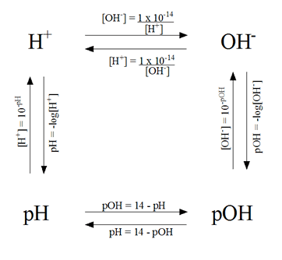
REVIEW OBJECTIVES
Calculate pH if given [H₃O⁺] or [OH⁻].
Calculate [H₃O⁺] if given pH or pOH.

Slide 15
REVIEW OBJECTIVES
Describe neutralization.
In chemistry, neutralization is a chemical reaction in which an acid and a base react quantitatively with each other.
With an acid and a hydroxide base, a salt and water forms.

Slide 16
REVIEW OBJECTIVES
Describe the purpose of a titration and how a titration is performed.
The purpose of a titration experiment is to discover the concentration of an unknown acid or base, by neutralizing it with a measured quantity of a base or acid solution whose concentration is known.
A chemical dye called an indicator is used instead of a pH meter. The equivalence point, or end point, is where the indicator changes color.

Slide 17
REVIEW OBJECTIVES
Define indicator and describe how they work.
An indicator is a weak acid or base that undergoes a color change when it gains or loses an H⁺ ion.
Each indicator has its own equilibrium constant and thus a different color range for different pH.
Because they are viewed by sight and thus subjective, they cannot be used to measure precise pH changes.

Slide 18
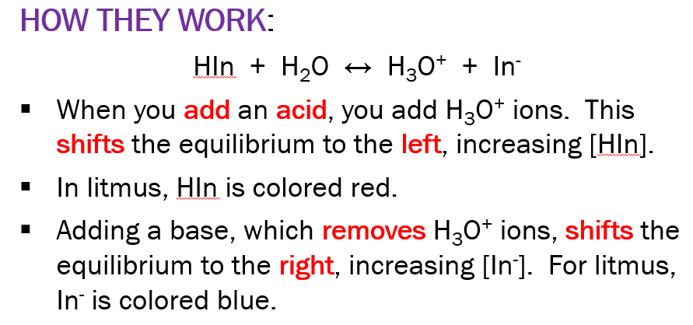
REVIEW OBJECTIVES
Define indicator and describe how they work.

Slide 19
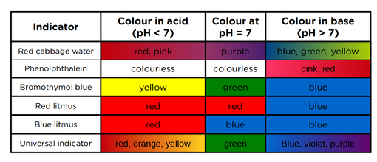
REVIEW OBJECTIVES
Name some common indicators we used in lab and their pH ranges.

Slide 20
REVIEW OBJECTIVES
Describe the function of a buffer.
A buffer solution is a solution that consists of either a weak acid and its conjugate base or a weak base and its conjugate acid.
The conjugate acids or bases are typical the respective salts of the weak base or acid.
Buffer solutions can resist changes in pH because the weak acid or base and conjugate salt parings allow for the solution to neutralize any changes within a specific range that varies between specific buffers.
If the pH is changed dramatically, a buffer solution may begin to fail to stabilize the pH level.

Slide 21
TEST FORMAT
13 multiple choice questions
Two short answer
ID acid, base, conjugate acid, conjugate base
Four pH/pOH/[H₃O⁺]/[OH⁻] problems
Nomenclature of acids and bases (eight)
Matching section over properties

