Slide 1
DO NOW
Turn in your Half-Life Computer Simulation lab.
Pick up the notes sheet and the blank periodic table.

Slide 2
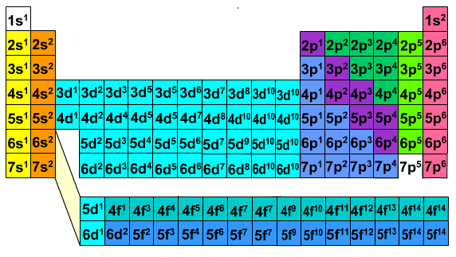
Electron Configuration

Slide 3
BLANK PERIODIC TABLE
We are going to take a moment and write in the atomic number – IN ORDER – on the blank periodic table – on one side only.
Go – be methodical – don’t mess up or you will have to start over.

Slide 4
BLANK PERIODIC TABLE
Periodic table is divided into four distinct regions.
Each region is given a name/symbol: s, p, d, f

Slide 5
ELECTRON CONFIGURATION
Electron configuration tells us how electrons are distributed among the various atomic orbitals.
It is a simple way of keeping track of electrons.
Electrons fill the energy levels in the electron cloud according to a set of rules.

Slide 6
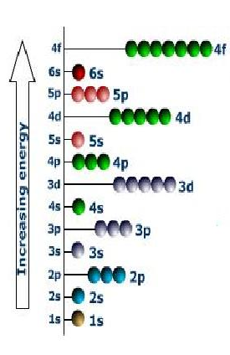
THREE RULES TO REMEMBER
Aufbau Principle
Each electron occupies the lowest energy orbital available.
Electrons are added from the ground state up.
Electrons fill in increasing energy order.

Slide 7
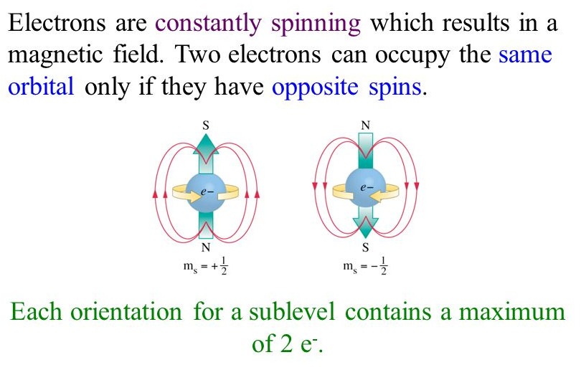
THREE RULES TO REMEMBER
Pauli Exclusion Principle
Each orbital can hold a maximum of only two electrons – one spinning clockwise and one spinning counter clockwise.

Slide 8
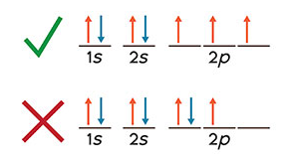
THREE RULES TO REMEMBER
Hund’s Rule
The most stable arrangement of electrons in orbitals is to fill singly and then go back and double up.

Slide 9
ELECTRON CONFIGURATION
1s²
The number of electrons in the sublevel
The energy level
The sublevel
Example:
1s²2s²2p⁶3s²3p5

Slide 10
ELECTRON CONFIGURATION
There are seven energy levels.
There are four sublevels: s, p, d, f.
There are different numbers of orbitals per sublevel:
s = 1 p = 3 d = 5 f = 7
Each orbital holds only two electrons.
1s²

Slide 11
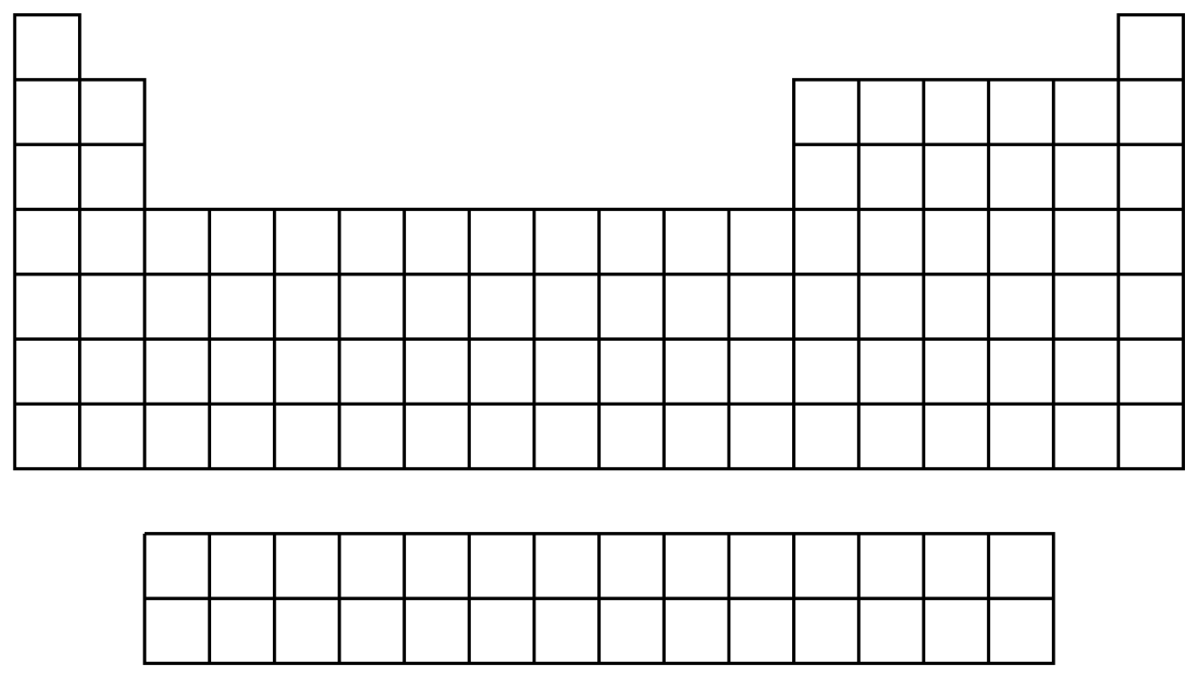
BLANK PERIODIC TABLE

Slide 12
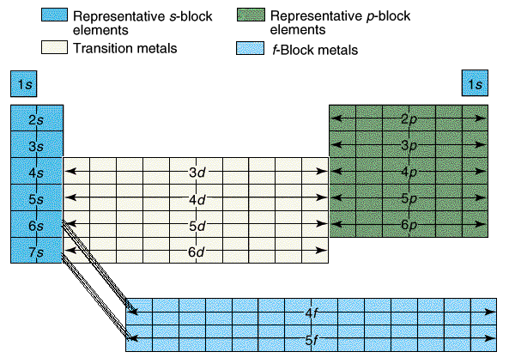

Slide 13
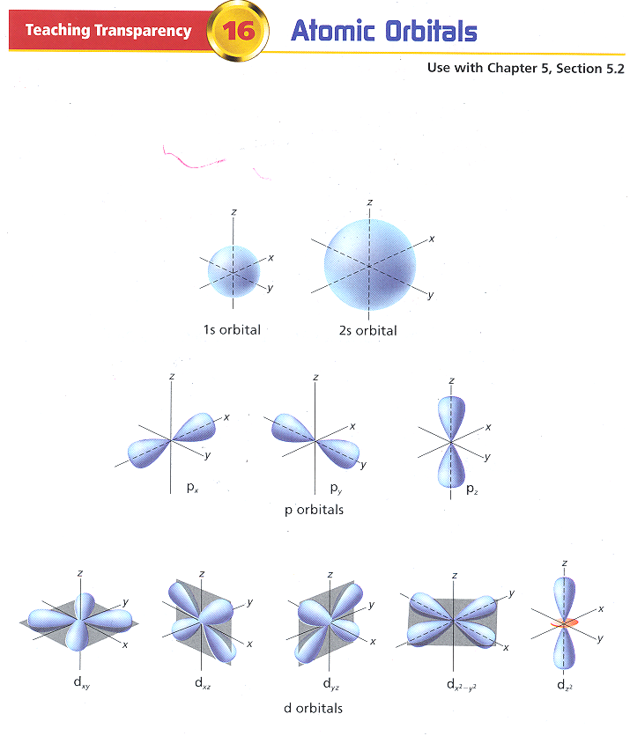

Slide 14
ELECTRON CONFIGURATION
The order that the levels and sublevels fill is based on energy.
They fill in the following order:
1s 2s 2p 3s 3p 4s 3d 4p 5s 4d 5p
6s 4f 5d 6p 7s 5f 6d 7p
There are two diagrams to help you remember the filling order: the diagonal rule or the arrow diagram. You decide which one you like best.

Slide 15
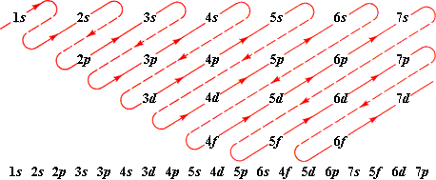
DIAGONAL RULE
You decide which one you like and then copy it into your notes in the box provided.

Slide 16
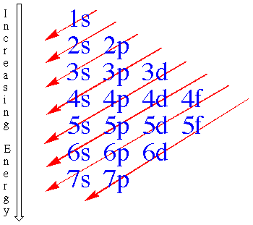
ARROW DIAGRAM
You decide which one you like and then copy it into your notes in the box provided.

Slide 17
ELECTRON CONFIGURATION
Hydrogen H 1 1s¹
Helium He 2 1s²
Lithium Li 3 1s²2s¹
Beryllium Be 4 1s²2s²
Boron B 5 1s²2s²2p¹
Carbon C 6 1s²2s²2p²
Nitrogen N 7 1s²2s²2p³
Oxygen O 8 1s²2s²2p⁴
Fluorine F 9 1s²2s²2p⁵
Neon Ne 10 1s²2s²2p⁶

Slide 18
ELECTRON CONFIGURATION
Sodium Na 11 1s²2s²2p⁶3s¹
Magnesium Mg 12 1s²2s²2p⁶3s²
Aluminum Al 13 1s²2s²2p⁶3s²3p¹
Silicon Si 14 1s²2s²2p⁶3s²3p²
Phosphorus P 15 1s²2s²2p⁶3s²3p³
Sulfur S 16 1s²2s²2p⁶3s²3p⁴
Chlorine Cl 17 1s²2s²2p⁶3s²3p⁵
Argon Ar 18 1s²2s²2p⁶3s²3p⁶
Potassium K 19 1s²2s²2p⁶3s²3p⁶4s¹

Slide 19
PRACTICE
FIRST: Find the atomic number.
That will tell you how many electrons you are filling.
SECOND: Determine its place on the periodic table.
That will tell you the ending configuration.
THIRD: Write the electron configuration using your diagram.

Slide 20
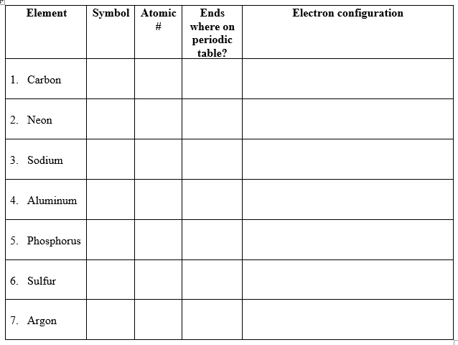
PRACTICE

Slide 21
ENDING CONFIGURATION

Slide 22
TO DO
Second Electron Configuration Practice – due tomorrow.
Burning Balls of Color – Flame test lab due tomorrow.

Slide 23
DO NOW
Get out your notes and the Second Electron Configuration Practice sheet.

Slide 24
2nd ELECTRON CONFIGURATION
With your partner, get a white board and marker.
Write the element name, atomic number, and electron configuration for the element listed.

Slide 25
PRACTICE
Third Electron Configuration Practice – due Monday.
Burning Balls of Color – Flame Test lab due Monday.

