Slide 1
DO NOW
Pick up notes and Review #31.

Slide 2

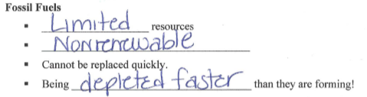
REVIEW #29

Slide 3
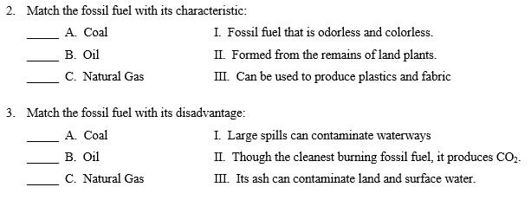
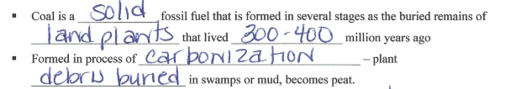
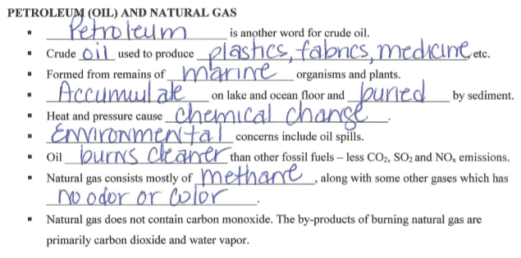
REVIEW #29

Slide 4
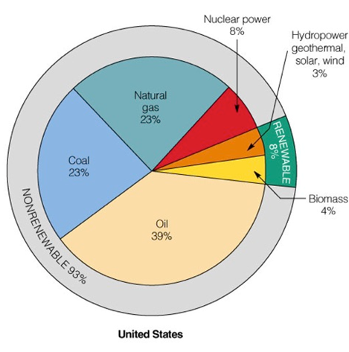
REVIEW
Where do we get our energy from?
What are the major advantages and disadvantages of using fossil fuels?
Advantages: cheap
Disadvantages: pollution, nonrenewable

Slide 5
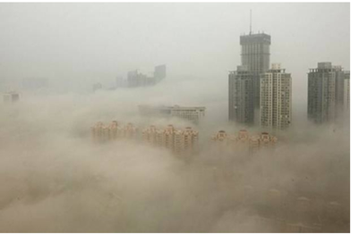
AIR POLLUTION
SES6. Students will explain how life on Earth responds to and shapes Earth systems.
c. Explain how geological and ecological processes interact through time to cycle matter and energy, and how human activity alters the rates of these processes (e.g., fossil fuel formation and combustion).

Slide 6

HUMAN SOURCES OF AIR POLLUTION
Coal combustion to produce electricity puts out:
67% of SO₂ emissions
36% of CO₂ emissions
28% of NOx emissions
Vehicle engines put out:
75% of CO emissions
33% of CO₂ emissions
44% of NO emissions
Fossil fuels are the major contributor.

Slide 7
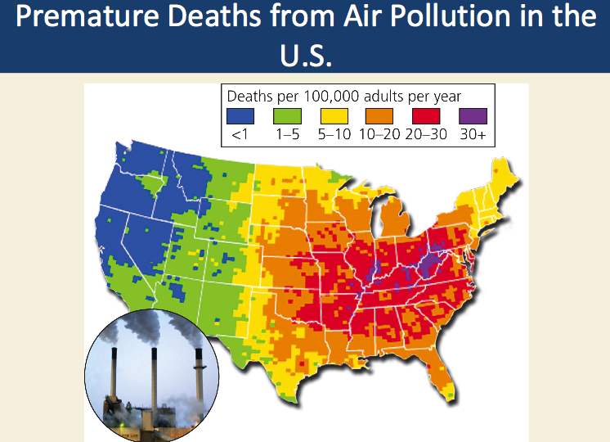
AIR POLLUTION
Approximately 14 million metric tons of air pollution are released annually into the atmosphere in the US by human activities.
Worldwide emissions total around 2 billion metric tons.

Slide 8
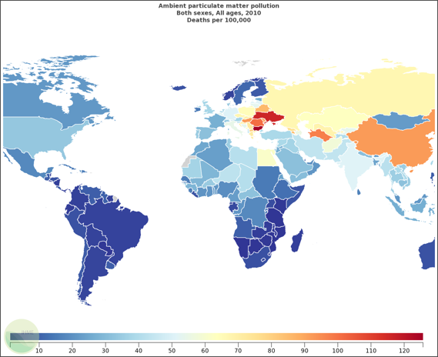
AIR POLLUTION KILLS
150,000 to 350,000 per year in the United States
2.4 million deaths per year world wide
Mostly in Asia; 750,000 in China

Slide 9
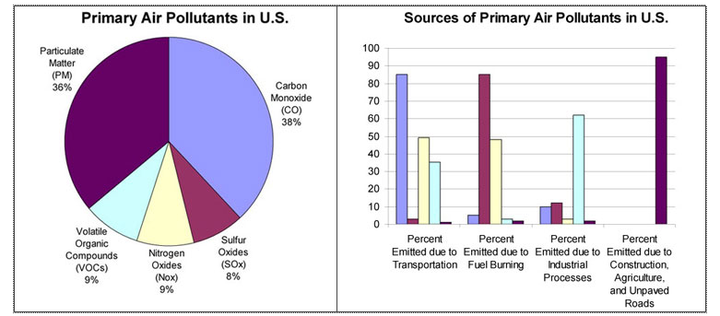
WHAT ARE THE MAJOR POLLUTANTS?

Slide 10
WHAT ARE THE MAJOR POLLUTANTS?
 | MAJOR SOURCES | HEALTH EFFECTS | ENVIRONMENTAL EFFECTS
SO₂ | Industry | Respiratory and cardiovascular illness | Precursor to acid rain which damages lakes, rivers, and trees; damage to cultural relics
NO_{x} | Vehicles / Industry | Respiratory and cardiovascular illness | Nitrogen deposition leading to over fertilization and eutrophication
PM | Vehicles / Industry | Particles penetrate deep in lungs and can enter bloodstream | Visibility
CO | Vehicles | Headaches and fatigue, especially in people with weak cardiovascular health
Lead | Vehicles (burning leaded gasoline) | Accumulates in the bloodstream over time; damages nervous system | Fish and Animal kills
Ozone | Formed from the reactions of NO_{x} and VOCs | Respiratory illness | Reduced crop production and forest growth; smog precursor
VOCs | Vehicles / Industrial Processes | Eye and skin irritation, nausea, headaches, carcinogens | Smog Precursor

Slide 11
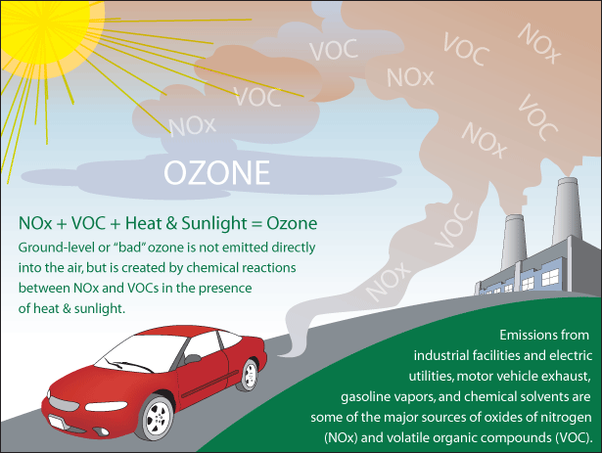
GROUND LEVEL OZONE:
PHOTOCHEMICAL SMOG
This is in the Troposphere.
Reaction of nitrogen oxides and volatile organic compounds (VOCs) in the presence of ultraviolet radiation (sunlight).
Produced in series of chemical reactions.
Responsible for brownish haze in afternoons of sunny days.
Builds up as traffic increases in cities with sunny, warm, dry climates.

Slide 12
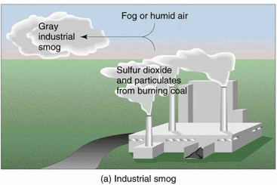
INDUSTRIAL SMOG
Combination of sulfur dioxide, sulfuric acid, and a variety of aerosols from burning coal and heavy oil.
Carbon in coal converted to CO₂ and CO.
Sulfur in coal reacts with oxygen and water vapor (H₂O) to form sulfuric acid (H₂SO₄)
Droplets with soot make smog grayish.

Slide 13

ACID RAIN
Higher than normal amounts of nitric and sulfuric acids in the atmosphere.
Wet deposition:
  Acid rain, fog, and snow
Natural CO₂ in atmosphere is reason for rain’s natural acidity of 5.6.
  Reacts with calcium carbonate in limestone, creates caves.

Slide 14
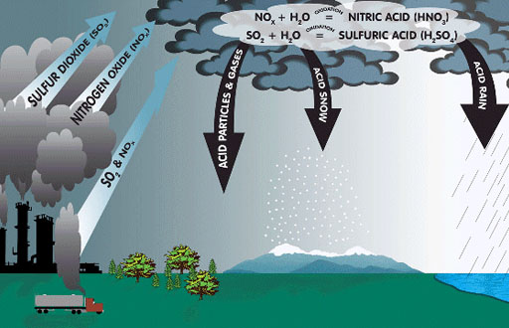
ACID RAIN: FORMATION
Mixing of Sulfur and NO_{x} pollutants with water to form acidic solutions
SO₂ forms sulfurous (H₂SO₃) and sulfuric acid (H₂SO₄)
NO_{x} forms nitric acid (HNO₃) and nitrous acid (HNO₂)

Slide 15
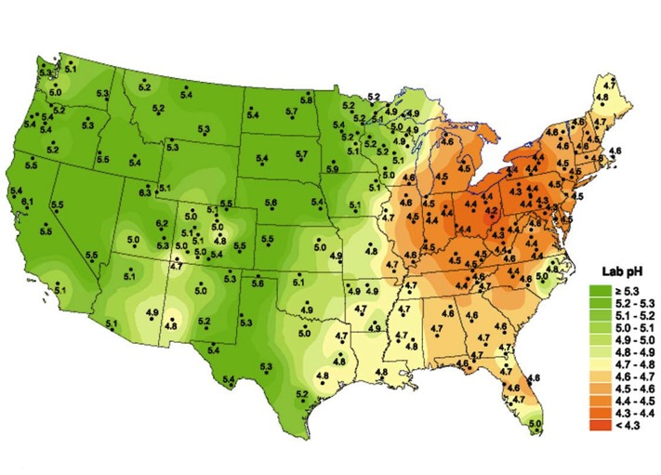
ACID DEPOSITION IN THE US

Slide 16
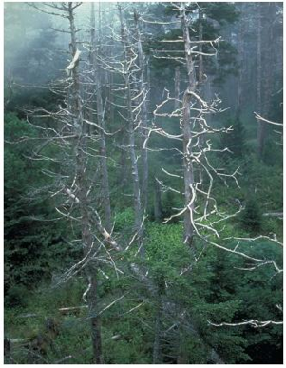
ACID RAIN DAMAGES ECOSYSTEMS
Forests:
Leaches into the ground and dissolves plant nutrients (Mg, Ca).
Releases Aluminum into soil when pH less than 5.
Acid fog/mist strips nutrients from leaves and needles and leaves trees susceptible to disease and insects.

Slide 17
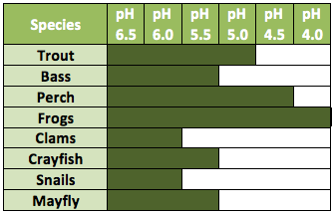
ACID RAIN DAMAGES ECOSYSTEMS
Aquatic Systems:
Can harm and kill fish, reduce fish populations, eliminates fish species and decrease biodiversity
Many aquatic species have narrow range of pH tolerance – at pH 5, most fish eggs cannot hatch.

Slide 18
FACTORS AFFECTING AIR POLLUTION
Reduced by:
Increased by:
Settling out
Precipitation
Sea spray
Winds
Chemical reactions
  Urban buildings - slow wind dispersal of pollutants.
  Mountains - promote temperature inversions
  High temperatures - promote photochemical reactions

Slide 19
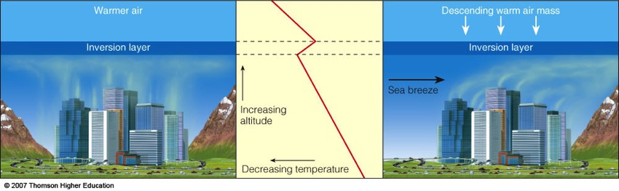
TEMPERATURE INVERSIONS
Often happens in summer months
Layer of pollution trapped by a stable layer of warm air above a layer of cooler air nearer the ground.

Slide 20
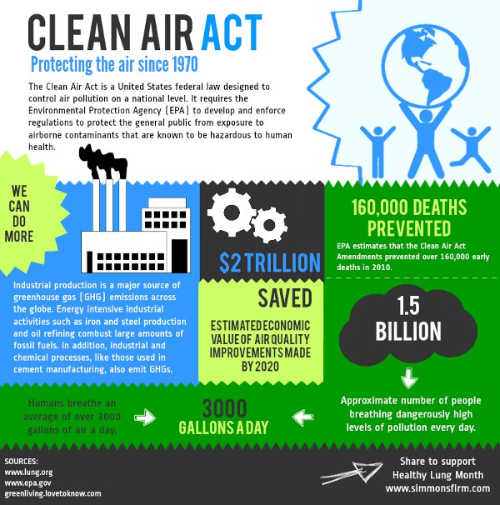

Slide 21
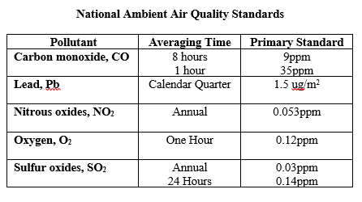
AIR QUALITY STANDARDS

Slide 22
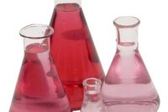
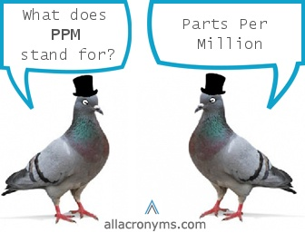
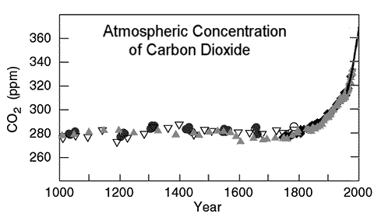
PPM: PARTS PER MILLION
This is a way of measuring concentrations of gases in the atmosphere.
How diluted a solution is.

Slide 23
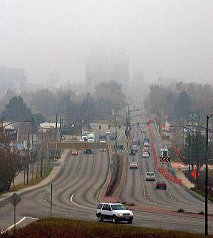
REVIEW
Which of the following is NOT involved in producing ozone in the troposphere?
Nitrous oxide
VOCs
El Nino
Sunlight

Slide 24
TO DO
Do Review #31.
Work on The Energy Resource Scavenger Hunt or the Renew-A-Bean lab.

