Slide 1
DO NOW
Turn in Review #25.
Pick up notes and Review #26.

Slide 2
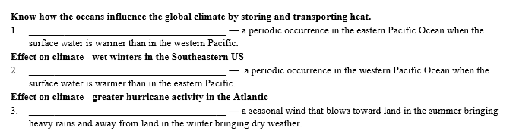
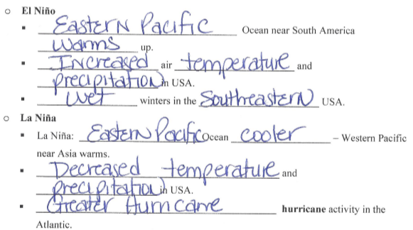
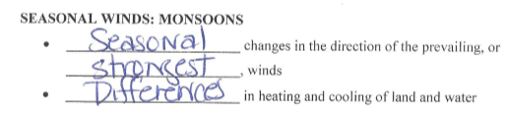
REVIEW #23

Slide 3
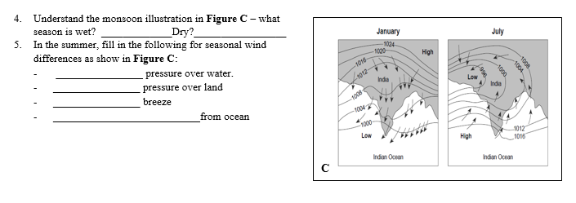
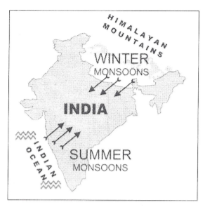

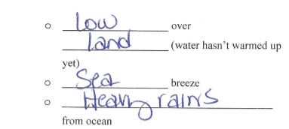
REVIEW #23

Slide 4

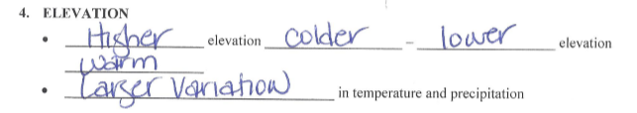
REVIEW #23

Slide 5
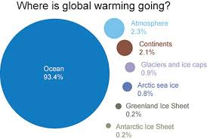
REVIEW
What is happening with ocean acidification?

Slide 6
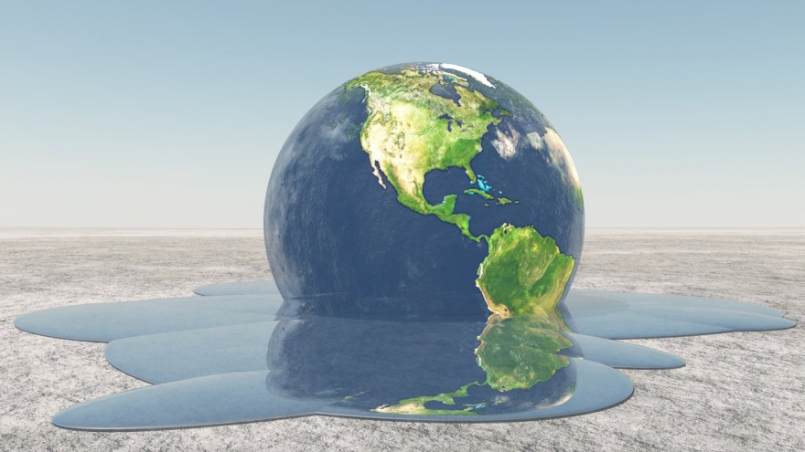
CLIMATE CHANGE:
WHAT’S CAUSING IT?
SES5. Students will investigate the interaction of insolation and Earth systems to produce weather and climate.
f. Relate changes in global climate to variation in Earth/Sun relationships and to natural and anthropogenic modification of atmospheric composition

Slide 7
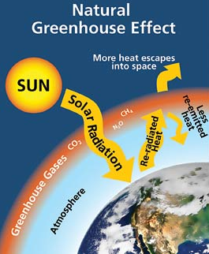
GREENHOUSE EFFECT
NATURAL factors shape the earth’s climate:
  The sun.
  Gases trap and retain heat in the atmosphere.
  Oceans store CO₂ and heat, evaporate and receive water, move stored heat to other parts of the world.
Greenhouse gases: water vapor, carbon dioxide, methane, and nitrous oxide.

Slide 8
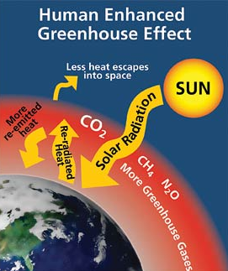
HUMAN INTERACTION
Evidence that the earth’s troposphere is warming, mostly because of human actions:
20th century was the hottest in the past 1000 years.
Since 1900, average tropospheric temperature has risen 0.6 C°.
Over the past 50 years, Arctic temperatures have risen almost twice as fast as the rest of the world.

Slide 9
HUMAN INTERACTION
Glaciers and floating sea ice are melting and shrinking at increasing rates.
Warmer temperatures in Alaska, Russia, and the Arctic are melting permafrost releasing more CO₂ and CH₄ into the troposphere.
Last century, sea levels rose by 10-20 cm, mostly due to runoff from melting and land-based ice and the expansion of ocean water as temperatures rise.

Slide 10
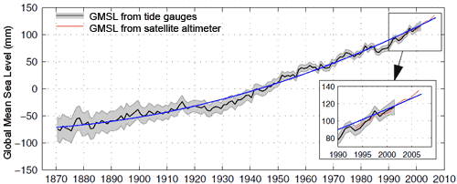
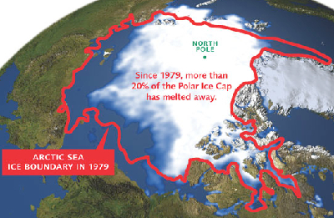
CLIMATE CHANGE EVIDENCE
Atmosphere and oceans have warmed.
Global average surface temperature has increased by about 0.8 °C since 1900 (1.4 °F)
Climate Change is faster than at any time in the last 65 million years

Slide 11
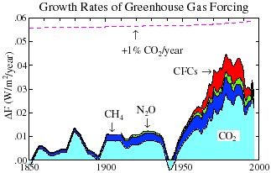
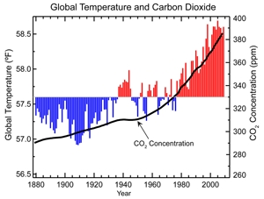
CLIMATE CHANGE EVIDENCE
Sea-level risen.
Strong decline in Arctic sea ice.
Increase in atmospheric CO₂ concentrations by about 40% since 1800’s, with more than half the increase occurring since 1970.

Slide 12
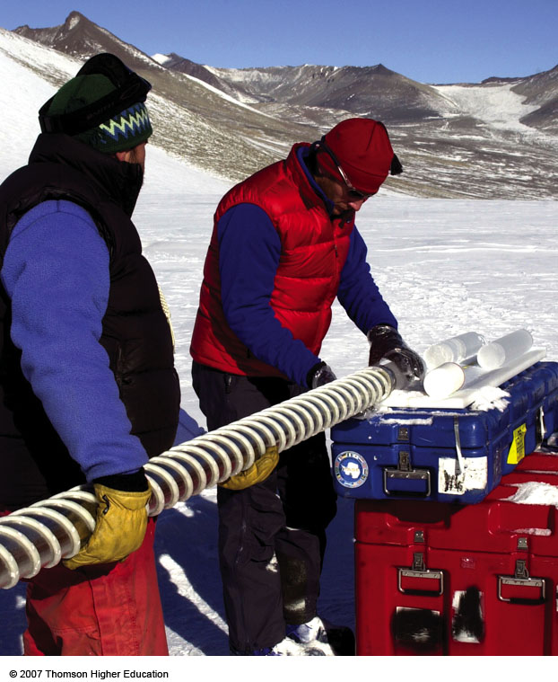
STRONG EVIDENCE FROM ICE CORES
Scientists analyze tiny air bubbles trapped in ice cores to learn about past

Slide 13
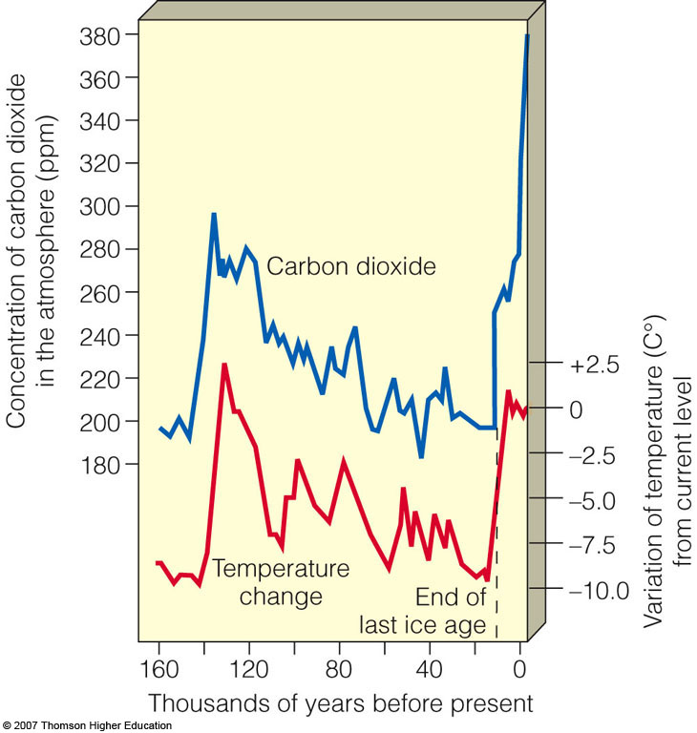
STRONG EVIDENCE FROM ICE CORES
  What the cores tell scientists:
  troposphere composition.
  temperature trends.
  greenhouse gas concentrations.
  solar, snowfall, and forest fire activity.

Slide 14
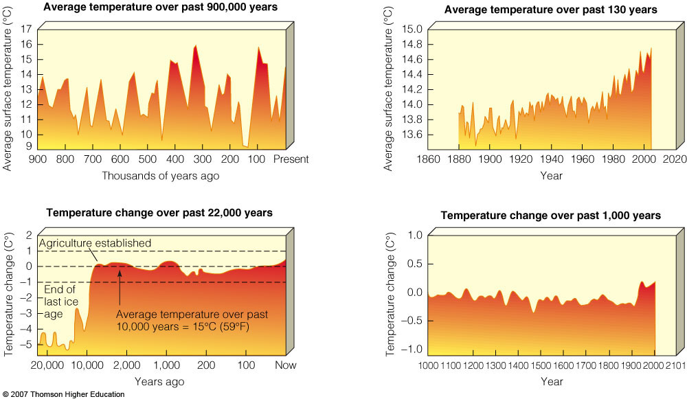
HISTORICAL DATA: TEMPERATURE

Slide 15



HUMAN FACTOR
Over 12,000 peer-reviewed abstracts on the subjects of ‘global warming’ and ‘global climate change’ published between 1991 and 2011 found that of the papers taking a position on the cause of global warming, over 97% agreed that humans are causing it.
Nearly 200 worldwide scientific organizations that hold the position that climate change has been caused by human action.

Slide 16




HUMAN FACTOR
Sep., 2013, the IPCC report "Climate Change 2013: The Physical Science Basis”, stated that evidence for human caused climate change has grown since the 2007 report, and it is now "extremely likely [95% confidence] that human influence has been the dominant cause of the observed warming since the mid-20th century.“
97% of climate scientists agree that humans are causing it.

Slide 17
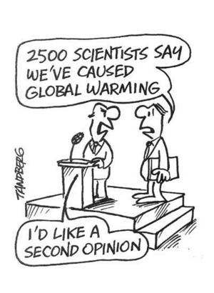
WHAT DOES 97% AGREEMENT MEAN?
NONE are denying Global Climate Change.
Only 3% (3 out of 100) Scientists disagree that humans are involved in climate change
Arguments addressed: http://www.skepticalscience.com/argument.php
It’s all about Energy in the Atmosphere!

Slide 18
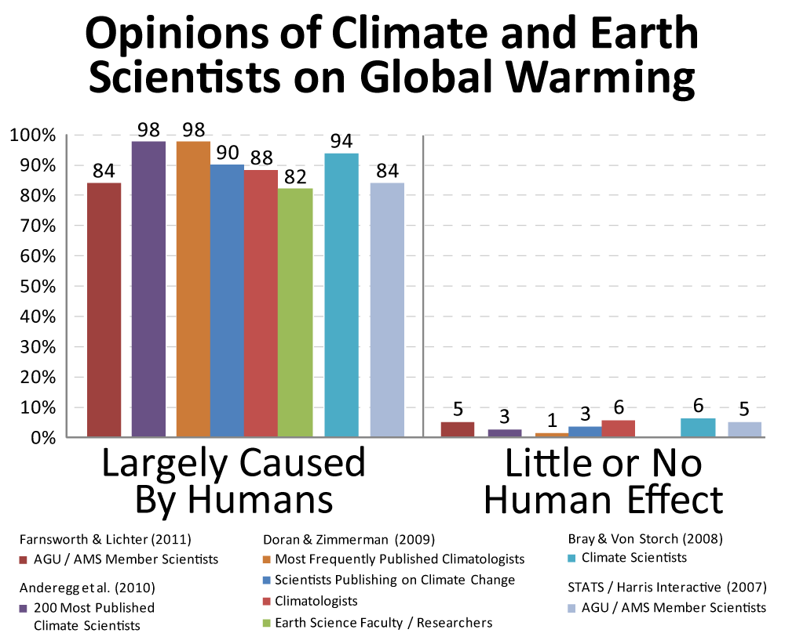

Slide 19
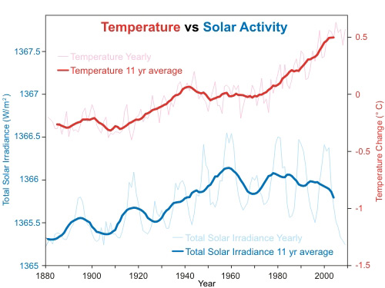
CLIMATE CHANGE DENIAL:
EARTH’S NATURAL CYCLES
No one is denying that Earth has natural climate cycles.
Only to what extent current observations are natural versus human caused.
Solar cycles
Ocean Current cycles
Other cycles?
Arguments Pro/Con:
  http://climatechange.procon.org/#background

Slide 20

CLIMATE CHANGE DENIAL:
EARTH’S NATURAL CYCLES
BIAS - Major critic of Human involvement in Global Warming: Heartland Institute.
  Exxon Mobile one of biggest contributors - how would this effect their position?
  Few (if any) actual climate scientists on review panel.

Slide 21
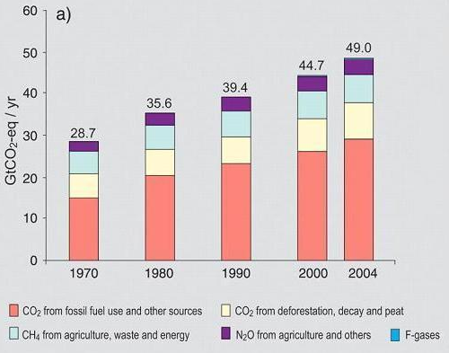
EVIDENCE FOR HUMAN SOURCES OF GREENHOUSE GASES

Slide 22
EVIDENCE FOR HUMAN SOURCES OF GREENHOUSE GASES
Global increases in CO2 concentrations are due primarily to fossil fuel use.
It is likely that the observed increase in methane, CH4, concentration is predominantly due to agriculture and fossil fuel use.
The increase in N₂O concentration is primarily due to agriculture.

Slide 23
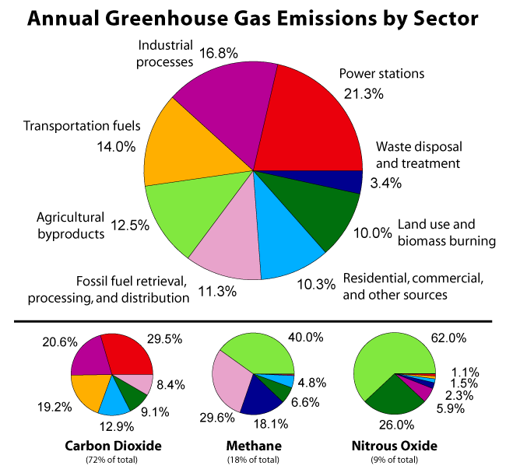
HUMAN SOURCES

Slide 24
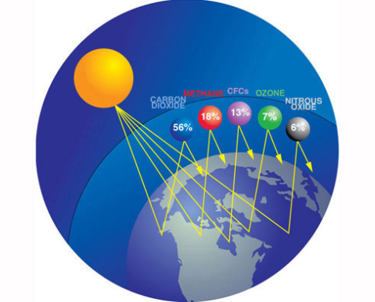
HUMAN SOURCES
Main source of CO2 emissions is burning of Fossil Fuels.
Increasing CO2 can add to Greenhouse effect and higher temperatures.

Slide 25
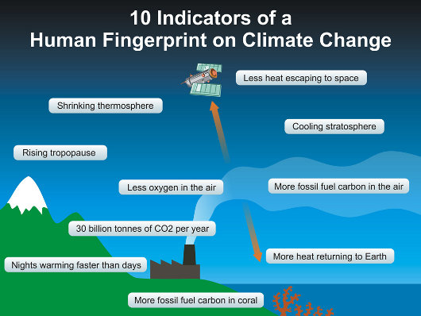

Slide 26
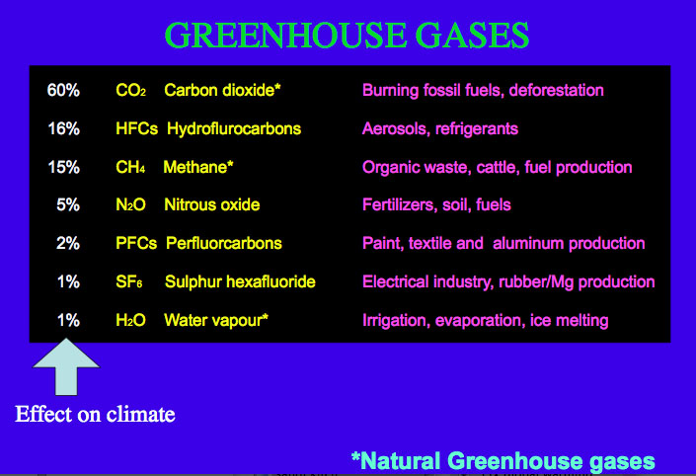

Slide 27
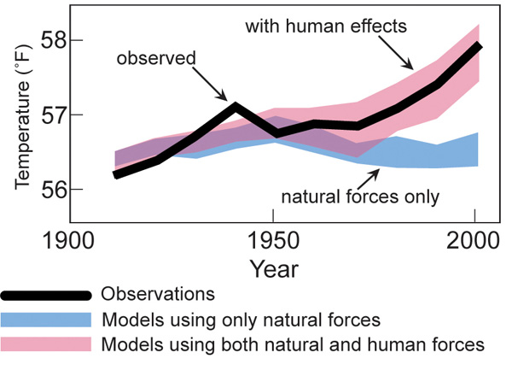
FACTORING BOTH NATURE AND HUMANS

Slide 28

Video:
Bill Nye & Climate Change
http://www.smithsonianmag.com/videos/category/3play_1/climate-change-101-with-bill-nye-the-science/?no-ist

Slide 29
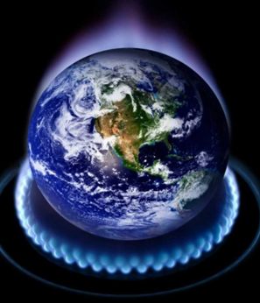
REVIEW
Anthropogenic means:
Naturally occurring
Accidental
Human caused
Observed phenomenon

Slide 30
TO DO
Do Review #26.
Work on missing labs.

Slide 31

Activity: Skeptical Science APP
A “skeptic” is a person inclined to question or doubt all accepted opinions.
Use the APP to explore the Skeptical arguments and how Science responds to those arguments.
Class discussion for Top 10 Arguments!
Activity Format: Group Assignments & Class Discussion

